Slide 1
OPC Unified Architecture (OPC UA)
The ideal communication protocol for Industry 4.0
The superiority of OPC UA?
OPC UA bridges the gap between the IP-based world of IT and the production floor.
Notes:
OPC UA 是工业4.0领域的理想通讯协议
The ideal communication protocol for Industry 4.0
OPC Unified Architecture (OPC UA) is a vendor-independent communication protocol for industrial automation applications. It is based on the client-server principle and allows seamless communication from the individual sensors and actuators up to the ERP system or the cloud. The protocol is platform-independent and features built-in safety mechanisms. Since OPC UA is flexible and completely independent, it is regarded as the ideal communication protocol for the implementation of Industry 4.0.
Why should I choose OPC UA?
OPC UA bridges the gap between the IP-based world of IT and the production floor. Interfaces, gateways and the associated loss of information are a thing of the past because all production process data is transferred via a single protocol – within a machine, between machines or between a machine and a cloud database. OPC UA is eliminating the need for traditional factory-level fieldbus systems.
B&R has been relying on OPC UA for years and is an active member of various OPC Foundation working groups. Find out more about the solutions and products with OPC UA offered by B&R:

Slide 2
思考:为什么OPC UA在处理复杂的实时进程需求上有其限制?时间敏感网络TSN又是怎么解决这个问题的?

Slide 3
OPC UA TSN
OPC UA has had its limitations when it comes to complex processes with real-time requirements
Publish-subscribe model

Slide 4
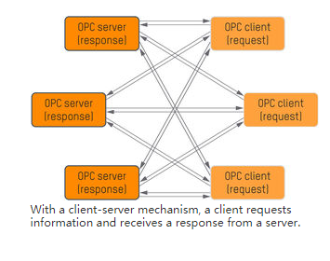
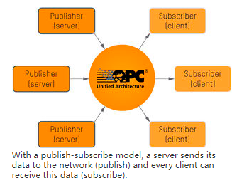

Slide 5
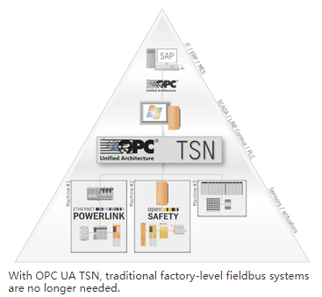

Slide 6
The combination of OPC UA TSN and POWERLINK will cover the full range of communication in industrial production

