Slide 1
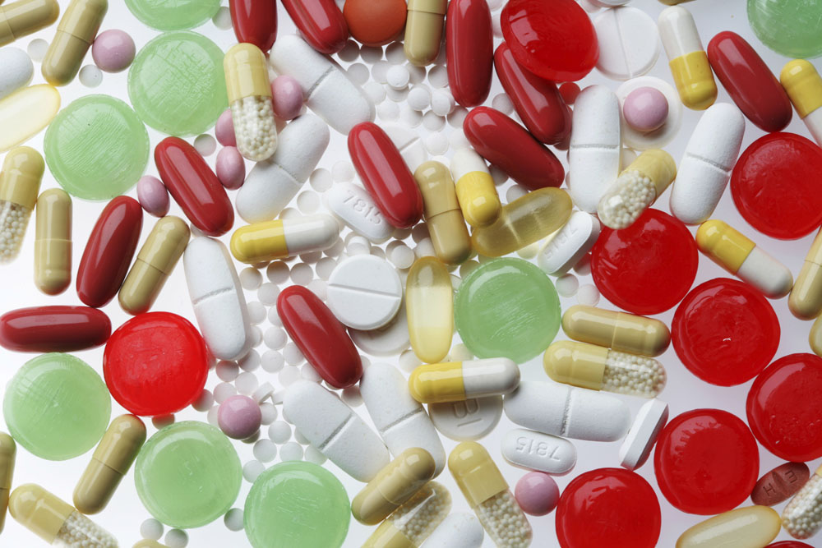
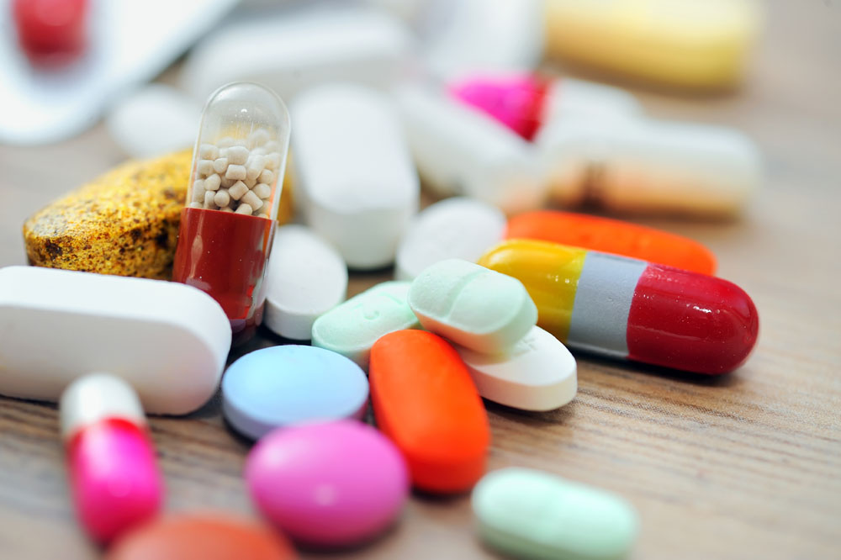
Drug bank

Slide 2
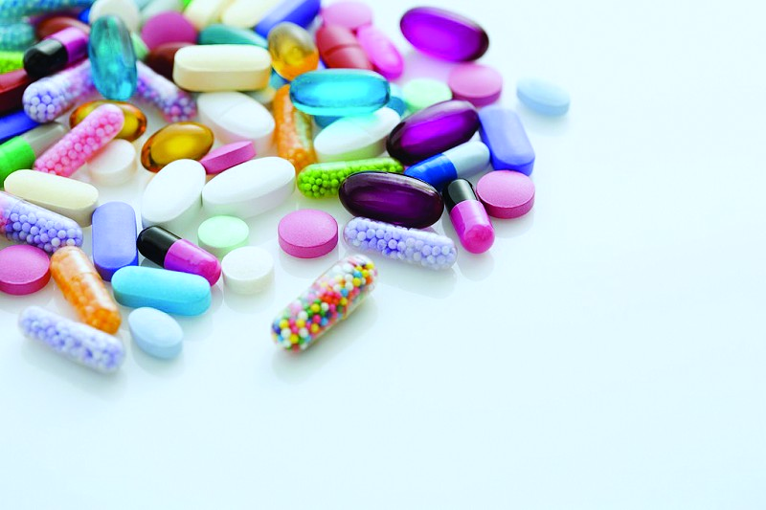
目的：1.使用并熟悉drug bank
2.利用drug bank查询所需数据
选定组方：上感佳
对乙酰氨基酚(Acetaminophen)、罗红霉素(Roxithromycin)、双嘧达莫（Dipyridamole） 、维生素C片(Vitamin C)、 地塞米松(dexamethasone) 、盐酸吗啉胍(Morpholinebiguanide)

Slide 3
Drug bank简介
该数据库含有药品的化学,生物资 料, 包括药 物作用机制, 药品作用受体目标. 共有4300多个药物. 其中FDA批准的小分子药物有1200多个, 生物药物有113个. 营养辅助药物62个, 正在临床试验的药物3000多个.
世界最大、最完整的药物和药物靶标资源库
Wishart和他的研究组创造了DrugBank

Slide 4
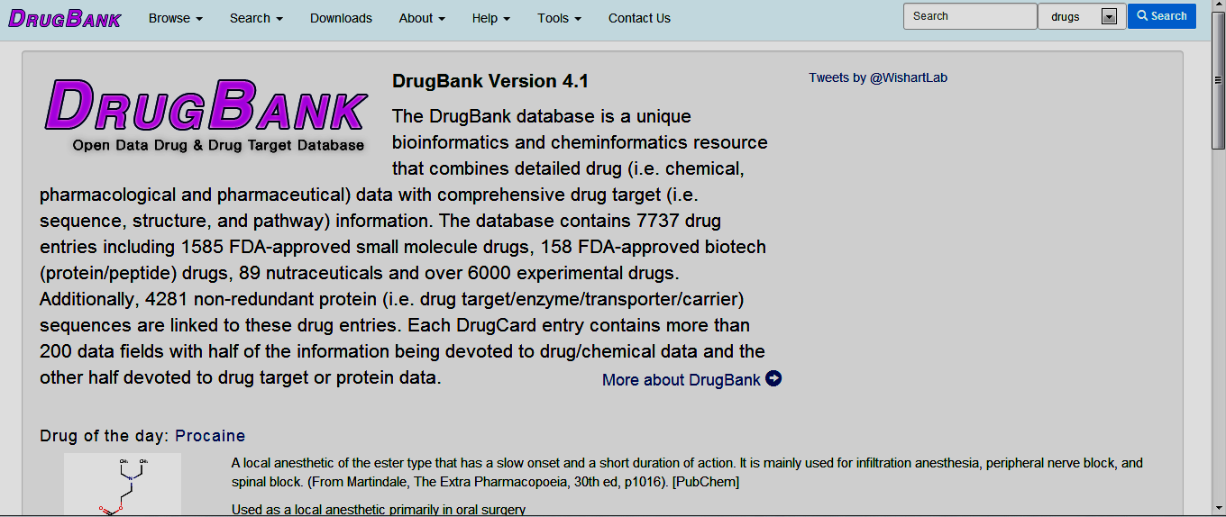
主页面

Slide 5
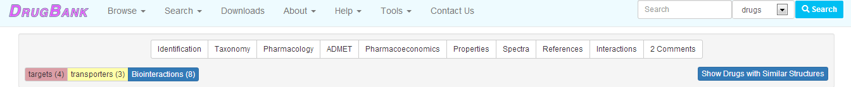
输入药物的通用名，可以得到以下信息：Identification、Taxonomy、Pharmacology、ADMET、Pharmacoeconomics、Properties、Spectra、References、
Interactions、Comments、Targets、Transporters、Biointeractions

Slide 6
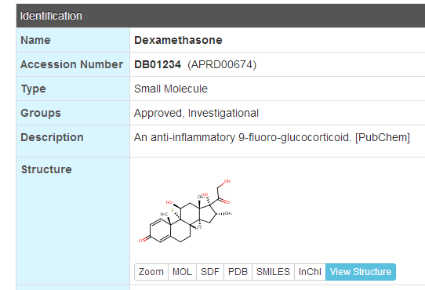
Dexamethasone

Slide 7
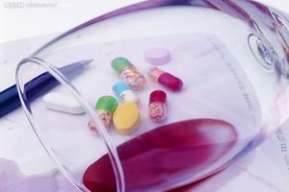
Dexamethasone-Pharmacology
Dexamethasone is a glucocorticoid agonist. Unbound dexamethasone crosses cell membranes and binds with high affinity to specific cytoplasmic glucocorticoid receptors. This complex binds to DNA elements (glucocorticoid response elements) which results in a modification of transcription and, hence, protein synthesis in order to achieve inhibition of leukocyte infiltration at the site of inflammation, interference in the function of mediators of inflammatory response, suppression of humoral immune responses, and reduction in edema or scar tissue. The antiinflammatory actions of dexamethasone are thought to involve phospholipase A₂ inhibitory proteins, lipocortins, which control the biosynthesis of potent mediators of inflammation such as prostaglandins and leukotrienes.

Slide 8
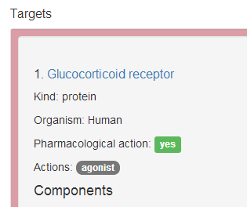
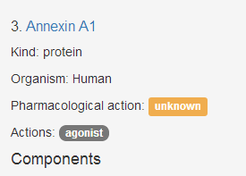
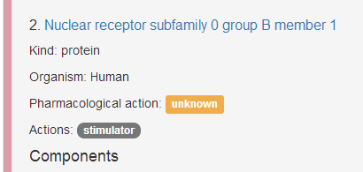
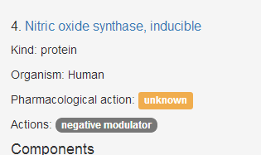
Dexamethasone-targets

Slide 9
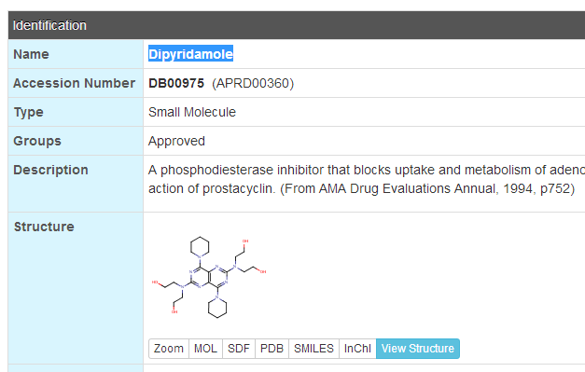
Dipyridamole

Slide 10
Dipyridamole-Pharmacology
Dipyridamole likely inhibits both adenosine deaminase and phosphodiesterase, preventing the degradation of cAMP, an inhibitor of platelet function. This elevation in cAMP blocks the release of arachidonic acid from membrane phospholipids and reduces thromboxane A2 activity. Dipyridamole also directly stimulates the release of prostacyclin, which induces adenylate cyclase activity, thereby raising the intraplatelet concentration of cAMP and further inhibiting platelet aggregation.

Slide 11
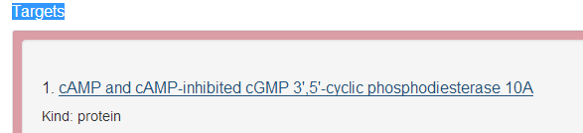

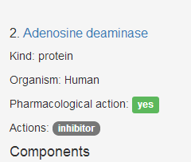

Dipyridamole-Targets

Slide 12
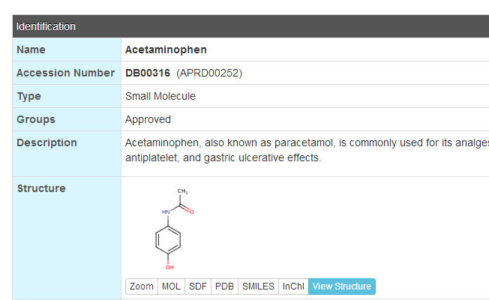
Acetaminophen

Slide 13
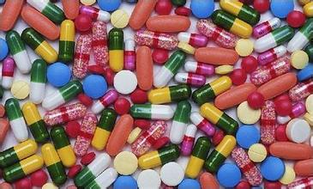
Acetaminophen-Pharmacology
Acetaminophen is thought to act primarily in the CNS, increasing the pain threshold by inhibiting both isoforms of cyclooxygenase, COX-1, COX-2, and COX-3 enzymes involved in prostaglandin (PG) synthesis. Unlike NSAIDs, acetaminophen does not inhibit cyclooxygenase in peripheral tissues and, thus, has no peripheral anti-inflammatory affects. While aspirin acts as an irreversible inhibitor of COX and directly blocks the enzyme's active site, studies have found that acetaminophen indirectly blocks COX, and that this blockade is ineffective in the presence of peroxides. This might explain why acetaminophen is effective in the central nervous system and in endothelial cells but not in platelets and immune cells which have high levels of peroxides. Studies also report data suggesting that acetaminophen selectively blocks a variant of the COX enzyme that is different from the known variants COX-1 and COX-2. This enzyme is now referred to as COX-3. Its exact mechanism of action is still poorly understood, but future research may provide further insight into how it works. The antipyretic properties of acetaminophen are likely due to direct effects on the heat-regulating centres of the hypothalamus resulting in peripheral vasodilation, sweating and hence heat dissipation.

Slide 14
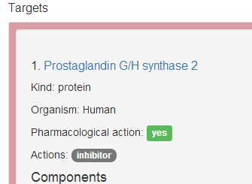
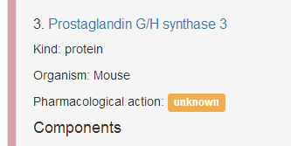
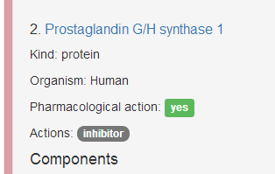
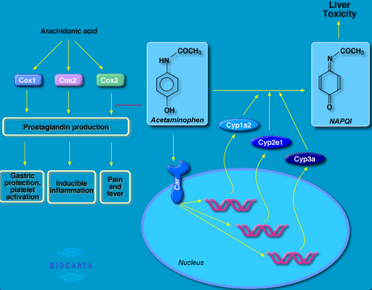
Acetaminophen-Targets

Slide 15
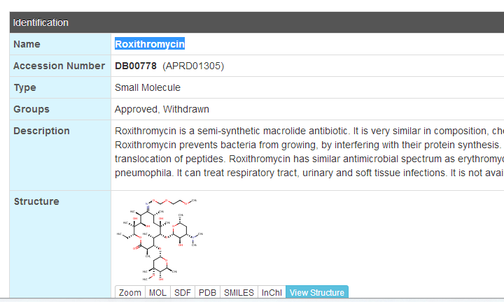
Roxithromycin

Slide 16
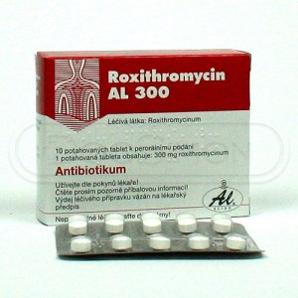
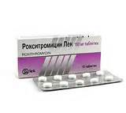
Roxithromycin-Pharmacology
Roxithromycin prevents bacteria from growing, by interfering with their protein synthesis. Roxithromycin binds to the subunit 50S of the bacterial ribosome, and thus inhibits the translocation of peptides. Roxithromycin has similar antimicrobial spectrum as erythromycin, but is more effective against certain gram-negative bacteria, particularly Legionella pneumophila.

Slide 17
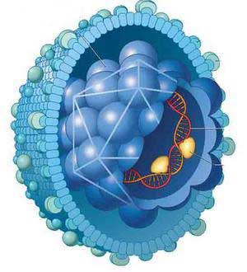
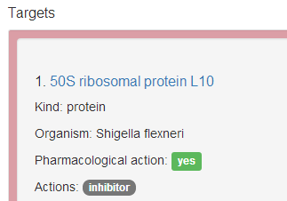
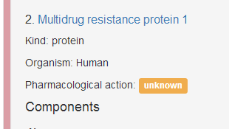
Roxithromycin-Targets

Slide 18
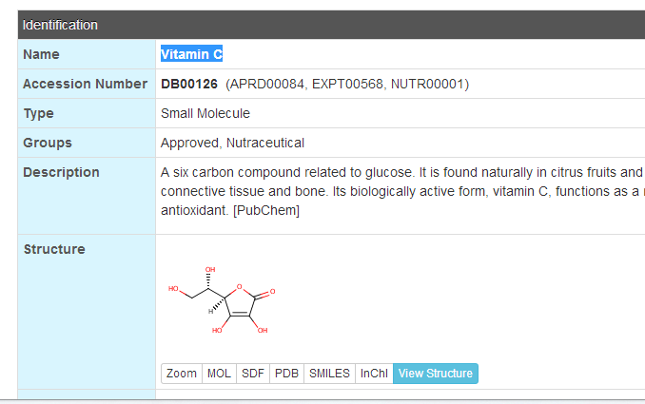
Vitamin C

Slide 19

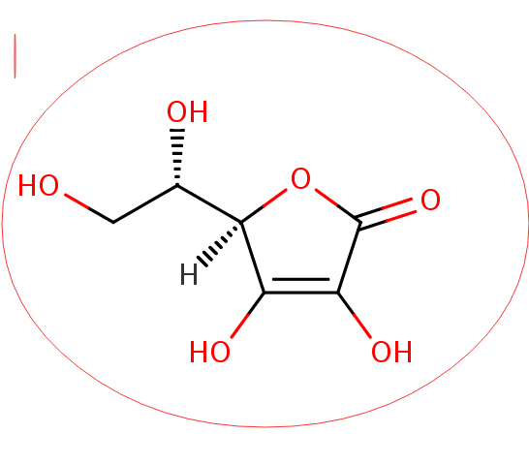

Vitamin C-Pharmacology
In humans, an exogenous source of ascorbic acid is required for collagen formation and tissue repair by acting as a cofactor in the posttranslational formation of 4-hydroxyproline in -Xaa-Pro-Gly- sequences in collagens and other proteins. Ascorbic acid is reversibly oxidized to dehydroascorbicacid in the body. These two forms of the vitamin are believed to be important in oxidation-reduction reactions. The vitamin is involved in tyrosine metabolism, conversion of folic acid to folinicacid, carbohydrate metabolism, synthesis of lipids and proteins, iron metabolism, resistance to infections, and cellular respiration.

Slide 20

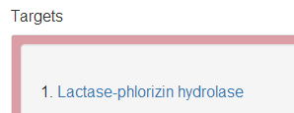










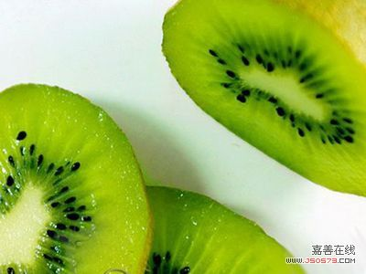

Vitamin C-Targets

Slide 21
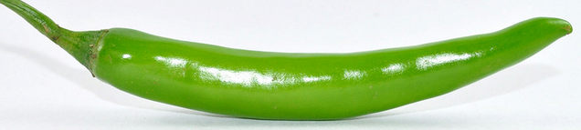














Vitamin C-Targets

Slide 22
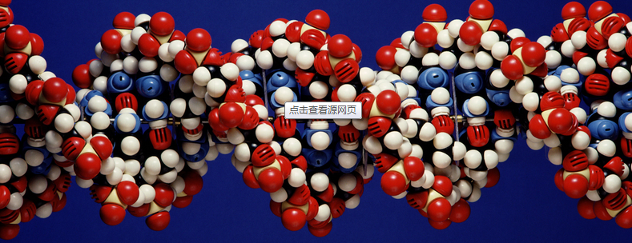
结果
这些药联合用药能比较好的用于治疗感冒
临床数据也表明这些药联合用药效果好

Slide 23

总结
Drugbank功能很强大，不仅内容多而且质量 高，可信度也强
Drugbank的系统比较简单方便，容易操作
Drugbank对于药理的学生很重要，有很多药物的参数我们都能从这里获得

