Slide 1

Dimensionality Reduction: SVD & CUR
Note to other teachers and users of these slides: We would be delighted if you found this our material useful in giving your own lectures. Feel free to use these slides verbatim, or to modify them to fit your own needs. If you make use of a significant portion of these slides in your own lecture, please include this message, or a link to our web site: http://www.mmds.org
Mining of Massive Datasets
Jure Leskovec, Anand Rajaraman, Jeff Ullman Stanford University
http://www.mmds.org

Slide 2
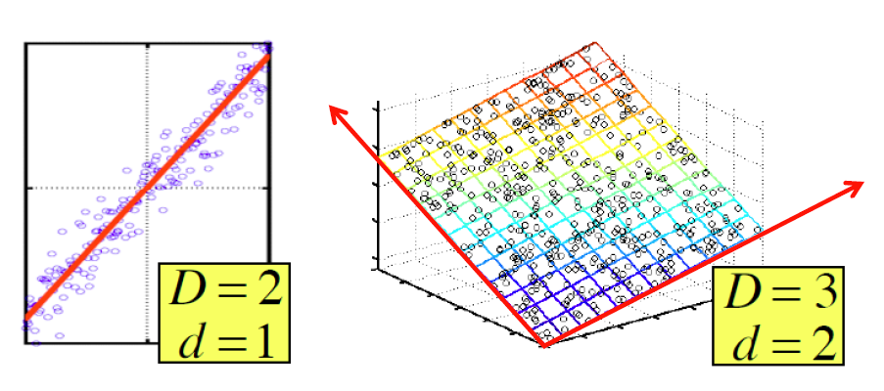
Dimensionality Reduction
Assumption: Data lies on or near a low d-dimensional subspace
Axes of this subspace are effective representation of the data

Slide 3
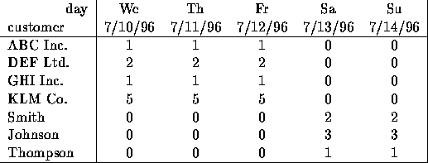
Dimensionality Reduction
Compress / reduce dimensionality:
10⁶ rows; 10³ columns; no updates
Random access to any cell(s); small error: OK
The above matrix is really “2-dimensional.” All rows can be reconstructed by scaling [1 1 1 0 0] or [0 0 0 1 1]

Slide 4

Rank of a Matrix
Q: What is rank of a matrix A?
A: Number of linearly independent columns of A
For example:
Matrix A = has rank r=2
Why? The first two rows are linearly independent, so the rank is at least 2, but all three rows are linearly dependent (the first is equal to the sum of the second and third) so the rank must be less than 3.
Why do we care about low rank?
We can write A as two “basis” vectors: [1 2 1] [-2 -3 1]
And new coordinates of : [1 0] [0 1] [1 1]

Slide 5
Rank is “Dimensionality”
Cloud of points 3D space:
Think of point positions as a matrix:
We can rewrite coordinates more efficiently!
Old basis vectors: [1 0 0] [0 1 0] [0 0 1]
New basis vectors: [1 2 1] [-2 -3 1]
Then A has new coordinates: [1 0]. B: [0 1], C: [1 1]
Notice: We reduced the number of coordinates!
A
B
C
A
1 row per point:

Slide 6
Dimensionality Reduction
Goal of dimensionality reduction is to discover the axis of data!
Rather than representing every point with 2 coordinates we represent each point with
1 coordinate (corresponding to the position of the point on the red line).
By doing this we incur a bit of error as the points do not exactly lie on the line

Slide 7
Why Reduce Dimensions?
Why reduce dimensions?
Discover hidden correlations/topics
Words that occur commonly together
Remove redundant and noisy features
Not all words are useful
Interpretation and visualization
Easier storage and processing of the data

Slide 8
SVD - Definition
A_{[m x n]} = U_{[m x r]} Σ _{[ r x r]} (V_{[n x r]})^{T}
A: Input data matrix
m x n matrix (e.g., m documents, n terms)
U: Left singular vectors
m x r matrix (m documents, r concepts)
Σ: Singular values
r x r diagonal matrix (strength of each ‘concept’) (r : rank of the matrix A)
V: Right singular vectors
n x r matrix (n terms, r concepts)

Slide 9
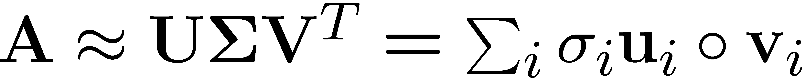
SVD
T
n
n
A
≈
Σ
V^{T}
m
m
U

Slide 10
SVD
T
n
σ₁u₁v₁
σ₂u₂v₂
A
≈
m
+
σ_{i} … scalar
u_{i} … vector
v_{i} … vector

Slide 11
SVD - Properties
It is always possible to decompose a real matrix A into A = U Σ V^{T} , where
U, Σ, V: unique
U, V: column orthonormal
U^{T} U = I; V^{T} V = I (I: identity matrix)
(Columns are orthogonal unit vectors)
Σ: diagonal
Entries (singular values) are positive, and sorted in decreasing order (σ₁ ≥ σ₂ ≥ ... ≥ 0)
Nice proof of uniqueness: http://www.mpi-inf.mpg.de/~bast/ir-seminar-ws04/lecture2.pdf

Slide 12
SVD – Example: Users-to-Movies
A = U Σ V^{T} - example: Users to Movies
Matrix
Alien
Serenity
Casablanca
Amelie
n
1 1 1 0 0
3 3 3 0 0
4 4 4 0 0
5 5 5 0 0
0 2 0 4 4
0 0 0 5 5
0 1 0 2 2
SciFi
Σ
V^{T}
=
m
Romnce
U
“Concepts” AKA Latent dimensions AKA Latent factors

Slide 13
SVD – Example: Users-to-Movies
A = U Σ V^{T} - example: Users to Movies
Matrix
Alien
Serenity
Casablanca
Amelie
1 1 1 0 0
3 3 3 0 0
4 4 4 0 0
5 5 5 0 0
0 2 0 4 4
0 0 0 5 5
0 1 0 2 2
0.13 0.02 -0.01
0.41 0.07 -0.03
0.55 0.09 -0.04
0.68 0.11 -0.05
0.15 -0.59 0.65
0.07 -0.73 -0.67
0.07 -0.29 0.32
SciFi
12.4 0 0
0 9.5 0
0 0 1.3
=
x
x
Romnce
0.56 0.59 0.56 0.09 0.09
0.12 -0.02 0.12 -0.69 -0.69
0.40 -0.80 0.40 0.09 0.09

Slide 14
SVD – Example: Users-to-Movies
A = U Σ V^{T} - example: Users to Movies
Matrix
Alien
Serenity
Casablanca
Amelie
SciFi-concept
Romance-concept
1 1 1 0 0
3 3 3 0 0
4 4 4 0 0
5 5 5 0 0
0 2 0 4 4
0 0 0 5 5
0 1 0 2 2
0.13 0.02 -0.01
0.41 0.07 -0.03
0.55 0.09 -0.04
0.68 0.11 -0.05
0.15 -0.59 0.65
0.07 -0.73 -0.67
0.07 -0.29 0.32
SciFi
12.4 0 0
0 9.5 0
0 0 1.3
=
x
x
Romnce
0.56 0.59 0.56 0.09 0.09
0.12 -0.02 0.12 -0.69 -0.69
0.40 -0.80 0.40 0.09 0.09

Slide 15
SVD – Example: Users-to-Movies
U is “user-to-concept”
similarity matrix
A = U Σ V^{T} - example:
Matrix
Alien
Serenity
Casablanca
Amelie
SciFi-concept
Romance-concept
1 1 1 0 0
3 3 3 0 0
4 4 4 0 0
5 5 5 0 0
0 2 0 4 4
0 0 0 5 5
0 1 0 2 2
0.13 0.02 -0.01
0.41 0.07 -0.03
0.55 0.09 -0.04
0.68 0.11 -0.05
0.15 -0.59 0.65
0.07 -0.73 -0.67
0.07 -0.29 0.32
SciFi
12.4 0 0
0 9.5 0
0 0 1.3
=
x
x
Romnce
0.56 0.59 0.56 0.09 0.09
0.12 -0.02 0.12 -0.69 -0.69
0.40 -0.80 0.40 0.09 0.09

Slide 16
SVD – Example: Users-to-Movies
A = U Σ V^{T} - example:
Matrix
Alien
Serenity
Casablanca
Amelie
SciFi-concept
“strength” of the SciFi-concept
1 1 1 0 0
3 3 3 0 0
4 4 4 0 0
5 5 5 0 0
0 2 0 4 4
0 0 0 5 5
0 1 0 2 2
0.13 0.02 -0.01
0.41 0.07 -0.03
0.55 0.09 -0.04
0.68 0.11 -0.05
0.15 -0.59 0.65
0.07 -0.73 -0.67
0.07 -0.29 0.32
SciFi
SciFi
12.4 0 0
0 9.5 0
0 0 1.3
=
x
x
Romnce
Romnce
0.56 0.59 0.56 0.09 0.09
0.12 -0.02 0.12 -0.69 -0.69
0.40 -0.80 0.40 0.09 0.09

Slide 17
SVD – Example: Users-to-Movies
A = U Σ V^{T} - example:
Matrix
Alien
Serenity
Casablanca
Amelie
V is “movie-to-concept”
similarity matrix
SciFi-concept
1 1 1 0 0
3 3 3 0 0
4 4 4 0 0
5 5 5 0 0
0 2 0 4 4
0 0 0 5 5
0 1 0 2 2
0.13 0.02 -0.01
0.41 0.07 -0.03
0.55 0.09 -0.04
0.68 0.11 -0.05
0.15 -0.59 0.65
0.07 -0.73 -0.67
0.07 -0.29 0.32
SciFi
12.4 0 0
0 9.5 0
0 0 1.3
=
x
x
Romnce
0.56 0.59 0.56 0.09 0.09
0.12 -0.02 0.12 -0.69 -0.69
0.40 -0.80 0.40 0.09 0.09
SciFi-concept

Slide 18
SVD - Interpretation #1
‘movies’, ‘users’ and ‘concepts’:
U: user-to-concept similarity matrix
V: movie-to-concept similarity matrix
Σ: its diagonal elements: ‘strength’ of each concept

Slide 19
Dimensionality Reduction with SVD

Slide 20
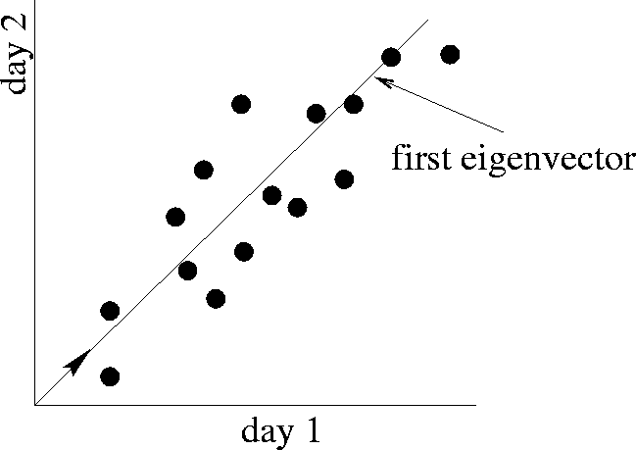
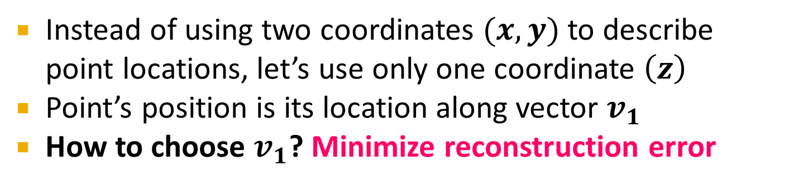
SVD – Dimensionality Reduction
Movie 2 rating
first right singular vector
v₁
Movie 1 rating
Instead of using two coordinates $(x,y)$ to describe point locations, let’s use only one coordinate $\left(z\right)$
Point’s position is its location along vector $v_{1}$
How to choose $v_{1}$? Minimize reconstruction error

Slide 21
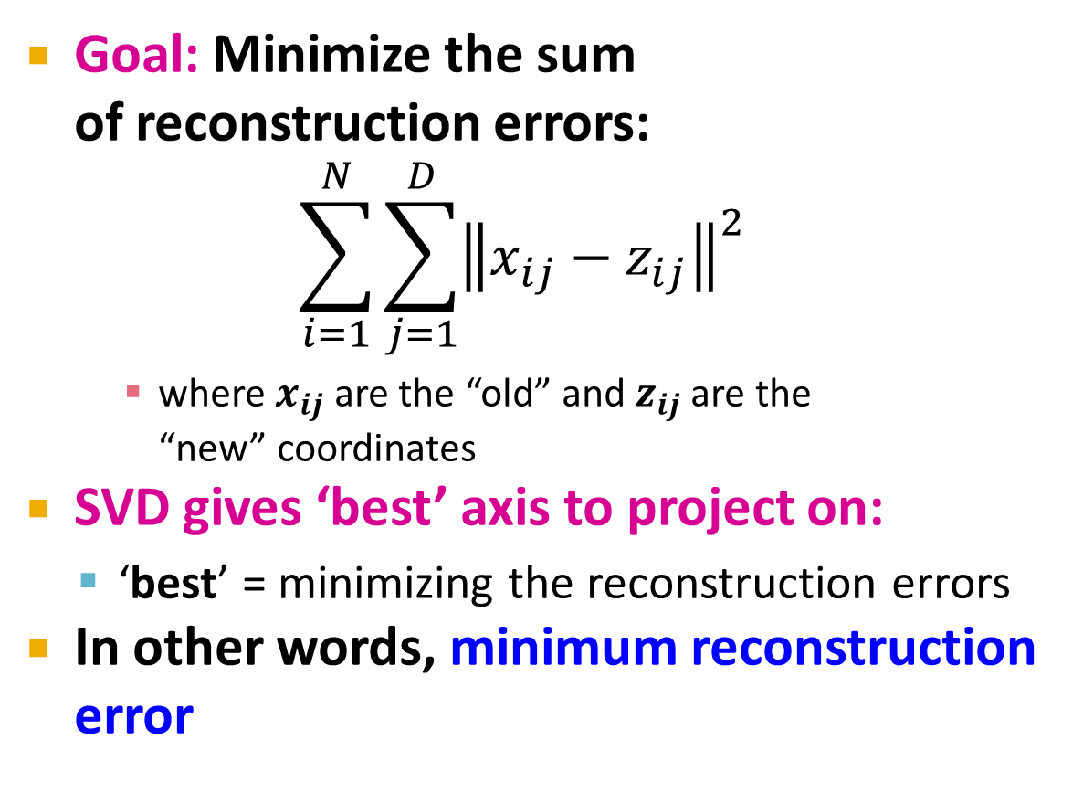
SVD – Dimensionality Reduction
Goal: Minimize the sum of reconstruction errors:
$$\sum_{i=1}^{N}{\sum_{j=1}^{D}{{\left\|x_{ij}−z_{ij}\right\|}^{2}}}$$
where $x_{ij}$ are the “old” and $z_{ij}$ are the “new” coordinates
SVD gives ‘best’ axis to project on:
‘best’ = minimizing the reconstruction errors
In other words, minimum reconstruction error
Movie 2 rating
first right singular vector
v₁
Movie 1 rating

Slide 22
SVD - Interpretation #2
A = U Σ V^{T} - example:
V: “movie-to-concept” matrix
U: “user-to-concept” matrix
Movie 2 rating
first right singular vector
v₁
1 1 1 0 0
3 3 3 0 0
4 4 4 0 0
5 5 5 0 0
0 2 0 4 4
0 0 0 5 5
0 1 0 2 2
0.13 0.02 -0.01
0.41 0.07 -0.03
0.55 0.09 -0.04
0.68 0.11 -0.05
0.15 -0.59 0.65
0.07 -0.73 -0.67
0.07 -0.29 0.32
Movie 1 rating
12.4 0 0
0 9.5 0
0 0 1.3
=
x
x
0.56 0.59 0.56 0.09 0.09
0.12 -0.02 0.12 -0.69 -0.69
0.40 -0.80 0.40 0.09 0.09

Slide 23
SVD - Interpretation #2
A = U Σ V^{T} - example:
Movie 2 rating
first right singular vector
variance (‘spread’) on the v₁ axis
v₁
1 1 1 0 0
3 3 3 0 0
4 4 4 0 0
5 5 5 0 0
0 2 0 4 4
0 0 0 5 5
0 1 0 2 2
0.13 0.02 -0.01
0.41 0.07 -0.03
0.55 0.09 -0.04
0.68 0.11 -0.05
0.15 -0.59 0.65
0.07 -0.73 -0.67
0.07 -0.29 0.32
Movie 1 rating
12.4 0 0
0 9.5 0
0 0 1.3
=
x
x
0.56 0.59 0.56 0.09 0.09
0.12 -0.02 0.12 -0.69 -0.69
0.40 -0.80 0.40 0.09 0.09

Slide 24
SVD - Interpretation #2
A = U Σ V^{T} - example:
U Σ: Gives the coordinates of the points in the projection axis
Movie 2 rating
first right singular vector
v₁
1 1 1 0 0
3 3 3 0 0
4 4 4 0 0
5 5 5 0 0
0 2 0 4 4
0 0 0 5 5
0 1 0 2 2
Projection of users on the “Sci-Fi” axis (U Σ) ^{Τ}:
Movie 1 rating
1.61 0.19 -0.01
5.08 0.66 -0.03
6.82 0.85 -0.05
8.43 1.04 -0.06
1.86 -5.60 0.84
0.86 -6.93 -0.87
0.86 -2.75 0.41

Slide 25
SVD - Interpretation #2
More details
Q: How exactly is dim. reduction done?
1 1 1 0 0
3 3 3 0 0
4 4 4 0 0
5 5 5 0 0
0 2 0 4 4
0 0 0 5 5
0 1 0 2 2
0.13 0.02 -0.01
0.41 0.07 -0.03
0.55 0.09 -0.04
0.68 0.11 -0.05
0.15 -0.59 0.65
0.07 -0.73 -0.67
0.07 -0.29 0.32
12.4 0 0
0 9.5 0
0 0 1.3
=
x
x
0.56 0.59 0.56 0.09 0.09
0.12 -0.02 0.12 -0.69 -0.69
0.40 -0.80 0.40 0.09 0.09

Slide 26
SVD - Interpretation #2
More details
Q: How exactly is dim. reduction done?
A: Set smallest singular values to zero
1 1 1 0 0
3 3 3 0 0
4 4 4 0 0
5 5 5 0 0
0 2 0 4 4
0 0 0 5 5
0 1 0 2 2
0.13 0.02 -0.01
0.41 0.07 -0.03
0.55 0.09 -0.04
0.68 0.11 -0.05
0.15 -0.59 0.65
0.07 -0.73 -0.67
0.07 -0.29 0.32
12.4 0 0
0 9.5 0
0 0 1.3
=
x
x
0.56 0.59 0.56 0.09 0.09
0.12 -0.02 0.12 -0.69 -0.69
0.40 -0.80 0.40 0.09 0.09

Slide 27
SVD - Interpretation #2
More details
Q: How exactly is dim. reduction done?
A: Set smallest singular values to zero
1 1 1 0 0
3 3 3 0 0
4 4 4 0 0
5 5 5 0 0
0 2 0 4 4
0 0 0 5 5
0 1 0 2 2
0.13 0.02 -0.01
0.41 0.07 -0.03
0.55 0.09 -0.04
0.68 0.11 -0.05
0.15 -0.59 0.65
0.07 -0.73 -0.67
0.07 -0.29 0.32
12.4 0 0
0 9.5 0
0 0 1.3
≈
x
x
0.56 0.59 0.56 0.09 0.09
0.12 -0.02 0.12 -0.69 -0.69
0.40 -0.80 0.40 0.09 0.09

Slide 28
SVD - Interpretation #2
More details
Q: How exactly is dim. reduction done?
A: Set smallest singular values to zero
1 1 1 0 0
3 3 3 0 0
4 4 4 0 0
5 5 5 0 0
0 2 0 4 4
0 0 0 5 5
0 1 0 2 2
0.13 0.02 -0.01
0.41 0.07 -0.03
0.55 0.09 -0.04
0.68 0.11 -0.05
0.15 -0.59 0.65
0.07 -0.73 -0.67
0.07 -0.29 0.32
12.4 0 0
0 9.5 0
0 0 1.3
≈
x
x
0.56 0.59 0.56 0.09 0.09
0.12 -0.02 0.12 -0.69 -0.69
0.40 -0.80 0.40 0.09 0.09

Slide 29
SVD - Interpretation #2
More details
Q: How exactly is dim. reduction done?
A: Set smallest singular values to zero
1 1 1 0 0
3 3 3 0 0
4 4 4 0 0
5 5 5 0 0
0 2 0 4 4
0 0 0 5 5
0 1 0 2 2
0.13 0.02
0.41 0.07
0.55 0.09
0.68 0.11
0.15 -0.59
0.07 -0.73
0.07 -0.29
12.4 0
0 9.5
≈
x
x
0.56 0.59 0.56 0.09 0.09
0.12 -0.02 0.12 -0.69 -0.69

Slide 30
SVD - Interpretation #2
More details
Q: How exactly is dim. reduction done?
A: Set smallest singular values to zero
1 1 1 0 0
3 3 3 0 0
4 4 4 0 0
5 5 5 0 0
0 2 0 4 4
0 0 0 5 5
0 1 0 2 2
0.92 0.95 0.92 0.01 0.01
2.91 3.01 2.91 -0.01 -0.01
3.90 4.04 3.90 0.01 0.01
4.82 5.00 4.82 0.03 0.03
0.70 0.53 0.70 4.11 4.11
-0.69 1.34 -0.69 4.78 4.78
0.32 0.23 0.32 2.01 2.01
≈
Frobenius norm:
ǁMǁ_{F} = √Σ_{ij} M_{ij}²
ǁA-Bǁ_{F} = √ Σ_{ij} (A_{ij}-B_{ij})²
^{is “small”}

Slide 31
SVD – Best Low Rank Approx.
A
U
Sigma
=
V^{T}
B is best approximation of A
B
U
Sigma
=
V^{T}

Slide 32
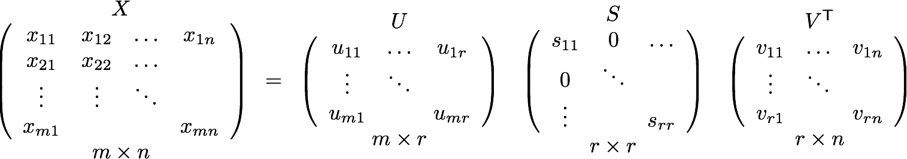
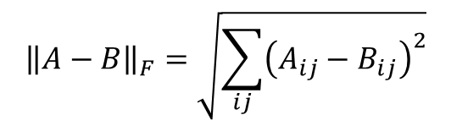



SVD – Best Low Rank Approx.
Theorem: Let A = U Σ V^{T} and B = U S V^{T} where S = diagonal rxr matrix with s_{i}=σ_{i} (i=1…k) else s_{i}=0 then B is a best rank(B)=k approx. to A
What do we mean by “best”:
B is a solution to min_{B} ǁA-Bǁ_{F} where rank(B)=k
$$Σ$$
$$σ_{11}$$
$$σ_{rr}$$
$${\left\|A−B\right\|}_{F}=\sqrt{\sum_{ij}{{\left(A_{ij}−B_{ij}\right)}^{2}}}$$
Notes:
Drop summations
USV – UXV = U-U(SV-XV)
AXC –AYC = (AC)(X-Y)

Slide 33
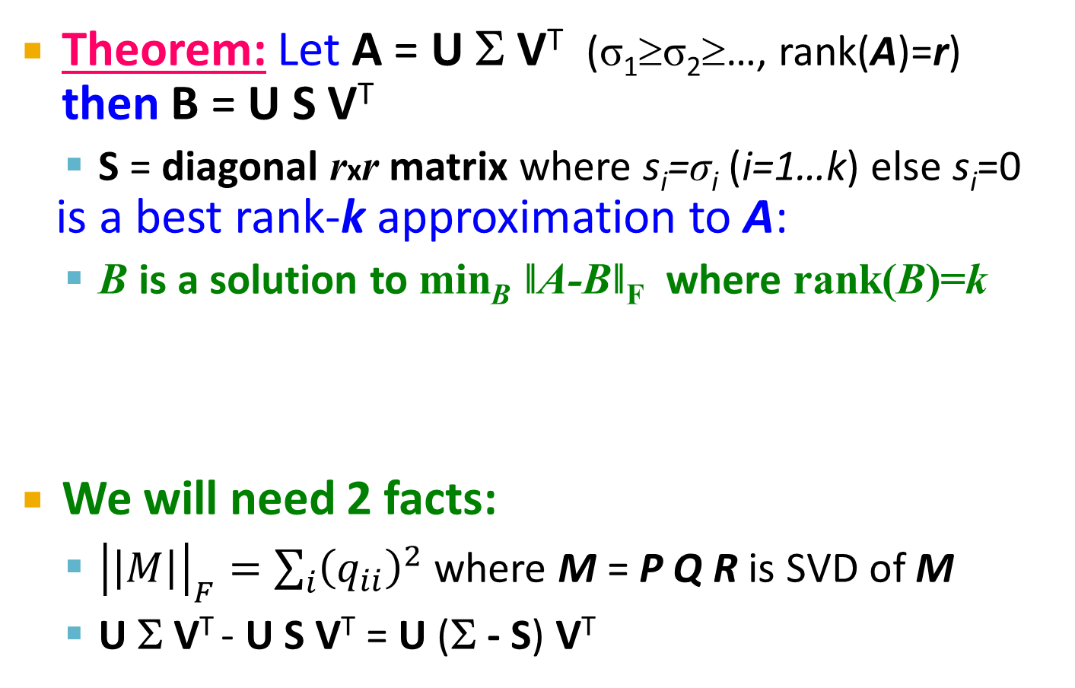



SVD – Best Low Rank Approx.
Details!
Theorem: Let A = U Σ V^{T} (σ₁≥σ₂≥…, rank(A)=r)
then B = U S V^{T}
S = diagonal rxr matrix where s_{i}=σ_{i} (i=1…k) else s_{i}=0
is a best rank-k approximation to A:
B is a solution to min_{B} ǁA-Bǁ_{F} where rank(B)=k
We will need 2 facts:
${\left|\left|M\right|\right|}_{F}=\sum_{i}{{\left(q_{ii}\right)}^{2}}$ where M = P Q R is SVD of M
U Σ V^{T} - U S V^{T} = U (Σ - S) V^{T}
$$Σ$$
$$σ_{11}$$
$$σ_{rr}$$
Notes:
Drop summations
USV – UXV = U-U(SV-XV)
AXC –AYC = (AC)(X-Y)

Slide 34
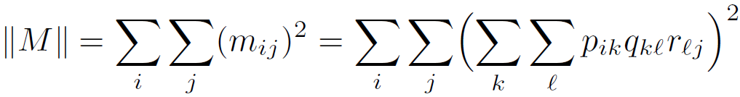

SVD – Best Low Rank Approx.
Details!
We will need 2 facts:
${\left|\left|M\right|\right|}_{F}=\sum_{k}{{\left(q_{kk}\right)}^{2}}$ where M = P Q R is SVD of M
U Σ V^{T} - U S V^{T} = U (Σ - S) V^{T}
We apply:
-- P column orthonormal
-- R row orthonormal
-- Q is diagonal
Notes:
Drop summations
USV – UXV = U-U(SV-XV)
AXC –AYC = (AC)(X-Y)

Slide 35

SVD – Best Low Rank Approx.
Details!
A = U Σ V^{T} , B = U S V^{T} (σ₁≥σ₂≥… ≥ 0, rank(A)=r)
S = diagonal nxn matrix where s_{i}=σ_{i} (i=1…k) else s_{i}=0
then B is solution to min_{B} ǁA-Bǁ_{F} , rank(B)=k
Why?
We want to choose s_{i} to minimize $\sum_{i}{{\left(σ_{i}−s_{i}\right)}^{2}}$
Solution is to set s_{i}=σ_{i} (i=1…k) and other s_{i}=0
We used: U Σ V^{T} - U S V^{T} = U (Σ - S) V^{T}
Notes:
USV – UXV = U-U(SV-XV)
AXC –AYC = (A-A)(XC-YC)
5 2 4 – 5 3 4
40-60 = 20

Slide 36
SVD - Interpretation #2
Equivalent:
‘spectral decomposition’ of the matrix:
1 1 1 0 0
3 3 3 0 0
4 4 4 0 0
5 5 5 0 0
0 2 0 4 4
0 0 0 5 5
0 1 0 2 2
x
σ₁
x
=
u₁
u₂
σ₂
v₁
v₂

Slide 37
SVD - Interpretation #2
Equivalent:
‘spectral decomposition’ of the matrix
m
1 1 1 0 0
3 3 3 0 0
4 4 4 0 0
5 5 5 0 0
0 2 0 4 4
0 0 0 5 5
0 1 0 2 2
k terms
=
σ₁
u₁
v^{T}₁
+
σ₂
u₂
v^{T}₂
+...
n x 1
1 x m
n
Assume: σ₁ ≥ σ₂ ≥ σ₃ ≥ ... ≥ 0
Why is setting small σ_{i} to 0 the right thing to do?
Vectors u_{i} and v_{i} are unit length, so σ_{i} scales them.
So, zeroing small σ_{i} introduces less error.

Slide 38
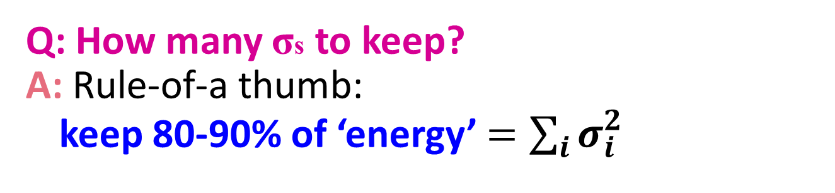
SVD - Interpretation #2
Q: How many σs to keep?
A: Rule-of-a thumb: keep 80-90% of ‘energy’ $=\sum_{i}{σ_{i}^{2}}$
m
1 1 1 0 0
3 3 3 0 0
4 4 4 0 0
5 5 5 0 0
0 2 0 4 4
0 0 0 5 5
0 1 0 2 2
=
σ₁
u₁
v^{T}₁
+
σ₂
u₂
v^{T}₂
+...
n
Assume: σ₁ ≥ σ₂ ≥ σ₃ ≥ ...

Slide 39
SVD - Complexity
To compute SVD:
O(nm²) or O(n²m) (whichever is less)
But:
Less work, if we just want singular values
or if we want first k singular vectors
or if the matrix is sparse
Implemented in linear algebra packages like
LINPACK, Matlab, SPlus, Mathematica ...

Slide 40
SVD - Conclusions so far
SVD: A= U Σ V^{T}: unique
U: user-to-concept similarities
V: movie-to-concept similarities
Σ : strength of each concept
Dimensionality reduction:
keep the few largest singular values (80-90% of ‘energy’)
SVD: picks up linear correlations

Slide 41
Relation to Eigen-decomposition
SVD gives us:
A = U Σ V^{T}
Eigen-decomposition:
A = X Λ X^{T}
A is symmetric
U, V, X are orthonormal (U^{T}U=I),
Λ, Σ are diagonal
Now let’s calculate:
AA^{T}= UΣ V^{T}(UΣ V^{T})^{T} = UΣ V^{T}(VΣ^{T}U^{T}) = UΣΣ^{T} U^{T}
A^{T}A = V Σ^{T} U^{T} (UΣ V^{T}) = V ΣΣ^{T} V^{T}
Notes:
the columns of U are orthonormal eigenvectors of AAT
the columns of V are orthonormal eigenvectors of ATA,
S is a diagonal matrix containing the square roots of eigenvalues from U or V in descending order.

Slide 42
Relation to Eigen-decomposition
SVD gives us:
A = U Σ V^{T}
Eigen-decomposition:
A = X Λ X^{T}
A is symmetric
U, V, X are orthonormal (U^{T}U=I),
Λ, Σ are diagonal
Now let’s calculate:
AA^{T}= UΣ V^{T}(UΣ V^{T})^{T} = UΣ V^{T}(VΣ^{T}U^{T}) = UΣΣ^{T} U^{T}
A^{T}A = V Σ^{T} U^{T} (UΣ V^{T}) = V ΣΣ^{T} V^{T}
Shows how to compute SVD using eigenvalue decomposition!
X Λ² X^{T}
X Λ² X^{T}
Notes:
the columns of U are orthonormal eigenvectors of AAT
the columns of V are orthonormal eigenvectors of ATA,
S is a diagonal matrix containing the square roots of eigenvalues from U or V in descending order.
If A = A^T is a symmetric matrix, its singular values are the absolute values of its nonzero eigenvalues: σi = | λi| > 0; its singular vectors coincide with the associated non-null eigenvectors.

Slide 43
SVD: Properties
A A^{T} = U Σ² U^{T}
A^{T}A = V Σ² V^{T}
(A^{T}A) ^{k} = V Σ^{2k} V^{T}
E.g.: (A^{T}A)² = V Σ² V^{T} V Σ² V^{T} = V Σ⁴ V^{T}
(A^{T}A) ^{k} ~ v₁ σ₁^{2k} v₁^{T} for k>>1

Slide 44
Example of SVD & Conclusion

Slide 45
Case study: How to query?
Q: Find users that like ‘Matrix’
A: Map query into a ‘concept space’ – how?
Matrix
Alien
Serenity
Casablanca
Amelie
1 1 1 0 0
3 3 3 0 0
4 4 4 0 0
5 5 5 0 0
0 2 0 4 4
0 0 0 5 5
0 1 0 2 2
0.13 0.02 -0.01
0.41 0.07 -0.03
0.55 0.09 -0.04
0.68 0.11 -0.05
0.15 -0.59 0.65
0.07 -0.73 -0.67
0.07 -0.29 0.32
SciFi
12.4 0 0
0 9.5 0
0 0 1.3
=
x
x
Romnce
0.56 0.59 0.56 0.09 0.09
0.12 -0.02 0.12 -0.69 -0.69
0.40 -0.80 0.40 0.09 0.09

Slide 46
Case study: How to query?
Q: Find users that like ‘Matrix’
A: Map query into a ‘concept space’ – how?
Matrix
Alien
Serenity
Casablanca
Amelie
Alien
q
q =
v2
v1
Project into concept space: Inner product with each ‘concept’ vector v_{i}
Matrix

Slide 47
Case study: How to query?
Q: Find users that like ‘Matrix’
A: Map query into a ‘concept space’ – how?
Matrix
Alien
Serenity
Casablanca
Amelie
Alien
q
q =
v2
v1
q*v₁
Project into concept space: Inner product with each ‘concept’ vector v_{i}
Matrix

Slide 48
Case study: How to query?
Compactly, we have:
q_{concept} = q V
E.g.:
Matrix
Alien
Serenity
Casablanca
Amelie
SciFi-concept
0.56 0.12
0.59 -0.02
0.56 0.12
0.09 -0.69
0.09 -0.69
x
=
2.8 0.6
q =
movie-to-concept
similarities (V)

Slide 49
Case study: How to query?
How would the user d that rated (‘Alien’, ‘Serenity’) be handled? d_{concept} = d V
E.g.:
Matrix
Alien
Serenity
Casablanca
Amelie
SciFi-concept
0.56 0.12
0.59 -0.02
0.56 0.12
0.09 -0.69
0.09 -0.69
x
=
5.2 0.4
q =
movie-to-concept
similarities (V)

Slide 50
Case study: How to query?
Observation: User d that rated (‘Alien’, ‘Serenity’) will be similar to user q that rated (‘Matrix’), although d and q have zero ratings in common!
Matrix
Alien
Serenity
Casablanca
Amelie
SciFi-concept
d =
5.2 0.4
q =
2.8 0.6
Zero ratings in common
Similarity ≠ 0
Notes:
True since ratings are correlated and SVD uncovered this correlation

Slide 51
SVD: Drawbacks
Optimal low-rank approximation in terms of Frobenius norm
Interpretability problem:
A singular vector specifies a linear combination of all input columns or rows
Lack of sparsity:
Singular vectors are dense!
V^{T}
Σ
=
U

Slide 52
CUR Decomposition

Slide 53
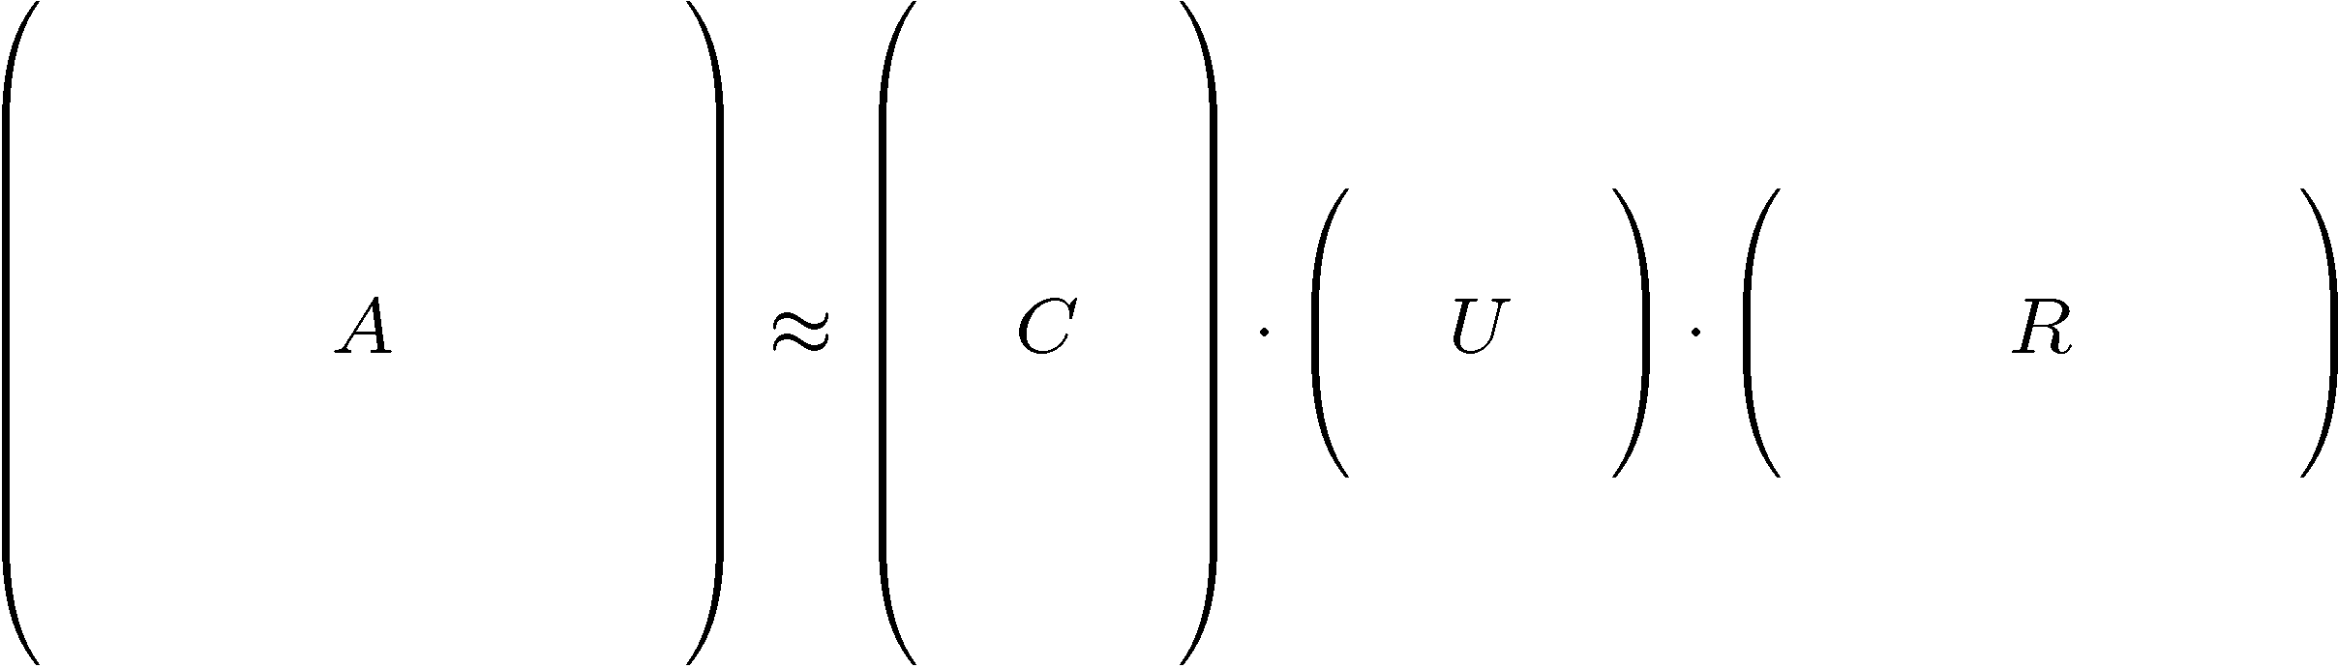
CUR Decomposition
Frobenius norm:
ǁXǁ_{F} = √ Σ_{ij} X_{ij}²
Goal: Express A as a product of matrices C,U,R
Make ǁA-C·U·Rǁ_{F} small
“Constraints” on C and R:
A
C
U
R

Slide 54
CUR Decomposition
Frobenius norm:
ǁXǁ_{F} = √ Σ_{ij} X_{ij}²
Goal: Express A as a product of matrices C,U,R
Make ǁA-C·U·Rǁ_{F} small
“Constraints” on C and R:
Pseudo-inverse of
the intersection of C and R
A
C
U
R

Slide 55
CUR: Provably good approx. to SVD
Let: A_{k} be the “best” rank k approximation to A (that is, A_{k} is SVD of A)
Theorem [Drineas et al.]
CUR in O(m·n) time achieves
ǁA-CURǁ_{F} ≤ ǁA-A_{k}ǁ_{F} + εǁAǁ_{F}
with probability at least 1-δ, by picking
O(k log(1/δ)/ε²) columns, and
O(k² log³(1/δ)/ε⁶) rows
In practice:
Pick 4k cols/rows
Notes:
HOW TO PICK NUMBER of COS/ROWS In practice. Mahoney’s slides say pick 4k cols/rows

Slide 56
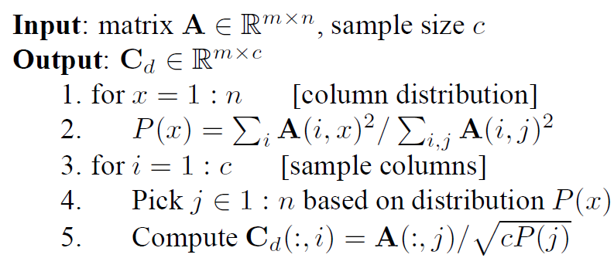
CUR: How it Works
Sampling columns (similarly for rows):
Note this is a randomized algorithm, same column can be sampled more than once

Slide 57
Computing U
Let W be the “intersection” of sampled columns C and rows R
Let SVD of W = X Z Y^{T}
Then: U = W⁺ = Y Z⁺ X^{T}
Ζ⁺: reciprocals of non-zero singular values: Ζ⁺_{ii} =1/ Ζ_{ii}
W⁺ is the “pseudoinverse”
Why pseudoinverse works?
W = X Z Y then W⁻¹ = X⁻¹ Z⁻¹ Y⁻¹
Due to orthonomality
X⁻¹=X^{T} and Y⁻¹=Y^{T}
Since Z is diagonal Z⁻¹ = 1/Z_{ii}
Thus, if W is nonsingular, pseudoinverse is the true inverse
A
C
R
W
≈
U = W⁺

Slide 58
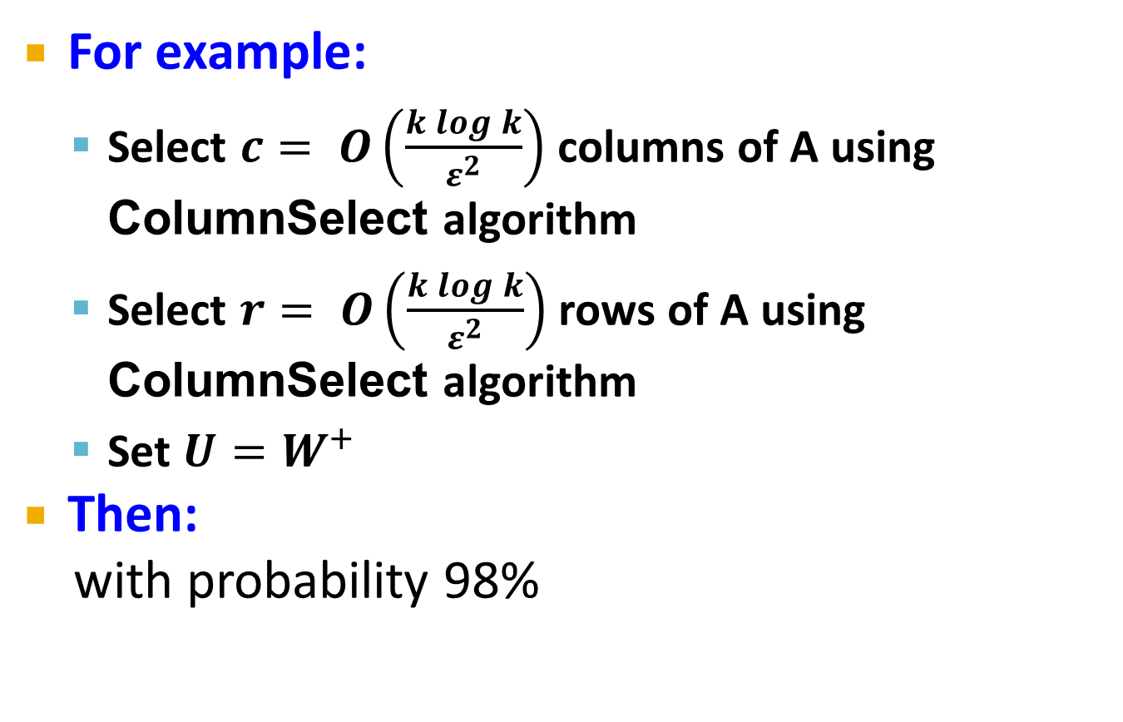
CUR: Provably good approx. to SVD
For example:
Select $c= O\left(\frac{k\log{k}}{ε^{2}}\right)$ columns of A using ColumnSelect algorithm
Select $r= O\left(\frac{k\log{k}}{ε^{2}}\right)$ rows of A using ColumnSelect algorithm
Set $U=W^{+}$
Then:
with probability 98%
CUR error
SVD error
In practice:
Pick 4k cols/rows for a “rank-k” approximation
Notes:
HOW TO PICK NUMBER of COS/ROWS In practice. Mahoney’s slides say pick 4k cols/rows

Slide 59
CUR: Pros & Cons
Easy interpretation
Since the basis vectors are actual columns and rows
Sparse basis
Since the basis vectors are actual columns and rows
Duplicate columns and rows
Columns of large norms will be sampled many times
Actual column
Singular vector

Slide 60
Solution
If we want to get rid of the duplicates:
Throw them away
Scale (multiply) the columns/rows by the square root of the number of duplicates
A
C_{d}
R_{d}
C_{s}
R_{s}
Construct a small U

Slide 61
SVD vs. CUR
sparse and small
SVD: A = U Σ V^{T}
Huge but sparse
Big and dense
dense but small
CUR: A = C U R
Huge but sparse
Big but sparse

Slide 62
SVD vs. CUR: Simple Experiment
DBLP bibliographic data
Author-to-conference big sparse matrix
A_{ij}: Number of papers published by author i at conference j
428K authors (rows), 3659 conferences (columns)
Very sparse
Want to reduce dimensionality
How much time does it take?
What is the reconstruction error?
How much space do we need?

Slide 63
Results: DBLP- big sparse matrix
SVD
SVD
CUR
CUR no duplicates
SVD
CUR
CUR no dup
CUR
Accuracy:
1 – relative sum squared errors
Space ratio:
#output matrix entries / #input matrix entries
CPU time
Sun, Faloutsos: Less is More: Compact Matrix Decomposition for Large Sparse Graphs, SDM ’07.
Notes:
http://www.cs.cmu.edu/~jimeng/papers/SunSDM07.pdf

Slide 64
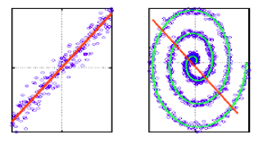
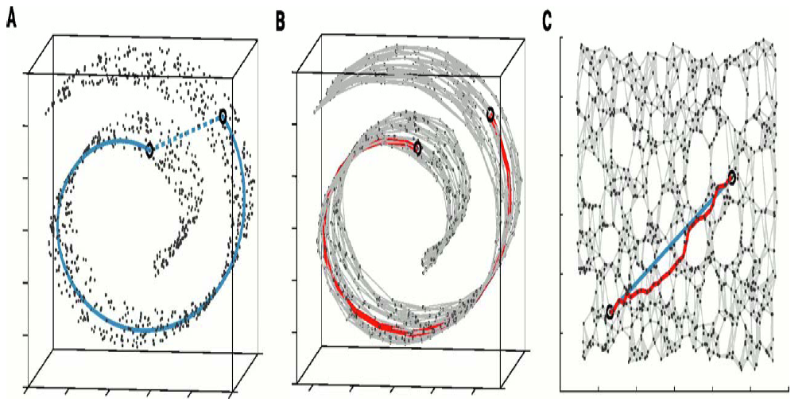
What about linearity assumption?
SVD is limited to linear projections:
Lower‐dimensional linear projection that preserves Euclidean distances
Non-linear methods: Isomap
Data lies on a nonlinear low‐dim curve aka manifold
Use the distance as measured along the manifold
How?
Build adjacency graph
Geodesic distance is graph distance
SVD/PCA the graph pairwise distance matrix

Slide 65
Further Reading: CUR
Drineas et al., Fast Monte Carlo Algorithms for Matrices III: Computing a Compressed Approximate Matrix Decomposition, SIAM Journal on Computing, 2006.
J. Sun, Y. Xie, H. Zhang, C. Faloutsos: Less is More: Compact Matrix Decomposition for Large Sparse Graphs, SDM 2007
Intra- and interpopulation genotype reconstruction from tagging SNPs, P. Paschou, M. W. Mahoney, A. Javed, J. R. Kidd, A. J. Pakstis, S. Gu, K. K. Kidd, and P. Drineas, Genome Research, 17(1), 96-107 (2007)
Tensor-CUR Decompositions For Tensor-Based Data, M. W. Mahoney, M. Maggioni, and P. Drineas, Proc. 12-th Annual SIGKDD, 327-336 (2006)

