Slide 1
Shannon Energy
Sales & Retention Analytics
Power BI demo project - end-to-end build
26,000 acquisitions · 17,000 churn events · 5 sales channels · 2023-2026
Raw CSV → cleaning in Power Query → star schema → 29 DAX measures → report
Marina Kulmane
Synthetic data. Built to demonstrate method.
Notes:
I built this as a demo project, the data is synthetic. I generated it myself to look like an energy retailer - around 26,000 acquisitions, 17,000 churn events, five sales channels, three and a half years. The numbers are not real, but everything else is: the messy source files, the cleaning, the model and the measures. I'll take about five minutes, and please stop me at any point.
An acquisition is one new customer who signed a contract. One row per customer - the date, the channel they came through, the region, the tariff, and what it cost us to acquire them. So 26,000 is customers who actually joined over three and a half years, not leads or quotes.
A churn event is one customer leaving - the date, the reason, who they switched to, and how long they'd been with us. That's 17,000.
The difference between the two is net adds, which is the number on the dashboard.
“So is 26,000 your customer base?"
No - the base is about 41,000. A lot of those customers joined before 2023, which is where my data starts. The 26,000 are only the ones acquired inside the period I can observe, and that matters for the retention analysis: I can only measure a cohort if I know when it started.
A cohort is a group of customers defined by when they joined - everyone who signed up in March 2025, for example. Retention is measured from that date, not from the calendar.
So I need two things. First, an acquisition date - customers who were already on the book before 2023 don't have one, and I can't tell whether they joined last year or ten years ago, so they're excluded. That's why the base is 41,000 but the cohort analysis uses 26,000.
Second, the cohort has to be old enough. Someone who joined two months ago hasn't had the chance to reach month twelve. If I count them as retained, my twelve-month number goes up for no real reason. So each cohort only enters the calculation once it's actually reached that month.

Slide 2
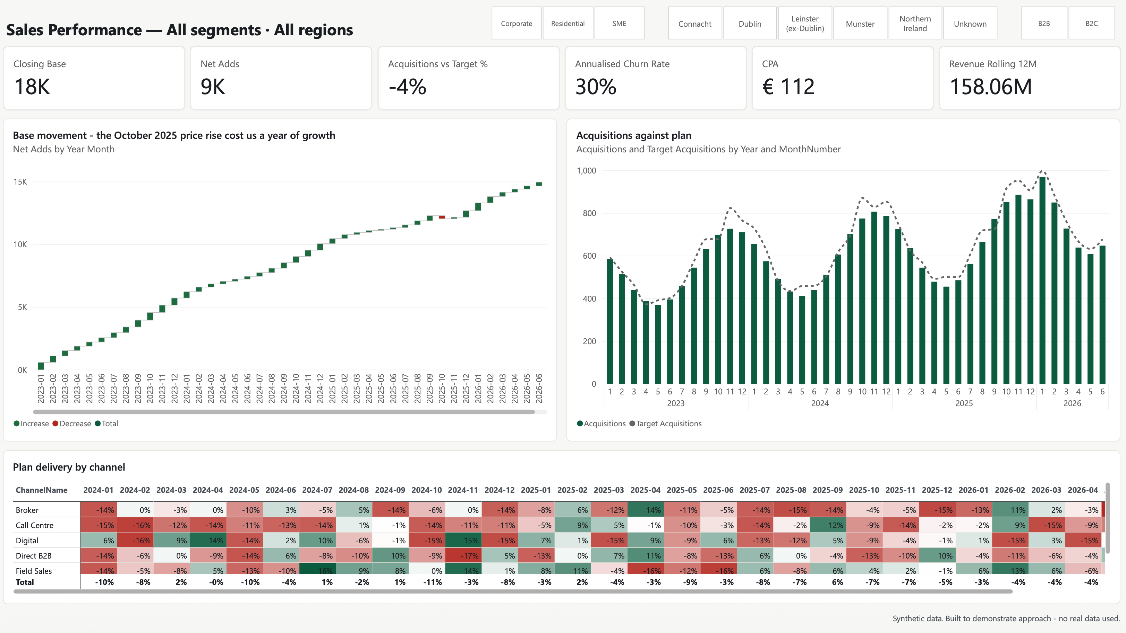
The view a sales director opens in the morning
One page: volume, cost, plan vs actual, churn - filtered by segment and region.
Every card is a DAX measure, not a hard-coded number.
Shannon Energy · Power BI demo
Notes:
This is the page a sales director would open in the morning. Closing base, net adds, how we're doing against plan, annualised churn, cost per acquisition, rolling twelve-month revenue. Everything is filtered by segment and by region at the top, so B2C and B2B are the same page, not two reports.
Nothing here is typed in. Every card is a DAX measure, so when next month's data arrives the page is correct without anyone touching it.
One thing I'd point out - the waterfall on the left. Growth is steady until October 2025, and then there's a red month. That was a price rise in my scenario, and you can see it cost about a year of growth.

Slide 3
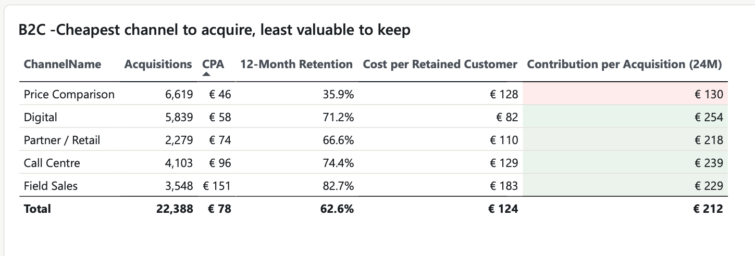
The cheapest channel to acquire is the least valuable to keep
B2C: acquisitions, CPA, 12-month retention, cost per retained customer, contribution.
Price Comparison: CPA €46 - the lowest. Retention 35.9% - the lowest.
Shannon Energy · Power BI demo
Notes:
This is the finding. Sort the channels by cost per acquisition: Price Comparison is the cheapest at 46 euro. If you stop there, the answer is obvious - put the money into price comparison sites.
But the next column is twelve-month retention, and Price Comparison is 36 percent. Field Sales costs 151, three times more, and keeps 83 percent.
So I added a column that combines them: cost per retained customer. That's CPA divided by twelve-month retention - what you actually pay for a customer who is still there after a year. The cheapest channel to buy becomes 128, which is almost the same as Call Centre and not far off Field Sales.
And the last column is contribution per acquisition over 24 months. Price Comparison is the lowest of all five. The cheapest channel to buy is the least valuable to keep.

Slide 4
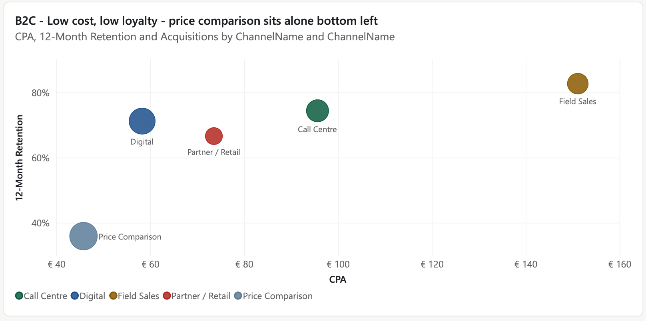
Low cost, low loyalty - Price Comparison sits alone
CPA against 12-month retention. Bubble size = acquisitions.
Cost per retained customer turns €46 into €128. Field Sales turns €151 into €183.
Shannon Energy · Power BI demo
Notes:
Cost on the horizontal axis, retention on the vertical, bubble size is volume.
Four channels sit roughly on a line - you pay more, you keep more. Price Comparison sits on its own in the bottom-left corner: cheap, and it doesn't stay.
I'd use this chart with a commercial audience rather than the table, because nobody has to read five columns to see the outlier.

Slide 5
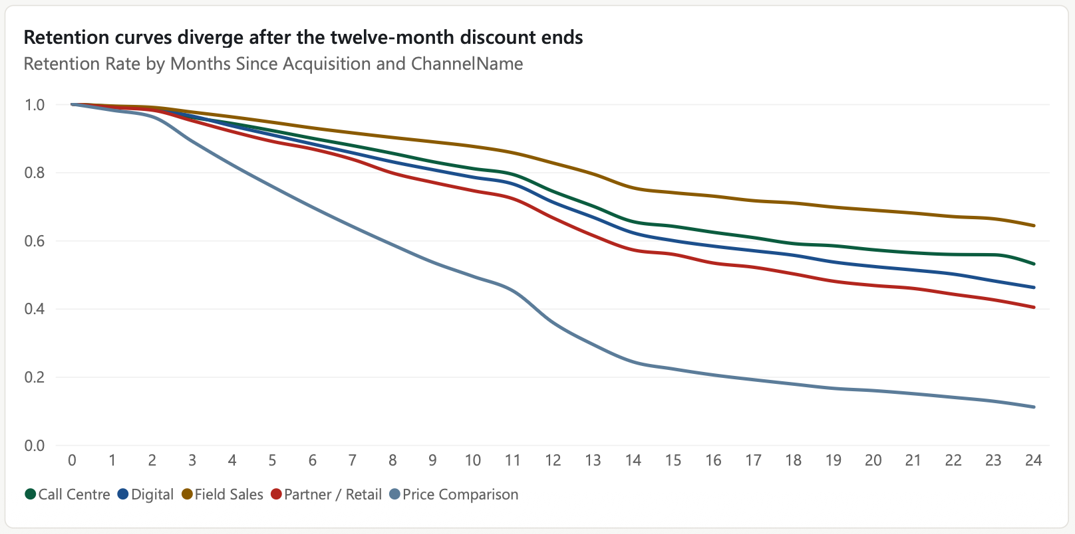
The curves diverge when the twelve-month discount ends
Retention curve by months since acquisition, by channel.
Cohorts too young to have reached month N are excluded, not counted as retained.
Shannon Energy · Power BI demo
Notes:
This is how I checked it wasn't an accident of the averages. Retention curve by months since acquisition, split by channel.
For the first two months all five channels look the same. They separate from about month three, and the gap really opens after month twelve.
The blue line at the bottom is Price Comparison. It's not that those customers leave immediately — they leave at the end of the introductory discount.
One technical point I'd make: a customer acquired three months ago cannot tell you anything about month twelve. So each point on this curve only counts cohorts old enough to have reached that month. If you don't do that, young cohorts count as retained and every curve looks too good.

Slide 6
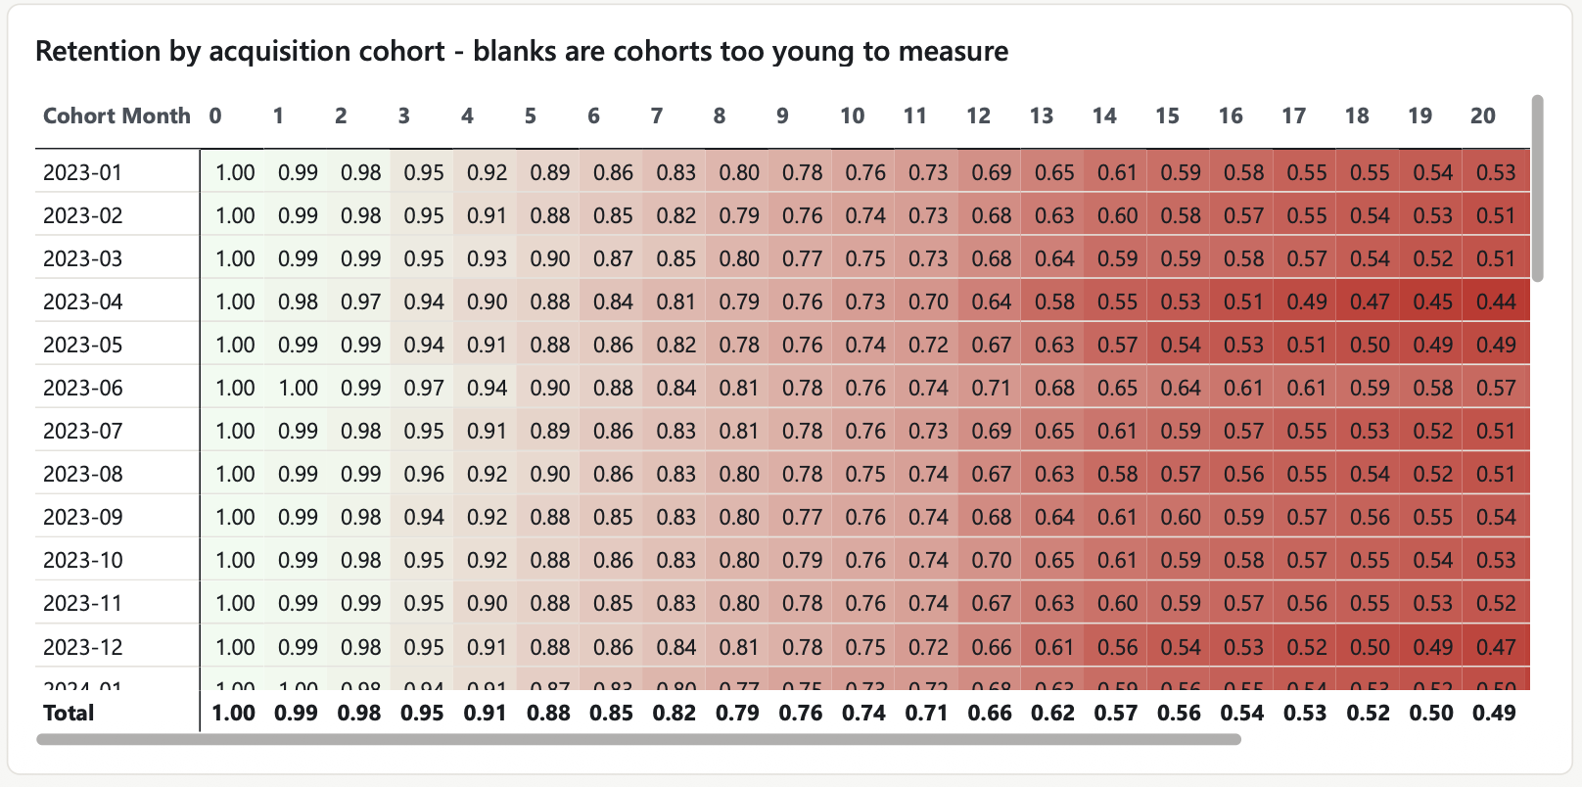
Blanks are cohorts too young to measure
Cohort matrix: acquisition month * months since acquisition.
A blank is an honest gap in the data. Filling it with 100% is the classic error.
Shannon Energy · Power BI demo
Notes:
Same data as a cohort matrix — acquisition month down the side, months since acquisition across the top.
I'm showing this slide mainly for the blanks in the bottom right. Those are cohorts too young to measure. I left them blank on purpose.
That's the most common mistake I see in retention reporting: the blank gets filled with 100 percent or with zero, and the recent cohorts look either brilliant or terrible. A blank is an honest gap, and I'd rather explain it than hide it.

Slide 7
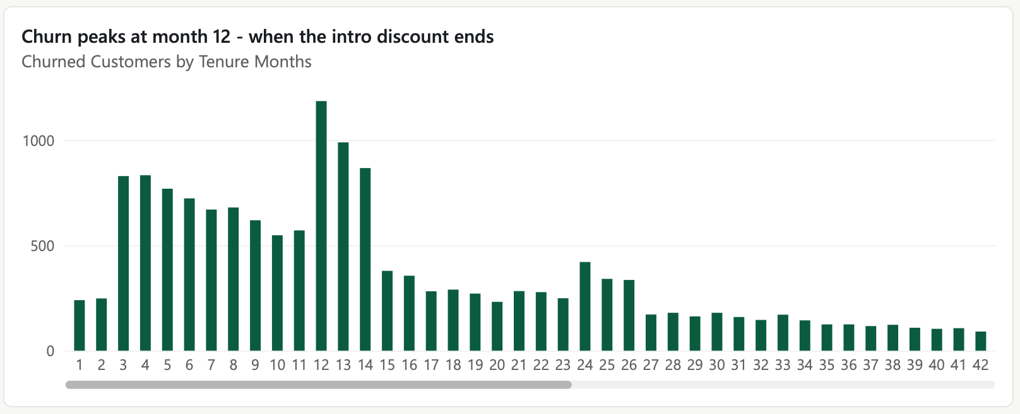
Churn peaks at month 12 - when the intro discount ends
Churned customers by tenure in months.
A pricing question, not a service question - and it is visible before it happens.
Shannon Energy · Power BI demo
Notes:
Churn by tenure in months. There's a clear spike at month twelve, and a smaller one at 24.
That tells you something useful about the cause. If churn were about service quality you'd expect it early and spread out. A spike exactly at the anniversary is a pricing event — the discount ends and the customer looks at the market again.
And the useful part commercially is that it's predictable. You know twelve months in advance which customers are going to hit that month.

Slide 8
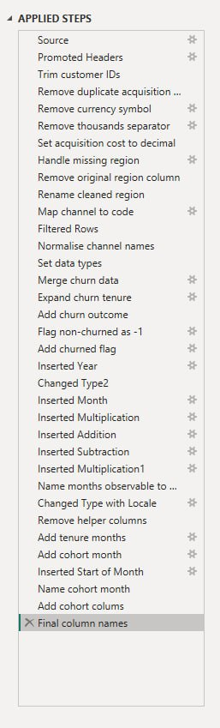
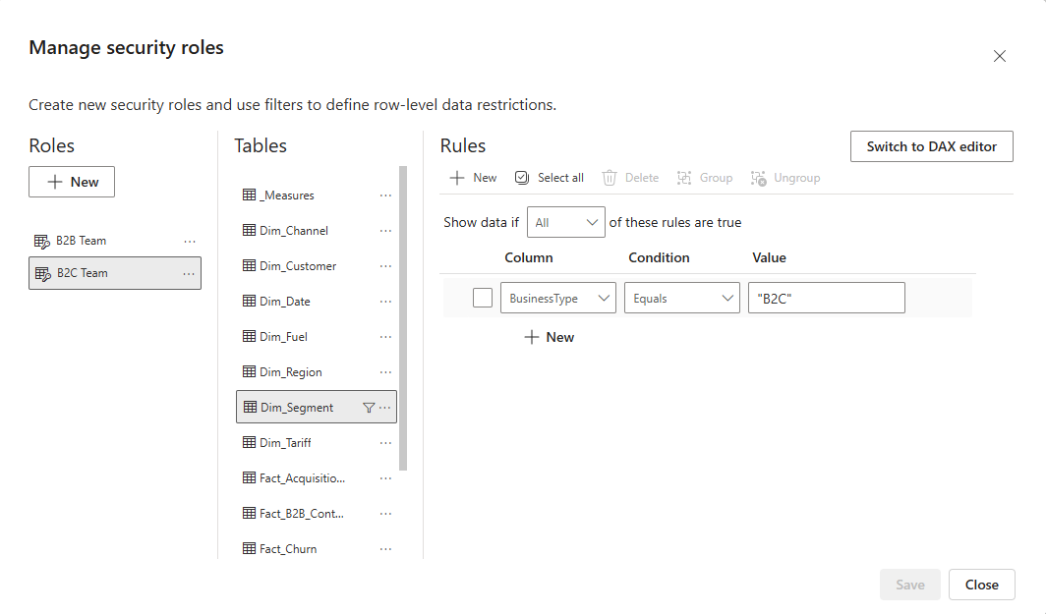
Cleaning and security are part of the build
Applied Steps in Power Query · Row-Level Security roles.
Every transformation step, named ->
Named steps, not "Changed Type1". Anyone can reopen this file and follow it.
Twenty spellings of the channel, currency as text, mixed date formats
Two security roles
The B2C and B2B teams don't see each other's numbers
Shannon Energy · Power BI demo
Notes:
I want to show what's behind it.
On the right are the Applied Steps in Power Query. Every step is named - handle missing region, normalise channel names, parse mixed date formats. The source files had the same channel written four different ways and dates in two formats, which is what real extracts look like. I didn't fix that by hand in Excel; it's all repeatable, so a new file refreshes in one click.
On the left is row-level security. I set up roles so a regional manager sees only their region. If it's going to more than one person, that has to be in the model, not in a promise not to look.

Slide 9
What the numbers say
€46
Price Comparison CPA - the cheapest channel to buy
35.9%
its 12-month retention - the worst of the five
€128
cost per retained customer, once churn is priced in
€130
contribution per acquisition - the lowest of the five
Shannon Energy · Power BI demo
Notes:
So, four numbers. Price Comparison costs 46 to acquire - the cheapest. It keeps 36 percent at twelve months - the worst. That makes the real cost 128 per retained customer, and the lowest contribution of the five channels.
My recommendation wouldn't be to switch it off - it delivers volume, and volume matters. It would be to stop judging channels on CPA alone, and to look at the month-twelve renewal, because that's where the value is leaking.
The reason I built it this way is that this is the question I think a sales director actually asks. You can always buy volume. The question is what it cost, and what's still there twelve months later.
CPA - cost per acquisition
«what's in that 46?»:
It's the acquisition cost divided by the number of customers acquired through that channel. In the data every acquisition row carries its own cost, so the measure just sums the cost and divides by the count.
For price comparison sites that cost is mainly the commission we pay the site for each customer who switches through them, plus the media spend on being listed there. For field sales it's the agent's commission and their time, which is why it's 155 — more than three times higher.
One thing I'd flag: this is fully loaded cost per successful acquisition, so the spend on people who looked and didn't sign is in there too. It's not a click price.

