Slide 1
Carrizo Results

Slide 2
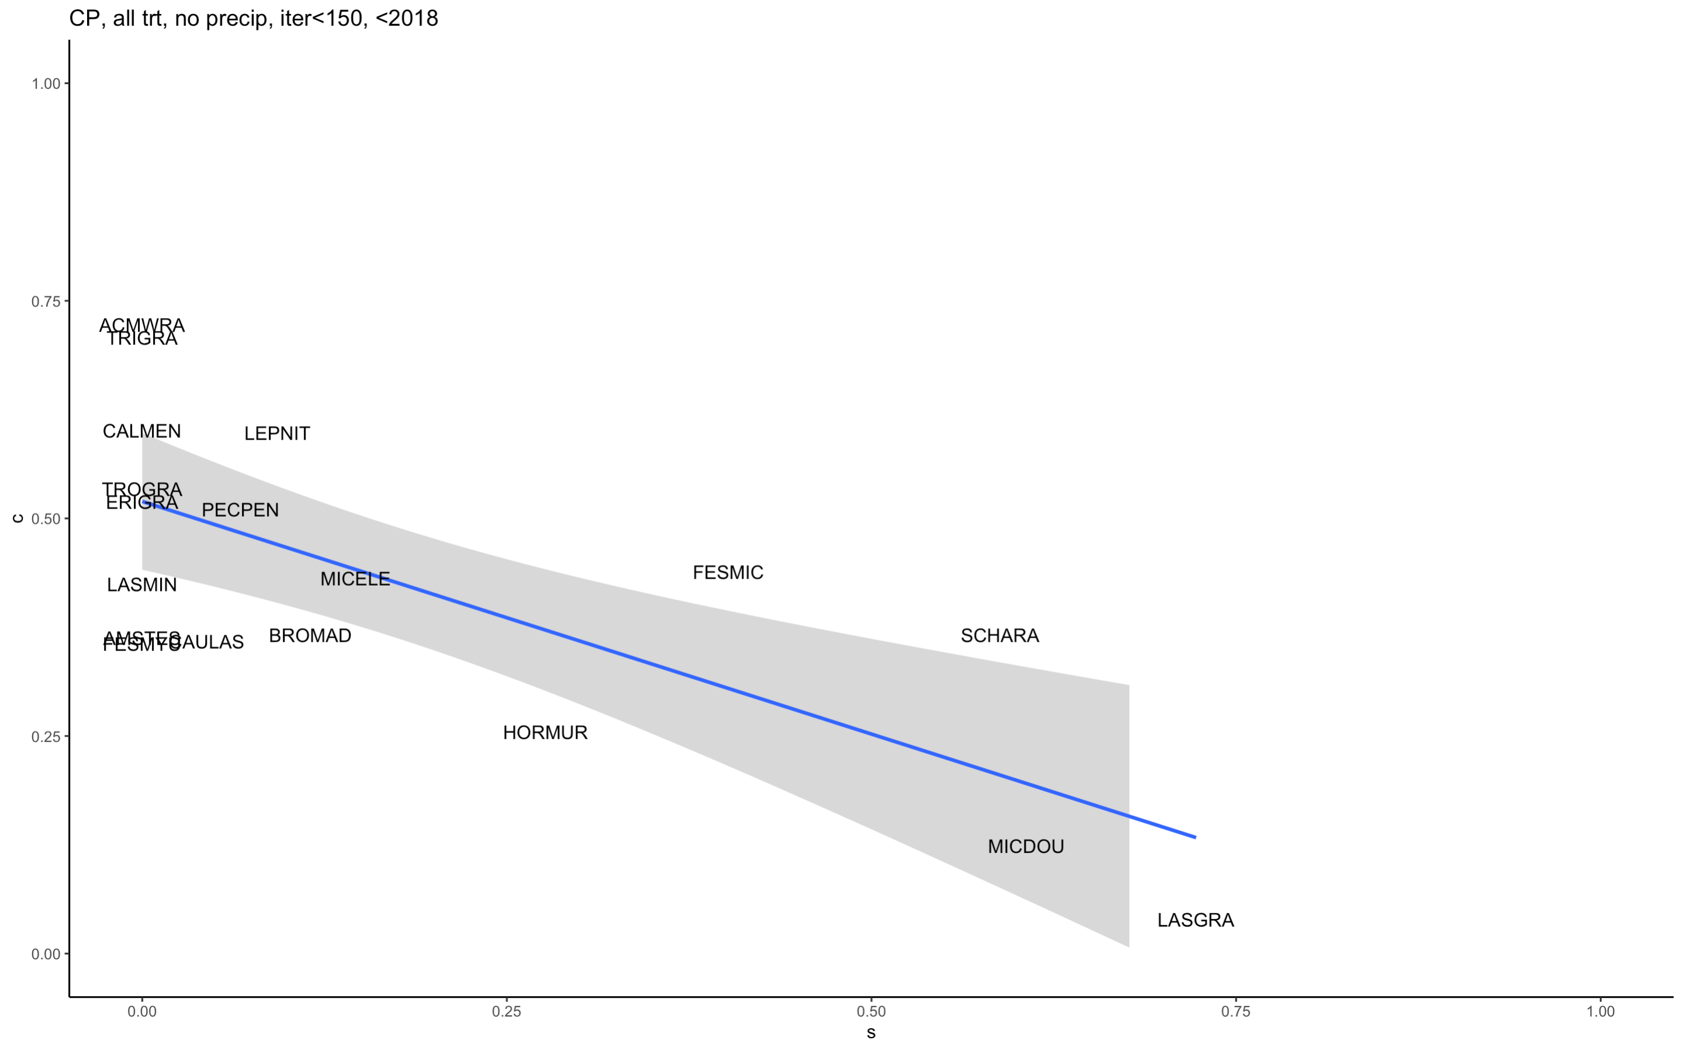
Notes:
Estimating 0% survival for most forbs, HMM using only plots that aren’t in the precip treatment, years before 2018 because that’s when plots started being funky, less than 150 iteration to converge, all GKR and Grazing treatments

Slide 3
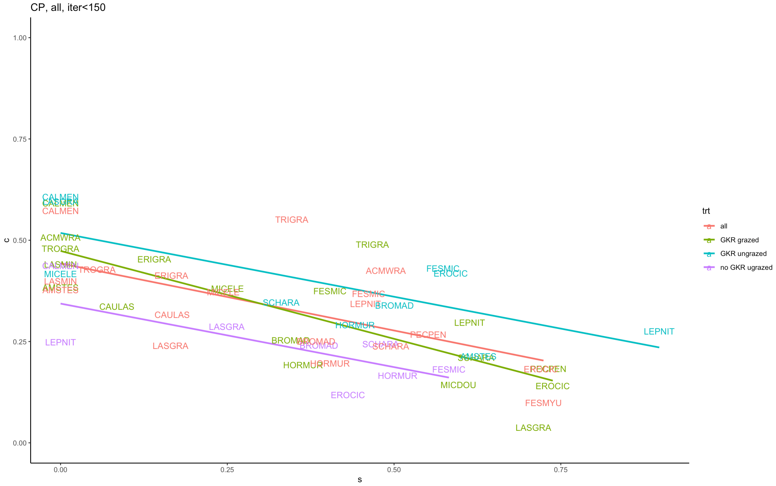
Notes:
S = seed survival estimated from HMM
C = colonization rate estimated from HMM
GKR might be slightly increasing c and s in some species

Slide 4
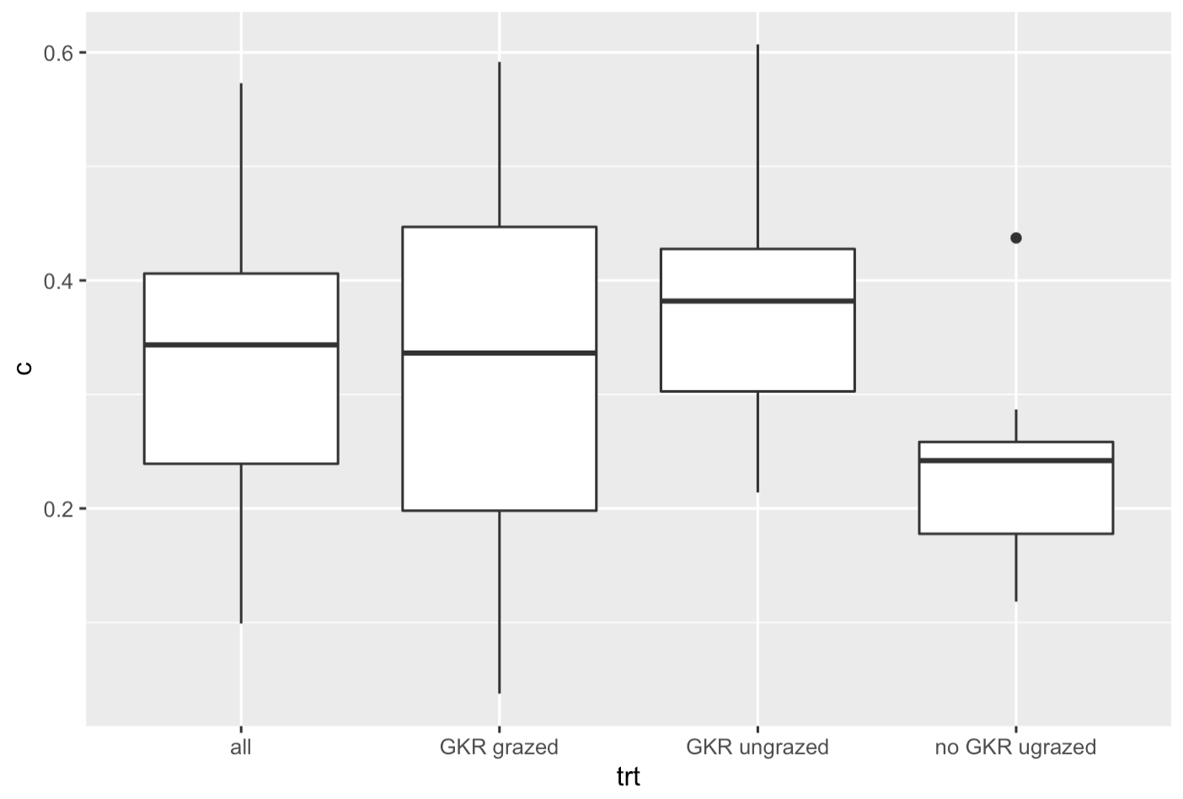
Notes:
Boxplot of how estimated colonization rates vary over treatments at carrizo, without GKR, colonization is lower

Slide 5
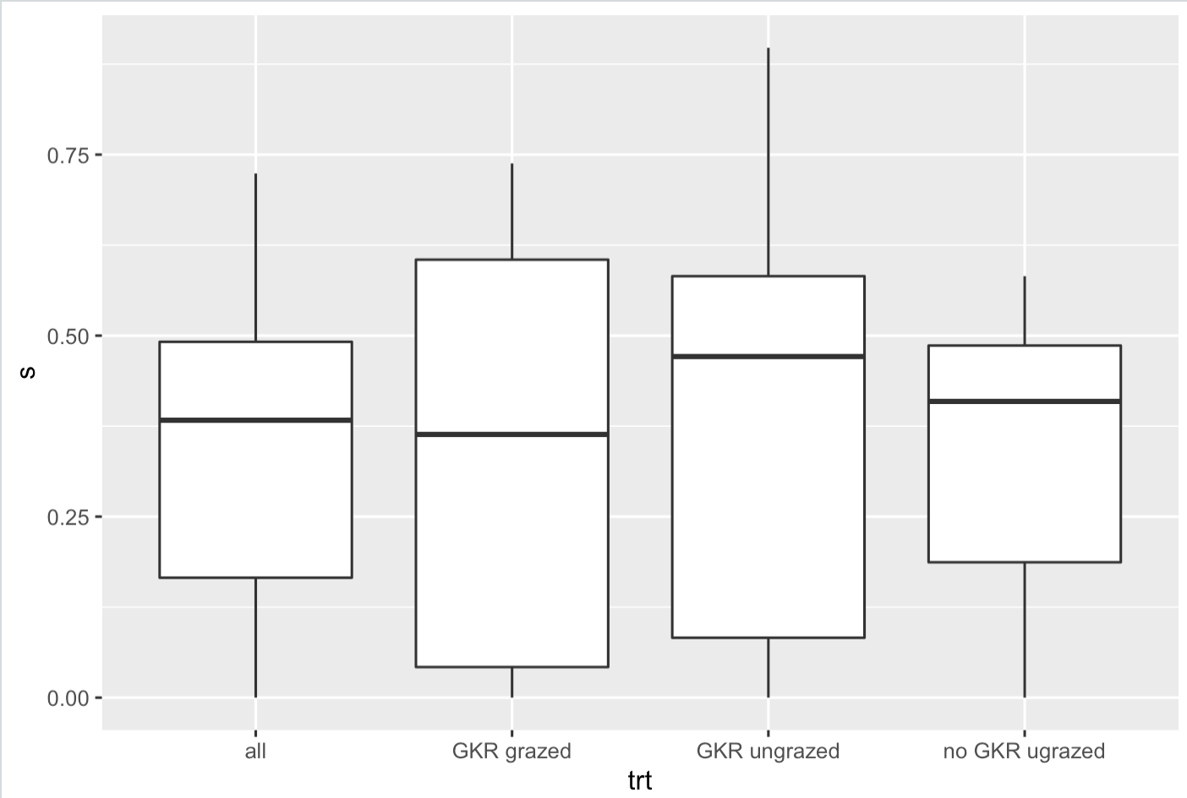
Notes:
Despite it looking like treatments with GKR increased survival, no overall difference, perhaps smaller species level effects

Slide 6
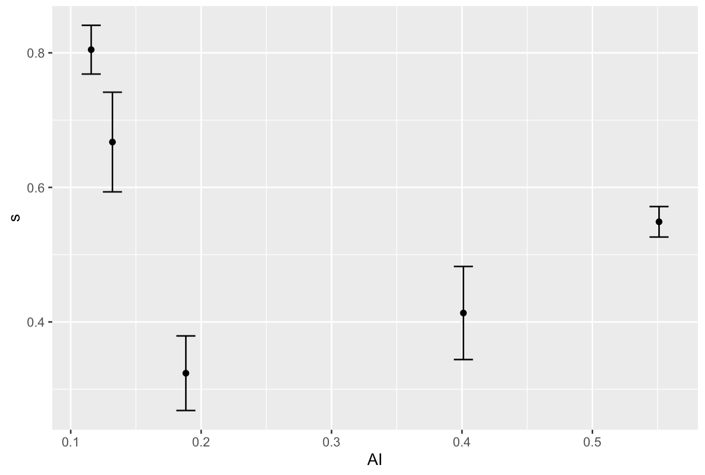
Notes:
Avg estimated seed survival in each dataset with aridity index on the x axis:
Sonoran desert: 0.1157
Chihuahuan desert <- 0.1320
Carrizo <- 0.1883
Jasper Ridge <- 0.4011
McLaughlin <- 0.5511
Why is Carrizo so low?? Would not expect that.

Slide 7
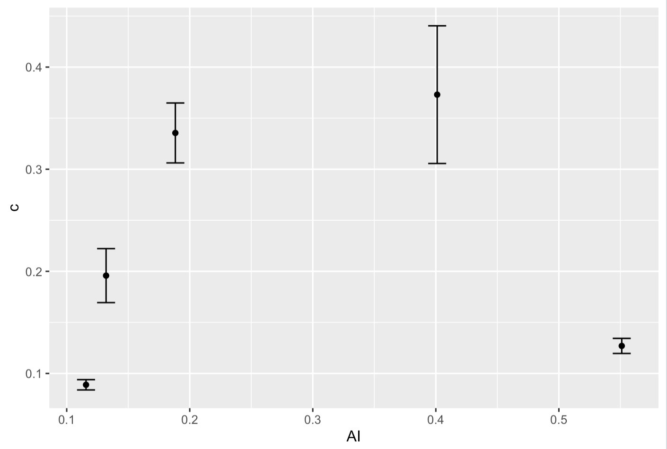
Notes:
Avg estimated colonization rate in each dataset with aridity index on the x axis:
Sonoran desert: 0.1157
Chihuahuan desert <- 0.1320
Carrizo <- 0.1883
Jasper Ridge <- 0.4011
McLaughlin <- 0.5511
Why is McLaughlin so low??

Slide 8
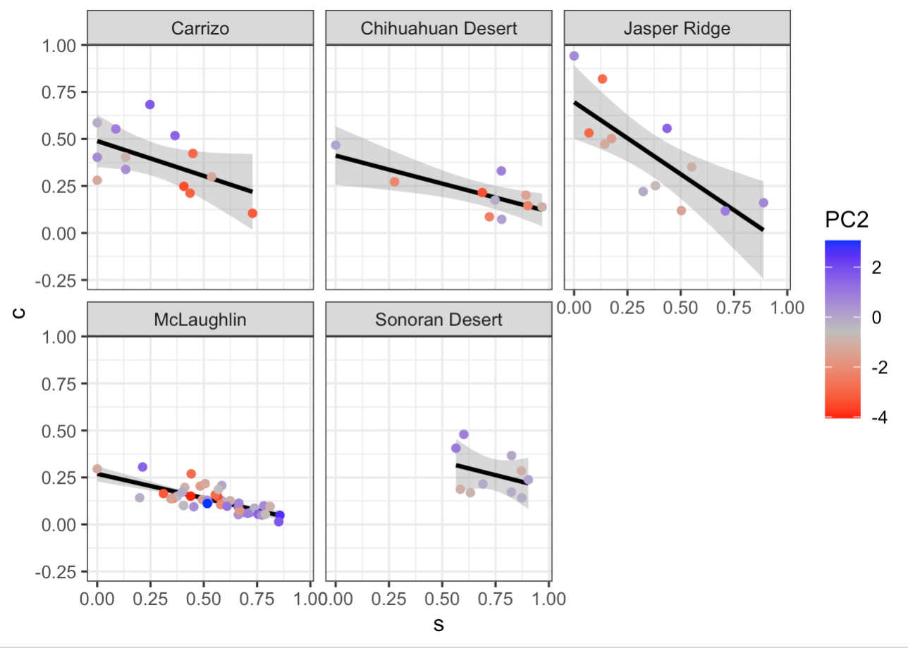
Notes:
For the most part, species with rounder smaller seeds (high PC2 scores, blue species here) have higher survival, but in Carrizo this flips – these species have lower survival

Slide 9
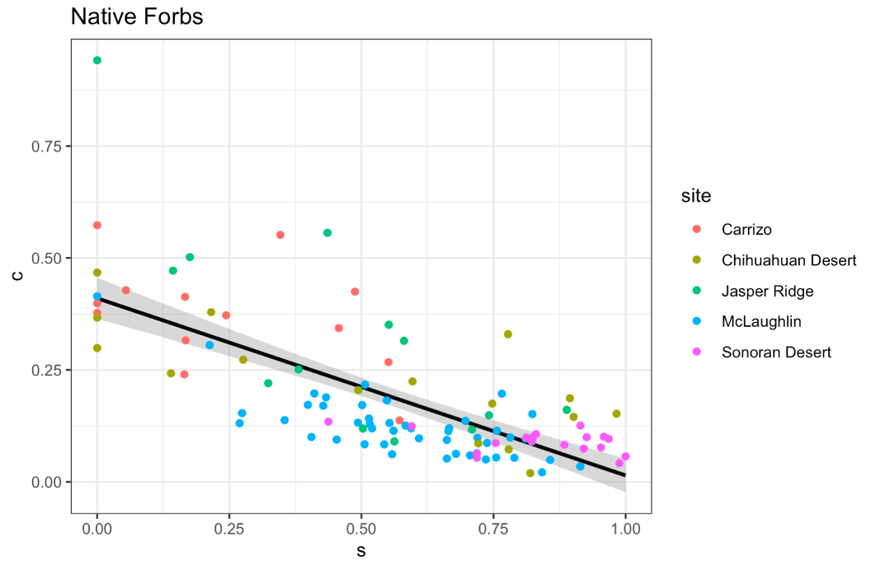
Notes:
How c&s of native forbs across the sites break down

