Slide 1
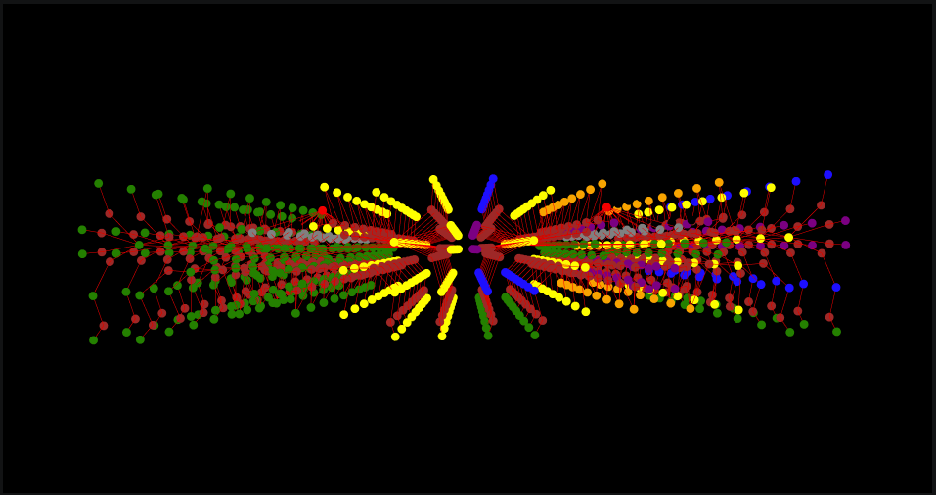
Iaac
GRAPH MACHINE LEARNING
Memorial in Topology
A Reading of Wartime Loss in Kyiv
Marina Osmolovska
MaCAD 2025 -- Semester 3
Buildings as Graphs Faculty: Angelos Chronis -- Orestis Pavlidis

Slide 2
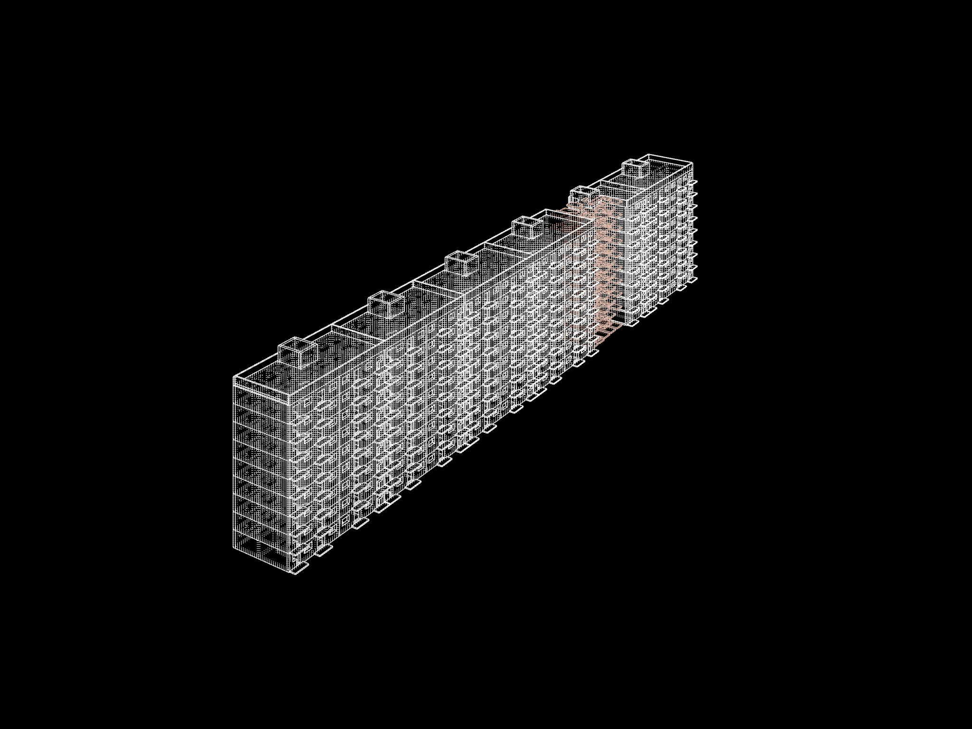
CONTEXT
The Building
87-02 Soviet panel block-section -- a standard type mass-produced across the USSR from the 1960s onwards. Nine storeys. Two apartments per floor, mirrored around a single staircase core.
In Kyiv, a rocket strike destroyed the right half of one such section. The staircase survived. The rooms on one side are gone. The stair now opens onto ruins.
The surviving stair leads, in graph terms, to nothing.
This project does not reconstruct what was lost. It reads the lost apartment as a spatial graph and translates those relationships into a memorial form.

Slide 3
THE PROPOSAL
Memorial, Not Reconstruction
Each room that no longer exists returns as a floor slab only -- no walls, just the trace of the floor. The slab perimeter is the room perimeter, shrunk by the thickness of the missing walls. The gaps between slab edges are the vanished walls.
Each destroyed room
Height encodes depth
Door positions
The formula
returns as a slab at the room's outline
from the entrance door
become step-bridges
slab Z = -step x depth
No walls. No reconstruction. Only the trace of the floor -- the memory of an outline.
The further a room sat from the apartment door, the lower its slab in the promenade.
The height difference between two connected rooms becomes the step. Gap is the lost wall.
One equation. Derived entirely from the building's own topological structure.
The promenade is the access graph of the lost apartment, made walkable.

Slide 4
WORKFLOW
Analysis Pipeline
01
02
03
04
Rhino Geometry
CellComplex
Graph Construction
BFS Depth Analysis
Closed room solids. Door aperture faces exported as OBJ.
TopologicPy reads OBJ. Builds 3D cell adjacency from shared faces.
Adjacency graph g1 (all shared faces) + Access graph g2 (doors only).
NetworkX BFS from staircase landing. Hop count per room.
08
07
06
05
ML Prediction
Feature Encoding
Combined Graph
Slab Formula
Pretrained GraphSAGE (MSD dataset) predicts new room functions.
7-dim node vector: 4 zoning one-hot + 3 connectivity ratios.
Intact section + damaged block + memorial in one graph.
slab Z = -step x depth Rhino: memorial slabs + step-bridges.
Output: 90 corridor + 63 kitchen + 9 livingroom -- predicted new functions for 162 surviving rooms
Geometry / topology
Analysis / design
ML

Slide 5
PHASE 3 -- GRAPH CONSTRUCTION
Why Two Graphs?
g1 Adjacency graph direct = True
g2 Access graph direct = False, viaSharedApertures = True
Every pair of rooms that share any face creates an edge -- including floors and ceilings. A bedroom on floor 3 connects directly to the bedroom above it on floor 4. The staircase, touching every floor slab, becomes an enormous hub with edges to every room in the building above and below it. The graph is dense and structurally misleading.
Only door aperture faces create edges. The OBJ export explicitly tags which shared faces are entrance doors, room doors, or passage thresholds. Bedrooms and bathrooms become leaf nodes -- reachable from one direction only. The staircase connects only to landings. This graph reflects how a person actually moves through the building.
Useful for: geometry inspection. Not for: design or ML.
Used for: BFS depth analysis, slab heights, ML feature encoding.
The same CellComplex. The same geometry. One flag changes the meaning of an edge -- and with it, the entire analysis.
306 apertures -- intact section
Door types become edge features in the ML feature vector: each node stores the fraction of its edges that are entrance doors, room doors, or passage thresholds. The model has learned from real apartment plans that kitchens sit behind 1 door + 1 balcony edge; bathrooms are single-door leaves. These ratios let the classifier distinguish room types from topology alone.
36
entrance doors
252
room doors
18
passage thresholds

Slide 6
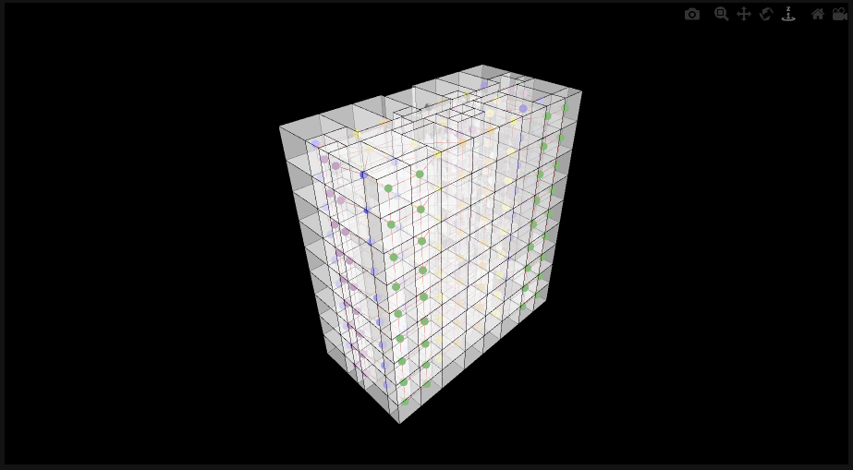
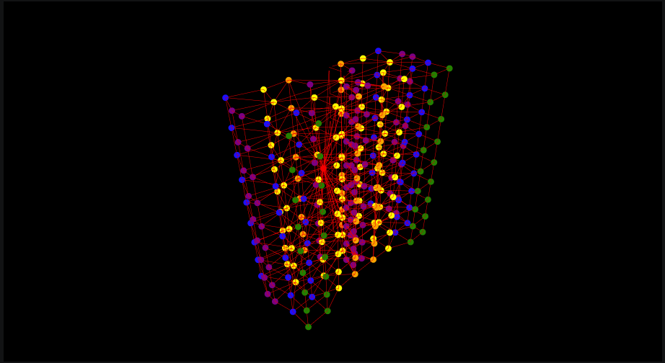
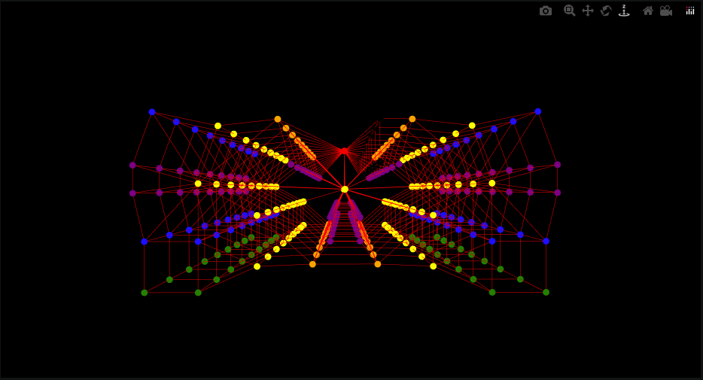
PHASE 3 -- INTACT SECTION
Adjacency Graph g1
direct = True -- every shared face including floors and ceilings creates an edge.
Left: nodes colored by room type inside the transparent CellComplex -- the geometry is still readable. Center: the graph without geometry -- the staircase dominates as a central hub with edges to every floor. Right: plan view -- all 9 floors collapsed, the repeating double-fan apartment pattern visible, through-slab connections converging at center.
On geometry
3D isolated -- dense through-slab edges
Plan view -- repeating double fan

Slide 7
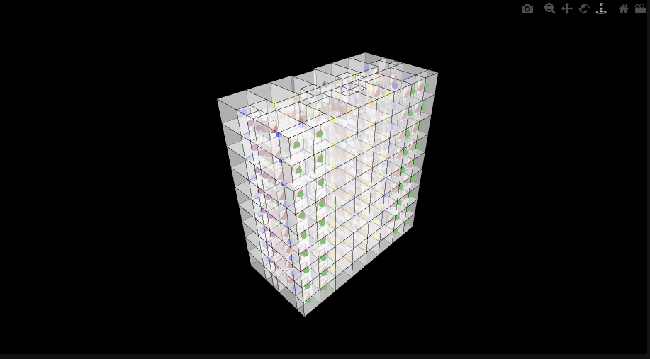
PHASE 3 -- INTACT SECTION
Access Graph g2
direct = False, viaSharedApertures = True -- only door apertures create edges.
The same building. The same CellComplex. Far fewer edges. Through-slab connections are gone entirely. Bedrooms and bathrooms are now leaf nodes -- reachable from one direction only. The staircase connects only to its own landings, not to every room above and below it. This is the graph that correctly represents how a person navigates the building, and the graph used for all subsequent analysis and design.
Access graph on geometry -- node colors = room type

Slide 8
PHASE 4 -- SPATIAL ANALYSIS
Depth from Entrance
Breadth-first search (BFS) starts at the staircase landing node and counts how many door edges must be crossed to reach each room. This hop count -- depth -- is the key metric driving the design. It is purely topological: no coordinates, no area, no geometry involved.
0
Staircase landing
The design formula
The graph origin. Every BFS path starts here.
slab Z = -step x depth
1
Apartment hall / corridor
Directly behind the entrance door -- 1 crossing.
depth 0 --> ground level depth 12 --> lowest slab 13 distinct Z levels in the promenade
2
Kitchen, bathroom, storeroom
One internal door from the hall -- 2 crossings.
What it means spatially
A room at depth 3 was 3 doors from the staircase. Its memorial slab sits 3 steps below the landing. Walking the promenade physically re-enacts the graph traversal of the lost apartment.
3
Bedroom, livingroom, balcony
Two internal doors from the hall -- 3 crossings.

Slide 9
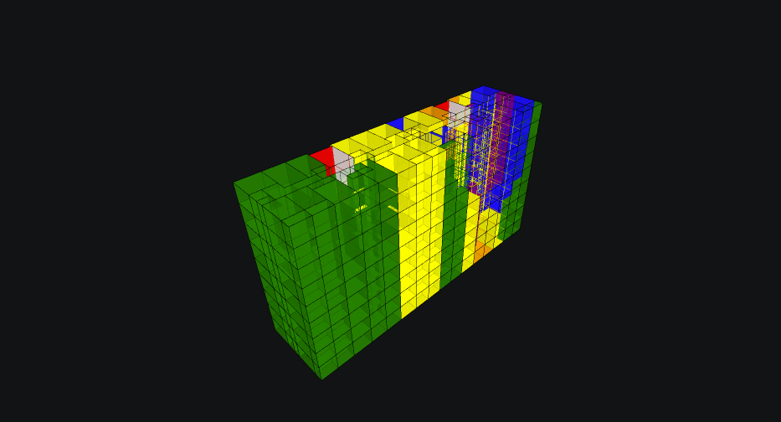
PHASE 6 -- COMBINED CELLCOMPLEX
Intact section + Damaged block + Memorial intervention
bedroom
living/kitchen/corridor
memorial slabs (balcony)
storeroom/bathroom
596 cells total. The staircase spine at center connects the two halves. Right: real apartment types. Left: corridor placeholders + balcony memorial slabs.

Slide 10
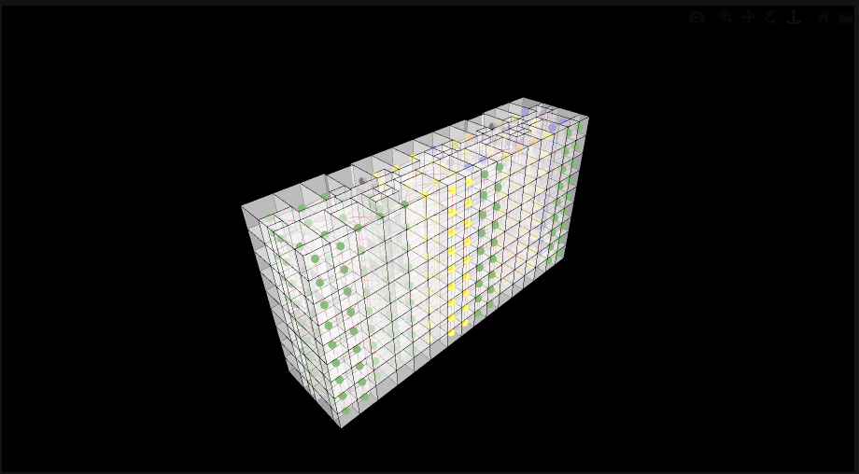
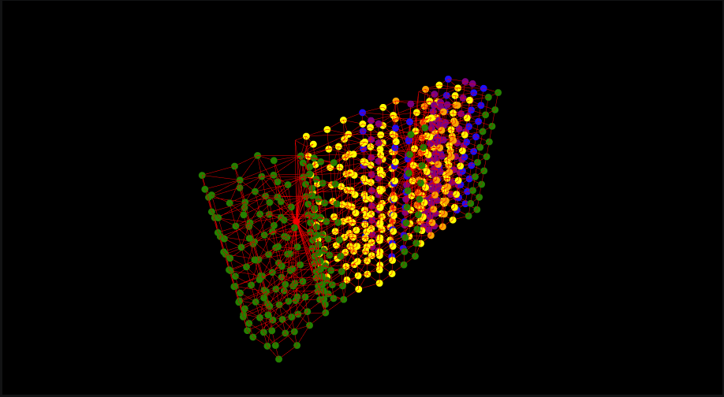
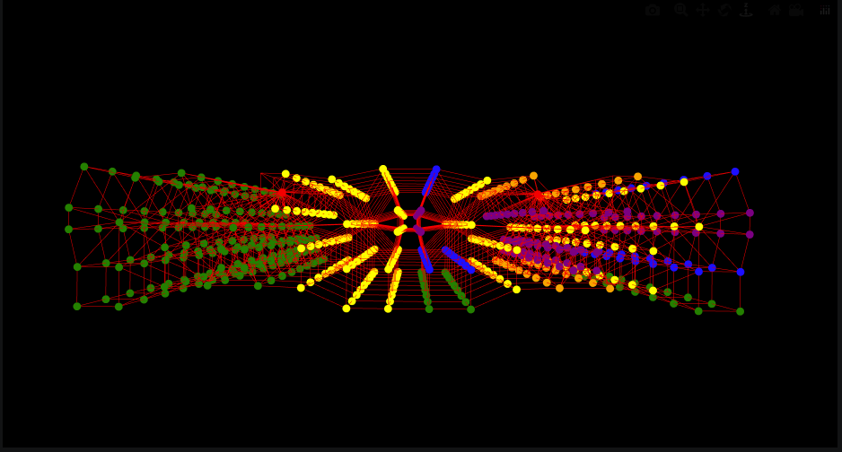
PHASE 6 -- COMBINED SECTION
Adjacency Graph g1 -- Both Sections
Through-face adjacency, now across the full 596-node graph.
The broken symmetry is immediately readable. Right (intact): tight double-fan apartment clusters repeating every floor. Left (damaged): the green balcony slab nodes form a distinct, sparser outer cloud -- a new typology that did not exist in the original building. The intervention has visibly altered the graph structure.
On geometry
3D isolated -- green balcony cluster (left) vs apartment fan (right)
Plan -- asymmetric double fan

Slide 11
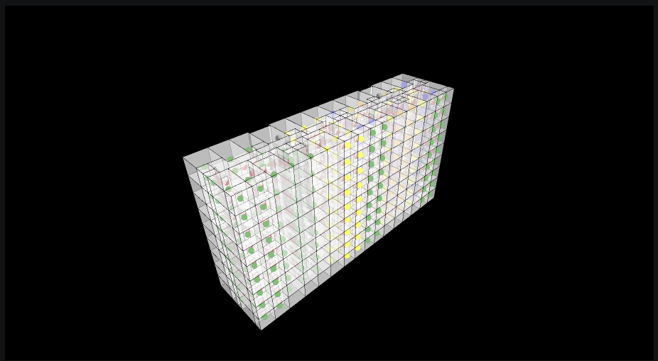
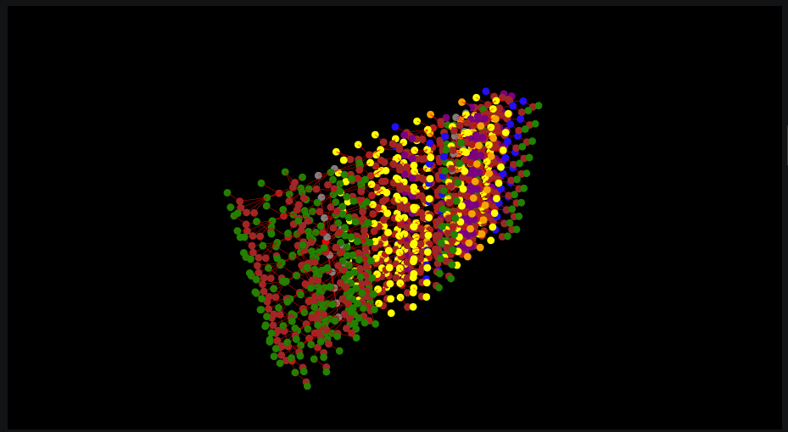
PHASE 6 -- COMBINED SECTION
Access Graph g2 -- Both Sections
Only door apertures. 596 nodes, 594 edges. The staircase landing is the sole topological bridge between the two sections.
Right (intact): the regular apartment tree -- corridors branch to rooms, rooms end at leaves. Left (damaged): surviving corridor nodes fan out to balcony slab leaves at their original positions, with stair-bridges at the door openings. The lost apartment's topology is preserved as structure, even though the space is gone.
On geometry
3D isolated -- corridors fan to balcony slab leaves
Plan -- staircase at hourglass center

Slide 12
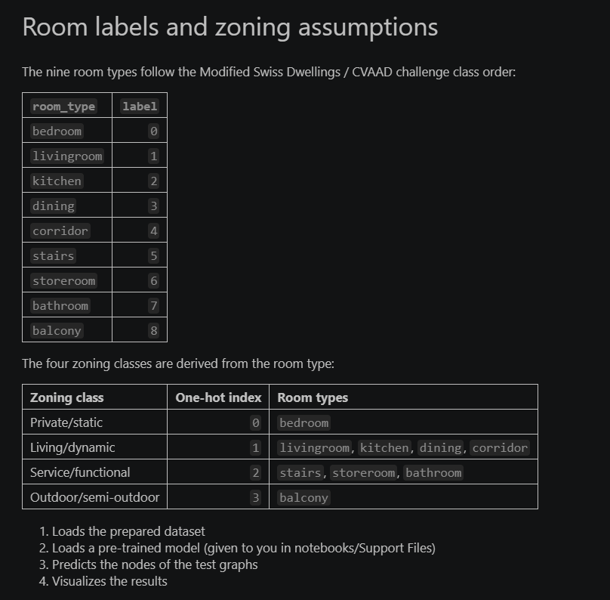
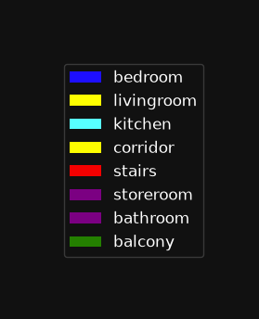
PHASE 8 -- ML NODE CLASSIFICATION
GraphSAGE Node Classifier
The pretrained model (MSD -- Milan Spatial Dataset) has learned room-type patterns from hundreds of real apartment plans. It knows what a kitchen looks like in graph form: typically depth 2, 1 room door + 1 balcony edge. It has never seen this building.
7-dimensional node feature vector
No geometry. No coordinates. No area.
feat_zoning_type_0
private / static (bedroom)
feat_zoning_type_1
living / dynamic (kitchen, corridor)
feat_zoning_type_2
service / functional (bath, stairs)
feat_zoning_type_3
outdoor (balcony)
feat_connectivity_0
fraction of edges that are passage
feat_connectivity_1
fraction of edges that are door
feat_connectivity_2
fraction of edges that are entrance door

Slide 13
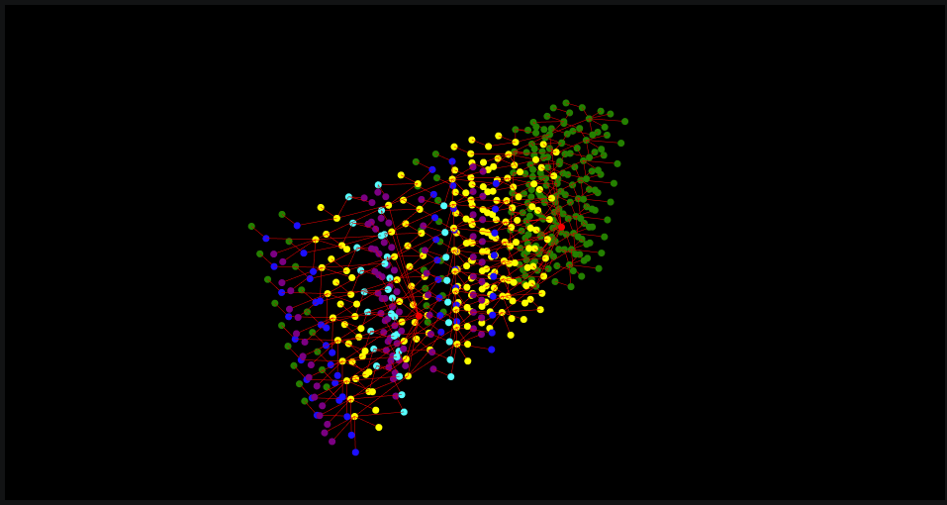
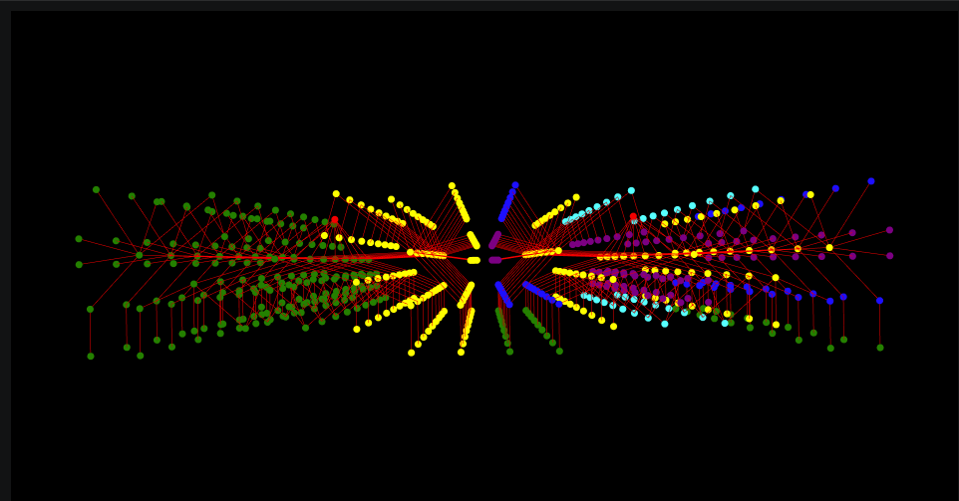
PHASE 8 -- BEFORE INFERENCE
Assigned Labels -- The Placeholder Strategy
The 162 surviving damaged-block rooms cannot have their real type -- they no longer exist as rooms. Each design decision about the memorial is encoded as a node label that the model will read.
Surviving damaged rooms
corridor
zoning [0,1,0,0]
Most neutral in-distribution label. Dynamic / living zone. ML predicts the new function.
Memorial slabs
balcony
zoning [0,0,0,1]
Outdoor / semi-outdoor. Propagates 'open space' signal to neighboring corridor nodes.
Step-bridges
stairs
zoning [0,0,1,0]
Service / functional. Encodes the passage relationship between slabs at different heights.
3D view -- yellow=corridor (162 placeholder), green=balcony slabs (216)
Plan view -- uniform placeholder assignment makes the asymmetry explicit

Slide 14
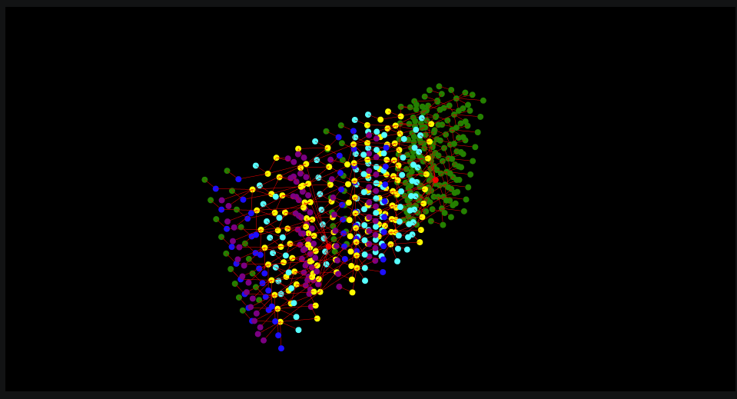
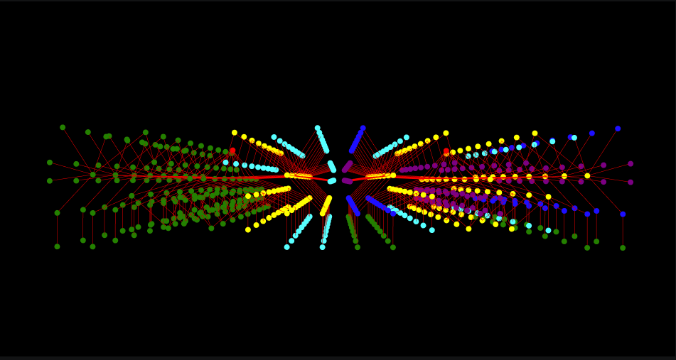
PHASE 8 -- AFTER INFERENCE
Predicted Functions -- What the Graph Suggests
GraphSAGE aggregates each node's feature vector with a learned summary of its neighbors. The balcony slabs and stair-bridges introduced by the design now propagate information back into the surviving corridor nodes.
Cyan (kitchen) nodes emerge in the damaged section. These are rooms with 2-3 door connections and at least one balcony neighbor -- a connectivity profile the model associates with kitchens in real apartments. The design choice to label slabs as 'balcony' directly caused this reclassification. The memorial's spatial logic is architecturally legible to the model.
3D view -- cyan=kitchen nodes emerge in damaged section
Plan view -- kitchen reclassification concentrates near staircase hub

Slide 15
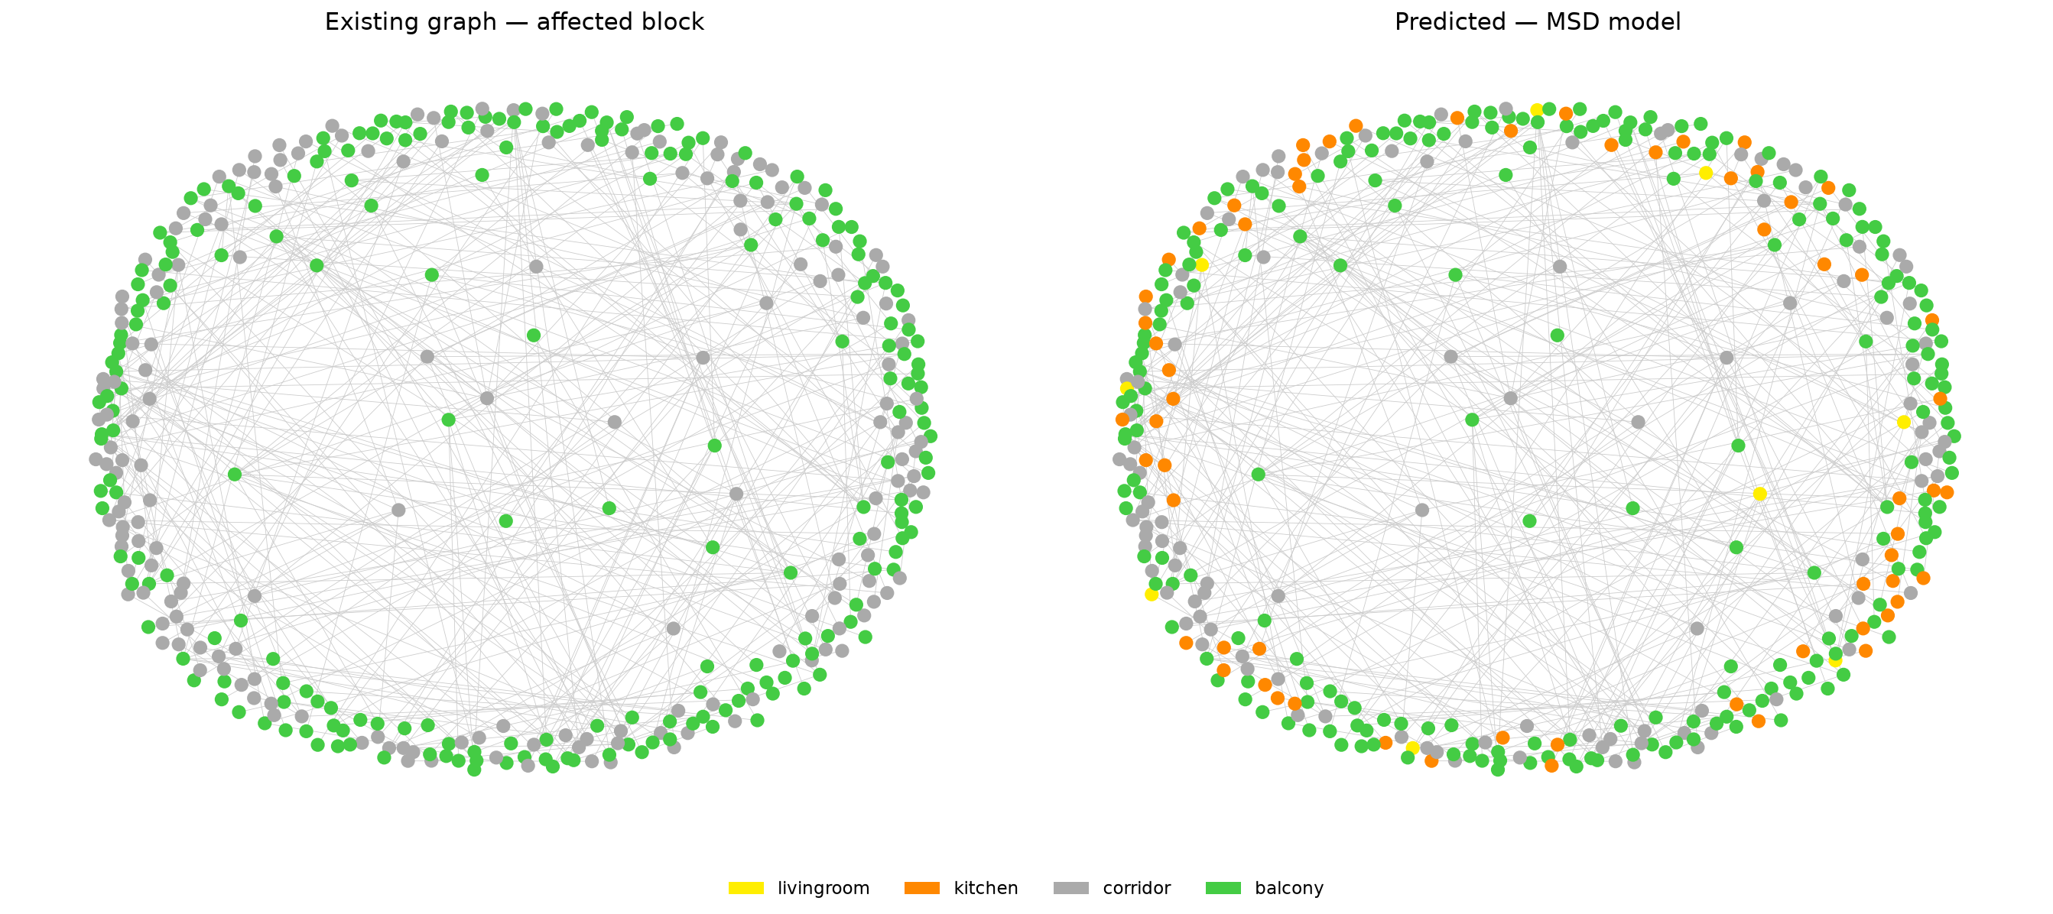
PHASE 8 -- RESULTS
Predictions for the Damaged Block
162 rooms assigned 'corridor' as placeholder. Model predicts new functions:
90
63
9
corridor
kitchen
livingroom
Rooms read as pure circulation. Deep from the entrance, low degree, few connections. They remain neutral.
Mixed door/balcony connectivity. Depth 2 from the landing. Matches the model's learned kitchen profile.
Single door to a large balcony or corridor node. Larger spatial zoning -- read as living space.
Interpretation: The design decision encodes meaning into the graph. Memorial slabs are labelled 'balcony' because they are open and outdoor-like. The model reads their proximity and reclassifies adjacent rooms as kitchens -- the room type most often found next to a balcony in the MSD training data. The memorial has the topology of a lived-in apartment.

Slide 16
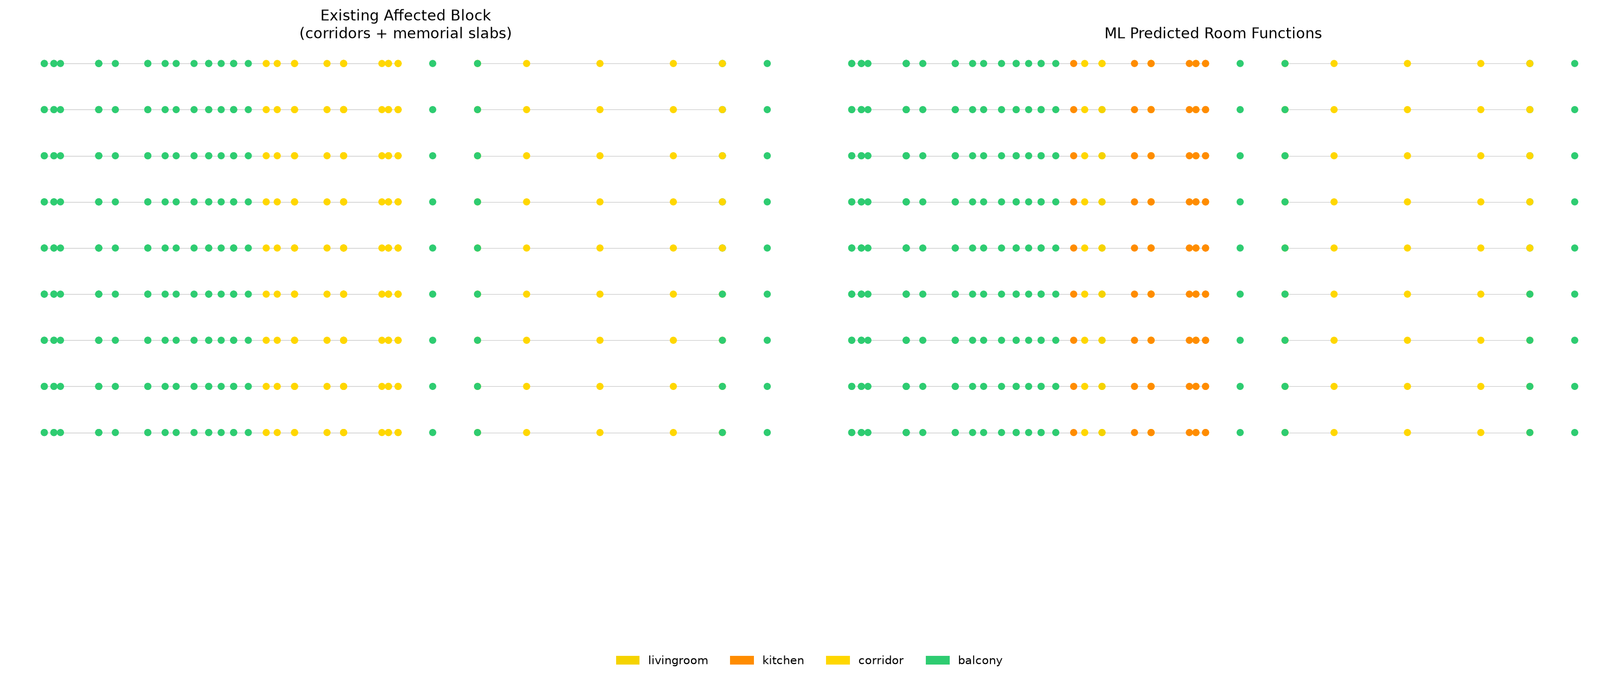
PHASE 8 -- RESULTS DETAIL
Floor-by-Floor Prediction
Each row is one floor. Each dot is one room. Left panel: placeholder labels assigned before inference. Right panel: ML-predicted functions after GraphSAGE runs.
The kitchen reclassification concentrates on floors where the surviving corridor nodes have the richest balcony connectivity -- i.e. floors where the most memorial slabs are directly reachable. Rooms at greater depth from the staircase tend to remain corridor.

Slide 17
SYNTHESIS
The Design-Analysis Loop
Graph analysis does not document the design after the fact. The graph generates the form. The form changes the graph. The graph changes the ML result. The loop closes.
1
2
3
Build access graph
Compute depth
Map depth to height
TopologicPy builds g2 from door apertures. Only doors create edges.
NetworkX BFS from the staircase landing. Hop count per room.
slab Z = -step x depth. The access graph drives the Rhino model.
4
5
6
Encode the memorial
Run ML inference
Read the result
Slabs = balcony. Bridges = stairs. Design choices become node labels.
Balcony neighbors change corridor node vectors via GraphSAGE aggregation.
63 rooms predicted as kitchen. The memorial has the topology of a lived-in apartment.
The design choice (labelling slabs 'balcony') affects the ML result. The ML result is a reading of the memorial's spatial quality -- what it would feel like to inhabit, according to a model trained on real apartments.

Slide 18

RESULT
The Memorial
Graph analysis translated into architectural form.

Slide 19
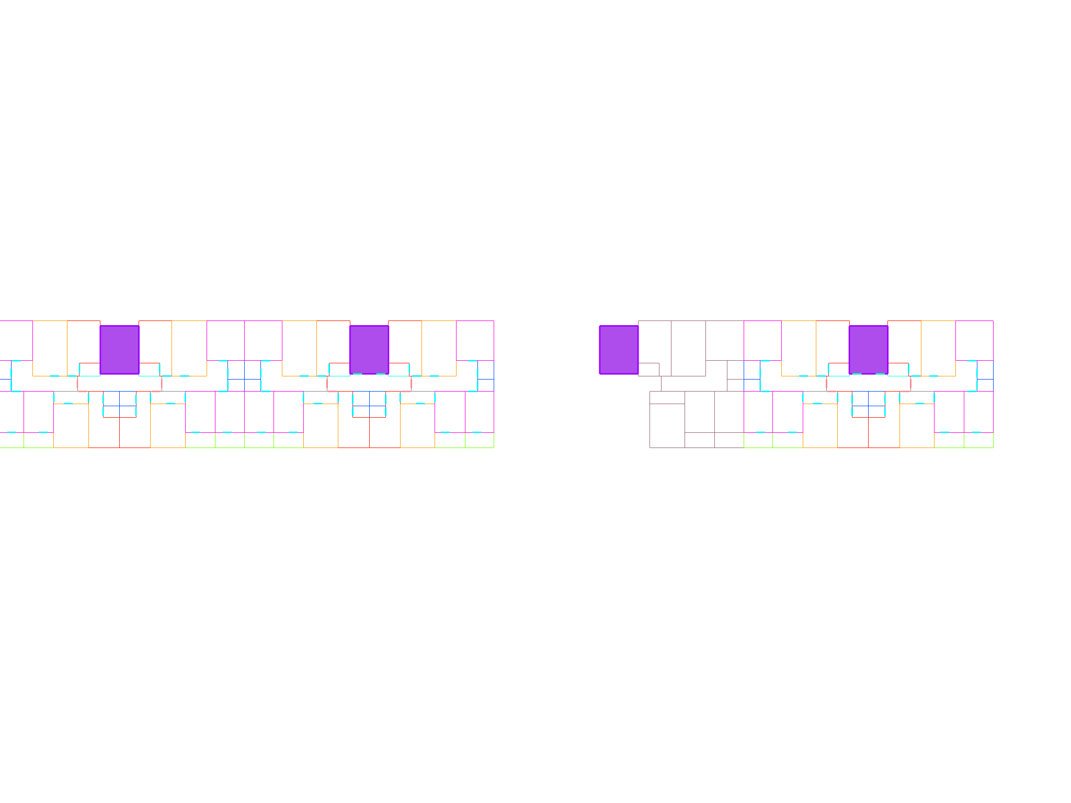
EXISTING CONDITION
Existing Plan
The 87-02 section as it stands after the strike: the intact half (right), the destroyed half (left). The staircase core at center now connects to a void.

Slide 20
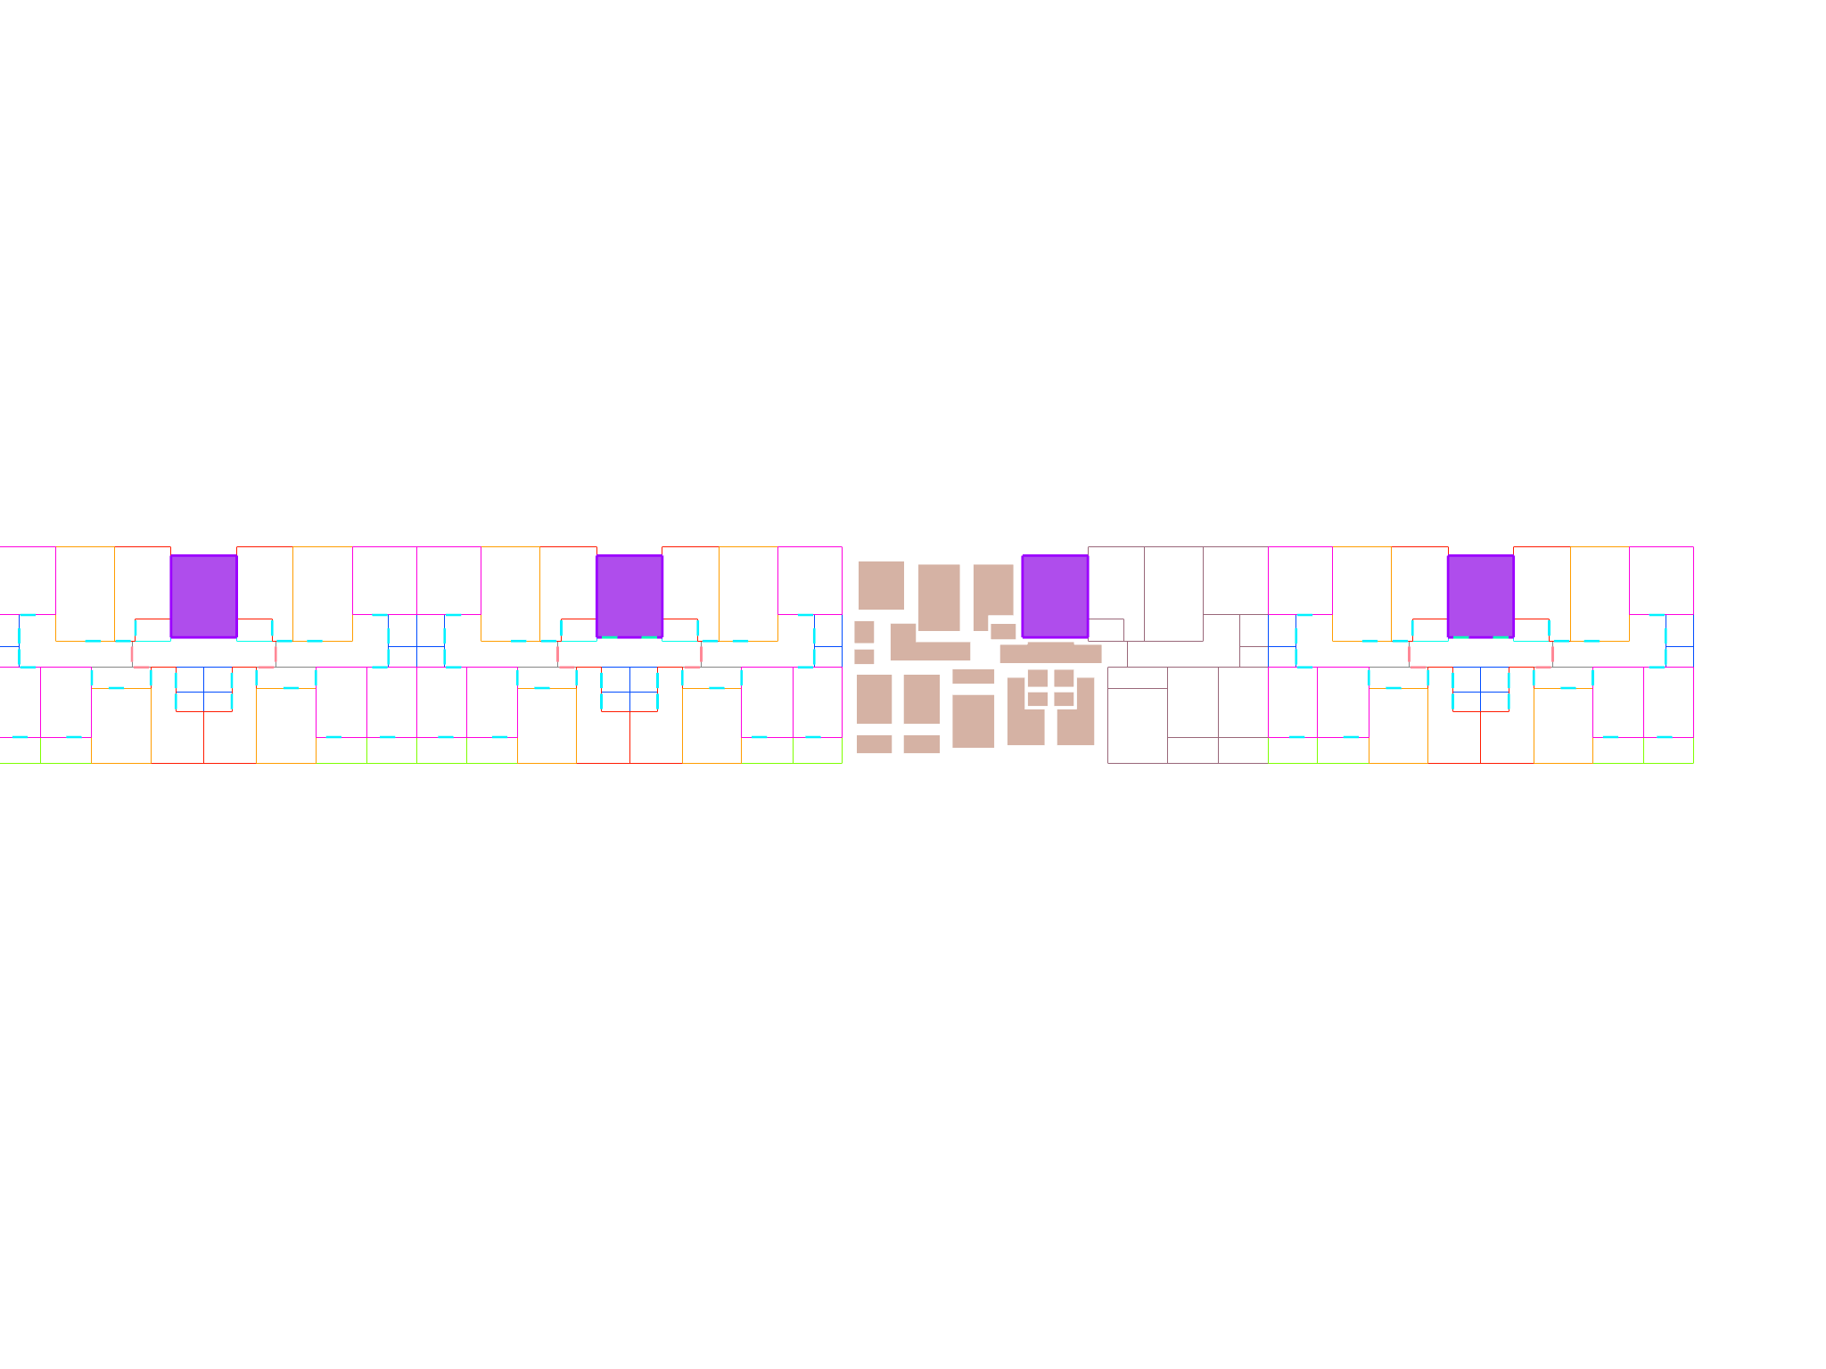
PROPOSAL
Proposed Plan -- Memorial Slabs
Each destroyed room returns as a slab at the room's original perimeter, shrunk inward by the missing wall thickness. Slab Z-height = -step x BFS depth from entrance. The deeper the room was from the apartment door, the lower its slab. The promenade descends as you move away from the staircase.

Slide 21
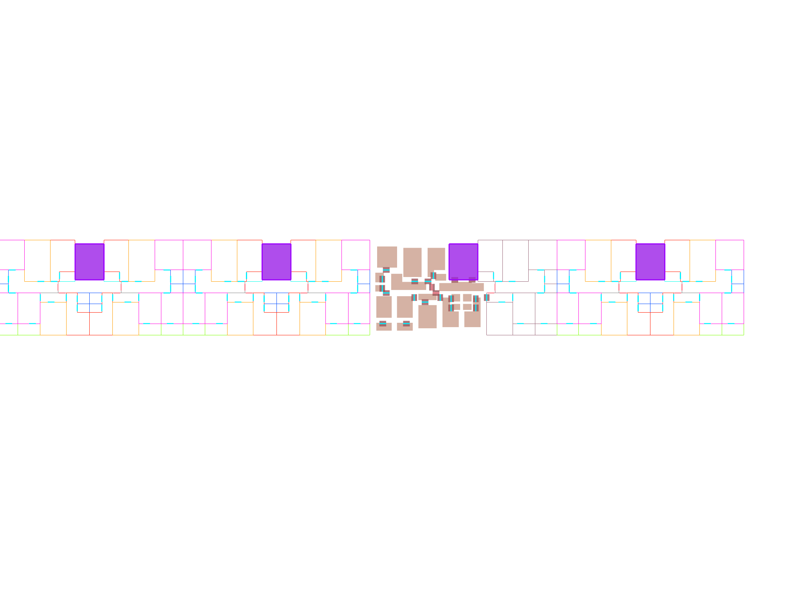
PROPOSAL -- DETAIL
Proposed Plan -- With Step-Bridges
Where two connected slabs sit at different heights, the original door position becomes a step-bridge. The height difference between the two slabs is the step height -- derived directly from the difference in BFS depth between the two rooms. The gap between slab edges at non-door positions is the missing wall.

Slide 22
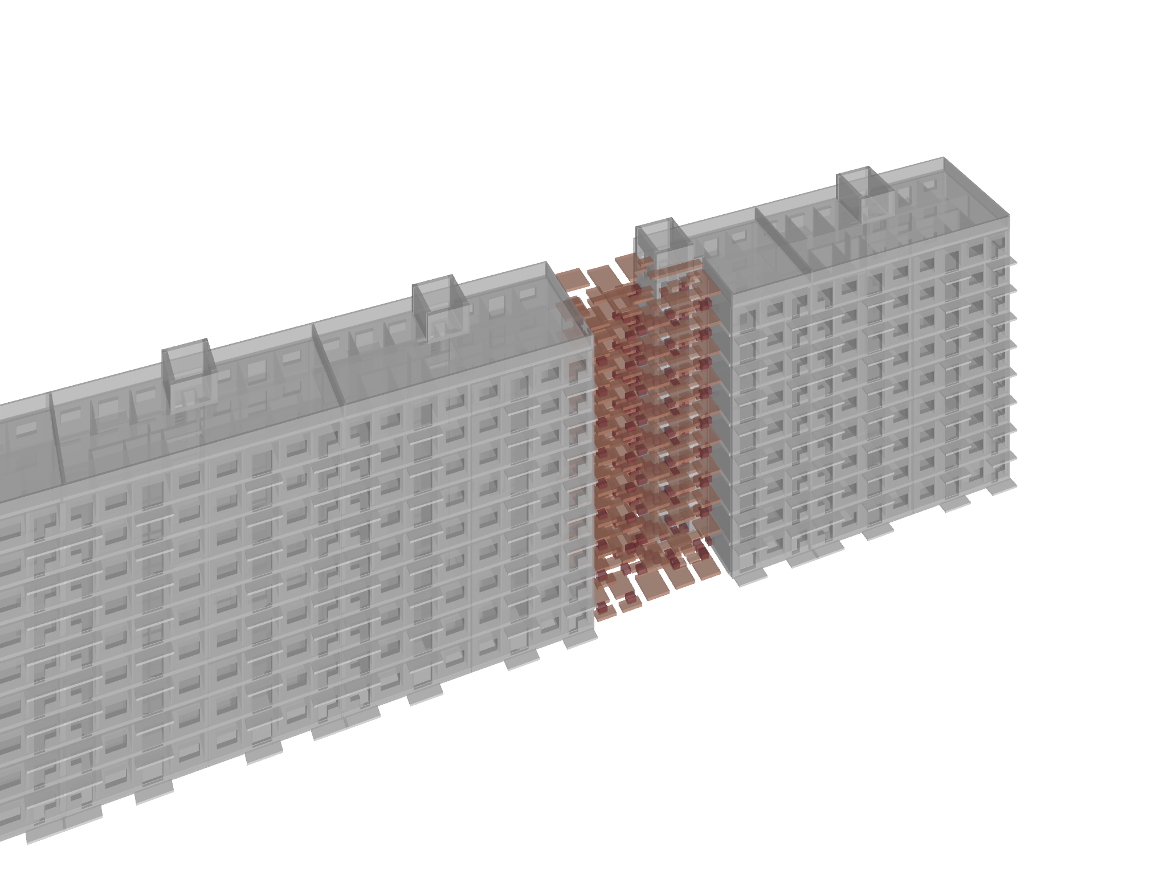

RESULT -- AXONOMETRY
Memorial Intervention in Context
The depth-mapped slabs step down into the gap left by the strike. The intact section continues as before -- the memorial does not alter it. The staircase at center now leads somewhere: a descending spatial sequence that traces the topology of the lost apartment.

Slide 23
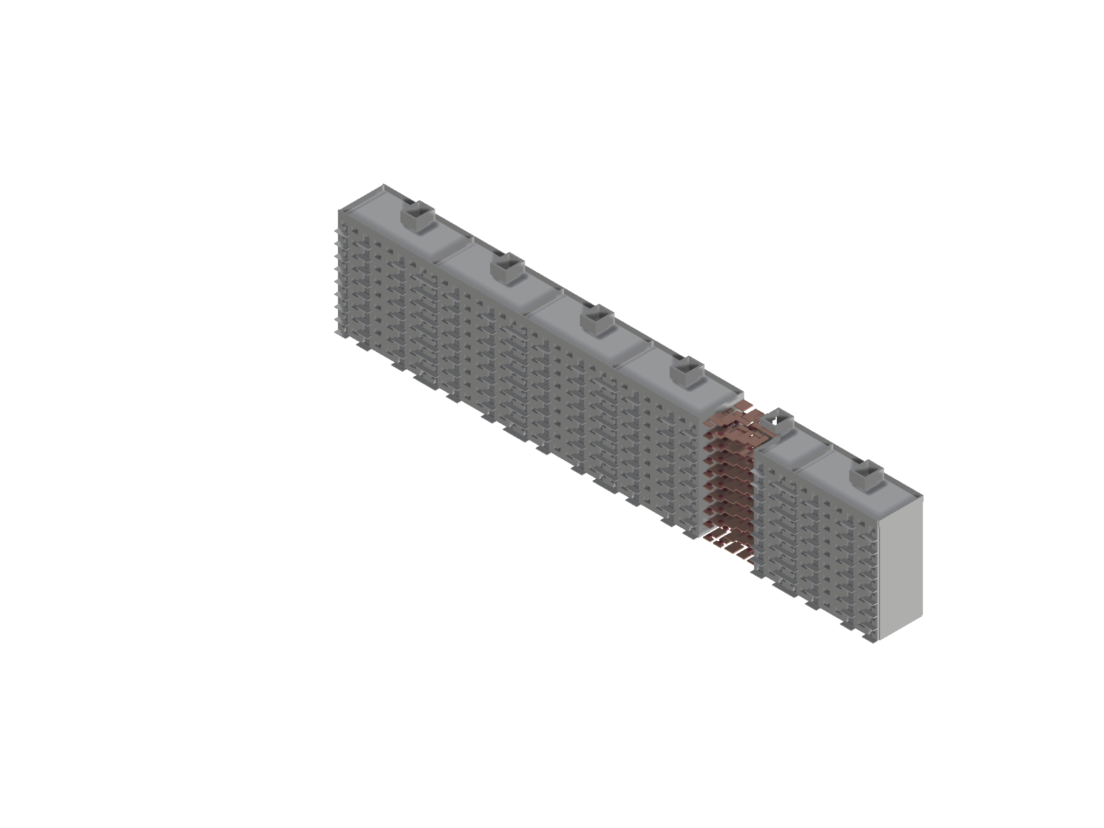
RESULT -- MEMORIAL
The Intervention
Slabs at depth-mapped Z heights. Perimeters shrunk by missing wall thickness. Gaps between edges = the vanished walls. Bridges at door positions = the surviving connections. The graph of the lost apartment, made physical.

Slide 24
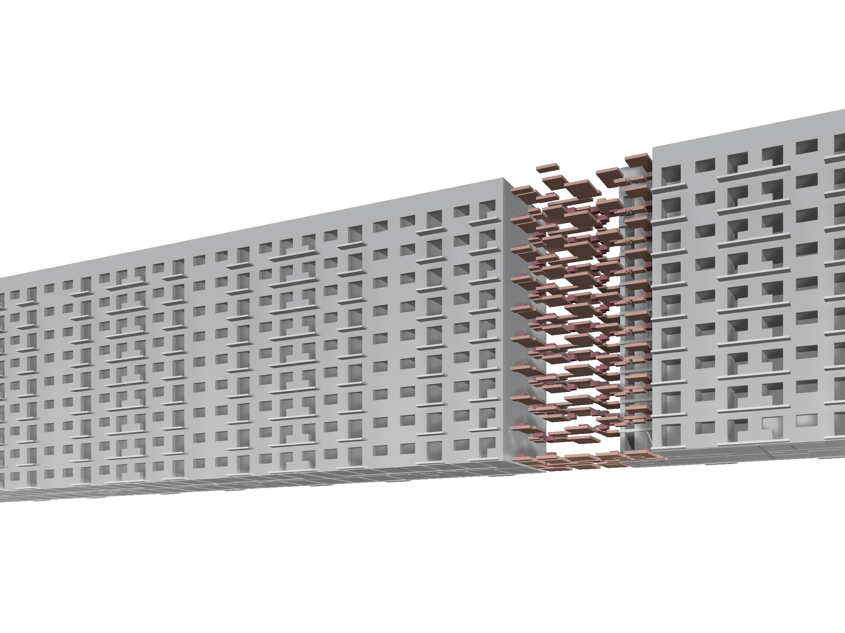
RESULT -- FACADE
The Memorial Seen from the Street
The promenade is the access graph of the lost apartment, made walkable.

