Slide 1
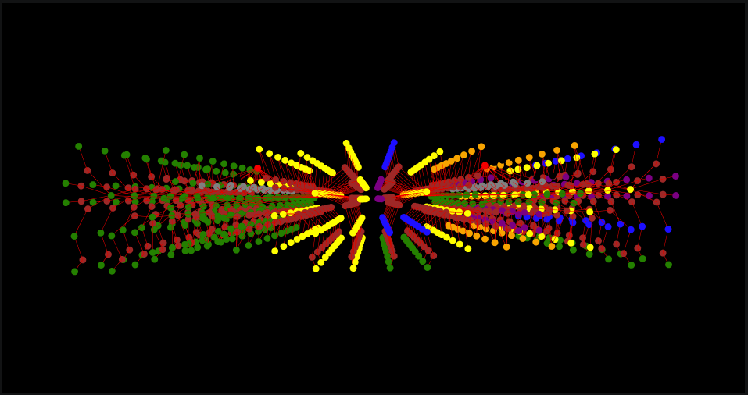
Iaac
GRAPH MACHINE LEARNING
Memorial in Topology
A Reading of Wartime Loss in Kyiv
Marina Osmolovska
MaCAD 2025 -- Semester 3
Buildings as Graphs Faculty: Angelos Chronis -- Orestis Pavlidis

Slide 2
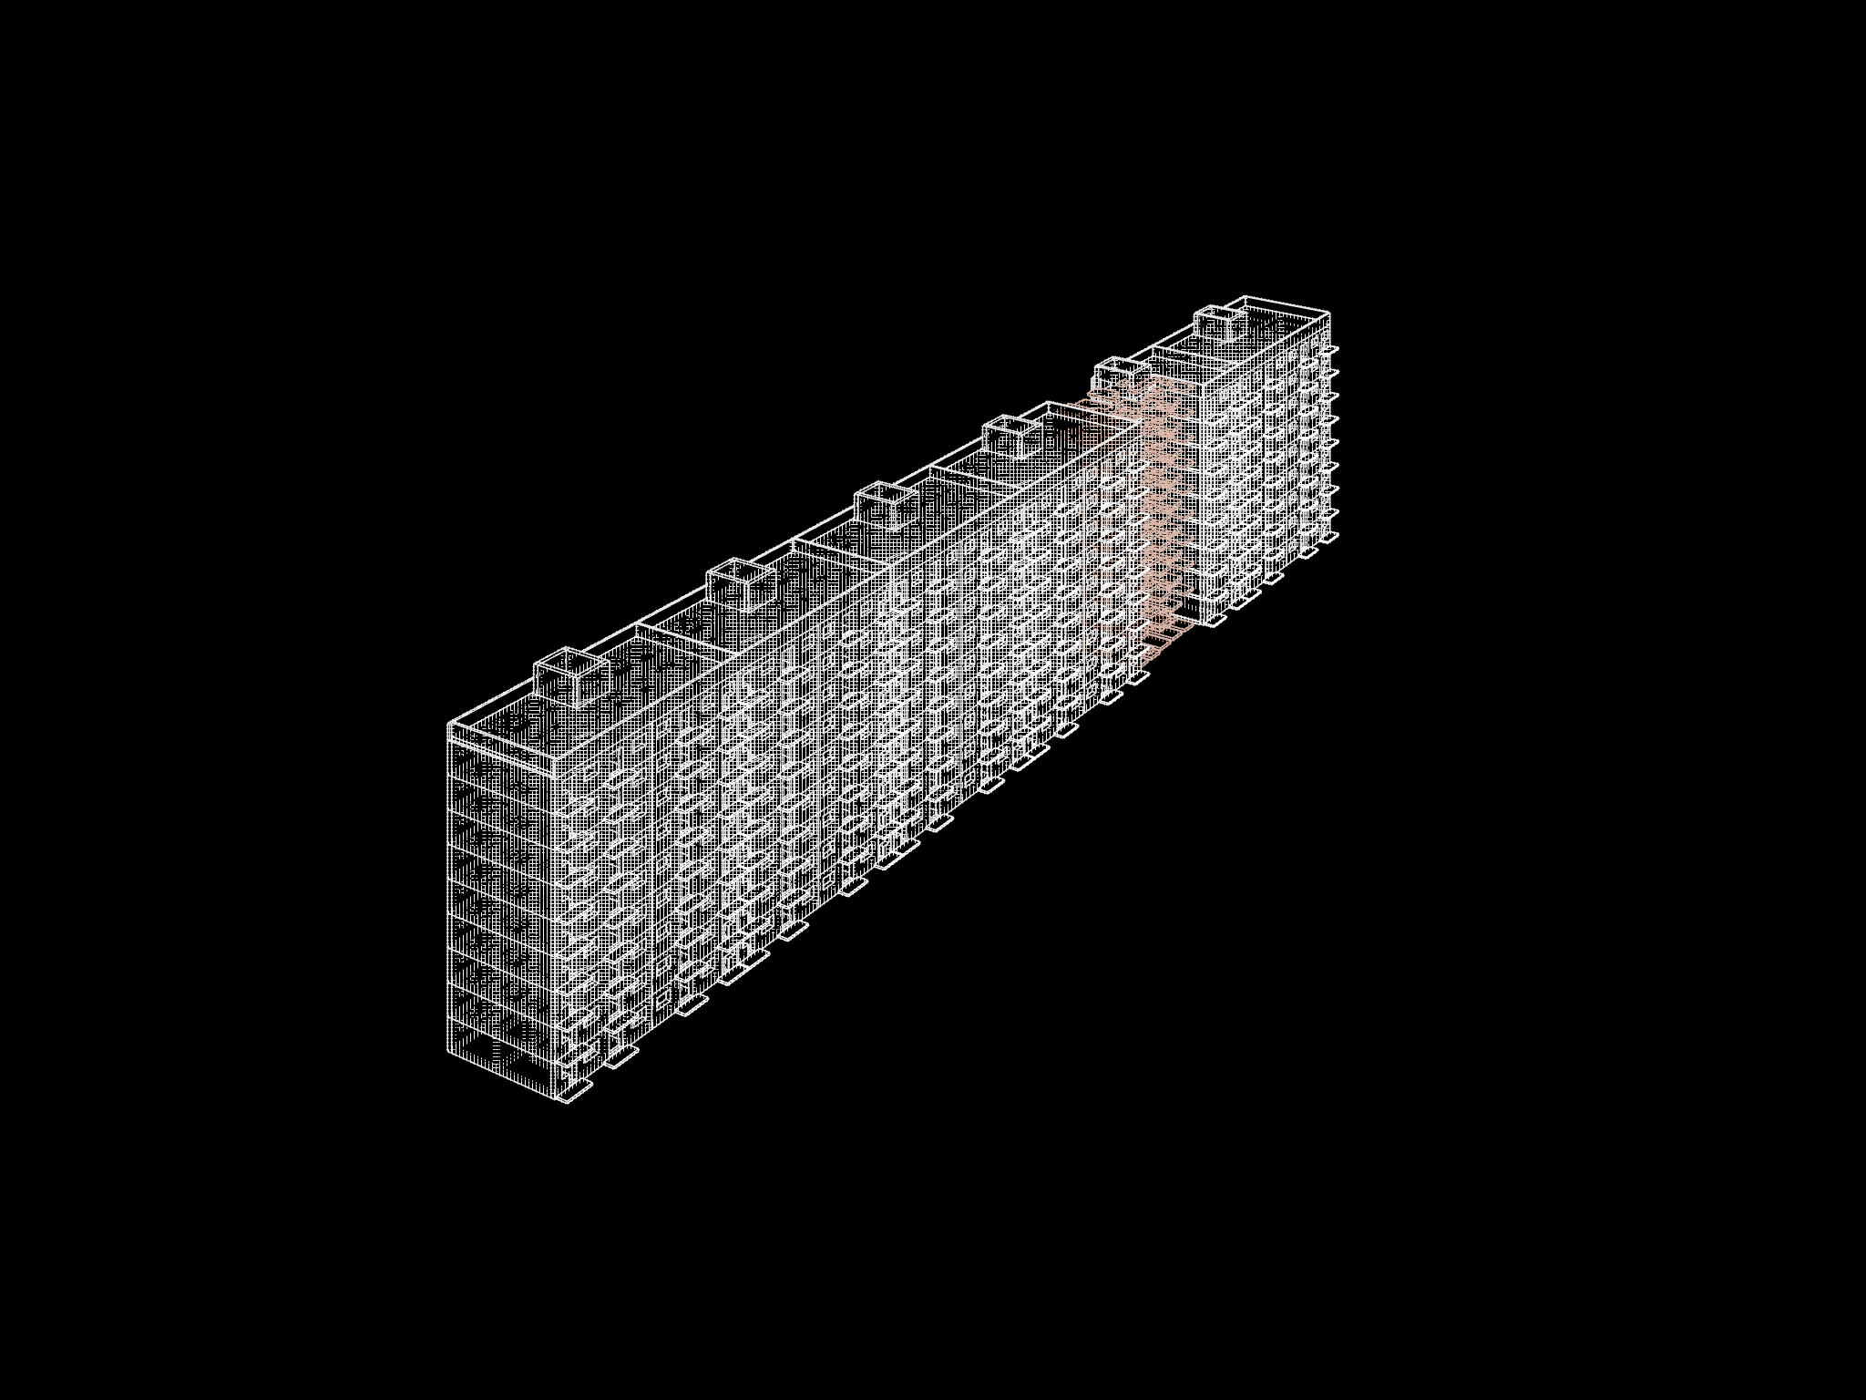
CONTEXT
The Building
87-02 Soviet panel block-section. Nine storeys, two apartments per floor, mirrored around a single staircase core. A standard type mass-produced across the USSR from the 1960s onward.
A rocket strike destroyed the right half of one such section in Kyiv. The staircase survived. The apartments on one side did not. The stair now opens onto a concrete void.
The surviving stair leads, in graph terms, to nothing.
The project reads the lost apartment as a spatial graph and uses that graph to generate a memorial form. Each room that no longer exists is given back a floor slab, positioned by the room's topological distance from the entrance.

Slide 3
THE PROPOSAL
Memorial in Topology
Depth logic
Bridge logic
The access graph of the damaged section encodes which rooms were adjacent via which door. BFS hop count from the staircase landing assigns a depth to each room on that graph. That depth maps directly to a vertical offset: slab Z = -step * depth.
Two connected rooms at different depths sit at different slab heights. The door that connected them in the original apartment marks the position of a step-bridge. The height of that step equals the height difference between the two slabs -- which equals one step unit, because adjacent rooms differ by exactly one BFS hop.
A room at depth 1 -- the apartment hall, directly behind the entrance door -- returns as a slab flush with the landing. A room at depth 3 -- a bedroom, a balcony -- sits three steps below. The further from the entrance, the lower the slab.
Where two rooms shared a face that was not a door, the gap between slab edges is left open. The opening is the missing wall.
In the damaged block, depth ranges from 0 to 12. The promenade descends through 13 levels, each level corresponding to one door crossing in the original apartment.
Slab perimeters are shrunk inward by the missing wall thickness. The gap between adjacent slab edges equals that wall dimension. The original room dimensions are still readable in the plan.
The step-bridges are encoded as stairs nodes in the combined graph. The memorial slabs are encoded as balcony nodes. Both are read by the ML model as part of the spatial context when it predicts what the surviving rooms become.
slab Z = -step x depth

Slide 4
WORKFLOW
Analysis Pipeline
01
02
03
04
Rhino Geometry
CellComplex
Graph Construction
BFS Depth Analysis
Closed room solids Door aperture faces exported as OBJ
TopologicPy reads OBJ Builds 3D cell adjacency from shared faces
g1: adjacency (all faces) g2: access (doors only) Both built from same CellComplex
NetworkX BFS on g2 Hop count from staircase landingper room
08
07
06
05
ML Prediction
Feature Encoding
Combined Graph
Slab Formula
Pretrained GraphSAGE (MSD dataset) new room function per node
7-dim node vector 4 zoning one-hot 3 door-type ratios
Intact section + damaged block + memorial in one CellComplex
slab Z = -step x depth Rhino: memorial slabs + step-bridges at doors
Output: 90 corridor + 63 kitchen + 9 livingroom -- predicted new functions for 162 surviving rooms

Slide 5
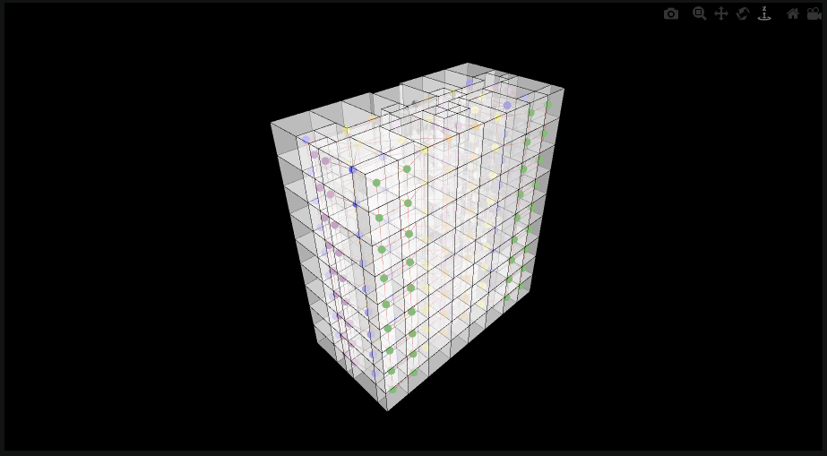
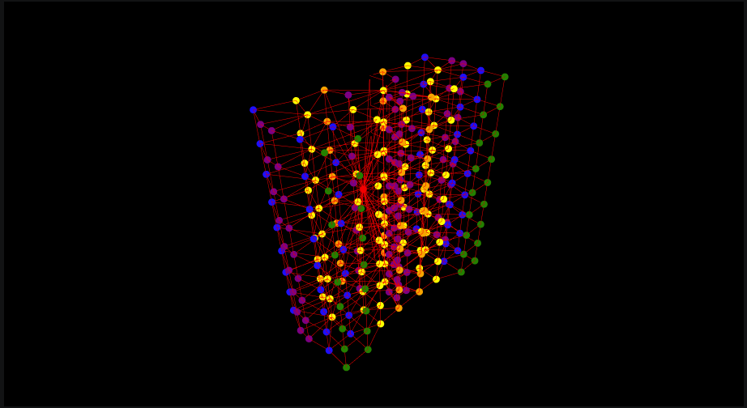
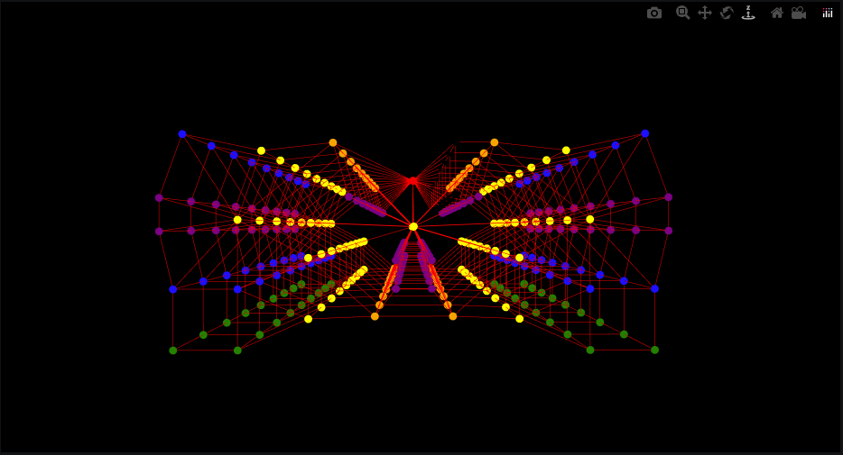
PHASE 3 -- INTACT SECTION
Adjacency Graph g1
direct = True -- every shared face creates an edge, including floors and ceilings between storeys.
The staircase box touches every floor slab in the building; in g1 it connects to every room above and below it, making it an enormous hub. A bedroom on floor 3 has a direct edge to the bedroom on floor 4 through the shared slab. g1 is used for geometry inspection only -- its connectivity is structurally misleading for analysis.
On geometry
3D isolated -- dense through-slab edges
Plan -- repeating double fan, 9 floors collapsed

Slide 6
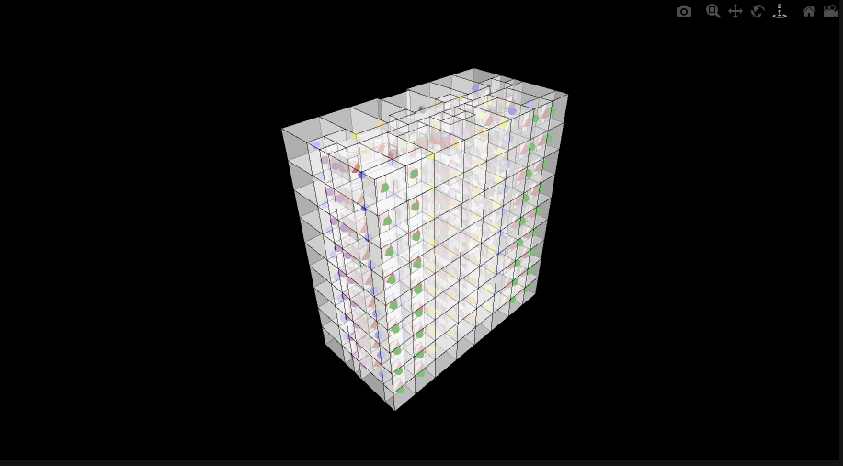
PHASE 3 -- INTACT SECTION
Access Graph g2
direct = False, viaSharedApertures = True -- only door aperture faces create edges.
The door OBJ files tag each aperture face by type: entrance door, room door, or passage threshold. Only these faces produce edges. Through-slab connections disappear entirely. Bedrooms and bathrooms become leaf nodes with a single incident edge. The staircase connects only to its landings. g2 represents the movement graph -- the paths a person can actually walk. This is the graph used for BFS depth analysis, slab height computation, feature encoding, and ML training.
g2 on geometry -- node colors = room type

Slide 7
PHASE 4 -- SPATIAL ANALYSIS
Depth from Entrance
BFS runs on g2, starting from the staircase landing node. The hop count to each room is its depth: the number of door apertures a person must cross to reach that room from the staircase. No geometry involved -- only graph structure.
0
Staircase landing
Formula
Graph origin. BFS starts here.
slab Z = -step x depth
1
Apartment hall / corridor
One door crossing: the entrance door.
depth 0 --> ground level depth 12 --> lowest slab 13 distinct Z levels
2
Kitchen, bathroom, storeroom
Two crossings: entrance + one internal door.
Intact section
BFS depth ranges from 0 to 3 across the intact nine-storey section. The damaged block, once merged, extends this to depth 12 because the memorial slabs fan outward from the surviving corridors, adding more graph distance from the staircase.
3
Bedroom, livingroom, balcony
Three crossings: entrance + two internal doors.

Slide 8
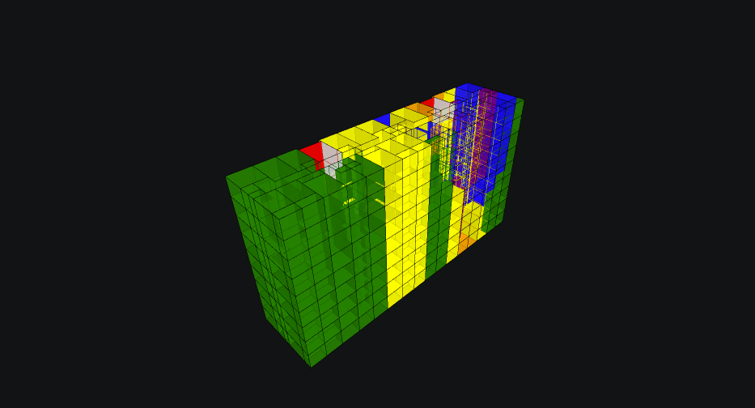
PHASE 6 -- COMBINED CELLCOMPLEX
Intact section + Damaged block + Memorial intervention
bedroom
living / kitchen / corridor
balcony -- memorial slabs
storeroom / bathroom
596 cells. The staircase spine at center connects both halves. Right: intact section, real room types. Left: surviving damaged rooms (corridor, yellow) and memorial slabs (balcony, green).

Slide 9
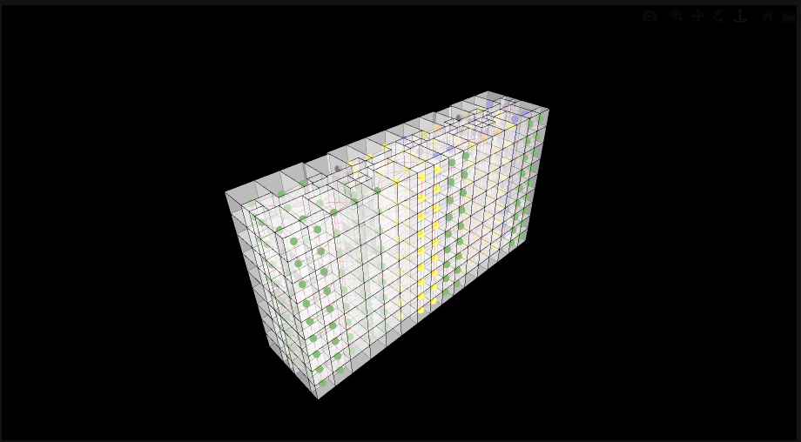
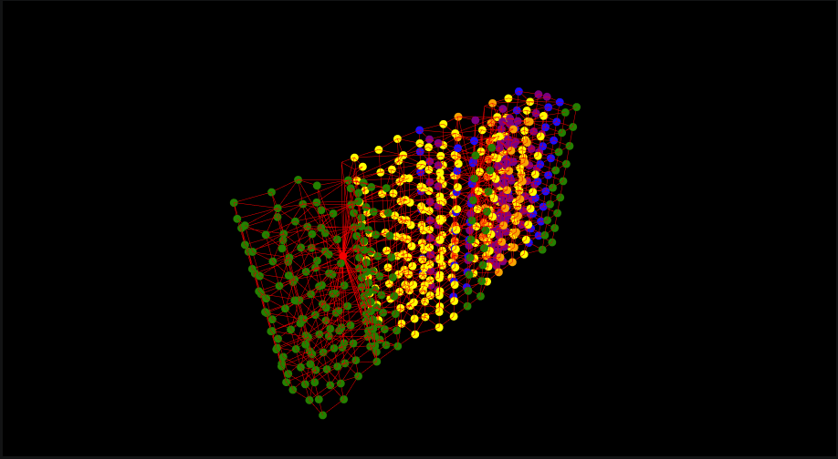
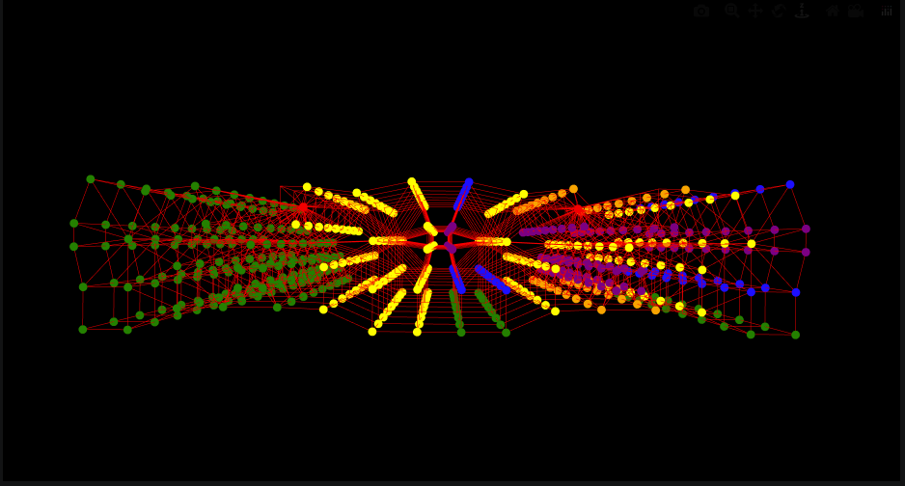
PHASE 6 -- COMBINED SECTION
Adjacency Graph g1 -- Both Sections
Through-face adjacency across the full 596-node graph.
The asymmetry between the two halves is directly visible. The intact section (right) produces the expected double-fan pattern: two apartment clusters per floor, repeating nine times, converging at the staircase. The damaged section (left) produces a different structure: the green balcony slab nodes form a wider, sparser cloud at the periphery -- a typology that did not exist in the original building.
On geometry
3D isolated -- balcony cluster (left) vs apartment fan (right)
Plan -- broken symmetry

Slide 10
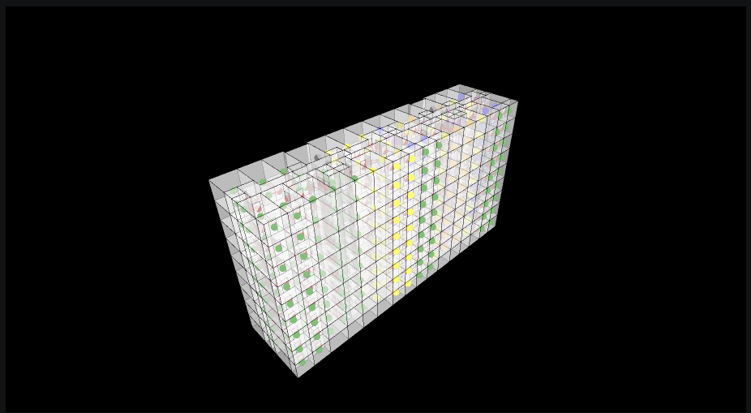
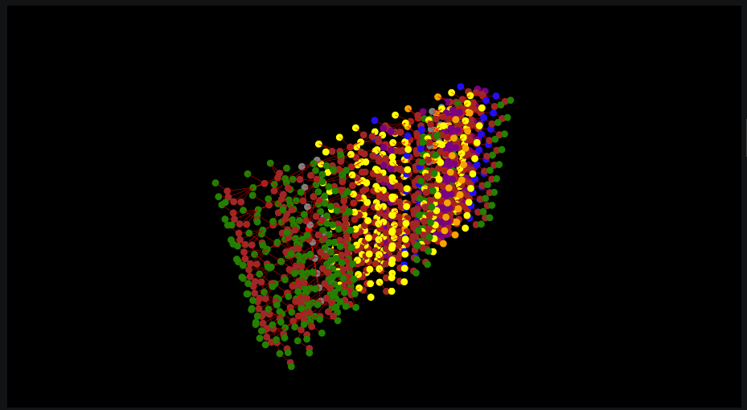
PHASE 6 -- COMBINED SECTION
Access Graph g2 -- Both Sections
596 nodes, 594 edges. The staircase landing is the only connection between the two sections.
The intact section (right) reads as a standard apartment tree: staircase branching to landings, landings to entrance doors, halls to rooms, rooms ending as leaves. The damaged section (left) carries the same branching logic but through different node types: surviving corridor nodes fan to balcony slab leaves, with stair-bridges at the original door positions. The lost apartment's topology is structurally intact -- the spatial relationships remain, even though the rooms are gone.
On geometry
3D isolated -- corridors fan to balcony slab leaves
Plan -- staircase at hourglass center

Slide 11
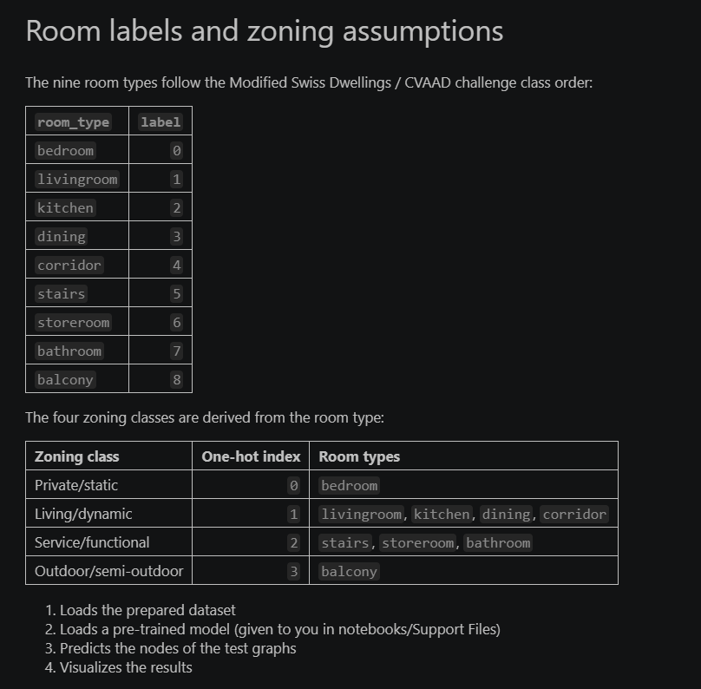
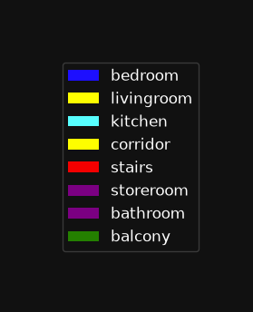
PHASE 8 -- ML NODE CLASSIFICATION
GraphSAGE -- Feature Design
The classifier (pretrained on the Milan Spatial Dataset, ~1000 apartment plans) takes a 7-dimensional feature vector per node. No coordinates, no area, no geometry.
Node feature vector x in R^7
zoning_type_0
1 if private/static (bedroom)
zoning_type_1
1 if living/dynamic (kitchen, corridor, dining)
zoning_type_2
1 if service/functional (bathroom, storeroom, stairs)
zoning_type_3
1 if outdoor (balcony)
connectivity_0
fraction of edges that are passage thresholds
connectivity_1
fraction of edges that are room doors
connectivity_2
fraction of edges that are entrance doors
The four zoning features are one-hot. The three connectivity features are ratios computed from the edge set of each node. A corridor node in the damaged section is assigned zoning_type_1 = 1. Its connectivity features depend on which door types connect it to its neighbors.

Slide 12
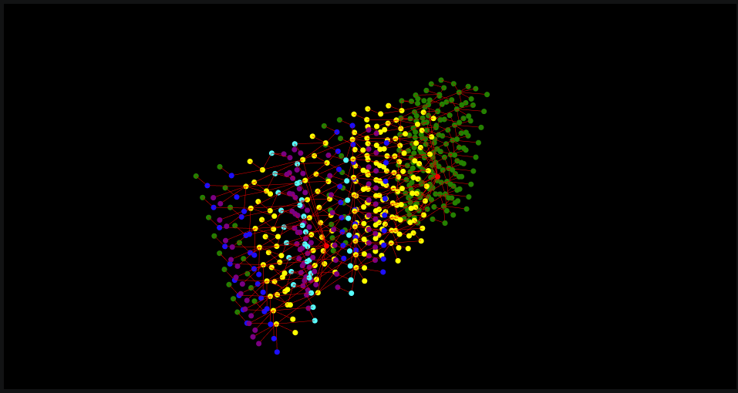
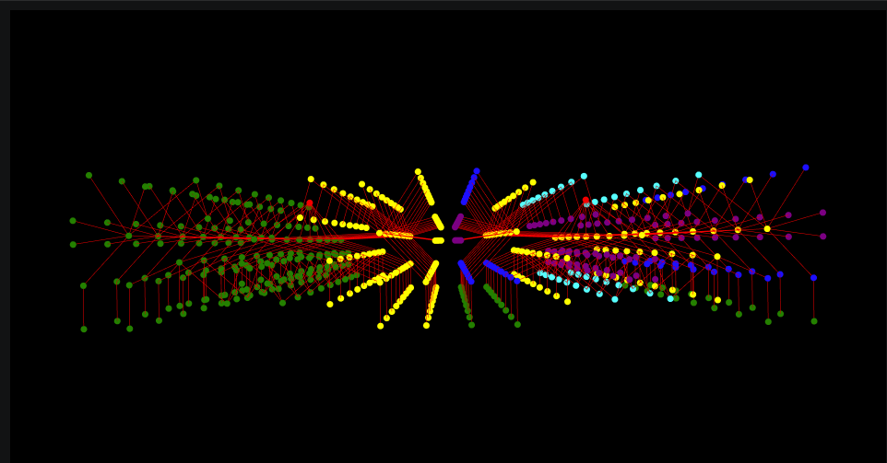
PHASE 8 -- BEFORE INFERENCE
Assigned Labels
Before the model runs, every node in the combined graph must have a label. The intact section nodes carry their real room types. The memorial nodes are assigned labels that encode the design intent.
162 surviving damaged rooms
corridor
zoning [0,1,0,0]
Neutral placeholder. zoning_type_1 = 1. The model will predict the new function for each of these nodes.
216 memorial slabs
balcony
zoning [0,0,0,1]
Outdoor / semi-outdoor. Signals open space to neighboring nodes through the aggregation step.
2 step-bridges
stairs
zoning [0,0,1,0]
Service / functional. Encodes the passage relationship between slabs at different heights.
3D view -- yellow = corridor placeholder (162), green = balcony slabs (216)
Plan view -- the uniform assignment in the damaged section is explicit

Slide 13
PHASE 8 -- ML CLASSIFICATION
How GraphSAGE Classifies Nodes
1. Neighborhood sampling
2. Feature aggregation
For each node, GraphSAGE samples a fixed number of neighbors at each layer. In this graph: 1-hop neighbors are rooms directly connected by a door aperture.
The sampled neighbors' feature vectors are aggregated (here: mean). The aggregated vector is concatenated with the node's own vector and passed through a learned linear transformation. This produces a new embedding for the node.
3. Two-layer propagation
4. Classification
The process runs twice (two GraphSAGE layers), so each node effectively sees its 2-hop neighborhood. In a typical apartment, 2 hops from a corridor reaches bedrooms and balconies -- the full local context of a room.
The final embedding is passed through a softmax layer that outputs a probability distribution over the 9 room types. The predicted label is the highest-probability class.
The model was pretrained on MSD (Milan Spatial Dataset) and has not seen this building. It transfers learned connectivity patterns from real apartments to the memorial graph.

Slide 14
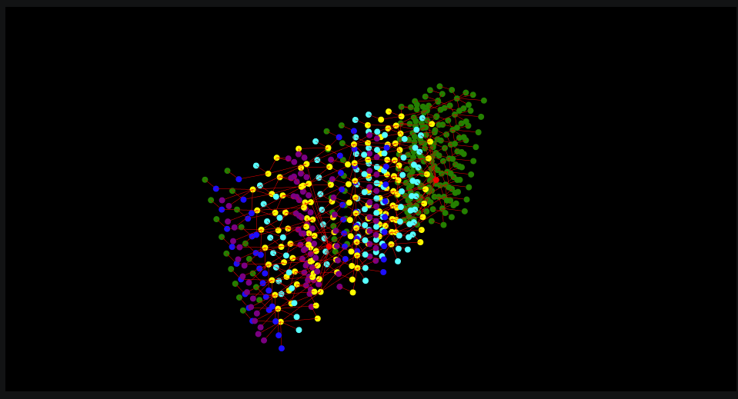
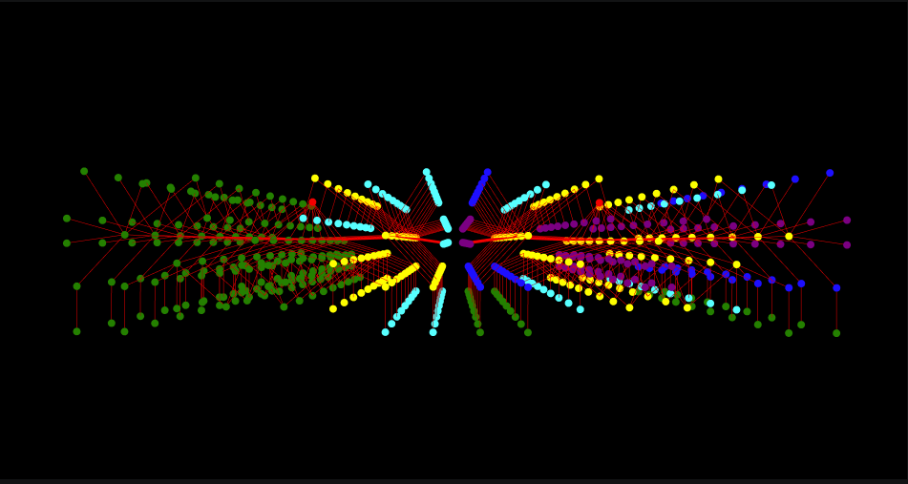
PHASE 8 -- AFTER INFERENCE
Predicted Functions
After two-layer GraphSAGE aggregation, the corridor nodes in the damaged section carry updated embeddings that reflect their local neighborhood -- which now includes balcony slab nodes and stair-bridge nodes introduced by the design.
Corridor nodes at depth 2, with 2-3 door edges and at least one balcony neighbor, produce embeddings that the classifier maps to kitchen. The model's learned kitchen profile -- rooms with mixed door/outdoor connectivity at depth 2 -- matches the connectivity structure of these nodes in the combined graph. 72 of 162 corridor placeholders are reclassified.
3D view -- cyan = kitchen nodes in the damaged section
Plan view -- kitchen predictions concentrate near the staircase hub

Slide 15
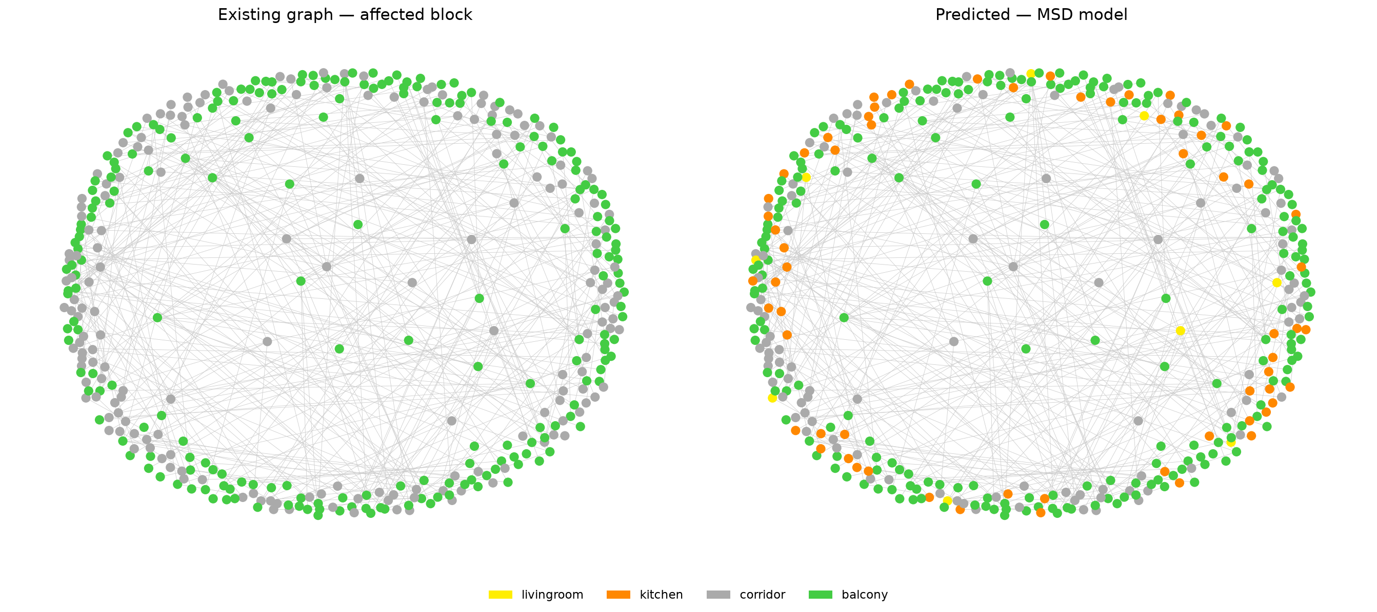
PHASE 8 -- RESULTS
Predictions for 162 Surviving Rooms
90
63
9
corridor
kitchen
livingroom
Rooms at depth 3 or greater. Low degree -- typically 1-2 door edges. Neighbors are other corridor or balcony nodes, without the mixed connectivity that would shift the embedding toward kitchen. The classifier keeps them as circulation.
Rooms at depth 2, with 2-3 door edges and at least one direct balcony neighbor. The connectivity_1 (door ratio) and zoning_type_1 features, combined with the aggregated outdoor signal from the balcony nodes, produce an embedding the model assigns to kitchen.
Rooms with a single door edge leading to a larger corridor or balcony node. Lower connectivity_1 ratio, higher degree on the balcony side. The model interprets this single-opening-to-open-space pattern as livingroom.
What the result means
The memorial slabs were labelled balcony because they are open, unenclosed surfaces. That label carried an outdoor zoning signal into the feature vectors of every adjacent corridor node via the aggregation step. The classifier read that signal and assigned kitchen -- the room type most often adjacent to a balcony in the MSD training data. The design choice (slab = balcony) directly produced the ML result (corridor --> kitchen).

Slide 16
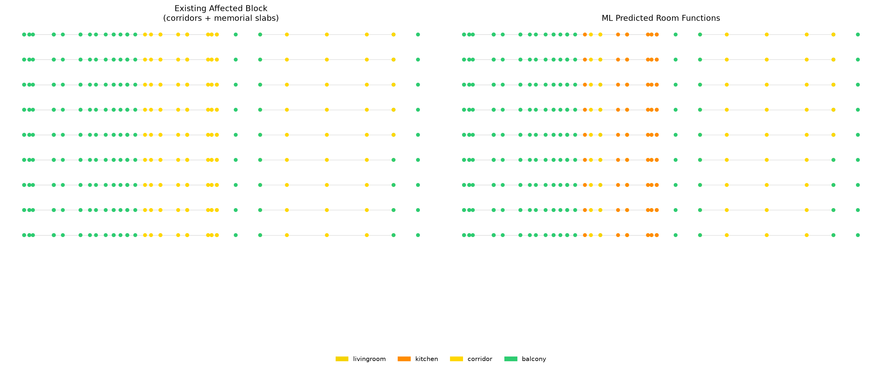
PHASE 8 -- RESULTS DETAIL
Floor-by-Floor Prediction
Each row is one floor. Each dot is one room. Left: assigned placeholder labels. Right: ML-predicted functions.
Kitchen reclassification concentrates on floors where corridor nodes have direct balcony connections -- floors where the memorial slabs are most densely distributed. Rooms at depth 3 and beyond (further from the staircase) remain corridor. The prediction is not uniform: it follows the graph structure floor by floor.

Slide 17
SYNTHESIS
Graph Analysis as Design Driver
The analysis does not document the design. The graph generates the form, and the form -- re-embedded in the graph -- changes the ML result.
1
2
3
Build g2 from intact section
BFS depth per room
Depth --> slab height
TopologicPy creates the access graph from door apertures only. This is the graph that reflects actual movement paths.
NetworkX BFS from the staircase landing. Hop count on g2 gives the topological distance for each room.
slab Z = -step x depth drives the Rhino model. The graph metric becomes the vertical dimension of the memorial.
4
5
6
Encode memorial as graph nodes
GraphSAGE aggregation
63 corridor --> kitchen
Slabs labelled balcony. Bridges labelled stairs. The design decisions are written as node feature vectors.
Balcony nodes propagate their outdoor zoning signal into adjacent corridor nodes through the aggregation step.
The classifier reads the updated embeddings. The balcony signal shifted 63 corridor nodes into the kitchen class. The memorial has the connectivity profile of a habitable apartment.

Slide 18

RESULT
The Memorial
Graph analysis translated into architectural form.

Slide 19
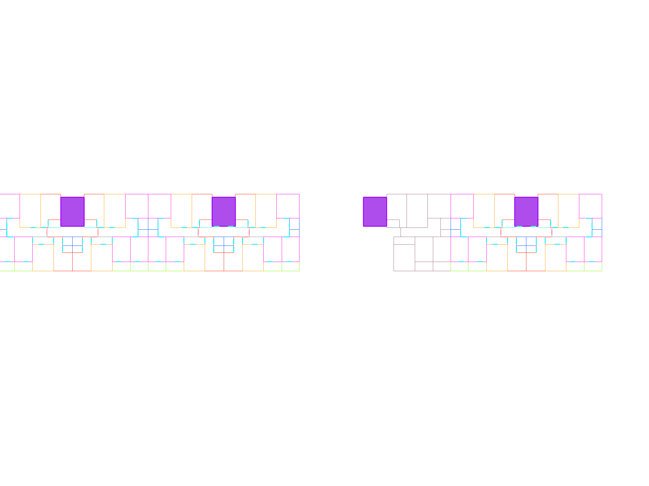
EXISTING CONDITION
Existing Plan
The 87-02 section after the strike: intact half (right), destroyed half (left). The staircase core at center connects to a void.

Slide 20
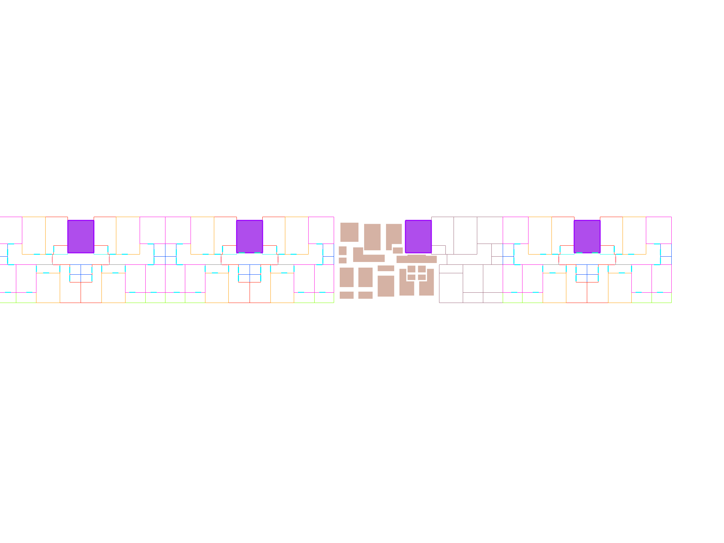
PROPOSAL
Proposed Plan -- Memorial Slabs
Each destroyed room returns as a slab at the room's original footprint, shrunk inward by the wall thickness. Z-height = -step x BFS depth from entrance. The promenade descends from the landing as graph depth increases.

Slide 21
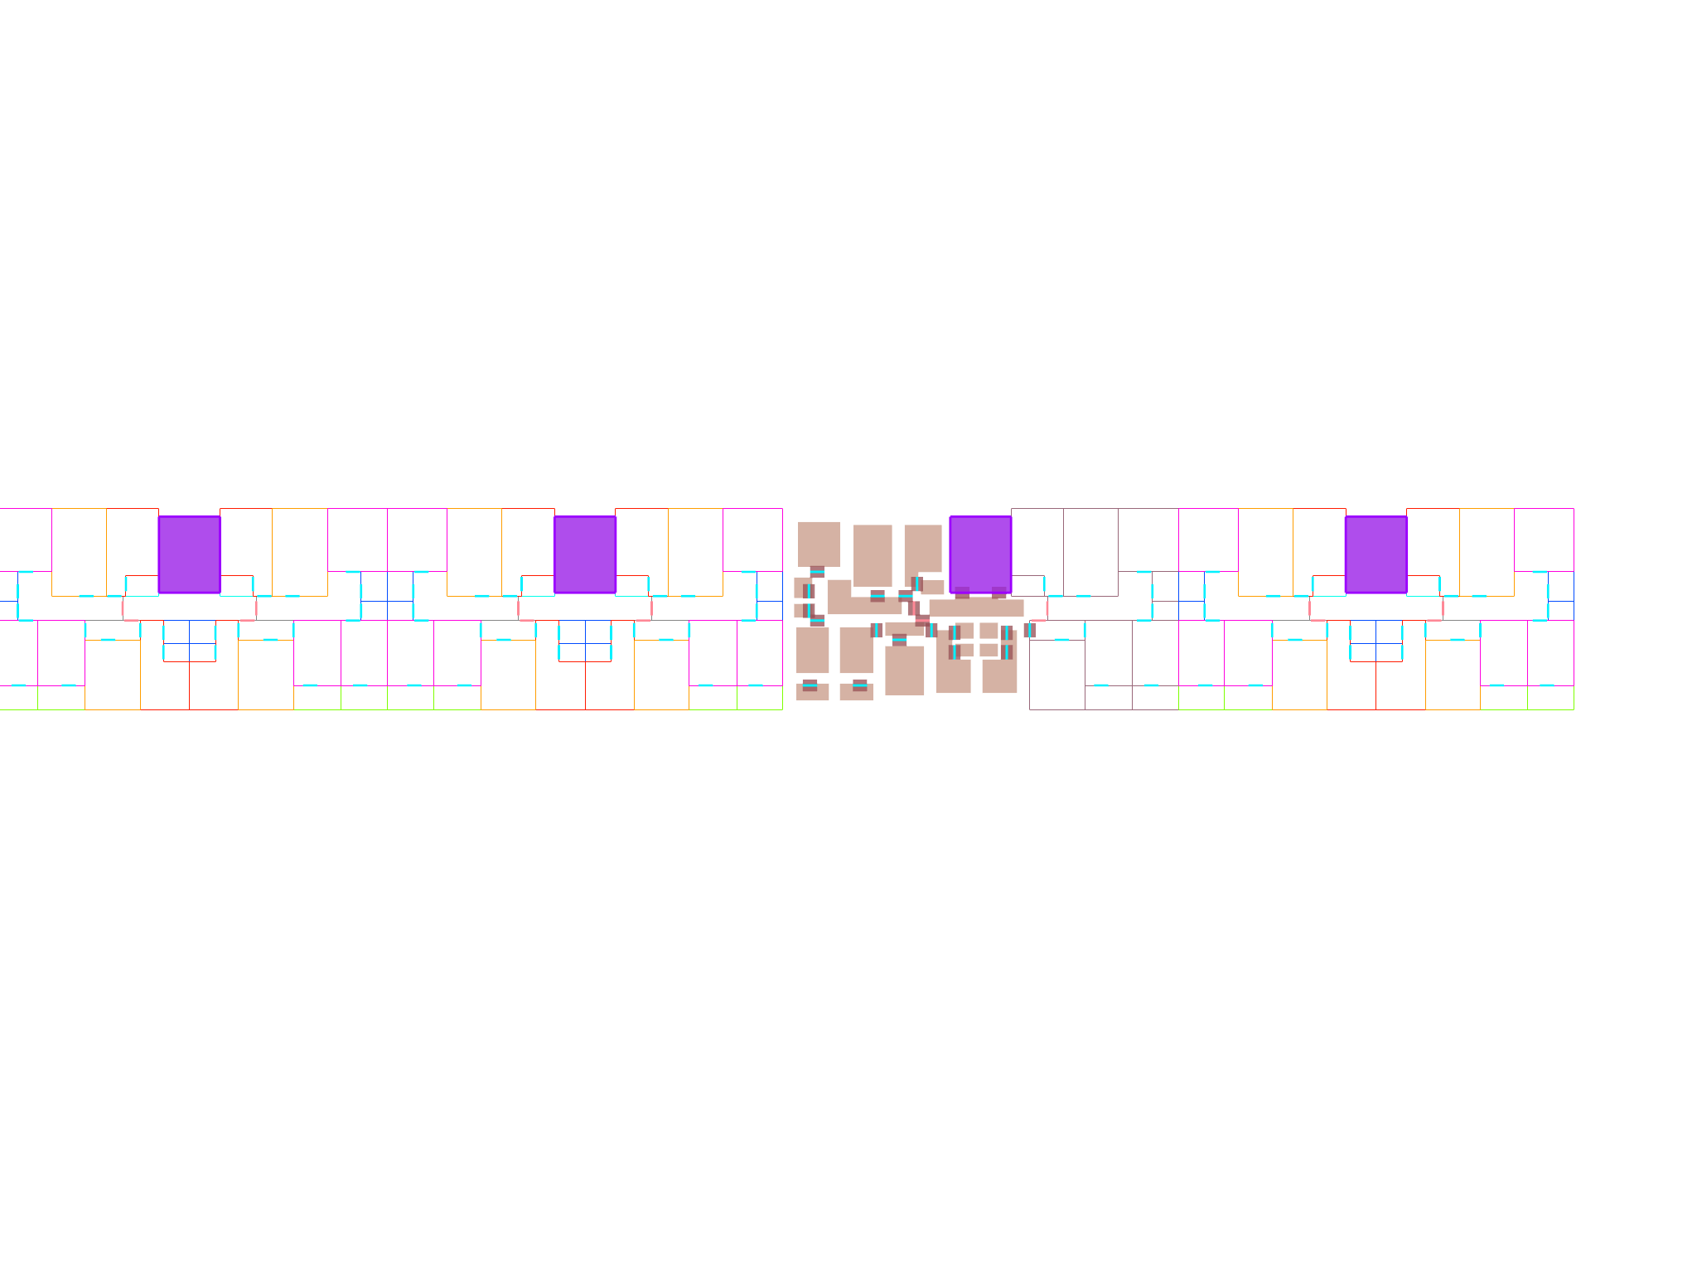
PROPOSAL -- DETAIL
Proposed Plan -- With Step-Bridges
Two connected slabs at different depths sit at different Z levels. The door position between them in the original plan becomes the step. The step height equals one step unit, because adjacent rooms differ by exactly one BFS hop. Slab edges at non-door positions are left open -- the gap is the missing wall.

Slide 22
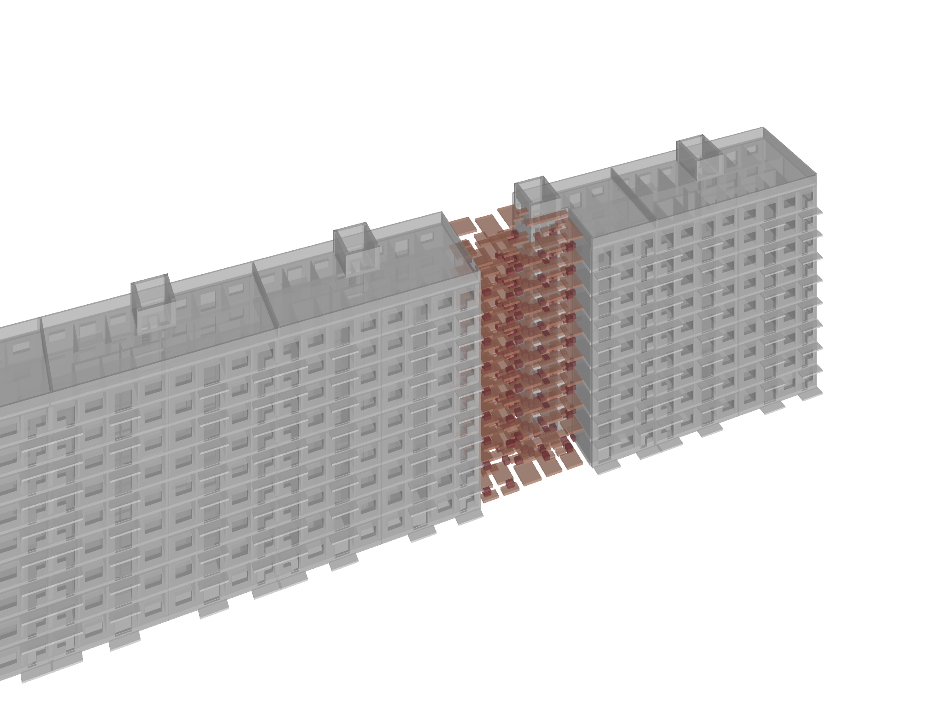

RESULT -- AXONOMETRY
Memorial Intervention in Context
The depth-mapped slabs step down into the gap. The intact section is unchanged. The staircase at center now leads into a descending spatial sequence that traces the access graph of the lost apartment.

Slide 23
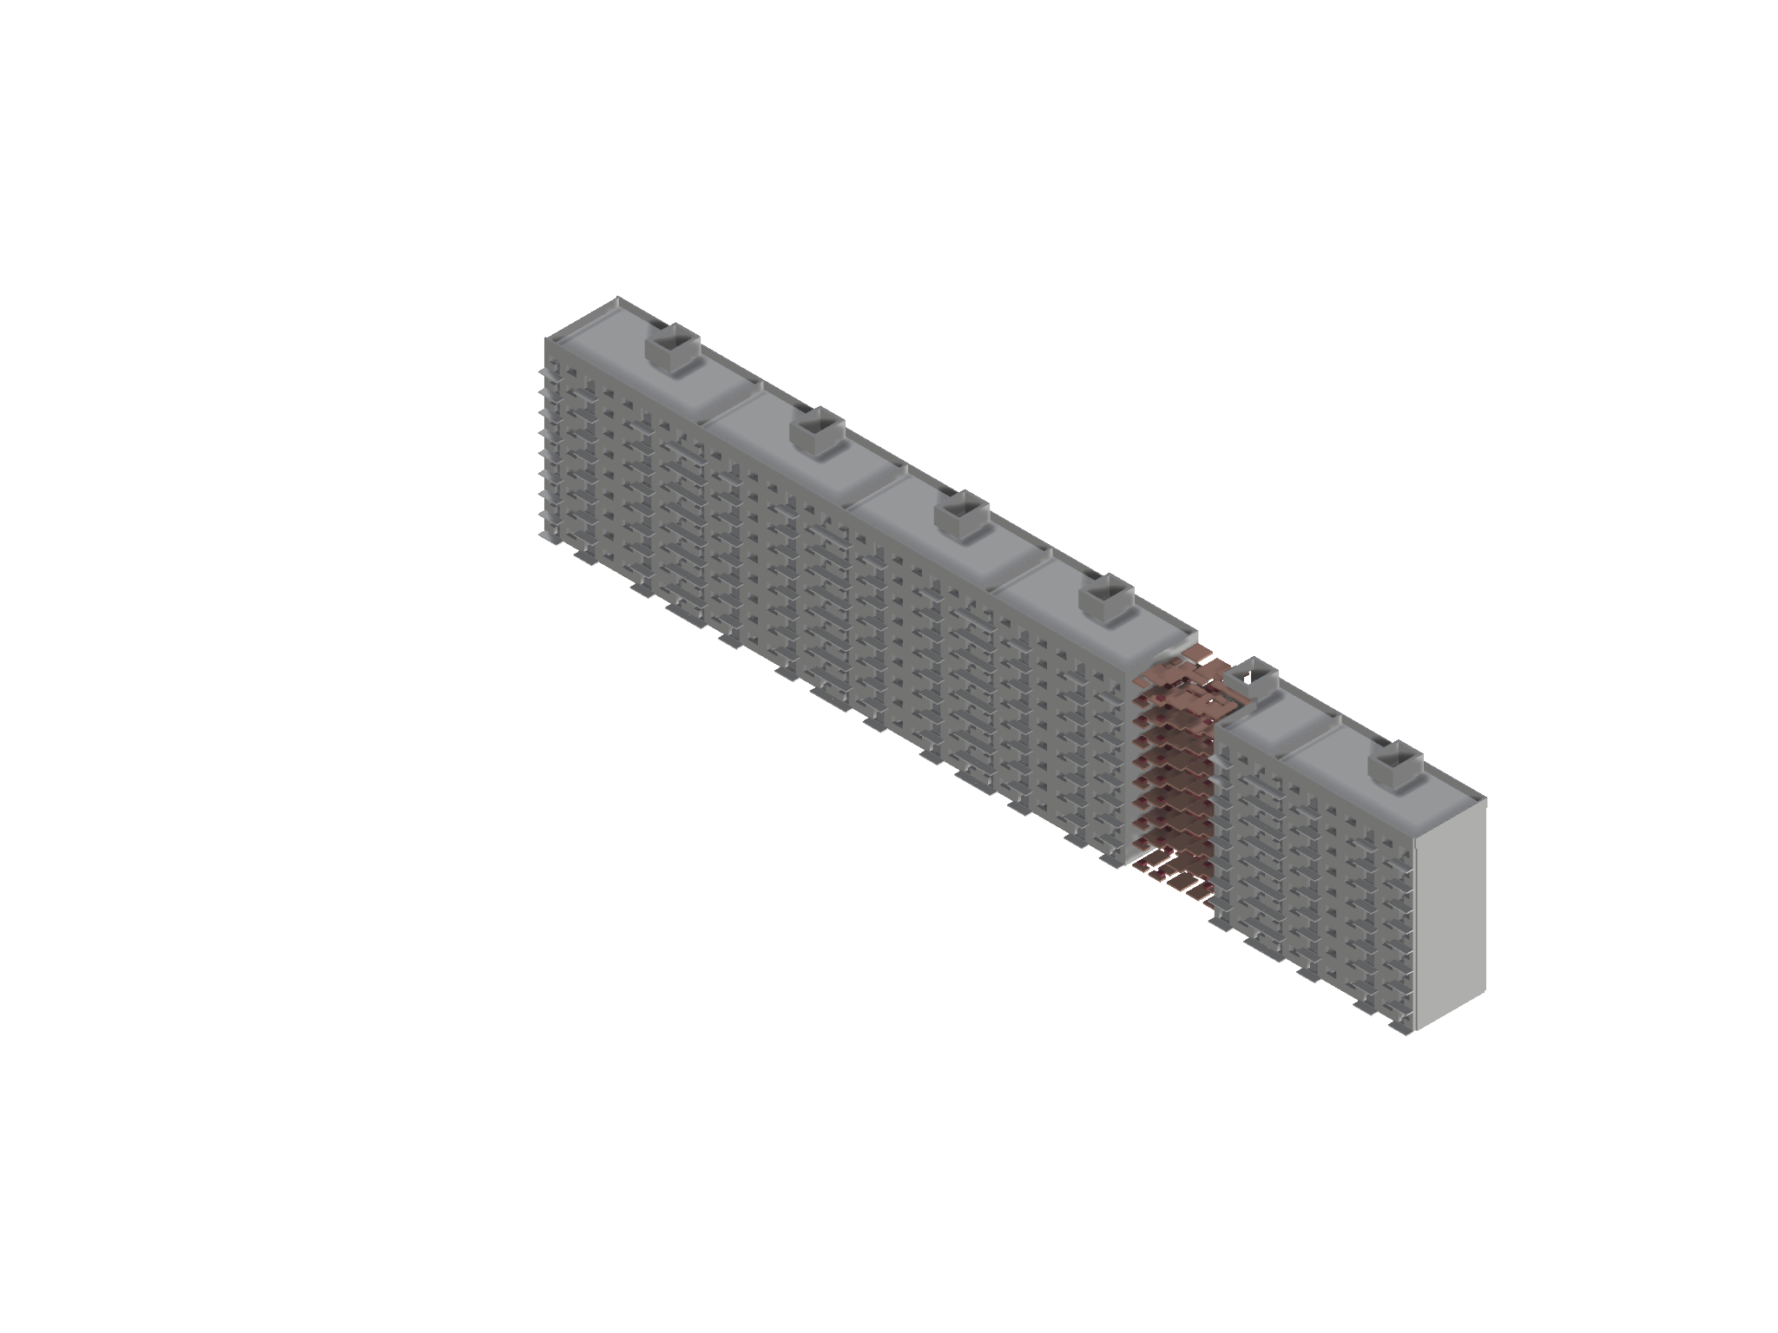
RESULT -- MEMORIAL
The Intervention
Slabs at depth-mapped Z heights. Gaps between slab edges at non-door positions = the vanished walls. Bridges at door positions connecting slabs at adjacent depths.

Slide 24
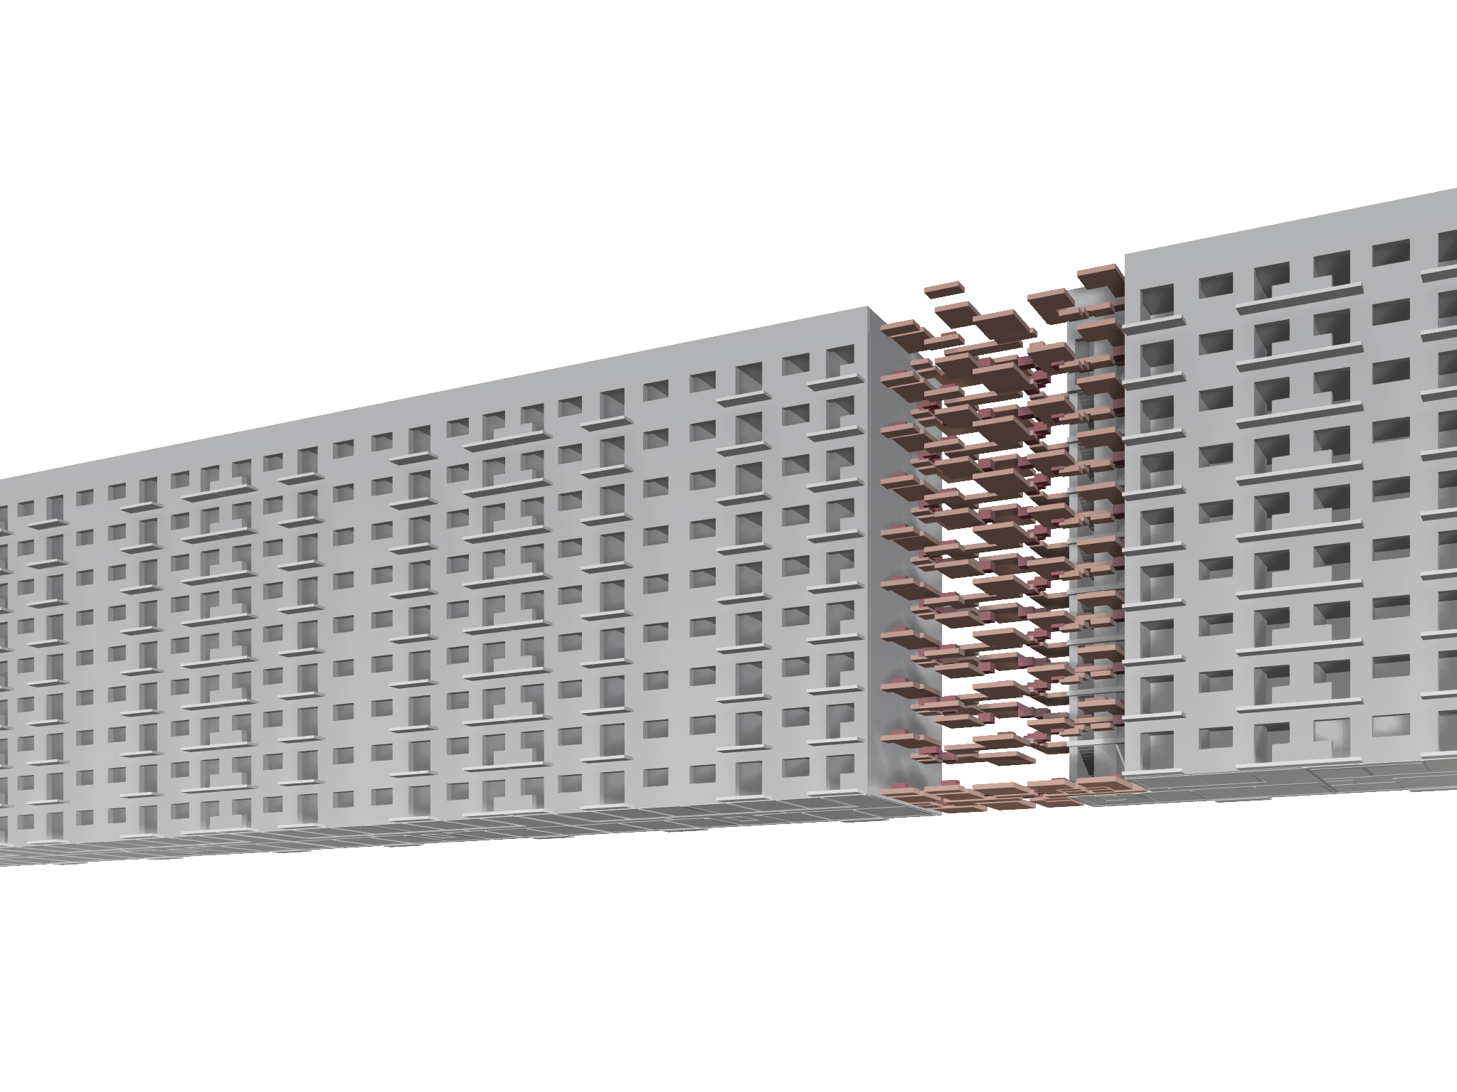
RESULT -- FACADE
The Memorial Seen from the Street
The promenade is the access graph of the lost apartment, made walkable.

