Slide 1


Diversity in Free Software: No Longer at Square One
Marina Zhurakhinskaya
Senior Outreach Specialist
Red Hat
@marinaz
Notes:
Back in 2009, I was the best established woman software developer working on the GNOME desktop. One day, I received an e-mail from the GNOME Foundation board asking me to mentor a woman in the GNOME project I was working on. Well, it turned out that to mentor a woman I needed to create a mentorship program. That program is now called Outreachy, and it has provided close to 450 people from underrepresented backgrounds with mentored internships in free software. Along the way, I have learned from and participated in many other initiatives that have helped promote diversity in free software. I personally have transitioned from development and community work on GNOME to a full time role working on community diversity and inclusion at Red Hat almost three years ago.
I would like to share information about some key initiatives that took place in the last nine years. I hope that you walk away from this talk with an inspiration to get involved with at least one of them. I have included links to the resources I'll be mentioning in one of the final slides and I will share my slides on Twitter later today.

Slide 2
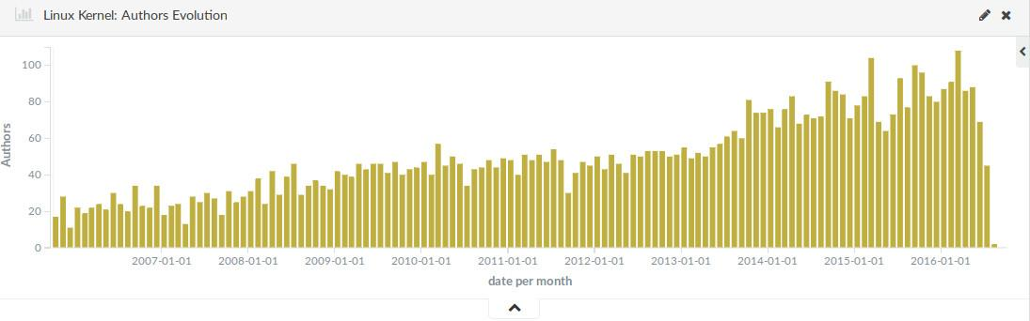
No Longer at Square One: Participation by Women
Overall: 1.1% in 2001 to 3% in 2017
Google Summer of Code: 7.1% in 2011 to 11.4% in 2017
PyCon speakers: 1% in 2011 to 40% in 2016
Linux kernel authors: 5% in 2005 to 9.9% in 2016
Notes:
First, let's look at some numbers. One of the dimensions of diversity that we have a lot of data for is gender make-up of free software participants. I have to admit that I was disappointed to see the finding in the recent GitHub survey that still only about 3% of free software contributors are women. The survey had 6,000 participants from over 3,800 GitHub repositories and, additionally, from projects not hosted on GitHub. While the survey showed that when you take a random sampling of free software projects, participation by women is extremely low, its results stood in stark contrast with participation in communities that are making outreach efforts. Those are the communities that are lifting the general average and are seeing results.
For example, Google Summer of Code offers projects with free software communities to over a thousand of students a year. Because of their outreach efforts participation by women in the program gradually increased from 7.1% in 2011 to 11.4% this year.
Python community has made many different outreach efforts, and I will talk about them in-depth later. As a result of these efforts, participation by women speakers in their North American conference PyCon rose from 1% in 2011 to 40% in 2016.
Linux kernel offers Outreachy internships and the Linux Foundation offers a variety of scholarships for training courses and for conference attendance to women and other minorities. As a result, based on research done by Bitergia, women currently represent 10% of Linux kernel authors. The image on the slide is a graph of the number of women kernel authors over time. In fact, when Linux kernel internships started being offered in Outreachy, they quickly became one of the most contested ones, showing that there has been a lot of pent up demand among women for getting involved in the project. You can see a spike in the summer of 2013 on the graph, when Sage Sharp got Linux kernel to join Outreachy.
Bitergia has also done similar research sponsored by Intel about participation of women in the OpenStack community, and that number is also at about 10%.
While historically, a lot of outreach work in free software has been to women and we have the best data about it, many efforts to address other dimensions of diversity are currently taking place and I will talk about them throughout my talk.

Slide 3

No Longer at Square One: Breaking the Unicorn Law
Notes:
Another way that I see that diversity in free software is no longer at square one is that we have been able to break the unicron law. The unicorn law was formulated by Emma Jane Hogbin in 2009 and it stated "If you are a woman in Open Source, you will eventually give a talk about being a woman in Open Source." I certainly come from the generation of women for whom that was the case. It's a relief for me to see that because of the amount of materials about best practices and because of the increase in the number of women participants, this law has been broken. Now anyone can learn about best practices for diversity and inclusion in free software from online resources and from experts, rather than asking women and other people from minority groups in their community to work on the issue.

Slide 4
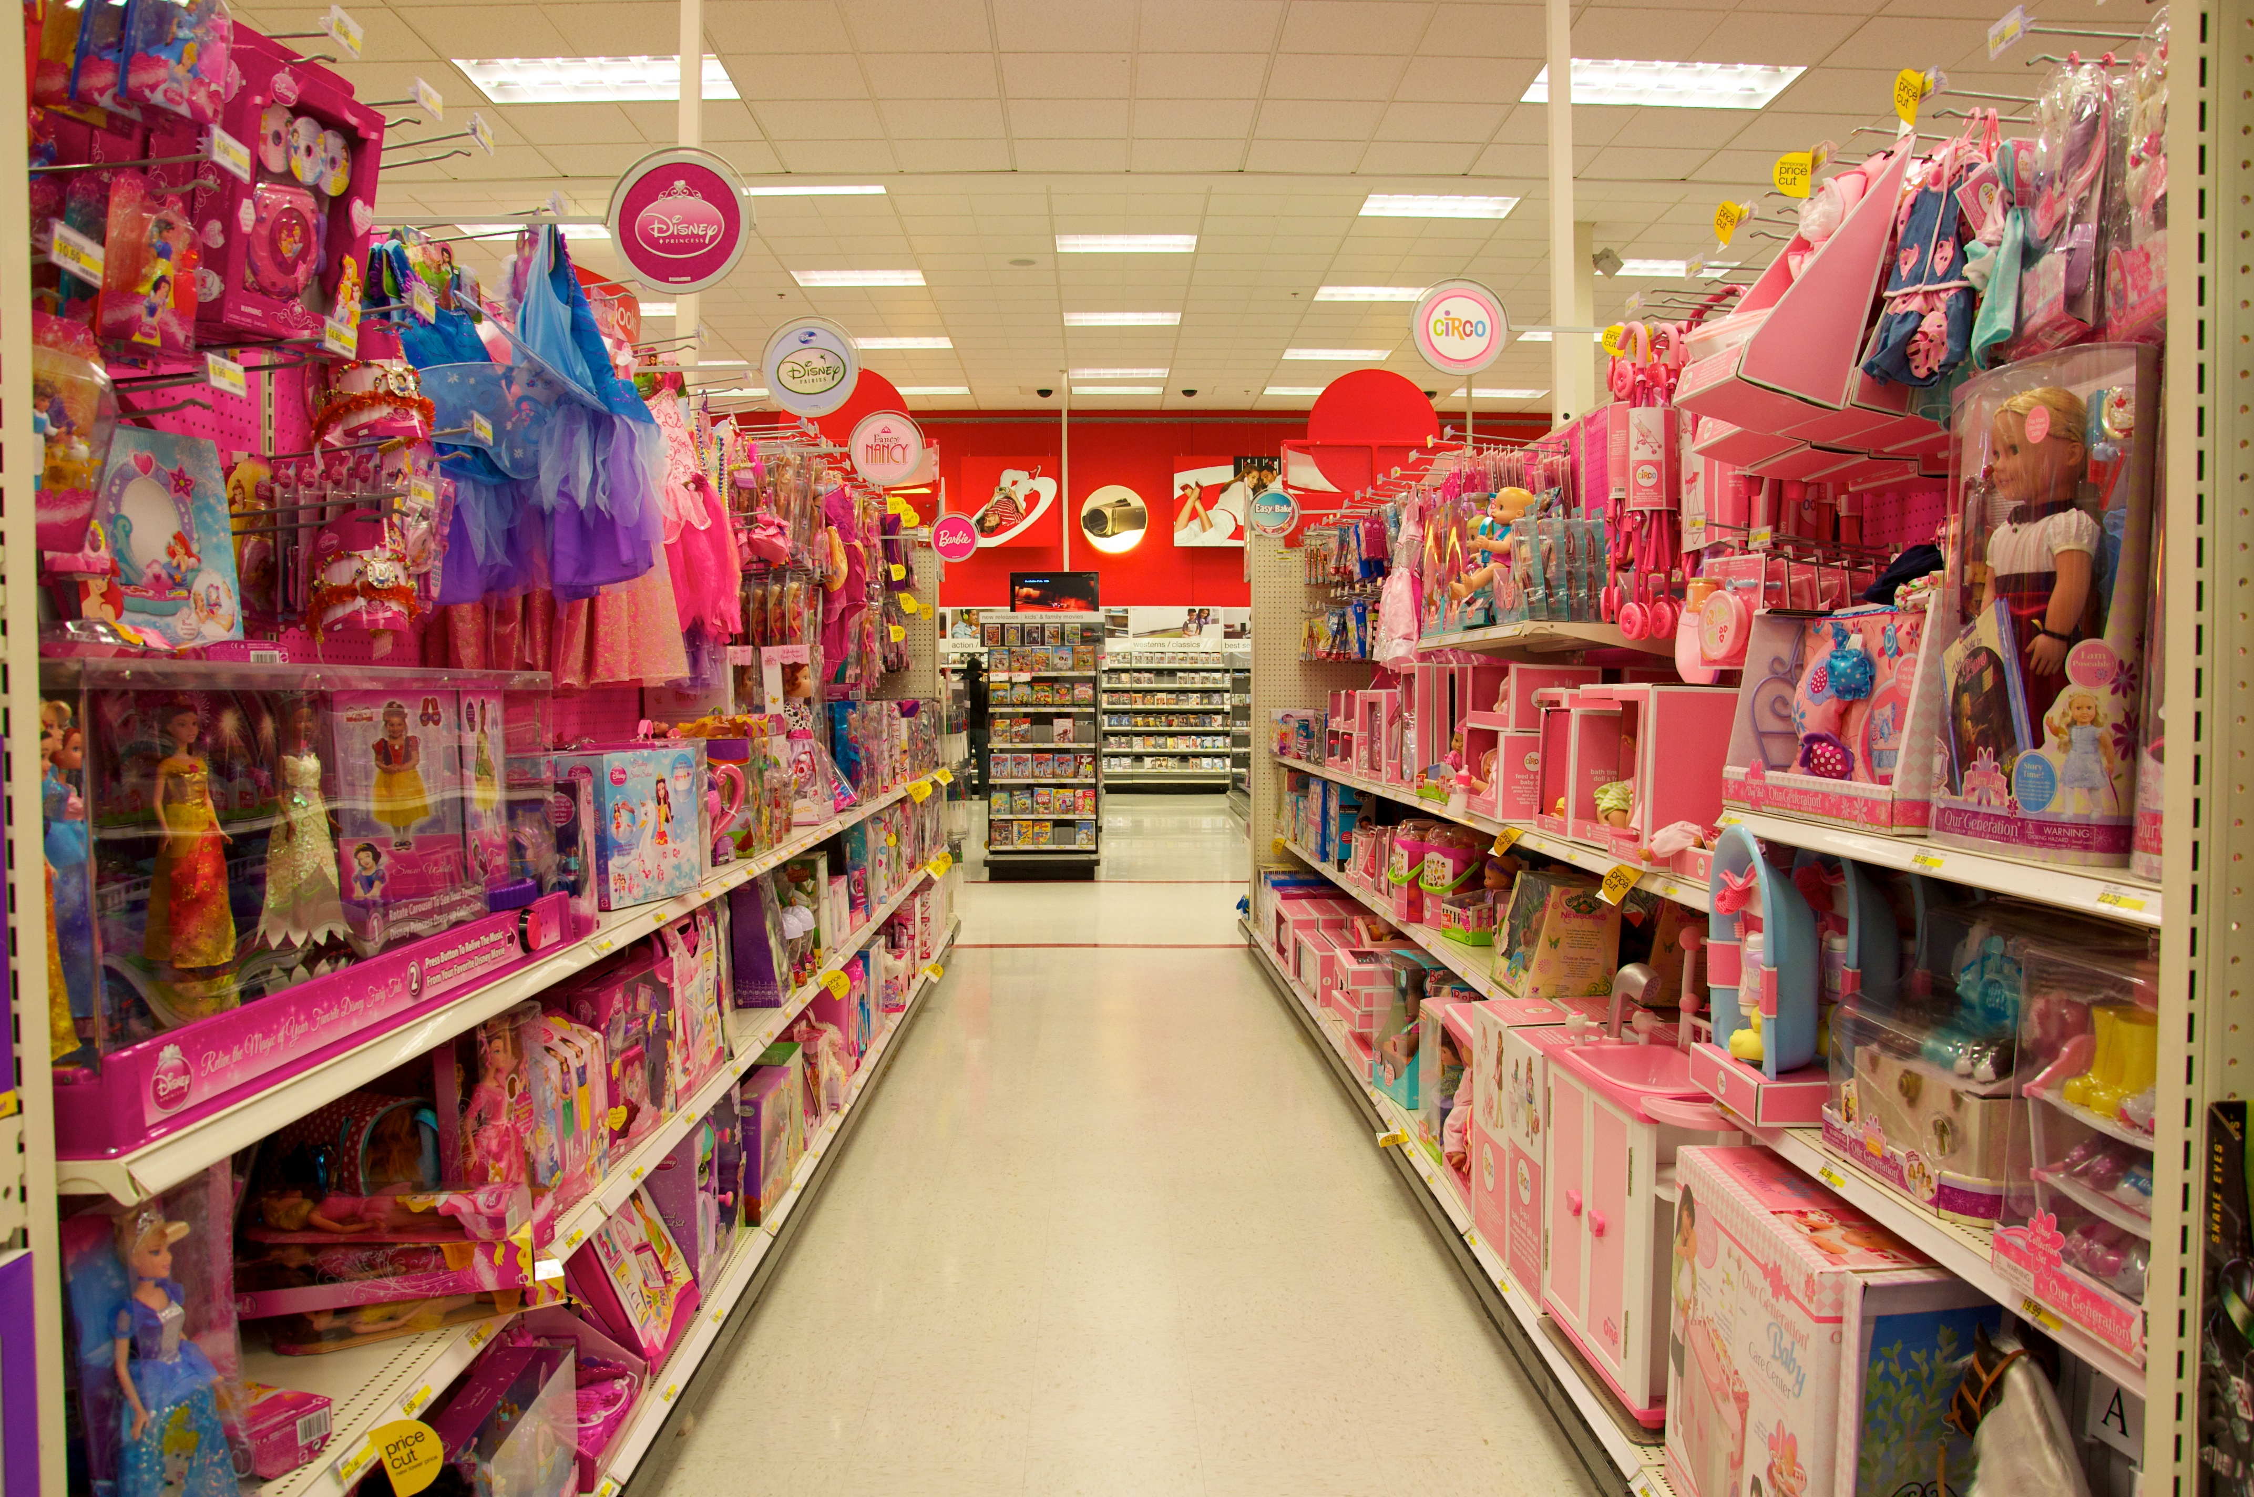
Why the Disparity?
Notes:
Now that we know about some changes that have happened in free software, I'd like to take a step back and talk about why there is a disparity in free software in the first place and why we choose to do something about it.
First the disparity is a result of how we socialize our children. In our culture, it's much more acceptable for boys to tinker with things and to break them, to take risks, and to have solitary hobbies. All of these are necessary when one is learning to code and connecting with an online community. Girls and minorities are simply not encouraged to pursue these types of activities in the same way.
Then, women and minorities who do choose to pursue studies and work in technology are faced with stereotypes or behavior that is not friendly to them. For example, the GitHub survey found that 25% of women respondents encountered language or content that made them feel unwelcome and 12% encountered stereotyping, with both numbers being significantly higher than corresponding numbers for men. While sometimes stereotypes are expressed in a way that is obvious to be completely unacceptable, many are expressed through microagressions, which are seemingly benign comments that in fact make someone feel uncomfortable in their own skin. Something like "for a girl, you are so good in math" is a classic example of a microagression, and it's very common for women and minorities in technology to receive such comments.
And then there is the impostor syndrome, which is internalized stereotypes. It happens when the person has encountered so many stereotypes and has felt so alone in the field, that even though they are sticking around, they believe they might be fraud and they might be called out on it if they ask the wrong question. They don't recognize their accomplishments and their potential, and instead they think that where they got was by chance or by luck, and not because of their hard work.
As a result of stereotypes, unwelcoming behavior, and the impostor syndrome, women and minorities who enter the technology field are less likely to stay in it or to progress as quickly.

Slide 5

Why Reach Out?
Notes:
So now that we know that there is this disparity, what are some of the reasons to change it?
First, it's a matter of fairness and offering opportunities to people who might not otherwise have them. It is very much within the ethos of free software to try to make participation in technology more accessible to everyone.
Second, your project gets more contributors and more perspectives, which in turn can help it reach broader audiences and serve them well.
Third, there is a lot of research that shows that diverse teams are more financially successful and more resilient. The culture of respect and inclusion that is needed to attract and retain people from diverse backgrounds benefits everyone in the community or a company.
Particularly for more information on why diversity is good for business, I recommend resources of the consulting firm "Exponential Talent", which is the firm that Red Hat and Mozilla have worked with on creating their diversity and inclusion strategies.

Slide 6
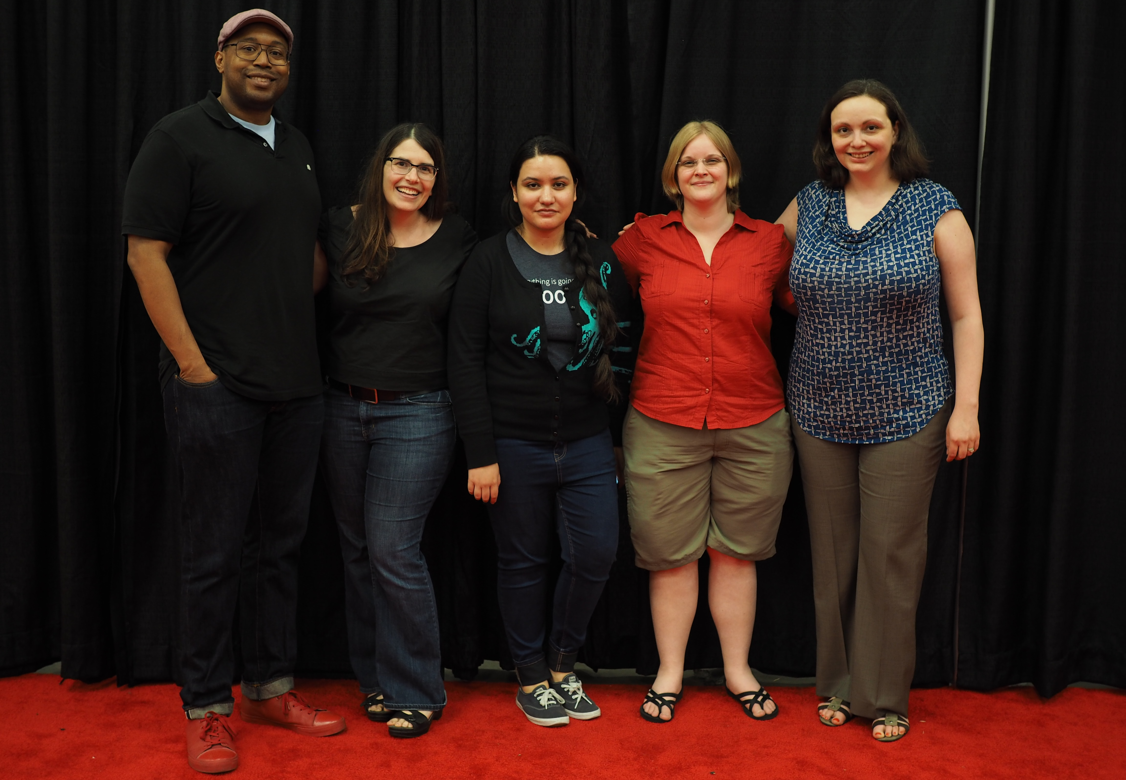
Change Agent: Outreachy
Notes:
Now I would like to highlight some initiatives that have been very effective in increasing diversity and inclusion in free software.
First, very near and dear to my heart, is Outreachy. It is the project of the Software Freedom Conservancy non-profit that connects people from underrepresented backgrounds with mentors in free software for three months remote internships. This is our team of organizers for the program in the picture. The program is currently open to women, trans men, and non-binary people worldwide and additionally to people of color from groups underrepresented in technology in the United States, such as African Americans and Latinos. Free software communities that offer internships in the program include GNOME, Linux kernel, Mozilla, Wikimedia, Free Software Foundation, and GNU Guix.
One of the things that we do to make the program effective is that we take different things that one needs to do to participate in the free software community, from figuring out what is an appropriate first contribution to make, to blogging about your work to make it visible and get feedback, and to going to a conference to meet other project contributors, and we make it a part of the program. For example, applicants are asked to collaborate with identified mentors on their first contribution as part of the application process. They blog about their work and their blogs are aggregated on Planet Outreach, where they can learn about each other's work and which I love to read. All participants get $500 stipend to travel to a relevant conference.
Close to 450 people have taken part in the internships with the program, and many went on to have jobs in free software and to speak on free software topics at conferences. For example, we know of 41 interns who spoke on free software topics at conferences in 2017.
We are still accepting applications with a number of communities through the upcoming Thursday, March 29, so if you or anyone you know meet our demographic criteria and are looking for an internship for this summer, please pick up a flyer from me in the end of the talk or find out more at outreachy.org.

Slide 7
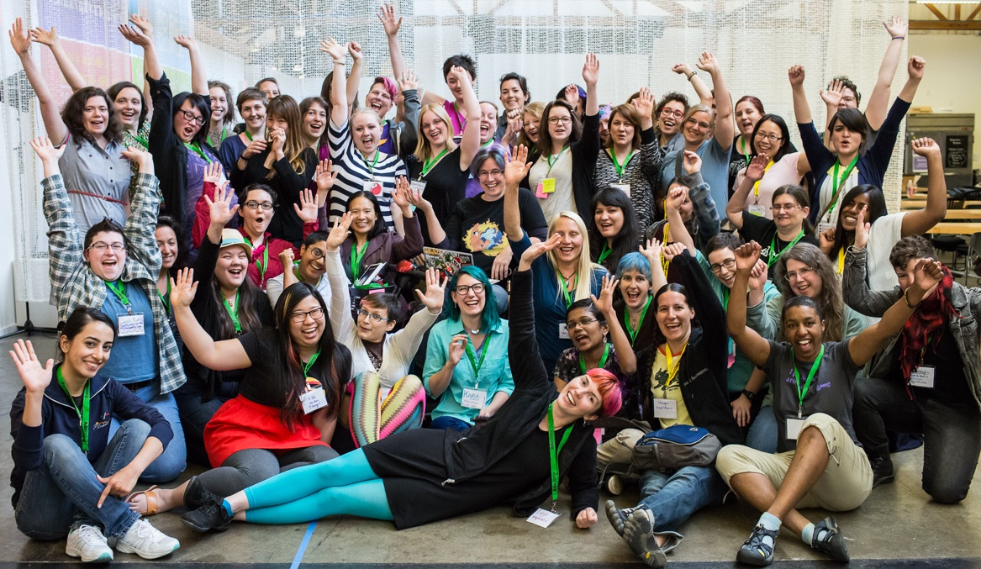
Change Agent: The Ada Initiative
Notes:
The Ada Initiative was an organization that operated between 2011 and 2015 with a mission to support women in open technology and culture. I had the privilege to be on the boards of advisors and directors of the Ada Initiative in the last two years of its operation and have continuously been impressed with the depth of thought of its founders, Valerie Aurora and Mary Gardiner. They have created some foundational resources on diversity and inclusion in free software.
The Ada Initiative ran AdaCamps, which were unconferences that helped many women in open technology and culture meet each other and discuss common issues and solutions. The Ada Initiative published the AdaCamp toolkit that talks about how to run an inclusive conference, from requirements for the nursing mothers' room to offering different food and drink options.
The Ada Initiative also created resources for event codes of conduct and conducted impostor syndrome and allies skills workshops. Materials for these workshops are also published under a Creative Commons license. The impostor syndrome workshop taught attendees to recognize their accomplishments and expertise. The allies skills workshop taught men how to support women by amplifying their voices and speaking up when someone makes a stereotype-driven comment. Valerie Aurora has since expanded the allies skills workshop to cover other dimensions like race, sexuality, disability, and age. I highly recommend taking a look at these resources.

Slide 8
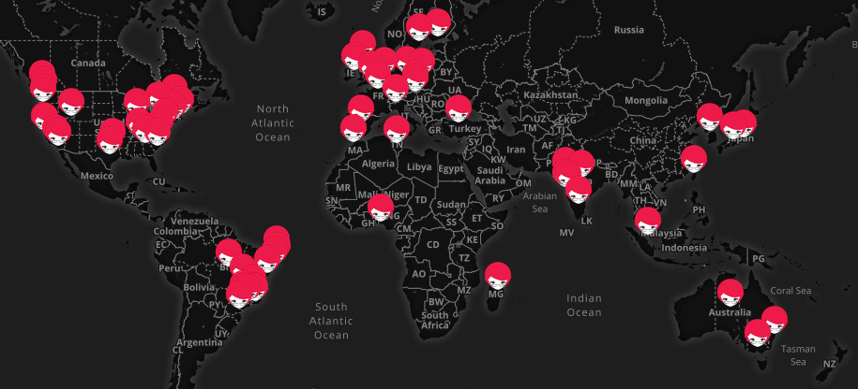
Change Agent: Python Community
Notes:
The Python community deserves a special recognition for comprehensively addressing diversity and inclusion in its community. Through outreach to diverse speakers and an extensive financial aid program, PyCon US went from having 1% women speakers in 2011 to 40% in 2016. Involvement of women in Python is driven by two organizations, PyLadies and Django Girls, which have a curriculum for helping women become Python/Django coders and have meetups and workshops around the world.
In her interview for opensource.com, PyCon Diversity Outreach Chair Jessica McKellar, identified four prerequisites for creating a diverse speaker line-up. First, you need to have an inclusive culture at the conference, making it accessible and safe for people from different backgrounds and financial situations. Having an enforced code of conduct and a robust financial aid program are some of the ways to accomplish it. Second, you need an equitable evaluation process, which starts with making sure that new speakers, who tend to be more diverse too, have the information and the support they need to submit a successful proposal for your conference. Many conferences offer help in creating proposals during designated online office hours to help achieve that goal. Third, do proactive outreach personally inviting many speakers from underrepresented backgrounds and partnering with groups such as PyLadies to encourage people to submit talks. Fourth, repeat year after year, documenting what worked and what didn't, and making sure the program continues even if there is a turn-over in conference staff.
To be able to offer a financial aid program Python conferences typically ask speakers to pay for their travel and ticket, reasoning that many speakers are established contributors whose company can cover these expenses. They ask speakers who can't cover expenses to apply for financial aid. EuroPython documents that they give out financial aid that covers conference passes, accommodations, and/or travel based on contributor/speaker status, financial situation, and diversity considerations. For example, in 2016 large percentages of the grants went to first-time conference attendees, speakers, and students. Enabling people from diverse backgrounds to attend a conference for the first time creates a virtuous cycle because it enables them to get access to the community of contributors and employers, helps them learn about a variety of projects, and also lets them gain an understanding of what might be a good talk for them to submit for a future conference.
Many other communities do similar things with skills-building workshops for people from underrepresented backgrounds and efforts to make their conferences welcoming and diverse. For example, LibrePlanet also had office hours for people writing proposals offered by Deb Nicholson and Vicky Brasseur. It also encouraged attendees to contribute directly to the travel scholarship fund. There are 20 women and non-binary people among the 56 speakers the conference has this year, or 36%. Due to the efforts by the organizers the conference has had such a high ratio relative to other technical conferences for many years now.

Slide 9
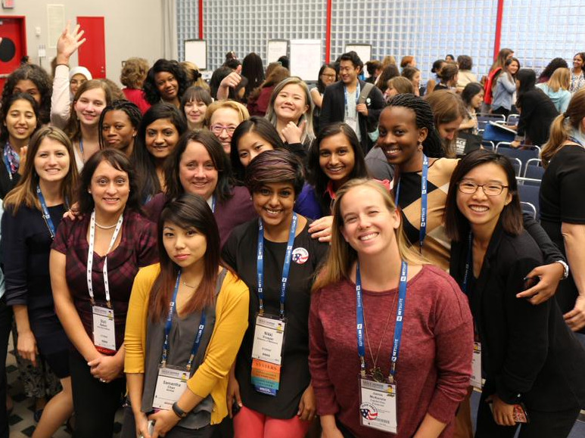
Change Agent: Grace Hopper Celebration
Notes:
Grace Hopper is the world's largest conference for women in technology. Last year’s conference in Orlando had about 18,000 attendees. Many college students and professors attend the conference. Exposure to free software is a big part of the conference program. Last year was the seventh year of the Code-A-Thon for Humanity, in which over 200 participants worked in groups for a full day on different free software projects. It was also the third year the conference had an Open Source track, with a variety of talks and workshops introducing attendees to free software.
Free software participation is still not a part of the standard college computer science curriculum in the United States, which contributes to the disparity even between the already low numbers of women and minorities pursuing computer science degrees and their numbers in free software. So connecting with women and educators at a conference like Grace Hopper plays an important role in getting more of them involved in free software. Two other related initiatives that help educators learn how to teach free software in their classroom are the Software Freedom Conservancy project called Teaching Open Source and POSSE, Professors' Open Source Software Experience.

Slide 10
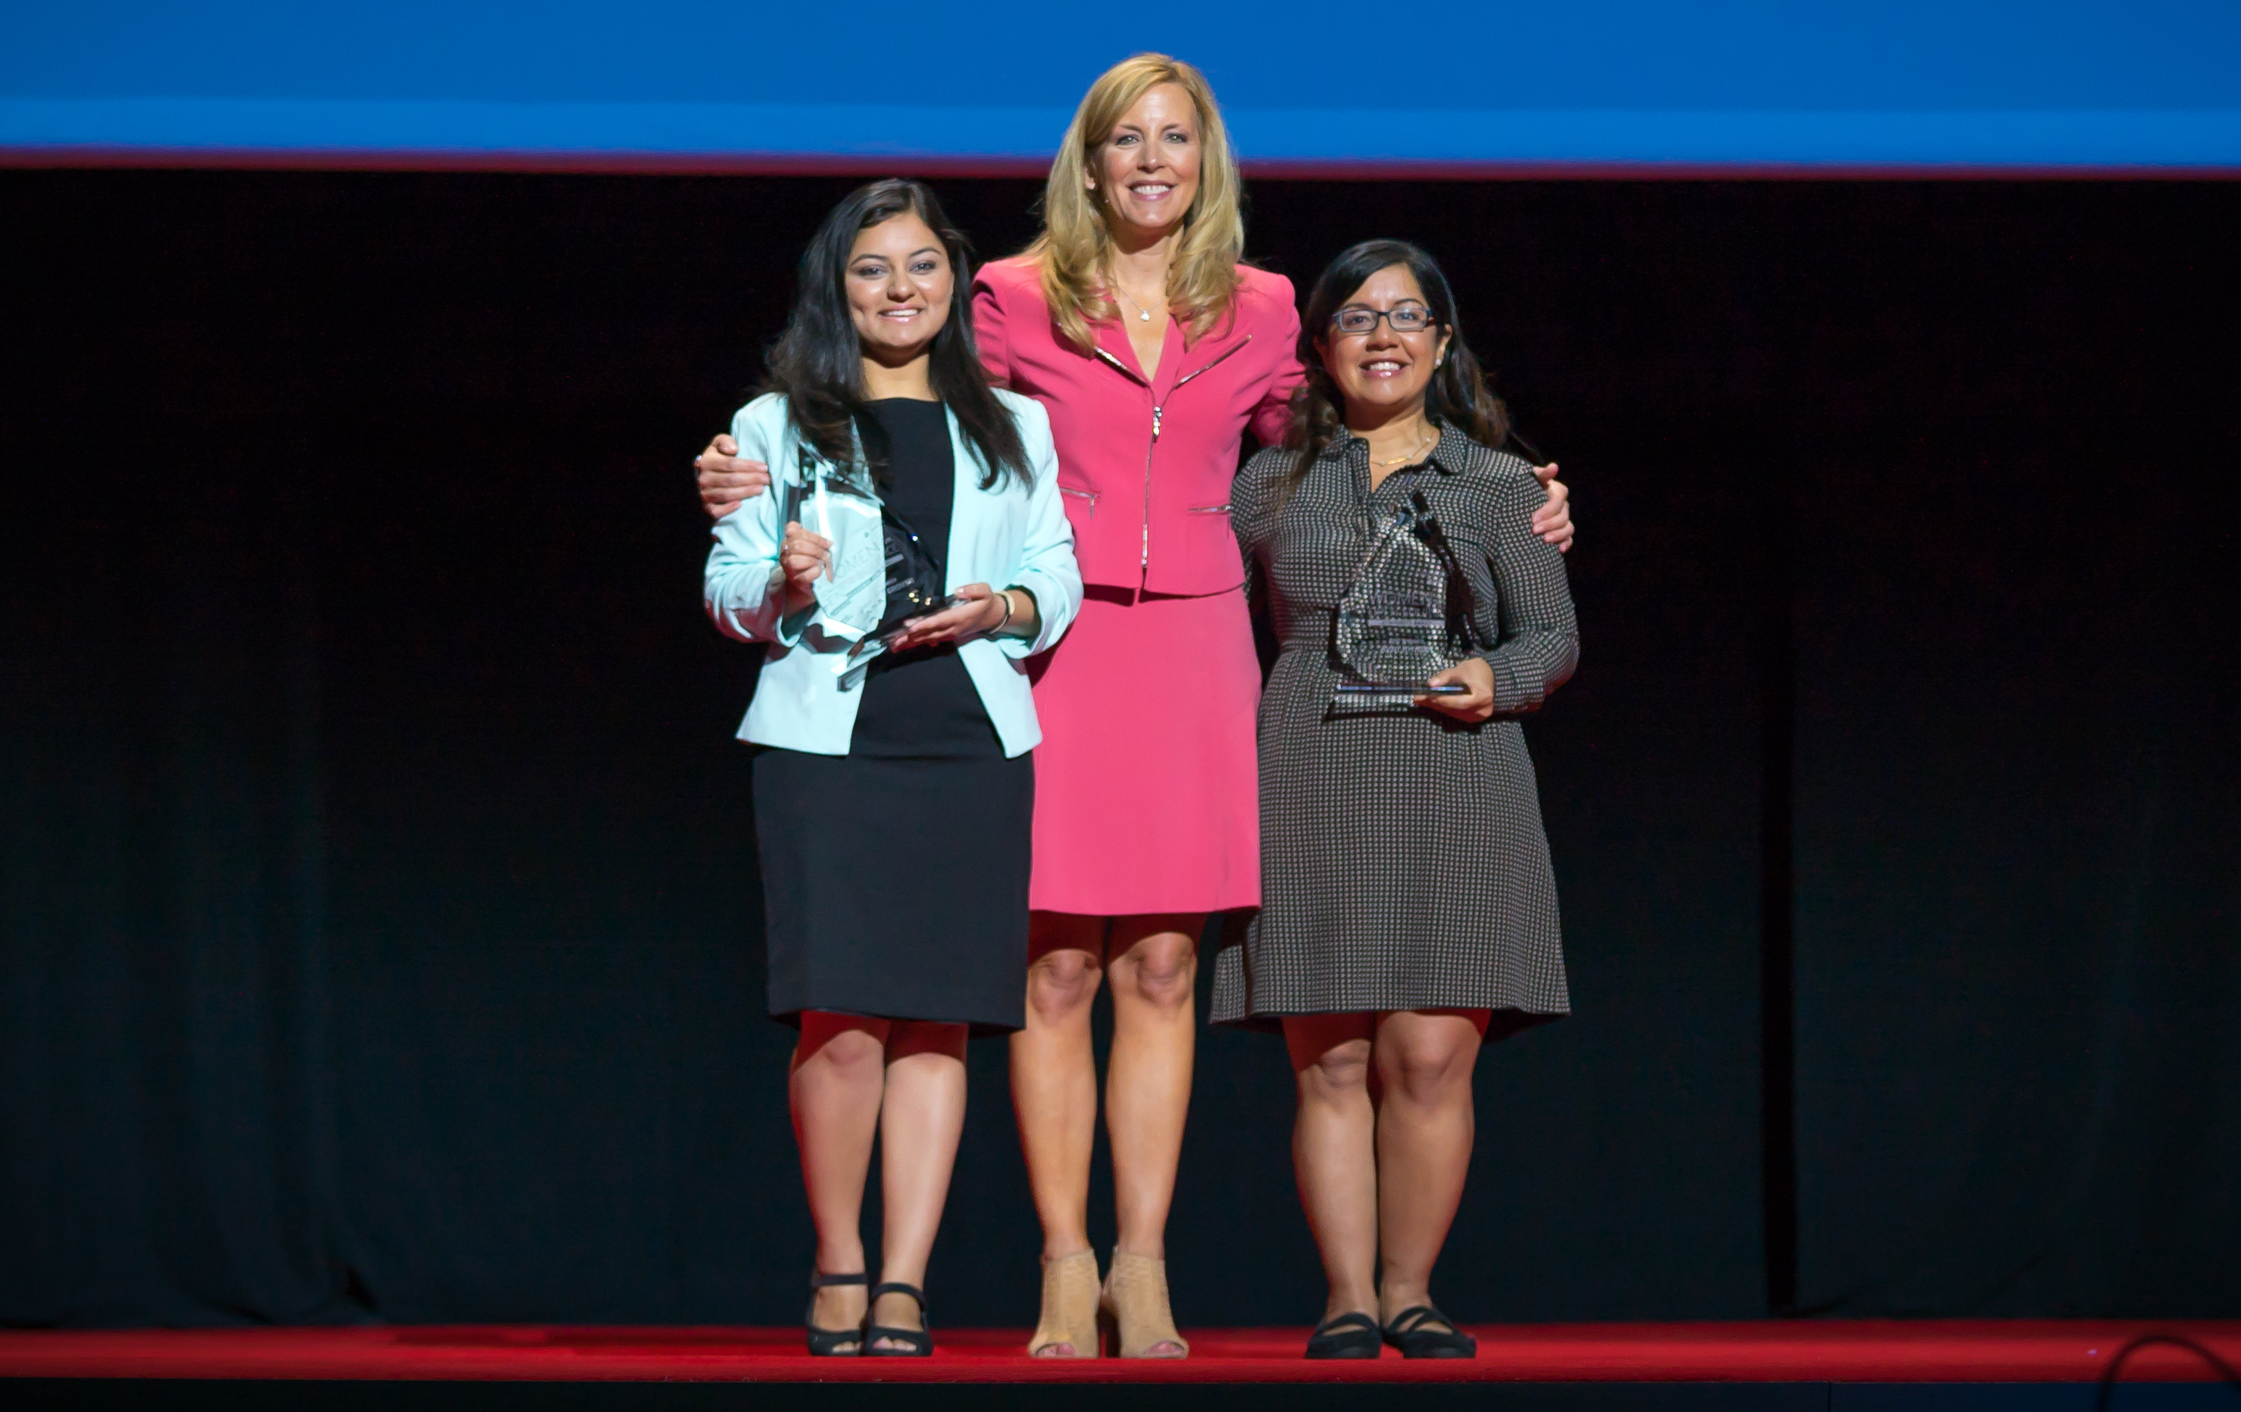
Change Agent: Women in Open Source Award
Notes:
The Women in Open Source Award sponsored by Red Hat helps shine a light on women leaders in the free software community and in academia. In the early days of outreach efforts, it was common to hear that perhaps women are not involved because they are not that interested. Increasing visibility of women who are already involved definitely helps combat that opinion and helps inspire more women to get involved. Each year, Red Hat collects nominations for people in two categories: one for community participants, who are usually professional women, and another one for students. Then a panel of judges, that includes Red Hat's senior leaders, selects five finalists in each category. After that, the free software community votes on the winners.
Last year, the winners were Avni Khatri and Jigyasa Grover. Avni, who lives in the Boston area, was the winner in the community category. She is the President of the non-profit Kids on Computers, which builds computer labs in schools in disadvantaged communities in Mexico, India, and Morocco. Jigyasa was the winner in the student category. She is a developer for the Pharo programming language and IDE. She participated in Google Summer of Code before and mentored last year. She is a director of Women Who Code Delhi and an organizer for Learn IT Girl.
Karen Sandler and Dana Lewis, who are speaking on the panel about freedom in medical devices this afternoon, are both finalists for this year’s award.
Nominations typically open in October, and I’d like to encourage you to nominate yourself or someone you know for the award.

Slide 11
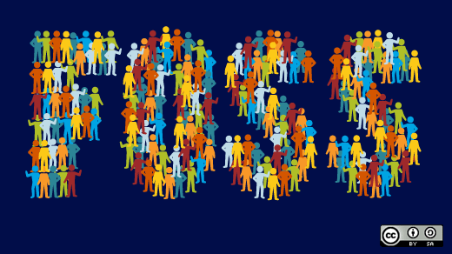
Current Trend: Building Broader Diversity
Notes:
In recent years there have been more efforts to increase diversity of free software beyond the participation of women. There have been sessions on free software and Outreachy has been a non-profit sponsor of the Tapia Celebration of Diversity in Computing conference, which is similar to Grace Hopper, but is focused on diversity more broadly, including racial and ethnic diversity. Just this week, we heard from someone we met at Tapia in 2016 and shared information about Google Summer of Code with, about how they have gone on to do cutting-edge work on the Chapel language through Google Summer of Code, did their first solo research paper, have an opportunity to join a national lab to use their expertise in Chapel, and confirmed their interest in pursuing a PhD. They have been accepted to University of Rochester. Reaching out to diverse communities, at events such as Tapia, is very important for creating such connections.
Also, last year, there was the first summit of black free software contributors called SourceRoad. Another group, Women in Linux, has an intersectional approach to diversity, with majority of speakers at its virtual summits being people of color. Hypatia Software Organization supports trans people interested in developing technical skills by contributing to free software. Lisa Marie Maginnis, whom some of you might know, is the president of that organization.
Two great conferences, AlterConf and Open Source & Feelings, have had speakers from diverse backgrounds who talk about their experiences with free software and community. Videos of talks from these conferences are posted online. AlterConf has had 28 events in various cities between 2014 and 2017, when it ended its series.

Slide 12
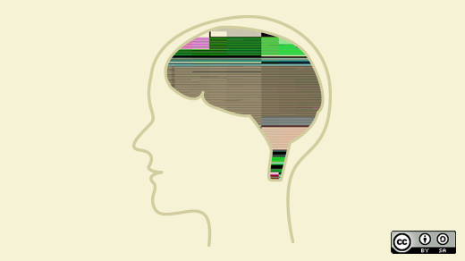
Current Trend: Diversity and Inclusion Experts
Notes:
There is also now a number of people who make their living working on diversity and inclusion in free software. I’m fortunate to have a position like this at Red Hat.
There are also several people at Mozilla and one of them, Emma Irwin, shares a lot about findings from their research and best practices they established in her blog. Emma has also started a monthly call about diversity and inclusion in free software to enable better collaboration between communities. Joining this call is the best way to stay up-to-date about and participate in diversity and inclusion work in free software. Some examples of findings that Emma shared are the importance of identity groups that help people from underrepresented backgrounds connect with each other and the need for leadership positions to have a certain term to make sure people from underrepresented groups have access to leadership positions.
There are also consultants like Sage Sharp who does contract work for Outreachy, Valerie Aurora, Ashe Dryden, and Audrey Eschright. All of them have experience with diversity and inclusion in the free software community and frequently write and speak on the topic.

Slide 13
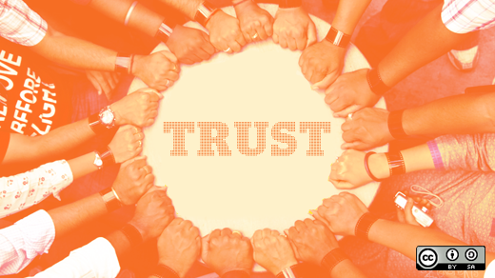
Current Trend: Code of Conduct Enforcement
Notes:
A topic that has recently had a lot of attention is that a code of conduct is only as good as its enforcement. Communities and events need a consistent and documented process for handling code of conduct issues. They need this both as a preparedness measure and to have the trust of the participants that any issues that arise will be handled.
One of the findings of a recent Mozilla survey of free software contributors from all communities was that only 41% of them believed that the code of conduct their community had was effectively enforced. The same survey found that 45.5% of non-male contributors said that they had experienced sexism and 9.6% of contributors said that they had experienced racism. With inappropriate behavior as widespread as Mozilla and GitHub surveys suggest, trusting that code of conduct incidents will be handled effectively is an important factor for someone’s decision to participate in a community.
Emma Irwin from Mozilla has recently published a lot of great resources on enforcement process for the Mozilla’s Community Participation Guidelines, which is how they call their code of conduct. It includes all the steps they take from triage to resolution. Code of conduct enforcement is done with the community health as the goal. For example, in Mozilla’s process, the person resolving the incident needs to help the subject of the report understand the impact their behavior had, or how it was perceived, and how to avoid this type of a problem in the future.
.Audrey Eschright has great resource for code of conduct accountability on the Safety First PDX website she maintains. Sage Sharp also recently wrote a great article about the types of language and situations that are a cause for concern when you consider if a community or event has a code of conduct they enforce. Both Audrey and Sage offer training for handling code of conduct incidents to communities. For example, Sage has done such training for the LibrePlanet staff ahead of the conference last year.
Statistics from the video and slides from the February 28 community call: http://tiny.cc/communitycall ; link to slides in Etherpad: https://docs.google.com/presentation/d/13UxBGj2lI66SLjl6sp4NE3DH2ndT0k5QM0pPyyzZXuY/edit#slide=id.g3240500814_0_0

Slide 14
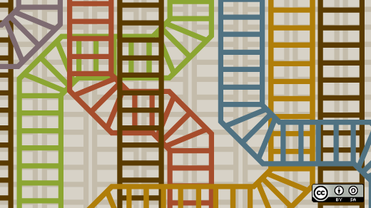
Diversity in Free Software: Our Journey Continues
Notes:
So as you see, there are many distributed initiatives, that also complement each other and share information openly. Most importantly, there is an increased understanding that diversity and inclusion is not a one and done kind of effort, but something that needs to fully permeate our community and company culture. In the same way as we embed free software in our devices, we need to build in diversity and inclusion in our projects by design. Also, it’s up to each one of us to make sure we reach out to people who are unlike us and make them feel welcome in the free software world.

Slide 15

Resources
http://tiny.cc/opensourcestats
http://tiny.cc/breakingunicornlaw
http://exponentialtalent.com
http://tiny.cc/adainitiativeimpact
http://tiny.cc/jessicamckellarinterview
http://teachingopensource.org
http://osfeels.com
http://alterconf.com
http://medium.com/@sunnydeveloper
http://tiny.cc/communitycall
http://otter.technology
http://frameshiftconsulting.com
http://ashedryden.com
http://lifeofaudrey.com
Follow @outreachy on Twitter!
Notes:
Here are some of the resources that I have mentioned throughout the talk. In particular, I’d like to encourage you to follow Outreachy on Twitter where we often share information about the work being done to promote diversity in free software and opportunities for both aspiring and established contributors to participate.

Slide 16

Image Credits and Slides License
Alone, 3D, Aluminium, Rise, Ball – CC0 realworkhard on Pixabay
Linux kernel women authors graphic – CC BY-SA Daniel Izquierdo Cortázar, Bitergia
Broken Unicorn – Standard License by Darla on GL Stock Images
The Girl Aisle - CC BY-NC joshpuetz on Flickr
Joyful Girls – CC BY-NC charamelody on Flickr
Outreachy coordinators – CC BY-SA Marina Zhurakhinskaya
AdaCamp Portland – CC BY-SA Jenna Saint Martin Photo from http://adainitiative.org/blog
PyLadies map – CC BY-SA Marina Zhurakhinskaya based on the map at http://www.pyladies.com/locations
GHC Open Source Day - http://ghc.anitaborg.org/2016-attend/conference-overview/open-source-day
Jigyasa Grover, DeLisa Alexander, Avni Khatri - Camp Suntichotinun
FOSS, Expert, Trust, Tracks images – CC BY-SA opensourceway on Flickr
Agapanthus – CC0 Bluesnap on Pixabay
Cupcakes – Leah Silber
These slides are available under CC BY-SA 3.0 (except for the Broken Unicorn image available for purchase on GL Stock Images)
Notes:
This slide has image credits and the license information for this presentation.

