Slide 1
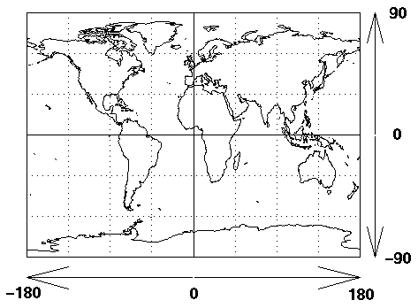
extract_ocean_data
distill_ocean_data
export_ocean_data
Spatial extent
Spatial points
(74,76, -2, 6)
Coords.xlsx
map_ocean_data
site | longitude | latitude
Site 1 | 74.2345 | -1.2234
Site 2 | 79.5432 | 0.7831
Site 3 | 76.1524 | 2.7831
output
.RDS file
output
.RDS file
animate_ocean_data
Interactive _ocean_data

