Slide 1



What can we learn from natural and artificial dependency trees ?
Chunxiao Yan, Modyco (CNRS) - Université Paris Nanterre
Marine Courtin, LPP (CNRS) - Paris 3 Sorbonne Nouvelle

Slide 2
TL;DR
Introduce several procedures for generating random syntactic dependency trees with constraints
Create artificial treebanks based on real treebanks
Compare the properties of theses trees (real / random-ish)
Try to find out how these properties interact, if the relationship between them is formally constrained and/or linguistically motivated.

Slide 3
What do we have to gain from comparing natural and random trees ?

Slide 4
Why ?
Natural syntactic trees are nice but :
  Very complex
  It’s hard to understand how some property influences other properties
  They mix formal and linguistic relationship between properties
+ we want to find out why some trees are linguistically implausible ? i.e what makes these trees special compared to random ones

Slide 5
Why random trees ?
Natural Languages have special syntactic properties
We can observe these properties by looking at natural (linguistic) trees
Some of the properties we observe might be artefacts : not properties of natural langages but properties of trees themselves (mathematical object)
  → By also looking at artificial trees we can distinguish between the two

Slide 6
Data
Based on Universal Dependencies (UD) treebanks (version 2.3, Nivre et al. 2018) for 4 languages: Chinese, English, French and Japanese.

Slide 7
Features
Feature name
Length
Height
Maximum arity
Mean dependency distance (MDD)
Mean flux weight (MFW)
                Add a tree and draw the features on it.
→ all related to syntactic complexity

Slide 8
Local configurations
25 possible trigram configurations.
Projective configurations like: a -> b -> c, (a -> b) & (a -> c),(a -> c) and (b <- c)
Non-projective cases like: a <- c and b -> c
To generalize we group these configurations into 4 types

Slide 9
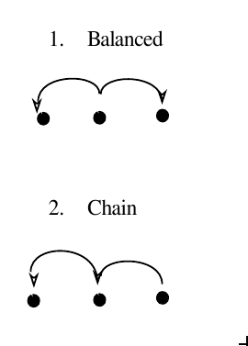
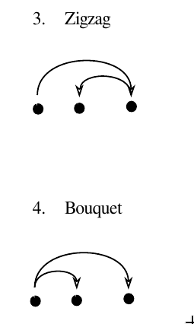
Typology of local configurations
balanced
bouquet
a ← b → c
a→ b →c
zigzag
chain
Introduces height in both
directions
Introduces height in one direction

Slide 10
Hypotheses ?
Tree length is positively correlated with other properties. As the number of nodes increases, the number of possible trees increases including more complex trees with longer dependencies (which would increase MDD) and more nestedness (which would result in a higher mean flux weight)
particularly interested in the relationship between mean dependency distance and mean flux weight. An increase in nestedness is likely to result in more descendents being placed between a governor and its direct dependents, which would mean an overall increase in mean dependency distance.

Slide 11
Generating random-ish trees

Slide 12
Generating random trees
We test 3 possibilities :
  Original tree, random linearisation
  Original tree, « optimal » linearisation
  Random tree, random linearisation
  → We expect that natural trees will be the furthest away from random random and somewhere between original random and original optimized

Slide 13
Original random

Slide 14
Original optimal

Slide 15
Random random

Slide 16
Generating random trees
Why this particular algo ?
  Separates generation of the unordered structure and of the linearisation which allows us to change only of the two steps.
  Easily extensible, we can add constraints :
    Set a parameter for the probability of a head-final edge
    Set a limit on lenth, height, maximum arity for a node..
    Set a limit on flux weight (can we actually do this?)

Slide 17
Results on correlations
Non surprising results :
  length/height : strong in both artificial and real → formal relationship, slightly intensified in non-artificial trees
    →(Zhang and Liu, 2018) found that the relation can be described as a powerlaw function in English and Chinese ; interesting to look if the same thing can be found in artificial trees)
  MDD/MFW, stronger in artificial than real (why?)
Weird/cool results :
  MDD/height is stronger in artificial treebanks than in real ones. Why ?

Slide 18
Distribution of the configurations
Non-linearized
  Random : b ←a → c (45%), a → b → (55%)
  Non-random : b ← a → c much more frequent, most extreme is the optimized (80-20), then original and original-random (60-40)
  Why ?
    b ← a → c is favoured because it contains the « balanced » configuration, i.e the optimal one for limiting dependency distance while preserving projectivity
    a → b → c is disfavoured because it introduces too much height

Slide 20
Limitations
We only generated projective trees
We looked at local configurations instead of all subtrees

Slide 21
Future work
Study the effects of the annotation scheme
What can we find out if we do the same thing using a schema with functional heads ?
Build a model to predict features of the tree
  Which features can we predict from which combination of features ?
  Are natural trees more predictible ? (They represent a smaller subset, so they should?)

