Slide 1




What can we learn from natural and artificial dependency trees ?
Marine Courtin, LPP (CNRS) - Paris 3 Sorbonne Nouvelle
Chunxiao Yan, Modyco (CNRS) - Université Paris Nanterre

Slide 2
Summary
Introduce several procedures for generating random syntactic dependency trees with constraints
Create artificial treebanks based on real treebanks
Compare the properties of theses trees (real / random)
Try to find out how these properties interact and to what extent the relationship between them is formally constrained and/or linguistically motivated.

Slide 3
What do we have to gain from comparing natural and random trees ?

Slide 4
Motivations
Natural syntactic trees are nice but :
  Very complex
  It’s hard to understand how some property influences other properties
  They mix formal and linguistic relationship between properties
We want to find out why some trees are linguistically implausible ? i.e what makes these trees special compared to random ones

Slide 5
Motivations
Natural languages have special syntactic properties and constraints that imposes limit on their variation.
We can observe these properties by looking at natural syntactic trees.
Some of the properties we observe might be artefacts : not properties of natural langages but properties of trees themselves (mathematical object).
  → By also looking at artificial trees we can distinguish between the two

Slide 6
Methods and data preparation

Slide 7
Data
Corpus : Universal Dependencies (UD) treebanks (version 2.3, Nivre et al. 2018) for 4 languages: Chinese, English, French and Japanese.
We removed punctuation links.
For every original tree we create 3 alternative trees.

Slide 8
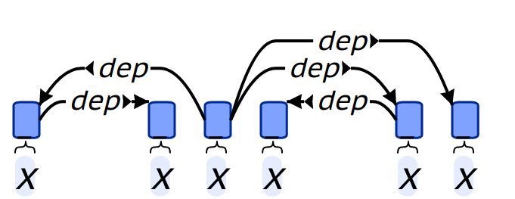
Features
Feature name | Value
Length | 6
Height | 3
Maximum arity | 3
Mean dependency distance (MDD) | (2+1+1+2+3)/5=1.8
Mean flux weight (MFW) | (1+1+1+2+1)/1.2
→ all related to syntactic complexity

Slide 9
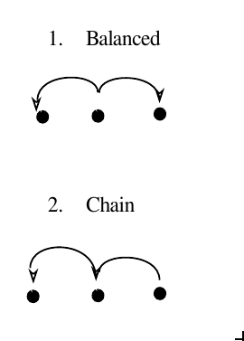
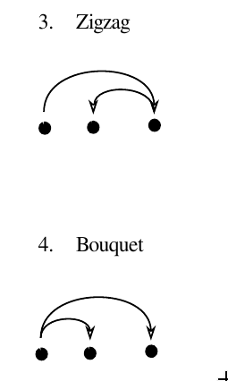
Typology of local configurations
25 possible trigram configurations : grouped into 4 types.
balanced
bouquet
a ← b → c
a→ b →c
zigzag
chain
Introduces height in both
directions
Introduces height in one direction

Slide 10
Hypotheses ?
Tree length is positively correlated with other properties.
Particularly interested in the relationship between mean dependency distance and mean flux weight.
  As tree length increases ⇒ the number of possible trees increases ⇒ more complex trees with longer dependencies (higher MDD) and more nestedness (higher mean flux weight)
  An increase in nestedness ⇒ more descendents between a governor and its direct dependents ⇒ increase in mean dependency distance.

Slide 11
Generating random trees

Slide 12
Generating random trees
We test 3 possibilities :
  Original-random : original tree, random linearisation
  Original-optimized : original tree, « optimal » linearisation
  Random-random : random tree, random linearisation
One more constraint : we only generate projective trees.
→ We expect that natural trees will be the furthest away from random-random and somewhere between original-random and original-optimized.
random-random
original-random
original
original-optimized

Slide 13
Random tree
1.
2.
3.

Slide 14
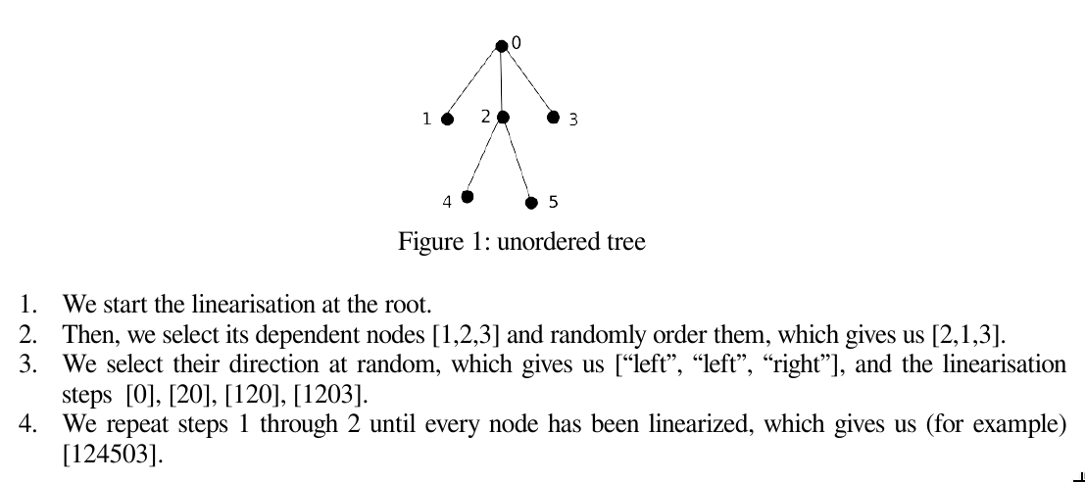
Random projective linearisation
1. Start at the root
2. Randomly order direct dependents → [2,1,3]
3. Select a random direction for each → [« left », « left », « right »] → [1203]
4. Repeat steps 2-3 until you have a full linearization → [124503]

Slide 15

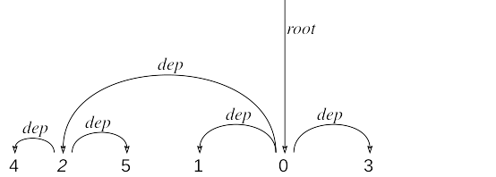
Optimal linearisation
1. Start at the root
2. Order direct dependents by their decreasing number of descendant nodes → [1,3,2]
3. Linearize by alternating directions (eg. left, right, left) → [2103]
4. Repeat until all nodes are linearized → [425103]

Slide 16
Generating random trees
Why this particular algo ?
  Separates generation of the unordered structure and of the linearisation → this allows us to change only of the two steps.
  Easily extensible, we have the possibility to add constraints :
    Set a parameter for the probability of a head-final edge
    Set a limit on lenth, height, maximum arity for a node..
    Set a limit on flux weight (can we actually do this?)

Slide 17
Results

Slide 18
Results on correlations
Non surprising results :
  length/height :
    strong in both artificial and real → formal relationship, slightly intensified in non-artificial trees
    Zhang and Liu (2018) : the relation can be described as a powerlaw function in English and Chinese ; interesting to look if the same thing can be found in artificial trees
  MDD/MFW :
    Strong in both real and artificial treebanks.
Interesting results :
  MDD/height is stronger in artificial than real treebanks.
  MDD/MFW is stronger in artificial than real treebanks.

Slide 19
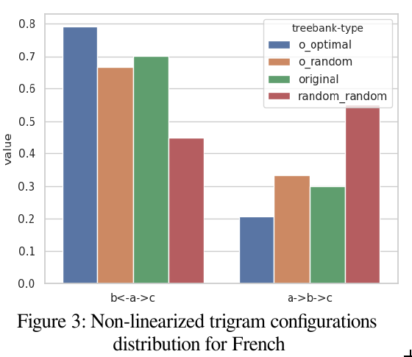
Distribution of configurations
Non-linearized case :
Potential explanations for the original distribution ?
    b←a→c is favoured because it contains the « balanced » configuration, i.e the optimal one for limiting dependency distance.
    a→b→c is disfavoured because it introduces too much height.

Slide 20
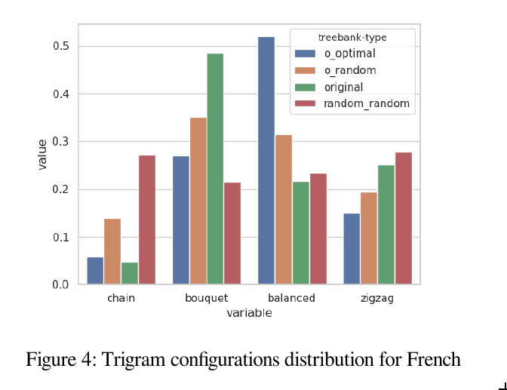
Distribution of configurations
Random random :
  slight preference for “chain” and “zigzag” : this is probably a by-product of the preference for b←a→c configurations rather than a → b → c.
  inside each group (“chain” and “zigzag” / “bouquet” and “balanced”) the distribution is equally divided.
Original optimal :
  very marked preference for “balanced”.

Slide 21
Distribution of configurations
Original trees :
  Contrary to the potential explanation we advanced for the high frequency of b←a→c configurations, “balanced” configurations are not particularly frequent in the original trees.
  The bouquet configuration is the most frequent, and it is much more frequent in the original trees than in the artificial ones.

Slide 22
Limitations
We only generated projective trees.
We looked at local configurations instead of all subtrees.
Linear correlation may not be the most interesting observation :
  The relationship between properties of the tree is probably not linear
  We can directly look at the properties themselves and compare groups to see where original trees fit compared to all random groups.

Slide 23
Future work
Compare directly the properties of the trees from the different groups. Which groups are more distant / similar ?
Build a model to predict features of the tree
  Which features can we predict from which combinations of features ?
  Are natural trees more predictible ? They represent a smaller subset, so they should (?)
Study the effects of the annotation scheme
  How will our results be affected if we repeat the same process using an annotation scheme with functional heads ?

