Slide 2
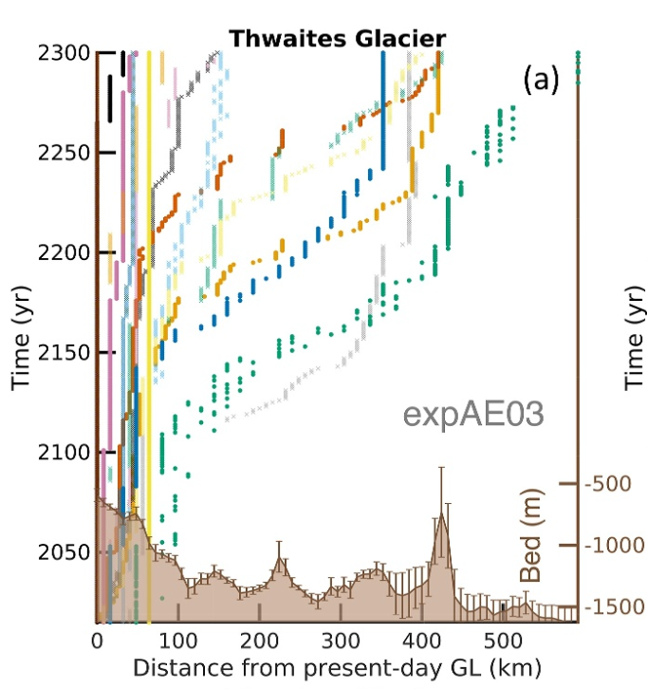
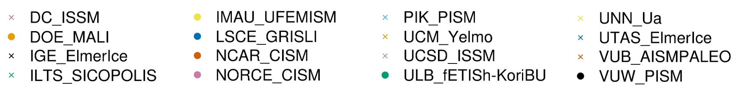
Modified figure from Seroussi 2024, evolution of the relative distance of the grounding line over the time

