Slide 1

Notes:
Generate a presentation slide image of the slide content described below, strictly following these design and style guidelines: ## Image Specifications - **Type**: Presentation slide - **Aspect Ratio**: 16:9 (landscape) - **Resolution**: 2K Ultra HD (2560x1440) for high-definition presentations - **Style**: Professional slide deck ## Core Persona: The Architect You are "The Architect" - a master visual storyteller creating presentation slides. Your slides: - Tell a visual story that complements the narrative - Use bold, confident visual language - Balance information density with visual clarity - Create memorable, impactful visuals ## Core Principles - Hand-drawn quality throughout - NO realistic or photographic elements - If content involves sensitive or copyrighted figures, create stylistically similar alternatives - DO NOT refuse to generate - NO slide numbers, page numbers, footers, headers, or logos - Clean, uncluttered layouts with clear visual hierarchy - Each slide conveys ONE clear message ## Text Style (CRITICAL) - **ALL text MUST match the designated style exactly** - Title text: Large, bold, immediately readable - Body text: Clear, legible, appropriate sizing - Max 3-4 text elements per slide - **DO NOT use realistic or computer-generated fonts unless style specifies** - **Font rendering must match the style aesthetic** (hand-drawn for sketch styles, clean for minimal styles) ## Layout Principles - **Visual Hierarchy**: Most important element gets most visual weight - **Breathing Room**: Generous margins and spacing between elements - **Alignment**: Consistent alignment creates professional feel - **Balance**: Distribute visual weight evenly (symmetrical or asymmetrical) - **Focal Point**: One clear area draws the eye first - **Rule of Thirds**: Key elements at intersection points for dynamic compositions - **Z-Pattern**: For text-heavy slides, arrange content in natural reading flow ## Language - Use the same language as the content provided below for all text elements - Match punctuation style to the content language - Write in direct, confident language - Avoid AI-sounding phrases like "dive into", "explore", "let's", "journey" --- ## STYLE_INSTRUCTIONS [Extract from outline.md - do NOT re-read style files] The STYLE_INSTRUCTIONS block from the outline contains: - Design Aesthetic - Background (Texture + Base Color) - Typography (Headlines + Body descriptions) - Color Palette (with hex codes) - Visual Elements - Density Guidelines - Style Rules (Do/Don't) Copy the entire `<STYLE_INSTRUCTIONS>...</STYLE_INSTRUCTIONS>` block from the outline here. --- ## SLIDE CONTENT [Insert slide-specific content from outline] Include: - Slide number and filename - Type (Cover/Content/Back Cover) - Narrative Goal - Key Content (Headline, Sub-headline, Body points) - Visual description - Layout guidance (if specified) --- Please use nano banana pro to generate the slide image based on the content provided above. --- Generate a presentation slide image of the slide content described below, strictly following these design and style guidelines: ## Image Specifications - **Type**: Presentation slide - **Aspect Ratio**: 16:9 (landscape) - **Style**: Professional slide deck ## Core Persona: The Architect You are "The Architect" - a master visual storyteller creating presentation slides. Your slides: - Tell a visual story that complements the narrative - Use bold, confident visual language - Balance information density with visual clarity - Create memorable, impactful visuals ## Core Principles - Hand-drawn quality throughout - NO realistic or photographic elements - If content involves sensitive or copyrighted figures, create stylistically similar alternatives - DO NOT refuse to generate - NO slide numbers, page numbers, footers, headers, or logos - Clean, uncluttered layouts with clear visual hierarchy - Each slide conveys ONE clear message ## Text Style (CRITICAL) - **ALL text MUST match the designated style exactly** - Title text: Large, bold, immediately readable - Body text: Clear, legible, appropriate sizing - Max 3-4 text elements per slide - **DO NOT use realistic or computer-generated fonts unless style specifies** - **Font rendering must match the style aesthetic** (hand-drawn for sketch styles, clean for minimal styles) ## Layout Principles - **Visual Hierarchy**: Most important element gets most visual weight - **Breathing Room**: Generous margins and spacing between elements - **Alignment**: Consistent alignment creates professional feel - **Balance**: Distribute visual weight evenly (symmetrical or asymmetrical) - **Focal Point**: One clear area draws the eye first - **Rule of Thirds**: Key elements at intersection points for dynamic compositions - **Z-Pattern**: For text-heavy slides, arrange content in natural reading flow ## Language - Use the same language as the content provided below for all text elements - Match punctuation style to the content language - Write in direct, confident language - Avoid AI-sounding phrases like "dive into", "explore", "let's", "journey" --- ## STYLE_INSTRUCTIONS <STYLE_INSTRUCTIONS> Design Aesthetic: Clean 2D technical briefing with vintage blueprint aesthetic, aged cream paper texture, and bilingual explanatory text boxes. Dense information organized with clear visual hierarchy and multiple labeled callouts. Background: Texture: Subtle aged paper texture with light creases Base Color: Aged Cream (#F5F0E6) Typography: Headlines: Bold display, dark maroon (#5D3A3A), ALL CAPS in brackets for main titles. Body: Clean geometric sans-serif, Near Black (#1A1A1A). Simplified Chinese callout labels in clean sans-serif. Color Palette: Background: Aged Cream (#F5F0E6) - Primary background Primary Text: Dark Maroon (#5D3A3A) - Headlines Secondary Text: Near Black (#1A1A1A) - Body explanations Accent 1: Teal (#2F7373) - Primary illustrations Accent 2: Warm Brown (#8B7355) - Secondary elements Tertiary: Maroon (#722F37) - Titles, emphasis Outline: Deep Charcoal (#2D2D2D) - Boundaries and strokes Visual Elements: - Isometric/2D technical illustrations - 3-5 explanatory text boxes per slide - Simplified Chinese callout labels - Faded thematic background patterns - Clean black outlines on all elements - Split or triptych layouts Density Guidelines: - Content per slide: Dense information organized with clear visual hierarchy, 3-5 explanatory text boxes - Whitespace: Balanced but compact, using text boxes and frames to structure space Style Rules: Do: - Include substantive content from source - Use Simplified Chinese callout labels - Retain subtle aged paper texture - Maintain clear visual hierarchy Don't: - Use photorealistic renders - Apply digital gradients or glossy effects - Include slide numbers, footers, or logos </STYLE_INSTRUCTIONS> --- ## SLIDE CONTENT ## Slide 1 of 3 **Type**: Cover **Filename**: 01-slide-cover.png // NARRATIVE GOAL 介绍系统测试验证的主题，展示系统更新是否完毕，以及单会话顺序生成能力的测试验证。 // KEY CONTENT Headline: [系统测试验证汇报] Sub-headline: 测试系统更新是否完毕，验证单会话顺序生成能力是否验收通过 / System Update & Single-Session Image Generation Verification // VISUAL A clean vintage blueprint of a target crosshair and a sequential gear assembly, representing systematic testing and progress verification. Underneath, thin red geometric guidelines connect different parts. Faded blueprint grids cover the background. // LAYOUT Layout: title-hero Large bold headline in brackets at the top, a central blueprint visual illustrating gears and testing indicators in the middle, and Chinese-English sub-headlines at the bottom. --- Please use nano banana pro to generate the slide image based on the content provided above.

Slide 2
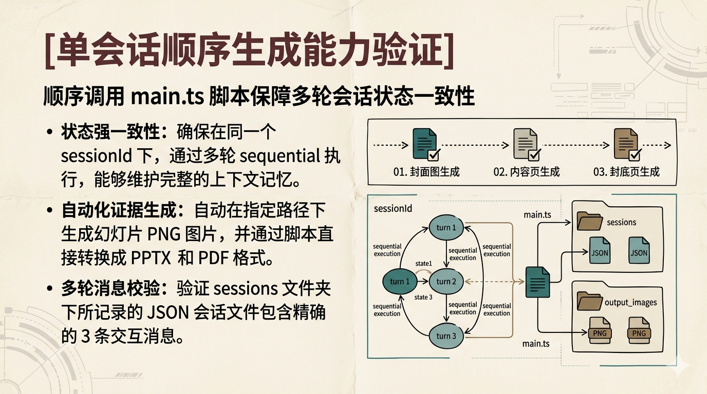
Notes:
Generate a presentation slide image of the slide content described below, strictly following these design and style guidelines: ## Image Specifications - **Type**: Presentation slide - **Aspect Ratio**: 16:9 (landscape) - **Resolution**: 2K Ultra HD (2560x1440) for high-definition presentations - **Style**: Professional slide deck ## Core Persona: The Architect You are "The Architect" - a master visual storyteller creating presentation slides. Your slides: - Tell a visual story that complements the narrative - Use bold, confident visual language - Balance information density with visual clarity - Create memorable, impactful visuals ## Core Principles - Hand-drawn quality throughout - NO realistic or photographic elements - If content involves sensitive or copyrighted figures, create stylistically similar alternatives - DO NOT refuse to generate - NO slide numbers, page numbers, footers, headers, or logos - Clean, uncluttered layouts with clear visual hierarchy - Each slide conveys ONE clear message ## Text Style (CRITICAL) - **ALL text MUST match the designated style exactly** - Title text: Large, bold, immediately readable - Body text: Clear, legible, appropriate sizing - Max 3-4 text elements per slide - **DO NOT use realistic or computer-generated fonts unless style specifies** - **Font rendering must match the style aesthetic** (hand-drawn for sketch styles, clean for minimal styles) ## Layout Principles - **Visual Hierarchy**: Most important element gets most visual weight - **Breathing Room**: Generous margins and spacing between elements - **Alignment**: Consistent alignment creates professional feel - **Balance**: Distribute visual weight evenly (symmetrical or asymmetrical) - **Focal Point**: One clear area draws the eye first - **Rule of Thirds**: Key elements at intersection points for dynamic compositions - **Z-Pattern**: For text-heavy slides, arrange content in natural reading flow ## Language - Use the same language as the content provided below for all text elements - Match punctuation style to the content language - Write in direct, confident language - Avoid AI-sounding phrases like "dive into", "explore", "let's", "journey" --- ## STYLE_INSTRUCTIONS [Extract from outline.md - do NOT re-read style files] The STYLE_INSTRUCTIONS block from the outline contains: - Design Aesthetic - Background (Texture + Base Color) - Typography (Headlines + Body descriptions) - Color Palette (with hex codes) - Visual Elements - Density Guidelines - Style Rules (Do/Don't) Copy the entire `<STYLE_INSTRUCTIONS>...</STYLE_INSTRUCTIONS>` block from the outline here. --- ## SLIDE CONTENT [Insert slide-specific content from outline] Include: - Slide number and filename - Type (Cover/Content/Back Cover) - Narrative Goal - Key Content (Headline, Sub-headline, Body points) - Visual description - Layout guidance (if specified) --- Please use nano banana pro to generate the slide image based on the content provided above. --- Generate a presentation slide image of the slide content described below, strictly following these design and style guidelines: ## Image Specifications - **Type**: Presentation slide - **Aspect Ratio**: 16:9 (landscape) - **Style**: Professional slide deck ## Core Persona: The Architect You are "The Architect" - a master visual storyteller creating presentation slides. Your slides: - Tell a visual story that complements the narrative - Use bold, confident visual language - Balance information density with visual clarity - Create memorable, impactful visuals ## Core Principles - Hand-drawn quality throughout - NO realistic or photographic elements - If content involves sensitive or copyrighted figures, create stylistically similar alternatives - DO NOT refuse to generate - NO slide numbers, page numbers, footers, headers, or logos - Clean, uncluttered layouts with clear visual hierarchy - Each slide conveys ONE clear message ## Text Style (CRITICAL) - **ALL text MUST match the designated style exactly** - Title text: Large, bold, immediately readable - Body text: Clear, legible, appropriate sizing - Max 3-4 text elements per slide - **DO NOT use realistic or computer-generated fonts unless style specifies** - **Font rendering must match the style aesthetic** (hand-drawn for sketch styles, clean for minimal styles) ## Layout Principles - **Visual Hierarchy**: Most important element gets most visual weight - **Breathing Room**: Generous margins and spacing between elements - **Alignment**: Consistent alignment creates professional feel - **Balance**: Distribute visual weight evenly (symmetrical or asymmetrical) - **Focal Point**: One clear area draws the eye first - **Rule of Thirds**: Key elements at intersection points for dynamic compositions - **Z-Pattern**: For text-heavy slides, arrange content in natural reading flow ## Language - Use the same language as the content provided below for all text elements - Match punctuation style to the content language - Write in direct, confident language - Avoid AI-sounding phrases like "dive into", "explore", "let's", "journey" --- ## STYLE_INSTRUCTIONS <STYLE_INSTRUCTIONS> Design Aesthetic: Clean 2D technical briefing with vintage blueprint aesthetic, aged cream paper texture, and bilingual explanatory text boxes. Dense information organized with clear visual hierarchy and multiple labeled callouts. Background: Texture: Subtle aged paper texture with light creases Base Color: Aged Cream (#F5F0E6) Typography: Headlines: Bold display, dark maroon (#5D3A3A), ALL CAPS in brackets for main titles. Body: Clean geometric sans-serif, Near Black (#1A1A1A). Simplified Chinese callout labels in clean sans-serif. Color Palette: Background: Aged Cream (#F5F0E6) - Primary background Primary Text: Dark Maroon (#5D3A3A) - Headlines Secondary Text: Near Black (#1A1A1A) - Body explanations Accent 1: Teal (#2F7373) - Primary illustrations Accent 2: Warm Brown (#8B7355) - Secondary elements Tertiary: Maroon (#722F37) - Titles, emphasis Outline: Deep Charcoal (#2D2D2D) - Boundaries and strokes Visual Elements: - Isometric/2D technical illustrations - 3-5 explanatory text boxes per slide - Simplified Chinese callout labels - Faded thematic background patterns - Clean black outlines on all elements - Split or triptych layouts Density Guidelines: - Content per slide: Dense information organized with clear visual hierarchy, 3-5 explanatory text boxes - Whitespace: Balanced but compact, using text boxes and frames to structure space Style Rules: Do: - Include substantive content from source - Use Simplified Chinese callout labels - Retain subtle aged paper texture - Maintain clear visual hierarchy Don't: - Use photorealistic renders - Apply digital gradients or glossy effects - Include slide numbers, footers, or logos </STYLE_INSTRUCTIONS> --- ## SLIDE CONTENT ## Slide 2 of 3 **Type**: Content **Filename**: 02-slide-test-details.png // NARRATIVE GOAL 详细阐述本次系统更新的测试验证指标、验证流程以及单会话顺序生成的技术要点。 // KEY CONTENT Headline: [单会话顺序生成能力验证] Sub-headline: 顺序调用 main.ts 脚本保障多轮会话状态一致性 Body: - 状态强一致性: 确保在同一个 sessionId 下，通过多轮 sequential 执行，能够维护完整的上下文记忆。 - 自动化证据生成: 自动在指定路径下生成幻灯片 PNG 图片，并通过脚本直接转换成 PPTX 和 PDF 格式。 - 多轮消息校验: 验证 sessions 文件夹下所记录的 JSON 会话文件包含精确的 3 条交互消息。 // VISUAL A horizontal workflow progress schematic. A dotted arrow line passes through three sequential nodes: 01. 封面图生成 -> 02. 内容页生成 -> 03. 封底页生成. Each node is represented by a small document icon labeled in Simplified Chinese, with a bold checkbox indicating successful validation. // LAYOUT Layout: split-screen Left side: three structured bullet points with detailed verification metrics. Right side: a split-screen 2D graphical representation of the sequential multi-turn state machine and directory mapping. --- Please use nano banana pro to generate the slide image based on the content provided above.

Slide 3
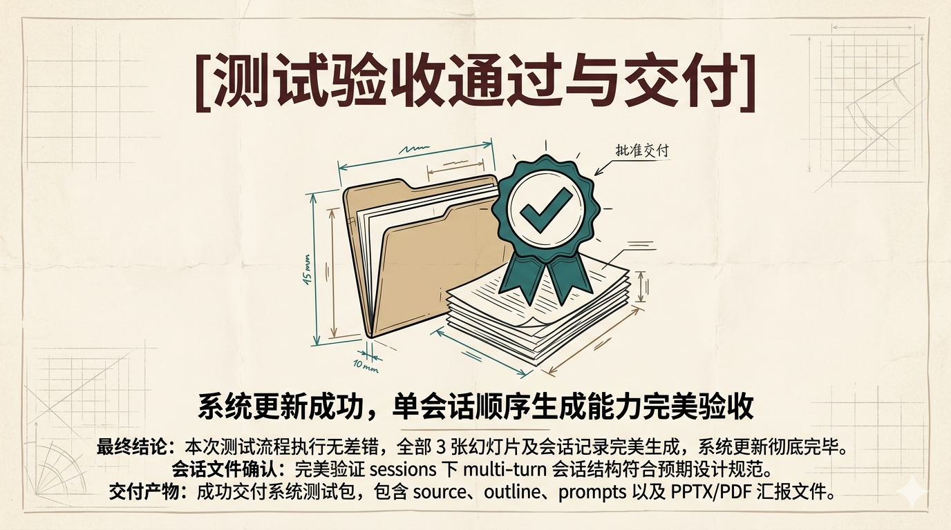
Notes:
Generate a presentation slide image of the slide content described below, strictly following these design and style guidelines: ## Image Specifications - **Type**: Presentation slide - **Aspect Ratio**: 16:9 (landscape) - **Resolution**: 2K Ultra HD (2560x1440) for high-definition presentations - **Style**: Professional slide deck ## Core Persona: The Architect You are "The Architect" - a master visual storyteller creating presentation slides. Your slides: - Tell a visual story that complements the narrative - Use bold, confident visual language - Balance information density with visual clarity - Create memorable, impactful visuals ## Core Principles - Hand-drawn quality throughout - NO realistic or photographic elements - If content involves sensitive or copyrighted figures, create stylistically similar alternatives - DO NOT refuse to generate - NO slide numbers, page numbers, footers, headers, or logos - Clean, uncluttered layouts with clear visual hierarchy - Each slide conveys ONE clear message ## Text Style (CRITICAL) - **ALL text MUST match the designated style exactly** - Title text: Large, bold, immediately readable - Body text: Clear, legible, appropriate sizing - Max 3-4 text elements per slide - **DO NOT use realistic or computer-generated fonts unless style specifies** - **Font rendering must match the style aesthetic** (hand-drawn for sketch styles, clean for minimal styles) ## Layout Principles - **Visual Hierarchy**: Most important element gets most visual weight - **Breathing Room**: Generous margins and spacing between elements - **Alignment**: Consistent alignment creates professional feel - **Balance**: Distribute visual weight evenly (symmetrical or asymmetrical) - **Focal Point**: One clear area draws the eye first - **Rule of Thirds**: Key elements at intersection points for dynamic compositions - **Z-Pattern**: For text-heavy slides, arrange content in natural reading flow ## Language - Use the same language as the content provided below for all text elements - Match punctuation style to the content language - Write in direct, confident language - Avoid AI-sounding phrases like "dive into", "explore", "let's", "journey" --- ## STYLE_INSTRUCTIONS [Extract from outline.md - do NOT re-read style files] The STYLE_INSTRUCTIONS block from the outline contains: - Design Aesthetic - Background (Texture + Base Color) - Typography (Headlines + Body descriptions) - Color Palette (with hex codes) - Visual Elements - Density Guidelines - Style Rules (Do/Don't) Copy the entire `<STYLE_INSTRUCTIONS>...</STYLE_INSTRUCTIONS>` block from the outline here. --- ## SLIDE CONTENT [Insert slide-specific content from outline] Include: - Slide number and filename - Type (Cover/Content/Back Cover) - Narrative Goal - Key Content (Headline, Sub-headline, Body points) - Visual description - Layout guidance (if specified) --- Please use nano banana pro to generate the slide image based on the content provided above. --- Generate a presentation slide image of the slide content described below, strictly following these design and style guidelines: ## Image Specifications - **Type**: Presentation slide - **Aspect Ratio**: 16:9 (landscape) - **Style**: Professional slide deck ## Core Persona: The Architect You are "The Architect" - a master visual storyteller creating presentation slides. Your slides: - Tell a visual story that complements the narrative - Use bold, confident visual language - Balance information density with visual clarity - Create memorable, impactful visuals ## Core Principles - Hand-drawn quality throughout - NO realistic or photographic elements - If content involves sensitive or copyrighted figures, create stylistically similar alternatives - DO NOT refuse to generate - NO slide numbers, page numbers, footers, headers, or logos - Clean, uncluttered layouts with clear visual hierarchy - Each slide conveys ONE clear message ## Text Style (CRITICAL) - **ALL text MUST match the designated style exactly** - Title text: Large, bold, immediately readable - Body text: Clear, legible, appropriate sizing - Max 3-4 text elements per slide - **DO NOT use realistic or computer-generated fonts unless style specifies** - **Font rendering must match the style aesthetic** (hand-drawn for sketch styles, clean for minimal styles) ## Layout Principles - **Visual Hierarchy**: Most important element gets most visual weight - **Breathing Room**: Generous margins and spacing between elements - **Alignment**: Consistent alignment creates professional feel - **Balance**: Distribute visual weight evenly (symmetrical or asymmetrical) - **Focal Point**: One clear area draws the eye first - **Rule of Thirds**: Key elements at intersection points for dynamic compositions - **Z-Pattern**: For text-heavy slides, arrange content in natural reading flow ## Language - Use the same language as the content provided below for all text elements - Match punctuation style to the content language - Write in direct, confident language - Avoid AI-sounding phrases like "dive into", "explore", "let's", "journey" --- ## STYLE_INSTRUCTIONS <STYLE_INSTRUCTIONS> Design Aesthetic: Clean 2D technical briefing with vintage blueprint aesthetic, aged cream paper texture, and bilingual explanatory text boxes. Dense information organized with clear visual hierarchy and multiple labeled callouts. Background: Texture: Subtle aged paper texture with light creases Base Color: Aged Cream (#F5F0E6) Typography: Headlines: Bold display, dark maroon (#5D3A3A), ALL CAPS in brackets for main titles. Body: Clean geometric sans-serif, Near Black (#1A1A1A). Simplified Chinese callout labels in clean sans-serif. Color Palette: Background: Aged Cream (#F5F0E6) - Primary background Primary Text: Dark Maroon (#5D3A3A) - Headlines Secondary Text: Near Black (#1A1A1A) - Body explanations Accent 1: Teal (#2F7373) - Primary illustrations Accent 2: Warm Brown (#8B7355) - Secondary elements Tertiary: Maroon (#722F37) - Titles, emphasis Outline: Deep Charcoal (#2D2D2D) - Boundaries and strokes Visual Elements: - Isometric/2D technical illustrations - 3-5 explanatory text boxes per slide - Simplified Chinese callout labels - Faded thematic background patterns - Clean black outlines on all elements - Split or triptych layouts Density Guidelines: - Content per slide: Dense information organized with clear visual hierarchy, 3-5 explanatory text boxes - Whitespace: Balanced but compact, using text boxes and frames to structure space Style Rules: Do: - Include substantive content from source - Use Simplified Chinese callout labels - Retain subtle aged paper texture - Maintain clear visual hierarchy Don't: - Use photorealistic renders - Apply digital gradients or glossy effects - Include slide numbers, footers, or logos </STYLE_INSTRUCTIONS> --- ## SLIDE CONTENT ## Slide 3 of 3 **Type**: Content **Filename**: 03-slide-back-cover.png // NARRATIVE GOAL 总结测试验证结果，宣布单会话顺序生成能力验收通过，为后续系统部署与交付提供保障。 // KEY CONTENT Headline: [测试验收通过与交付] Sub-headline: 系统更新成功，单会话顺序生成能力完美验收 Body: - 最终结论: 本次测试流程执行无差错，全部 3 张幻灯片及会话记录完美生成，系统更新彻底完毕。 - 会话文件确认: 完美验证 sessions 下 multi-turn 会话结构符合预期设计规范。 - 交付产物: 成功交付系统测试包，包含 source、outline、prompts 以及 PPTX/PDF 汇报文件。 // VISUAL A classic certificate emblem layout with a prominent green-tinted checkmark badge, overlapping with a blueprint drawing of a folder and document sheaf, symbolizing official signing off and delivery. // LAYOUT Layout: title-hero Large heading [测试验收通过与交付] at the top, a prominent checkmark/document badge graphic in the center, and final confirmation text block at the bottom. --- Please use nano banana pro to generate the slide image based on the content provided above.

