Slide 1
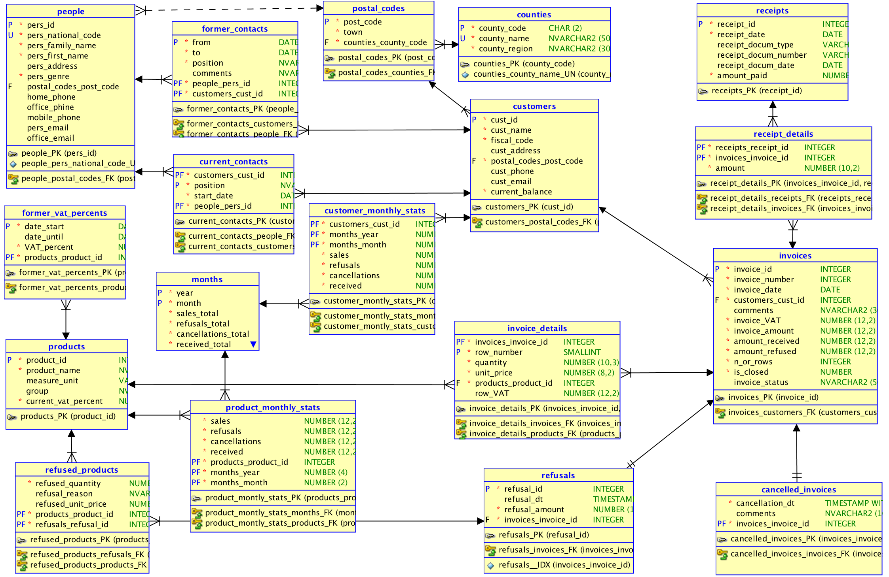
Computed (by Triggers) Attributes in sales

