Slide 1
Social Media Data Challenges
Drawing from:
John Canny’s Intro to Data Science
Farida Vis’ Keynote at Social Media in Social Research Conference
Shuaiqiang Wang’s Advanced Topics in Social Media Mining

Slide 2
Social Media Data Challenges
Social Media Data Challenges
Collecting Twitter data in (real) time (APIs)
Collecting social media data in (real) time (APIs)
Methods for building a reliable corpus
Problems with language bias
Problems with hashtag/keyword bias
API bias
Demographics of Twitter users – who are they?
Problems with escalating volume
Problems with data sharing / replicating studies + findings

Slide 3
Data challenge 1: Know your API

Slide 7
Keyword Data Collection
Specialized software for high-volume Twitter data collection
Streaming API
Keywords: frankenstorm, hurricane, hurricanesandy, perfectstorm, sandy, sandycam, stormporn, superstorm
Notes:
First, we collected data using the Twitter Streaming API using the these keywords

Slide 8
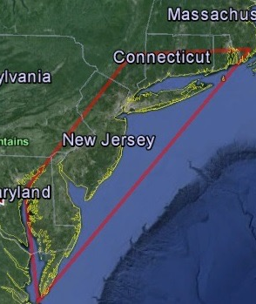
Local Contextual Dataset
Notes:
We then defined the geographic bounding box of the region most affected by Sandy. <POINT>

Slide 9

Local Contextual Dataset
Notes:
Tweets within the bounding box

Slide 10
Local Contextual Dataset
Local Keyword
225K tweets
Notes:
were considered local to the event
and constitute local keyword dataset

Slide 11
Local Contextual Dataset
username 1
username 2
username 3
username 4
username 5
…
Local Keyword
225K tweets
Notes:
We then identified the users who produced at least one local tweet in the time period of interest

Slide 12
Local Contextual Dataset
username 1
username 2
username 3
username 4
username 5
…
Local Keyword
Local Contextual
225K tweets
5.6M tweets
Notes:
And then collected all their tweets using REST API. All these tweets comprise the Local Contextual data set.
Collecting all these tweets for context is important because prior research shows that many disaster-related tweets did not contain any keywords, often instead referencing earlier tweets.

Slide 13
Streaming API
1% random sample of the firehose
Issues with how random – black box

Slide 14
FIREHOSE

Slide 15
Data challenge 2: API bias?

Slide 16
We collect and analyse messages exchanged in Twitter using two of the platform’s publicly available APIs (the search and stream specifications). We assess the differences between the two samples, and compare the networks of communication reconstructed from them. The empirical context is given by political protests taking place in May 2012: we track online communication around these protests for the period of one month, and reconstruct the network of mentions and re-tweets according to the two samples. We find that the search API over-represents the more central users and does not offer an accurate picture of peripheral activity; we also find that the bias is greater for the network of mentions.
(González-Bailón et al., 2014)

Slide 17
Data challenge 3: relation to firehose?

Slide 18
The essential drawback of the Twitter API is the lack of documentation concern- ing what and how much data users get. This leads re- searchers to question whether the sampled data is a valid representation of the overall activity on Twitter. In this work we embark on answering this question by comparing data collected using Twitter’s sampled API service with data collected using the full, albeit costly, Firehose stream that includes every single published tweet.
(Morstatter et al., 2013)

Slide 19
Data challenge 4: relation to ‘general public’?

Slide 20
Data challenge 5: what data to collect?

Slide 21
For hashtag datasets: contributions made by specific users and groups of users; overall patterns of activity over time; combinations to examine contributions by specific users and groups over time. (Bruns and Stieglitz, 2013)

Slide 22
Data challenge 6: data quality and cleanliness

Slide 23
Data Quality Challenges
Big Data Paradox
Social media data is big, yet not evenly distributed.
Often little data is available for an individual
Obtaining Sufficient Samples
Are our samples reliable representatives of the full data?
Noise Removal Fallacy
Too much removal makes data more sparse
Noise definition is relative and complicated and is task-dependent
Evaluation Dilemma
When there is no ground truth, how can you evaluate?
Notes:
Data Quality Challenges

Slide 24
Data Quality Challenges
When making data ready for analysis, data quality need to be assured
Noise
Noise is the distortion of the data
Outliers
Outliers are data points that are considerably different from other data points in the dataset
Missing Values
Missing feature values in data instances
To solve this problem: 1) remove instances that have missing values 2) estimate missing values, and 3) ignore missing values when running data mining algorithm
Duplicate data

Slide 25
Data Preprocessing
Aggregation
It is performed when multiple features need to be combined into a single one or when the scale of the features change
Example: image width , image height -> image area (width x height)
Discretization
From continues values to discrete values
Example: money spent -> {low, normal, high}
Feature Selection
Choose relevant features
Feature Extraction
Creating new features from original features
Often, more complicated than aggregation
Sampling
Random Sampling
Sampling with or without replacement
Stratified Sampling: useful when having class imbalance
Social Network Sampling

Slide 26

Who’s Calling Who’S Data Dirty?

Slide 27
Dirty Data
The Statistics View:
There is a process that produces data
We want to model ideal samples of that process, but in practice we have non-ideal samples:
Distortion – some samples are corrupted by a process
Selection Bias - likelihood of a sample depends on its value
Left and right censoring - users come and go from our scrutiny
Dependence – samples are supposed to be independent, but are not (e.g. social networks)
You can add new models for each type of imperfection, but you can’t model everything.
What’s the best trade-off between accuracy and simplicity?

Slide 28
Dirty Data
The Database View:
I got my hands on this data set
Some of the values are missing, corrupted, wrong, duplicated
Results are absolute (relational model)
You get a better answer by improving the quality of the values in your dataset

Slide 29
Dirty Data
The Domain Expert’s View:
This Data Doesn’t look right
This Answer Doesn’t look right
What happened?
Domain experts have an implicit model of the data that they can test against…

Slide 30
Data Quality Problems
(Source) Data is dirty on its own.
Transformations corrupt the data (complexity of software pipelines).
Data sets are clean but integration (i.e., combining them) screws them up.
“Rare” errors can become frequent after transformation or integration.
Data sets are clean but suffer “bit rot”
Old data loses its value/accuracy over time
Any combination of the above

Slide 31
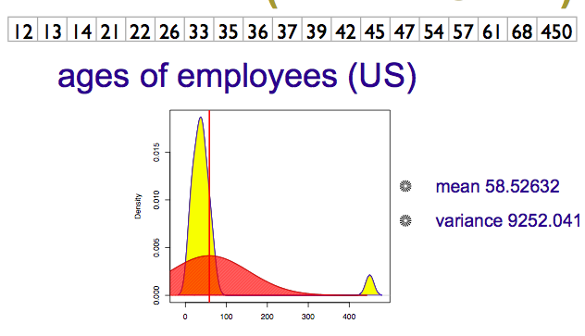

Numeric Outliers
Adapted from Joe Hellerstein’s 2012 CS 194 Guest Lecture

Slide 32
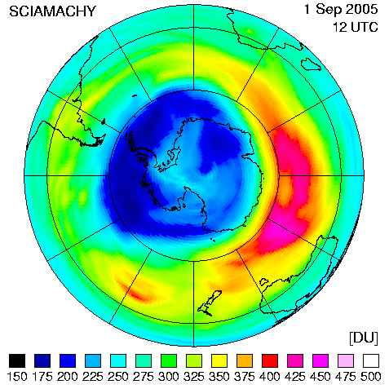
Data Cleaning Makes Everything Okay?
The appearance of a hole in the earth's ozone layer over Antarctica, first detected in 1976, was so unexpected that scientists didn't pay attention to what their instruments were telling them; they thought their instruments were malfunctioning.
National Center for Atmospheric Research
In fact, the data were rejected as unreasonable by data quality control algorithms

Slide 33
Dirty Data Problems
From Stanford Data Integration Course:
parsing text into fields (separator issues)
Naming conventions: ER: NYC vs New York
Missing required field (e.g. key field)
Different representations (2 vs Two)
Fields too long (get truncated)
Primary key violation (from un- to structured or during integration
Redundant Records (exact match or other)
Formatting issues – especially dates
Licensing issues/Privacy/ keep you from using the data as you would like?

Slide 34
Conventional Definition of Data Quality
Accuracy
The data was recorded correctly.
Completeness
All relevant data was recorded.
Uniqueness
Entities are recorded once.
Timeliness
The data is kept up to date.
Special problems in federated data: time consistency.
Consistency
The data agrees with itself.
Adapted from Ted Johnson’s SIGMOD 2003 Tutorial

Slide 35
Problems …
Unmeasurable
Accuracy and completeness are extremely difficult, perhaps impossible to measure.
Context independent
No accounting for what is important. E.g., if you are computing aggregates, you can tolerate a lot of inaccuracy.
Incomplete
What about interpretability, accessibility, metadata, analysis, etc.
Vague
The conventional definitions provide no guidance towards practical improvements of the data.
Adapted from Ted Johnson’s SIGMOD 2003 Tutorial

Slide 36
Finding a modern definition
We need a definition of data quality which
Reflects the use of the data
Leads to improvements in processes
Is measurable (we can define metrics)
First, we need a better understanding of how and where data quality problems occur
The data quality continuum
Adapted from Ted Johnson’s SIGMOD 2003 Tutorial

Slide 37
Meaning of Data Quality
There are many types of data, which have different uses and typical quality problems
Network data
High dimensional data
Descriptive data
Longitudinal data
Streaming data
Web (scraped) data
Numeric vs. categorical vs. text data
Adapted from Ted Johnson’s SIGMOD 2003 Tutorial

Slide 38
Meaning of Data Quality
There are many uses of data
Operations
Aggregate analysis
Customer relations …
Data Interpretation: the data is useless if we don’t know all of the rules behind the data.
Data Suitability: Can you get the answer from the available data
Use of proxy data
Relevant data is missing
Adapted from Ted Johnson’s SIGMOD 2003 Tutorial
Notes:
Challenge in operations : many handoffs. Some processes more important than others.
Challenge in aggregate analysis: can tolerate errors, but you’re summing up over a lot of data, therefore likely to add in glitched data.
Customer relations : the fields must be accurate, but errors don’t spread.

Slide 39
The Data Quality Continuum
Data and information is not static, it flows in a data collection and usage process
Data gathering
Data delivery
Data storage
Data integration
Data retrieval
Data mining/analysis
Adapted from Ted Johnson’s SIGMOD 2003 Tutorial

Slide 40
Data Gathering
How does the data enter the system?
Sources of problems:
Manual entry
No uniform standards for content and formats
Parallel data entry (duplicates)
Approximations, surrogates – SW/HW constraints
Measurement or sensor errors.
Adapted from Ted Johnson’s SIGMOD 2003 Tutorial
Notes:
MPDS workshop, John Bates

Slide 41
Data Gathering - Solutions
Potential Solutions:
Preemptive:
Process architecture (build in integrity checks)
Process management (reward accurate data entry, data sharing, data stewards)
Retrospective:
Cleaning focus (duplicate removal, merge/purge, name & address matching, field value standardization)
Diagnostic focus (automated detection of glitches).
Adapted from Ted Johnson’s SIGMOD 2003 Tutorial

Slide 42
Data Delivery
Destroying or mutilating information by inappropriate pre-processing
Inappropriate aggregation
Nulls converted to default values
Loss of data:
Buffer overflows
Transmission problems
No checks
Adapted from Ted Johnson’s SIGMOD 2003 Tutorial

Slide 43
Data Delivery - Solutions
Build reliable transmission protocols
Use a relay server
Verification
Checksums, verification parser
Do the uploaded files fit an expected pattern?
Relationships
Are there dependencies between data streams and processing steps
Interface agreements
Data quality commitment from the data stream supplier.
Adapted from Ted Johnson’s SIGMOD 2003 Tutorial

Slide 44
Data Storage
You get a data set. What do you do with it?
Problems in physical storage
Can be an issue, but terabytes are cheap.
Problems in logical storage
Poor metadata.
Data feeds are often derived from application programs or legacy data sources.
Inappropriate data models.
Missing timestamps, incorrect normalization, etc.
Ad-hoc modifications.
Structure the data to fit the GUI.
Hardware / software constraints.
Data transmission via Excel spreadsheets, Y2K
Adapted from Ted Johnson’s SIGMOD 2003 Tutorial

Slide 45
Data Storage - Solutions
Metadata
Document and publish data specifications.
Planning
Assume that everything bad will happen.
Can be very difficult.
Data exploration
Use data browsing and data mining tools to examine the data.
Does it meet the specifications you assumed?
Has something changed?
Adapted from Ted Johnson’s SIGMOD 2003 Tutorial

Slide 46
Data Retrieval
Exported data sets are often a view of the actual data. Problems occur because:
Source data not properly understood.
Need for derived data not understood.
Just plain mistakes.
Inner join vs. outer join
Understanding NULL values
Computational constraints
E.g., too expensive to give a full history, we’ll supply a snapshot.
Incompatibility
Ebcdic? Unicode?
Adapted from Ted Johnson’s SIGMOD 2003 Tutorial

Slide 47
Data Mining and Analysis
What are you doing with all this data anyway?
Problems in the analysis.
Scale and performance
Confidence bounds?
Black boxes
Attachment to models
Insufficient domain expertise
Casual empiricism
Adapted from Ted Johnson’s SIGMOD 2003 Tutorial
Notes:
Casual empiricism : use an arbitrary number to support a pre-conception.

Slide 48
Retrieval and Mining - Solutions
Data exploration
Determine which models and techniques are appropriate, find data bugs, develop domain expertise.
Continuous analysis
Are the results stable? How do they change?
Accountability
Make the analysis part of the feedback loop.
Adapted from Ted Johnson’s SIGMOD 2003 Tutorial

Slide 49
Data Quality Constraints
Many data quality problems can be captured by static constraints based on the schema.
Nulls not allowed, field domains, foreign key constraints, etc.
Many others are due to problems in workflow, and can be captured by dynamic constraints
E.g., orders above $200 are processed by Biller 2
The constraints follow an 80-20 rule
A few constraints capture most cases, thousands of constraints to capture the last few cases.
Constraints are measurable. Data Quality Metrics?
Adapted from Ted Johnson’s SIGMOD 2003 Tutorial
Notes:
Dynamic constraints often come from operational databases. But analysis data sets, CRM databases are often derived from operational data.

Slide 50
Data Quality Metrics
We want a measurable quantity
Indicates what is wrong and how to improve
Realize that DQ is a messy problem, no set of numbers will be perfect
Types of metrics
Static vs. dynamic constraints
Operational vs. diagnostic
Metrics should be directionally correct with an improvement in use of the data.
A very large number metrics are possible
Choose the most important ones.
Adapted from Ted Johnson’s SIGMOD 2003 Tutorial
Notes:
Metrics can give incentives for bad behavior : throw away data that doesn’t join.

Slide 51
Examples of Data Quality Metrics
Conformance to schema
Evaluate constraints on a snapshot.
Conformance to business rules
Evaluate constraints on changes in the database.
Accuracy
Perform inventory (expensive), or use proxy (track complaints). Audit samples?
Accessibility
Interpretability
Glitches in analysis
Successful completion of end-to-end process
Adapted from Ted Johnson’s SIGMOD 2003 Tutorial

Slide 52
Technical Approaches
We need a multi-disciplinary approach to attack data quality problems
No one approach solves all problem
Process management
Ensure proper procedures
Statistics
Focus on analysis: find and repair anomalies in data.
Database
Focus on relationships: ensure consistency.
Metadata / domain expertise
What does it mean? Interpretation
Adapted from Ted Johnson’s SIGMOD 2003 Tutorial

Slide 53
Data Integration
Combine data sets (acquisitions, across departments).
Common source of problems
Heterogenous data : no common key, different field formats
Approximate matching
Different definitions
What is a customer: an account, an individual, a family, …
Time synchronization
Does the data relate to the same time periods? Are the time windows compatible?
Legacy data
IMS, spreadsheets, ad-hoc structures
Adapted from Ted Johnson’s SIGMOD 2003 Tutorial

Slide 54
Duplicate Record Detection
Resolve multiple different mentions:
Entity Resolution
Reference Reconciliation
Object Identification/Consolidation
Remove Duplicates
Merge/Purge
Record Linking (across data sources)
Householding (interesting special case)
Approximate Match (accept fuzziness)

Slide 55
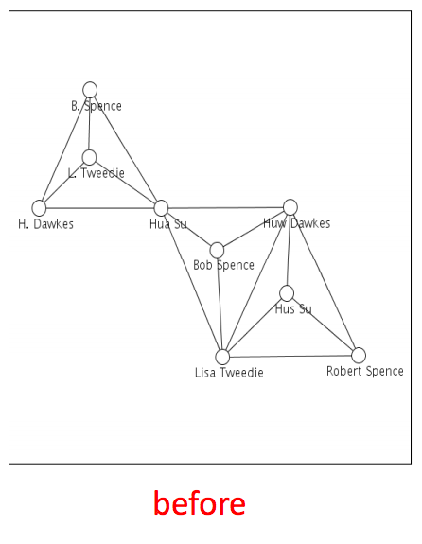
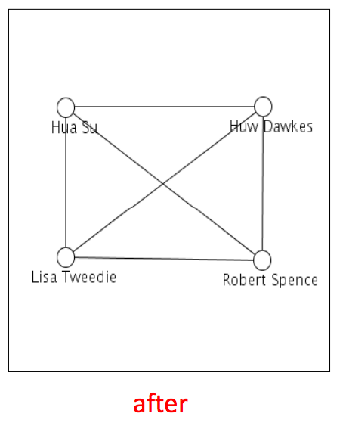
Example: Network Analysis
From: Getoor & Machanavajjhala: “Entity Resolution Tutorial”, VLDB 2012

Slide 56
Approximate Matching
Relate tuples whose fields are “close”
Approximate string matching
Generally, based on edit distance.
Fast SQL expression using a q-gram index (a q-gram is like an n-gram on syllables)
Approximate tree matching
For Nested Data Structures (or flattened ones)
Much more expensive than string matching
Recent research in fast approximations
Feature vector matching
Similarity search
Many techniques discussed in the data mining literature.
Ad-hoc or Domain-focused matching
Use domain insights and/or clever tricks.

Slide 57
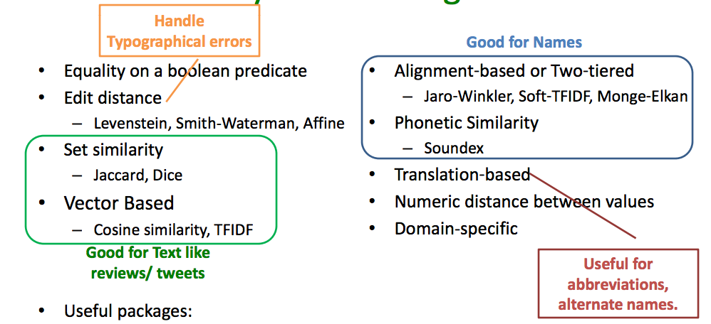
Some Similarity Measures
From: Getoor & Machanavajjhala: “Entity Resolution Tutorial”, VLDB 2012

Slide 58
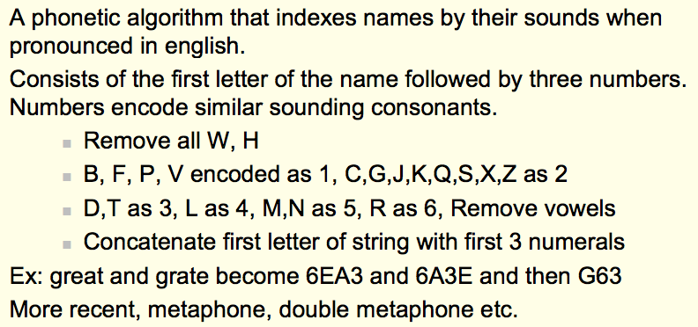
Soundex Encoding
From: Koudas, Sarawagi, Strivastava, “Record Linkage: Similarity Measures and Algorithms”, VLDB 2006

Slide 59
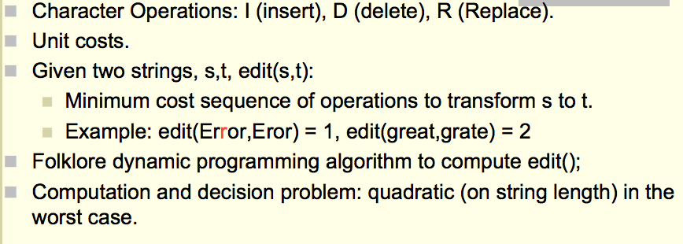
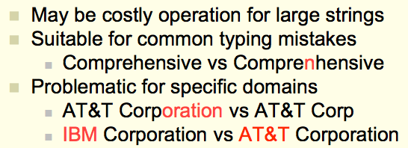
Edit Distance
From: Koudas, Sarawagi, Strivastava, “Record Linkage: Similarity Measures and Algorithms”, VLDB 2006

Slide 60
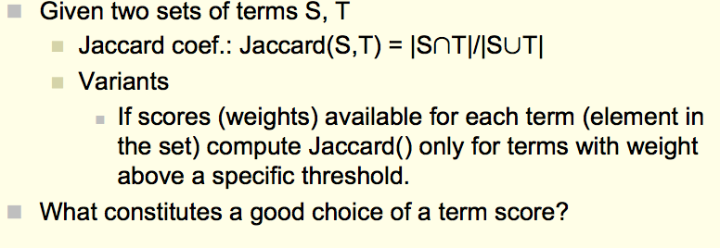
Overlap Metrics
Terms can be words or “q-grams” (sequence of q characters in a field:
e.g., {‘AT&’, ‘T&T’, ‘&T ‘, ‘T C’, …} for AT&T Corp.
From: Koudas, Sarawagi, Strivastava, “Record Linkage: Similarity Measures and Algorithms”, VLDB 2006

Slide 61
Approximate Joins and Duplicate Elimination
Perform joins based on incomplete or corrupted information.
Approximate join: between two different tables
Duplicate elimination: within the same table
More general than approximate matching.
Semantics: Need to use special transforms and scoring functions.
Correlating information: verification from other sources, e.g. usage correlates with billing.
Missing data: Need to use several orthogonal search and scoring criteria.
But approximate matching is a valuable tool …

Slide 62
Schema Matching
Use similarity measures and structural cues (e.g. column names, data types, etc.) to match data definitions
Looking at data instances (or examples of them can help)
Constraints in the schema (if you have them) can also help.
Auxiliary Information: dictionaries, documentation, usage

Slide 63
Lots of Additional Problems
Address vs. Number, Street, City, …
Units
Differing Constraints
Multiple versions and schema evolution
Ontologies and other Metadata

