Slide 1
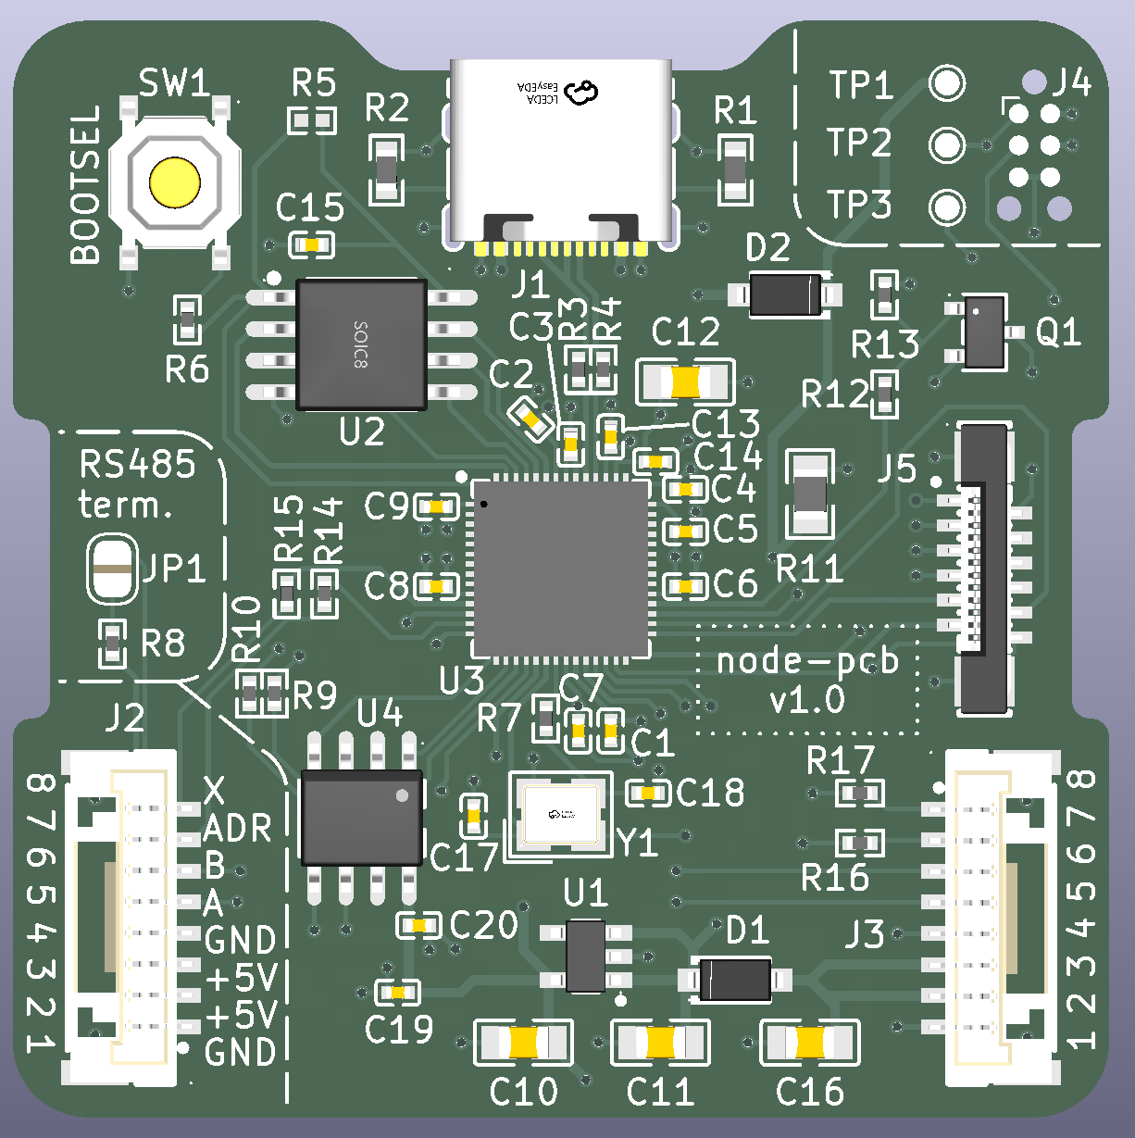
Power Supply
SWD Debug
Testpoints
Flash Storage
RS485
RP2040
SPI Display
Crystal oscillator
Daisy Chain Connector
Daisy Chain Connector
Power Supply

