Slide 1

FACTORED AI & DATA HACKATHON 2026 / SAVIA
Ask once.
Carry on.
You shouldn’t have to repeat your story or chase updates. Savia keeps your place.
01 ASK
Use your own words
02 TEAM
Find helpful angles
03 RETURN
Come back to progress
MEET SAVIA · YOUR FRIENDLY VOICE ASSISTANT
SAVIA • 01/05
Notes:
Open with the product promise: ask once, let Savia gather useful perspectives, then return to progress without starting over. The home scene is an illustrative fictional TV-spot image, not a service screenshot. The captured evidence that follows uses fictional customer data and informational suggestions.

Slide 2
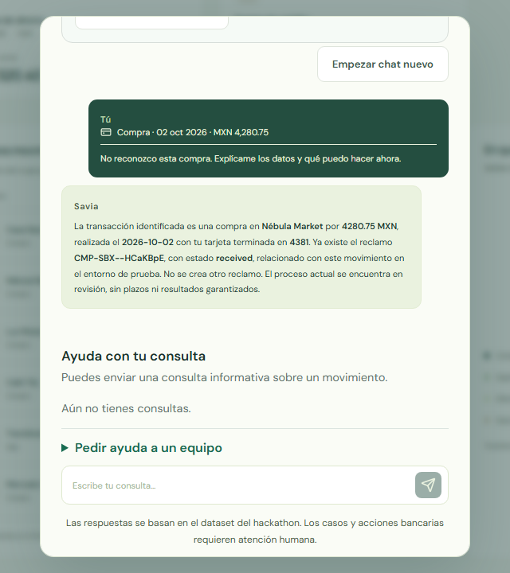
02 / A TEAM IN YOUR CORNER
A grounded answer, in the moment.
Savia explains the selected charge and the existing record, in the customer's words.
MODEL ANSWER
Useful in 9.338 s
Grounded to the selected MXN 4,280.75 charge and existing claim.
STATUS
Already in review
Savia explains the existing record; it creates no new claim.
SEPARATE MCP
2 workers · 2.783 s
Standalone stdio run; separate from this browser answer.
Actual Spanish browser answer · selected fictional charge
Existing simulated claim · no bank decision or new request
SAVIA • 02/05
Notes:
The screenshot is the actual grounded Spanish answer in docs/submission/measurements/team-story-final/04-grounded-answer.png. The selected model answer was useful and took 9.338 seconds. The browser showed the existing fictional claim and its current review status; it did not create another claim. The informational team interaction completed in 4.278 seconds. Keep these measurements distinct: the separate standalone stdio MCP smoke in docs/submission/assistant/mcp-smoke.json completed two workers in 2.783 seconds; it is not the timing for this browser answer or team interaction. No bank decision or real action is claimed.

Slide 3
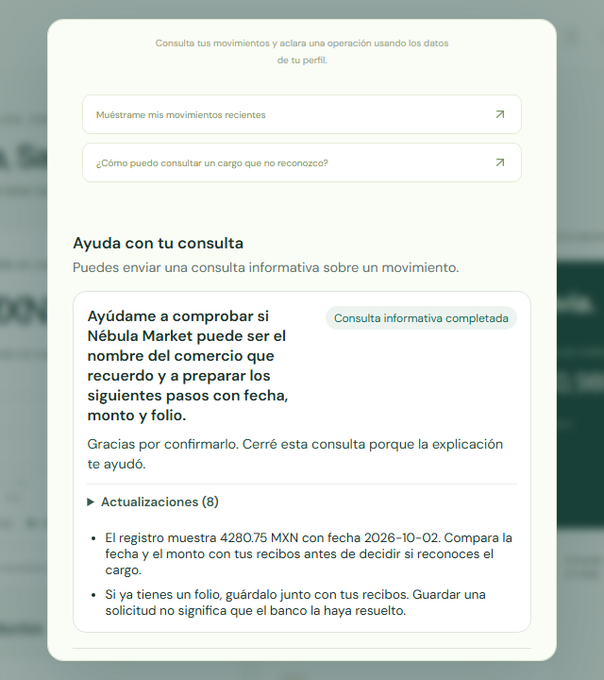
03 / COME BACK WHEN IT SUITS YOU
Your team’s suggestions stay with you.
Mark an answer helpful. Start a new chat. Return to the same saved perspectives.
CUSTOMER CHOICE
Closed as helpful
The customer explicitly confirmed the informational answer helped.
SAVED TOGETHER
Two team suggestions
Both remained available after a new chat and reload.
BANK RECORD
Existing claim
No new claim was created by the assistant team.
Actual Spanish browser capture · closure and saved result
Informational help saved · existing claim only · no bank decision
SAVIA • 03/05
Notes:
The screenshot is the actual saved-result capture docs/submission/measurements/team-story-final/11-saved-useful-result.png. The customer explicitly closed the informational inquiry as helpful. Both real Savia-team suggestions remained visible after starting a new chat and reloading. The selected bank claim shown in context was already present; the team did not create a new claim or resolve it. The actual UI completion for the team inquiry was 4.278 seconds. The selected grounded answer was separately measured at 9.338 seconds; the standalone MCP smoke took 2.783 seconds. These are different runs and timings.

Slide 4
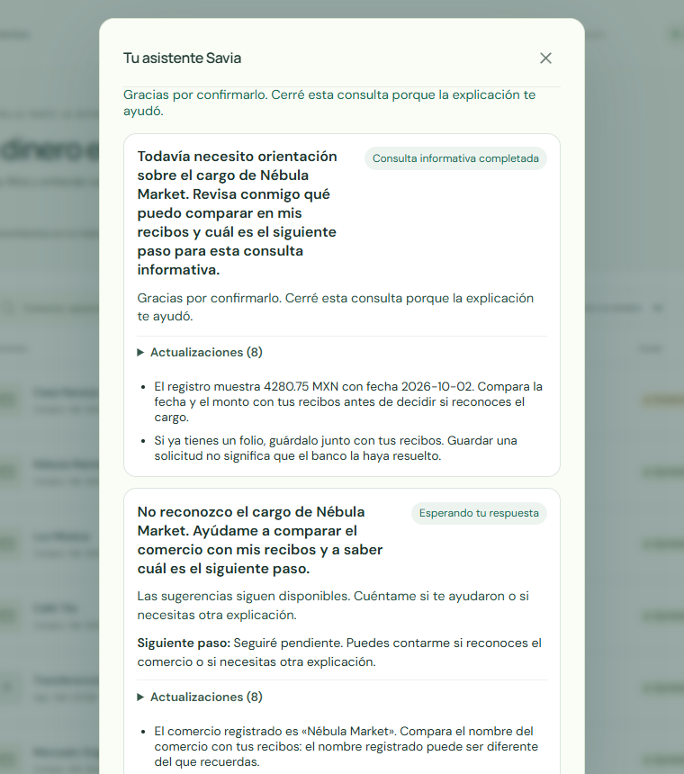
04 / VOICE THAT STAYS WITH YOU
A voice that keeps your place.
A calm moment, then a spoken confirmation when your explanation helps.
FOREGROUND · 6.6 S · FULL ACK 200
Calm reassurance
“Despacio, sí, bien tranquilo, aquí estoy.”
HELPFUL CLOSURE · 3.95 S · FULL ACK 200
Customer-confirmed closure
“Cerró la consulta, ya te ayudó la explicación.”
Actual integrated Savia voice · customer-marked-helpful inquiry · saved context restored
SAVIA • 04/05
Notes:
This is the accepted integrated Savia UI capture from source 9d77a7599128b668b0e34f9c2937eb40b6bd3824, image sha256 484fe8edc07ac37dd78f61deb7a08254352b8ce597fa8265f917706e93d199a5, and served JS hash f06ecbad1ea5089a227a04ea7468aeb8f4b1ef023ac04a98e6b71379771cc8bd. The foreground provider transcript was “Despacio, sí, bien tranquilo, aquí estoy.” (6.6 s; exact 158,400 samples) and received one complete HTTP 200 playback acknowledgement at 21.473 s. While it played, the existing third informational inquiry was marked helpful at 14.949 s; its canonical closure became available at 15.836 s and was queued until the next native request at 21.503 s. The closure transcript was “Cerró la consulta, ya te ayudó la explicación.” (3.95 s; exact 94,800 samples) with one complete HTTP 200 acknowledgement at 26.659 s. The screenshot shows the customer-marked helpful closure and saved team suggestions. This closed an informational case only; no bank decision or refund occurred. The existing case, two completed worker suggestions and prior bank reply were restored; this continuation created zero bank chats, inquiries or workers. It does not claim a new team task or recommendations spoken aloud. Input used typed Spanish and a file-backed fictional WAV through the browser voice control; physical-microphone quality is not qualified, and the raw final ASR contained errors. Optional recorder cleanup diagnostics later exceeded the 180-second cap while awaiting unused response bodies; both exact playback receipts and required product checks had already passed. The diagnostic exit status is not a product failure. Evidence: docs/submission/measurements/intended-savia-native/receipt.json.

Slide 5
05 / HOW SAVIA HOLDS THE THREAD
One guide, with clear boundaries.
Savia keeps the conversation, brings perspectives together, and returns useful progress over time.
01
02
03
04
05
You ask
→
Savia host
→
Savia team
→
Informational read
→
Check back
Voice or text
Holds context
Two perspectives
Can fail safely
30 min · up to 7 days
Fictional information service · no bank actions or real resolution
Prompt flow & decision design: Gloria Yanta Salc • Data pipeline & lookup: Carlos Diaz • Integration: Savia team
SAVIA • 05/05
Notes:
Explain the current structure without promising production integration. The canonical browser path uses the Savia app host loop to coordinate two direct-provider informational tasks, hold the customer's inquiry, and return progress; the actual team smoke used direct OpenRouter Gemini and both tasks completed in 2,783 ms. The app-owned inquiry policy supports a first reminder after 30 minutes and a tracking window up to seven days; the seven-day operation has not been observed live. Separately, one real-clock simulated receipt check repeated after 30 minutes and deduplicated the unchanged result. The optional generic FLUJO/MCP schedule was qualified with one connected tool call against empty informational state: it completed without queueing a case or making a paid model call, and its 30-minute schedule is installed but disabled. That optional tick is not the browser's Savia team path, and the empty-state run does not demonstrate a scheduled case event. Informational reads may fail; the voice surface reported the read failure. No bank action, real dispute decision or refund is established here. Credits: Gloria Yanta Salc for prompt flow/R0–R18 design, Carlos Diaz for data pipeline and lookup, Savia team for integration. Evidence: docs/submission/runtime-mcp.json and docs/submission/measurements/actual-half-hour-followup.json.

