Slide 1

FACTORED AI & DATA HACKATHON 2026
Ask once.
Carry on.
You shouldn’t have to repeat your story or chase updates. Savia keeps your place.
A small team finds useful perspectives. Savia keeps the thread while you get on with your day.
SAVIA · YOUR FRIENDLY VOICE ASSISTANT
SAVIA • 01/05
Notes:
Meet Savia: ask once, carry on. The home scene is an illustrative fictional customer image for the TV spot, not a service screenshot. Savia's product promise is to keep the question moving, bring useful perspectives back, and remember the thread.

Slide 2
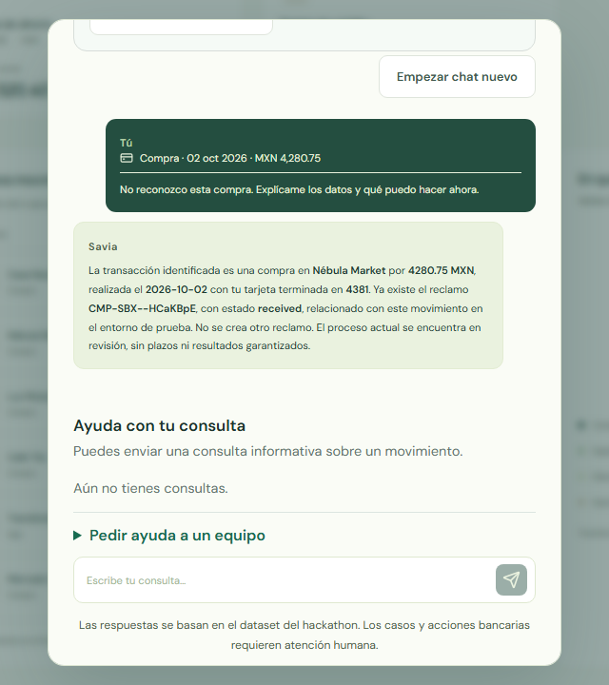
THE TEAM BEHIND THE ANSWER
A grounded answer, in the moment.
Savia explained the selected charge and existing claim in a useful Spanish answer.
MODEL ANSWER
Useful in 9.338 s
Grounded to the selected MXN 4,280.75 charge and existing claim.
STATUS
Already in review
No duplicate claim was created.
SEPARATE MCP
2 workers · 2.783 s
Standalone stdio run, separate from this browser answer.
Actual Spanish browser answer · selected fictional charge
Existing simulated claim · no bank decision or new request
SAVIA • 02/05
Notes:
Actual grounded answer captured in docs/submission/measurements/team-story-final/04-grounded-answer.png. The selected model answer was useful and took 9.338 seconds. It described the existing fictional claim and current review status; it did not create another claim. The informational team interaction completed in 4.278 seconds. Keep these separate from the standalone two-worker stdio MCP smoke, which completed in 2.783 seconds. No real bank decision or action is claimed.

Slide 3
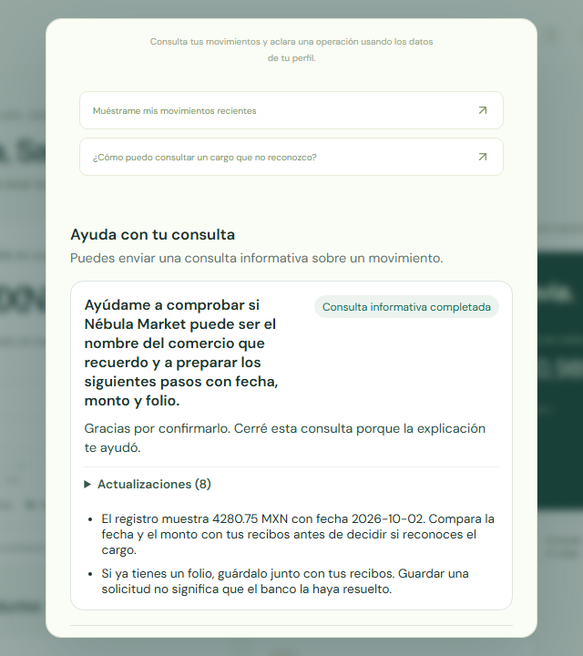
COME BACK WHEN IT SUITS YOU
Your team’s suggestions stay with you.
Confirm that it helped, begin a new chat, and return to the saved perspectives.
CUSTOMER CHOICE
Marked helpful
The customer explicitly closed the informational inquiry.
PERSISTENCE
Two suggestions saved
They remained after a new chat and reload.
BANK RECORD
Existing claim
The team did not create a new claim.
Actual Spanish browser capture · saved result after return
Informational help saved · existing claim only · no bank decision
SAVIA • 03/05
Notes:
Actual saved-result capture in docs/submission/measurements/team-story-final/11-saved-useful-result.png. The customer explicitly confirmed the answer was helpful and closed the informational inquiry. Both Savia-team suggestions stayed visible after a new chat and reload. The bank claim was an existing simulated record and was not newly created. The UI team interaction completed in 4.278 seconds; the selected grounded model answer took 9.338 seconds. The 2.783-second MCP smoke was a separate standalone run.

Slide 4
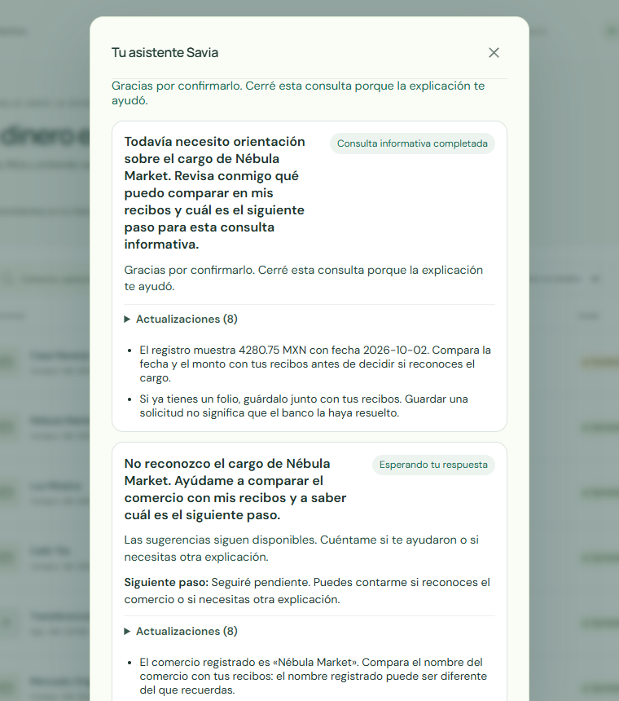
A VOICE THAT STAYS PRESENT
A voice that keeps your place.
A calm moment, then a spoken confirmation when your explanation helps.
FOREGROUND · 6.6 S · FULL ACK 200
Calm reassurance
“Despacio, sí, bien tranquilo, aquí estoy.”
HELPFUL CLOSURE · 3.95 S · FULL ACK 200
Customer-confirmed closure
“Cerró la consulta, ya te ayudó la explicación.”
Actual integrated Savia voice · customer-marked-helpful inquiry · saved context restored
SAVIA • 04/05
Notes:
Accepted actual integrated Savia UI capture, source 9d77a7599128b668b0e34f9c2937eb40b6bd3824, image sha256 484fe8edc07ac37dd78f61deb7a08254352b8ce597fa8265f917706e93d199a5, served JS hash f06ecbad1ea5089a227a04ea7468aeb8f4b1ef023ac04a98e6b71379771cc8bd. Foreground Spanish transcript: “Despacio, sí, bien tranquilo, aquí estoy.” (6.6 s; exact 158,400 samples), full browser playback acknowledged once with HTTP 200 at 21.473 s. The existing third informational inquiry was marked helpful at 14.949 s during the foreground playback. Its canonical closure was available at 15.836 s and queued until native request 21.503 s. Closure transcript: “Cerró la consulta, ya te ayudó la explicación.” (3.95 s; exact 94,800 samples), acknowledged once with HTTP 200 at 26.659 s. This is an informational helpful closure, not a bank decision or refund. Existing case context, two completed team suggestions and prior bank reply were restored; the continuation created zero bank chats, inquiries or workers. No additional worker concurrency or spoken recommendations are claimed. Input used typed Spanish plus a file-backed fictional WAV through the browser control; the physical microphone is unqualified and raw final ASR contained errors. Optional recorder cleanup exceeded its 180-second cap while awaiting unused response bodies after both playback receipts and required product checks passed; its diagnostic exit 1 is not a product failure. Evidence: docs/submission/measurements/intended-savia-native/receipt.json.

Slide 5
THE SERVICE UNDER THE SURFACE
Let’s prove value with a bounded pilot.
Partner with a bank to test the customer-support journey and its handoffs.
01
02
03
04
05
You ask
→
Savia host
→
Savia team
→
Info read
→
Check back
Voice or text
Keeps context
Two perspectives
May fail safely
30 min · up to 7 days
BANK PARTNER INVITED · bounded customer-support pilot · no production actions
Gloria Yanta Salc · prompt flow | Carlos Diaz · data pipeline | Savia team · integration
Measure: repeat contacts · time to first useful answer · helpful closure · handoff quality
SAVIA • 05/05
Notes:
Close with the invitation for a bank partner to run a bounded customer-support pilot. The value hypothesis is fewer repeat contacts and clearer context for support; this deck claims no ROI or measured reduction. Agree measures for repeat contacts, time to first useful answer, customer helpful closure and handoff quality. Use a fictional, informational scope and no production actions. The canonical browser path uses the Savia app host loop for two direct-provider tasks; it is separate from optional generic FLUJO/MCP scheduling. The latter's qualification made one connected call against empty informational state, queued no case, made no paid model call, and left its installed 30-minute schedule disabled. The 2.783-second standalone MCP smoke is also separate from the browser answer and team UI times. Evidence: docs/submission/runtime-mcp.json.

