Slide 1
TEACHING PROTOTYPE
Spatiotemporal Urban Activity Patterns
A hands-on prototype for students — Zurich, 2025
Based on: Barrena-Herrán, Modrego-Monforte & Grijalba (2025). Revealing Spatiotemporal Urban Activity Patterns. ISPRS Int. J. Geo-Inf. 14, 221.

Slide 2
Motivation
Why study the temporal rhythm of cities?
Where people concentrate during the day shapes almost everything in a city — transport demand, noise, retail turnover, public safety, air quality. Classical urban planning focused on space. Time-geography (Hägerstrand, 1970) added the temporal dimension. Today, location-based data lets us measure both at scale.
24/7
Cities are now measured continuously
5
Stages in the reference methodology
k-shape
Clustering on normalised profile shape

Slide 3
The paper in one slide
Barrena-Herrán, Modrego-Monforte & Grijalba (2025)
Study area · Donostia-San Sebastián (ES). Data · Google Popular Times for 1,378 POIs, one typical Friday. Unit · Morphological grid (Voronoi cells around street intersections). Method · Hourly weighted occupancy → k-shape → NNA + KDE. Result · 5 distinct daily rhythm clusters with clear spatial footprints.
KEY INSIGHT
Urban form and daily rhythm are coupled — medieval cores, retail streets and residential neighbourhoods each have their own temporal fingerprint.
→ Our job today: reproduce this with open Zurich data.

Slide 4
Methodology
The five-stage pipeline
01
02
03
04
05
Collect POI + GPT data
Define the unit of analysis
Weighted hourly occupancy
Time-series clustering
Spatial analysis
This deck follows the same five stages — but uses an open, reproducible dataset that students can run end-to-end in an afternoon.

Slide 5
Our Zurich dataset (2025)
Open pedestrian & bicycle counts from Stadt Zürich
25
207k
15 min
12 mo
Active sensors
Hourly rows
Native resolution
Full year 2025
Source files 2025_verkehrszaehlungen_werte_fussgaenger_velo.csv taz.view_eco_standorte.csv Measured quantities Directional bike & pedestrian counts (IN / OUT).
Why substitute? Google Popular Times requires scraping. Municipal sensor data is open, licence-clean, reproducible and exposes the same temporal structure we want to teach. Trade-off Fewer spatial units (25 vs. ~570) but a full year of data — ideal for teaching time-series clustering.

Slide 6
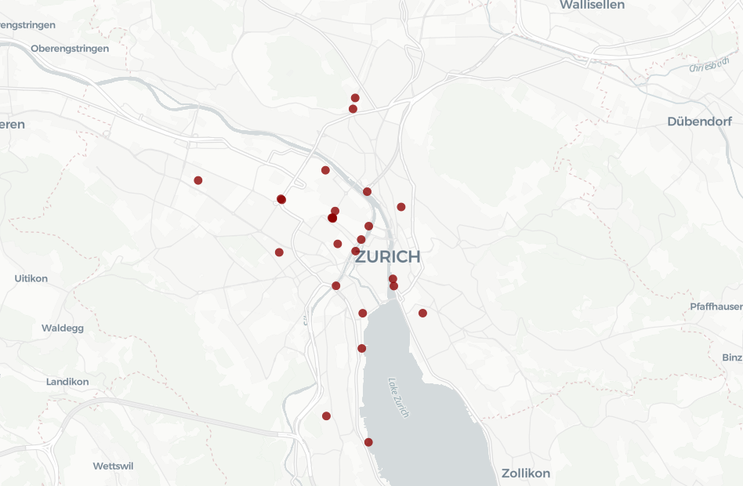
Counting stations
25 active pedestrian & bicycle sensors across the city
Concentration in the city centre (Limmat axis, Bahnhofstrasse area) and sparser coverage in residential districts. Most sensors count bikes in both directions; a subset (~6) is pedestrian-only.

Slide 7
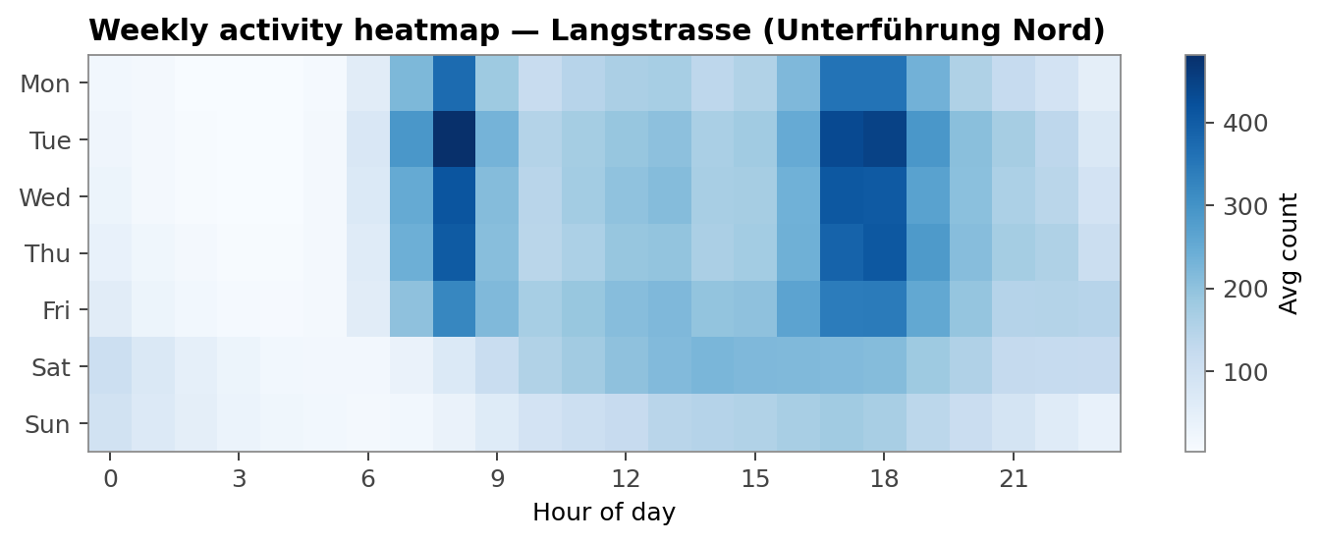
Exploratory analysis
Weekly activity heatmap — day of week × hour
What to look for • Weekday bimodal peaks → commuter site • Saturday midday peak → shopping street • Warm Friday evenings → leisure / nightlife
Before clustering, always eyeball the data. Weekly heatmaps let students spot commuter, retail and leisure patterns without any maths.

Slide 8
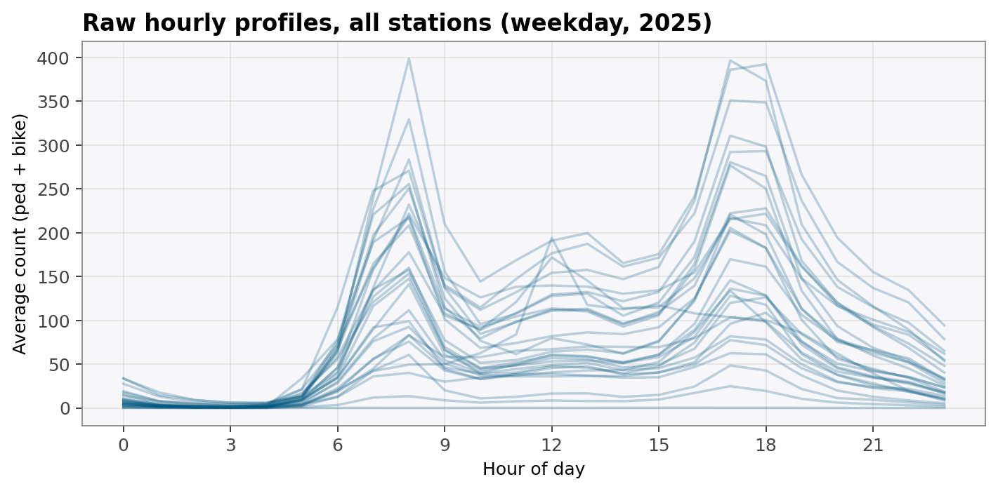
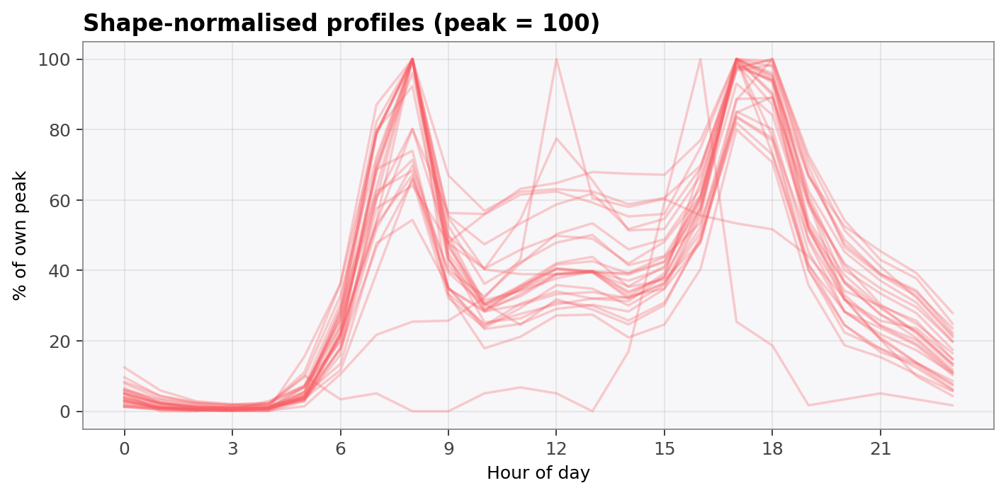
From counts to fingerprints
Stage 3 → 4 — why we normalise time series
Absolute magnitudes (problem)
Divide by peak → shape only (solution)
A quiet residential sensor and a busy central sensor can have the exact same shape — two peaks at 8 & 18. After dividing by peak, they live on the same [0, 100] scale and the clustering compares what actually matters: the rhythm.

Slide 9
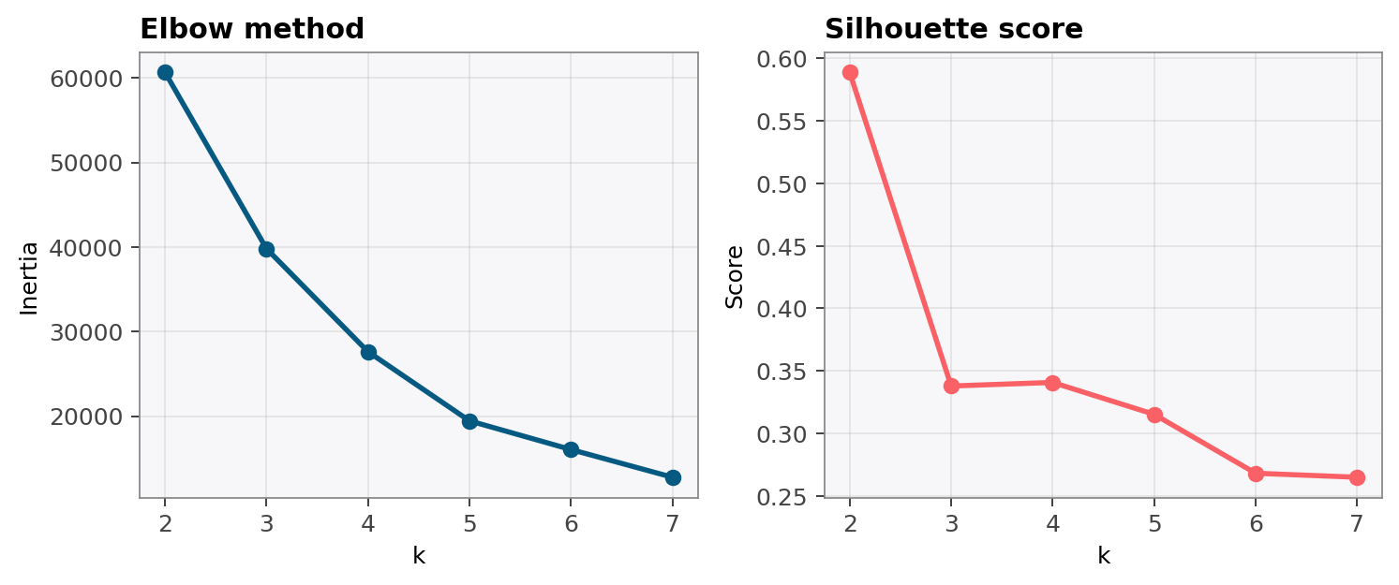
Model selection
Choosing k — elbow + silhouette
Elbow method Pick the k where adding clusters stops paying off — here k ≈ 4. Silhouette Score in [-1, 1]. Higher means denser, better-separated clusters.
Both diagnostics agree that small k (3–4) already captures most of the structure in our 25-sensor dataset.

Slide 10
Clustering algorithm
k-means (today) vs. k-shape (paper)
k-means
k-shape
• Minimises Euclidean distance to centroids • Works on raw or normalised vectors • Sensitive to time shifts (8:00 ≠ 9:00 peak) • Built-in to sklearn — fast, simple, ideal for teaching
• Shape-based distance (cross-correlation) • Invariant to amplitude AND phase shift • Better for time-series → chosen in the paper • In tslearn — drop-in replacement in app.py
Teaching strategy: start with k-means (transparent), then let students swap it for k-shape and observe the difference.

Slide 11
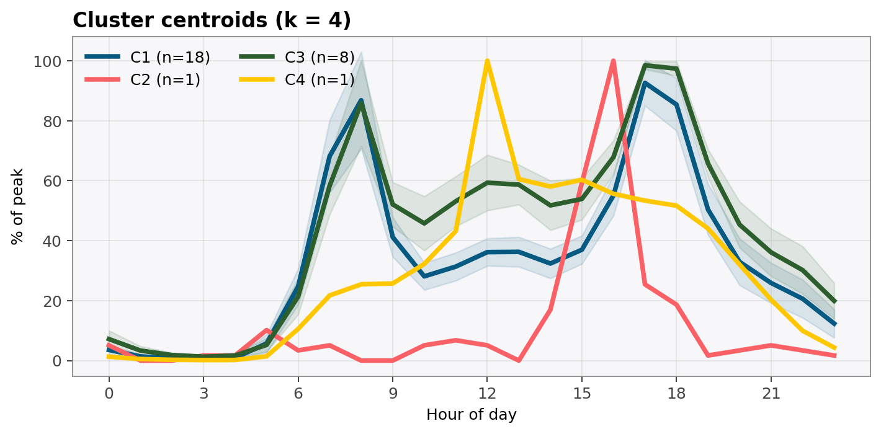
Results — temporal clusters
Four distinct Zurich daily rhythms
C1 — Classic commuter
Twin peaks, 8h & 17–18h
C2 — Flat residential
Small, late-night outlier
C3 — Steady hotspot
Strong all-day activity
C4 — Lunchtime leisure
Midday bump, no morning

Slide 12
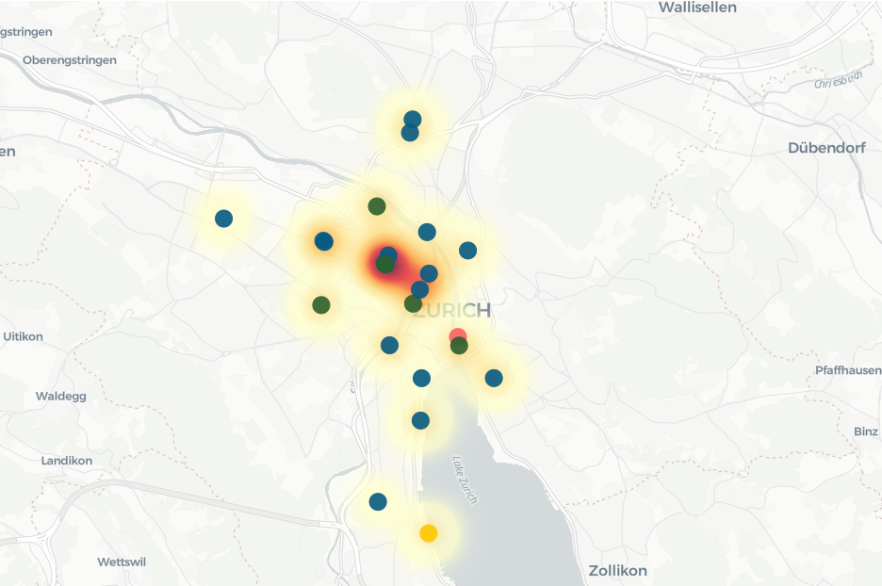
Results — spatial distribution
Where does each rhythm live in Zurich?
What to notice • Commuter cluster dominates peripheral bike corridors. • Hotspot cluster concentrates in the CBD and along the Limmat. • Outlier stations stand out — often night-time or sparse sites.

Slide 13
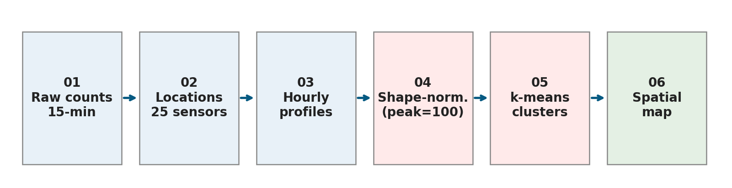
Prototype
The accompanying Streamlit app
Six pages, one sidebar of controls: 1 · Introduction — paper summary & pipeline 2 · Dataset exploration — interactive map + heatmap 3 · Temporal profiles — raw vs. normalised 4 · Clustering — elbow, silhouette, centroids 5 · Spatial analysis — map coloured by cluster 6 · Exercises — Level 1–4 student tasks Sidebar: modality, day type, month range, k.
RUN
streamlit run app.py
Requires: pandas, scikit-learn, streamlit, altair, pydeck
All data (CSV) bundled in /data — no download step.

Slide 14
PART 2
Student exercises
Four levels — from sidebar tweaking to method swapping.

Slide 15
Level 1 — Reproduce
Warm up: exploring the sidebar
01
02
03
Modality sensitivity
Weekday vs. weekend
Seasonality check
Switch between pedestrian-only and bike-only. Which stations cluster differently?
Some rhythms invert — identify a 'commuter on weekdays, leisure on weekends' sensor.
Summer (6–8) vs. winter (12–2): which clusters are robust, which change?

Slide 16
Level 2 — Explain
From clusters to narratives
04 · Name each cluster centroid (k = 4) in one sentence — 'commuter', 'evening peak', 'flat', etc. 05 · Pick two stations from your map and justify their cluster assignment given their land-use context (check on OpenStreetMap). 06 · Write a 100-word planning takeaway: which neighbourhoods might benefit from intervention based on what the rhythms reveal?
DELIVERABLE
A 1-page 'Temporal fingerprints of my neighbourhood' briefing with the cluster map, 4 centroids and 3 sentences of interpretation per cluster.
Submit as PDF.

Slide 17
Level 3 — Extend
Swap the algorithm, add dimensions
Hierarchical
DTW / k-shape
Replace KMeans with AgglomerativeClustering. Plot the dendrogram.
Install tslearn, swap in KShape — compare cluster memberships.
PCA embedding
Stability
Project 24-dim profiles to 2-D, colour by cluster, check separability.
Run 20 seeds; measure how often two sensors end up together.

Slide 18
Level 4 — Connect
Bridge back to the paper
10 · Build a toy example: two sine waves offset by 1 hour. Show that k-means assigns them to different clusters, but k-shape does not. 11 · Read Section 3.2 of the paper. Map their five clusters to the ones you found in Zurich — which correspond and which have no Zurich equivalent? 12 · The paper weights cells by capacity (people/m²). Add a weight to our k-means based on total counts — does the clustering change?

Slide 19
Summary
Five things to take home
1
Cities have rhythms.
Normalised hourly profiles reveal structure that raw counts hide.
2
Shape beats scale.
Normalising to peak lets a quiet alley share a cluster with a busy square if their rhythms match.
3
Pick k with diagnostics.
Elbow + silhouette give you a defensible choice — not a guess.
4
Algorithm matters.
k-means is a starting point; k-shape and DTW fit time-series better.
5
Pipelines transfer.
The paper's methodology works on any spatiotemporal activity dataset.

Slide 20
THANK YOU
Questions & discussion
REFERENCES & DATA
Barrena-Herrán, M., Modrego-Monforte, I. & Grijalba, O. (2025). Revealing Spatiotemporal Urban Activity Patterns: A Machine Learning Study Using Google Popular Times. ISPRS Int. J. Geo-Inf., 14, 221. Stadt Zürich Open Data · Verkehrszählungen Fussgänger & Velo 2025.

