Slide 1
Applied Data Science in Fintech Summerschool Bayonne 2022 | Cryptocurrency Trading-Bot Workshop
mario.gellrich@zhaw.ch
Dr. Mario Gellrich

Slide 2
Program for July 8
Time* | Program: Automated Cryptocurrency Trading
9:00 – 10:00 | Introduction, installation of software, brainstorming-sessions
11:00 – 12:00 | Working in groups on the tasks; technical sessions
12:00 – 13:00 | Lunch break
13:00 – 14:00 | Working in groups on the tasks; technical sessions
14:00 – 15:00 | Working in groups on the tasks; technical sessions
15:00 – 16:00 | Presentation of topics and results
*additional breaks are included
Dr. Mario Gellrich, Summer School 2022

Slide 3

Workshop procedure and philosophy
No permanent presentations by the lecturer
Group work (8 groups each with 3 students)
Groups are mixed (Bachelor and Master students)
Each «expert» group is responsible for one «topic»
Methods are explained in detail in «technical sessions»
Students ask members of «expert groups» for help
The more experienced students help the others
At the end of the day, groups present their topics and results
Presentations are evaluated with pass/fail
Image Credit: https://revistaempresarial.com
Dr. Mario Gellrich, Summer School 2022

Slide 4
Prerequisites for July 8
Software:
R (latest version from CRAN: https://cran.r-project.org)
RStudio (latest desktop version from: https://www.rstudio.com/products/rstudio)
Accounts:
Binance Spot Test Network (https://testnet.binance.vision); access via GitHub
Coinbase Pro (we will work with the public sandbox environment)
Link: https://public.sandbox.pro.coinbase.com/trade
Material for exercises
R-Scripts (will be used to guide the exercises and provided by the end of the day)
Dr. Mario Gellrich, Summer School 2022

Slide 5
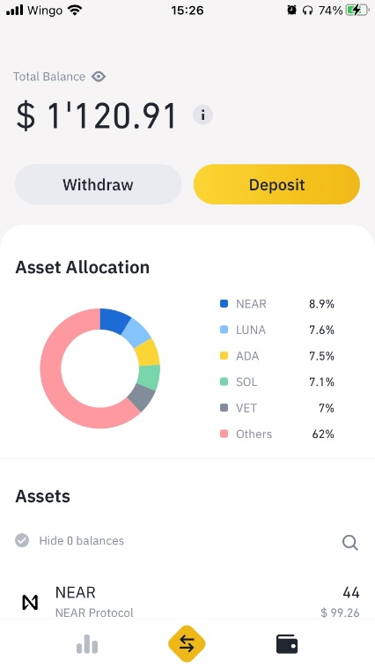
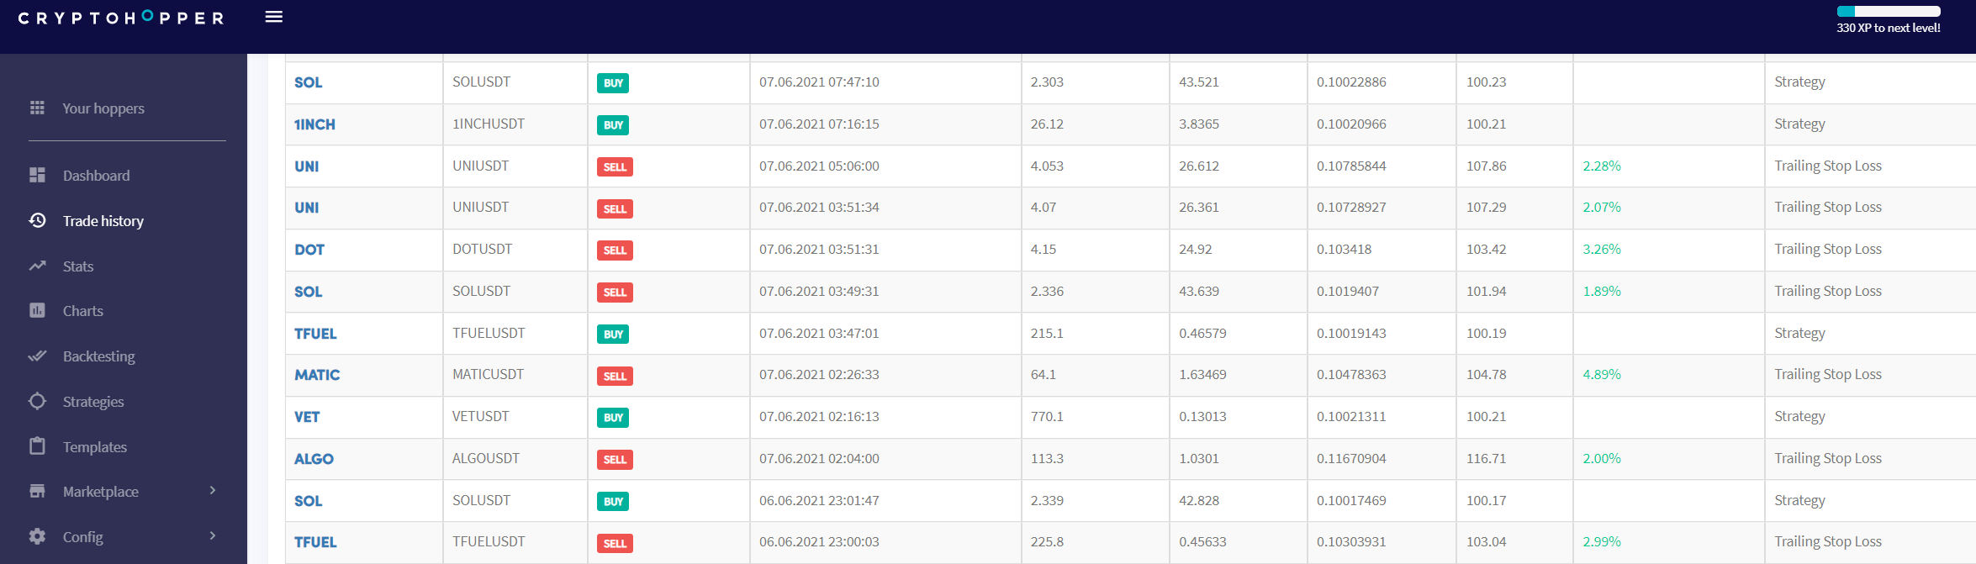
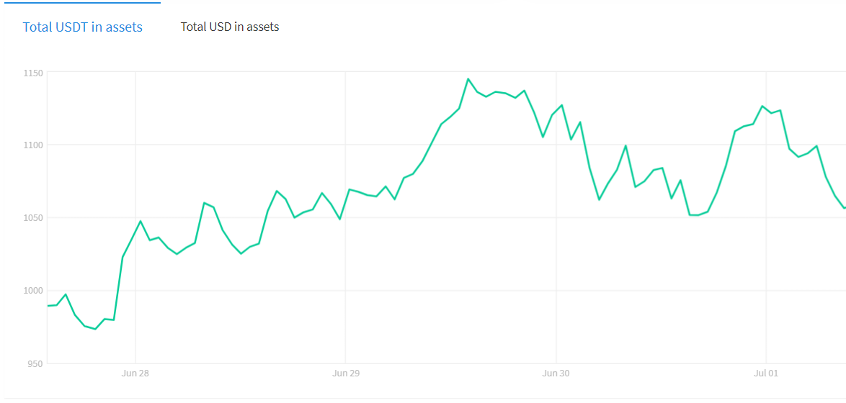
Motivation
Self-Experiment using Binance (exchange) and Cryptohopper (commercial trading bot)
Dr. Mario Gellrich, Summer School 2022

Slide 6
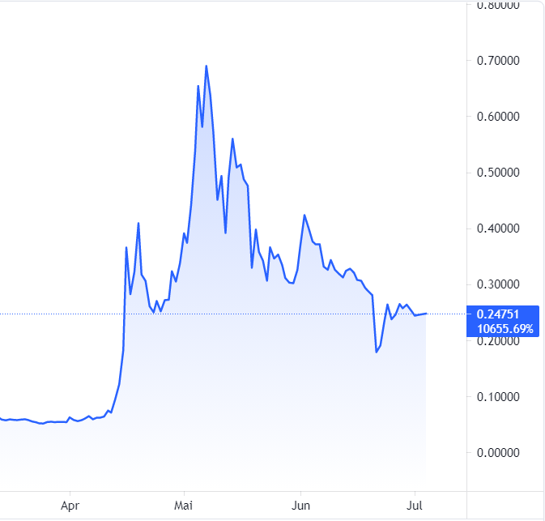
Motivation
Self-Experiment using Binance (exchange) and Cryptohopper (commercial trading bot)
Findings:
Setting up Binance (online wallet) is straightforward.
Setting up the Cryptohopper is more complex.
Cryptohopper works fine (and makes fun) but has some limitations.
Limitations were found e.g. with the shortage functionality.
Very volatile market in both directions (-30% to +30% per day observed)
Current market is under presure (e.g. due to regulations).
Price development of diff. coins seem to be «linked».
Prices of different coins seem to increase and decrease in «waves».
Number of coins on the market is rising (e.g. on Binance ~ 150 coins).
Example: DOGEUSDT
Image Credit: https://de.tradingview.com
Dr. Mario Gellrich, Summer School 2022

Slide 7
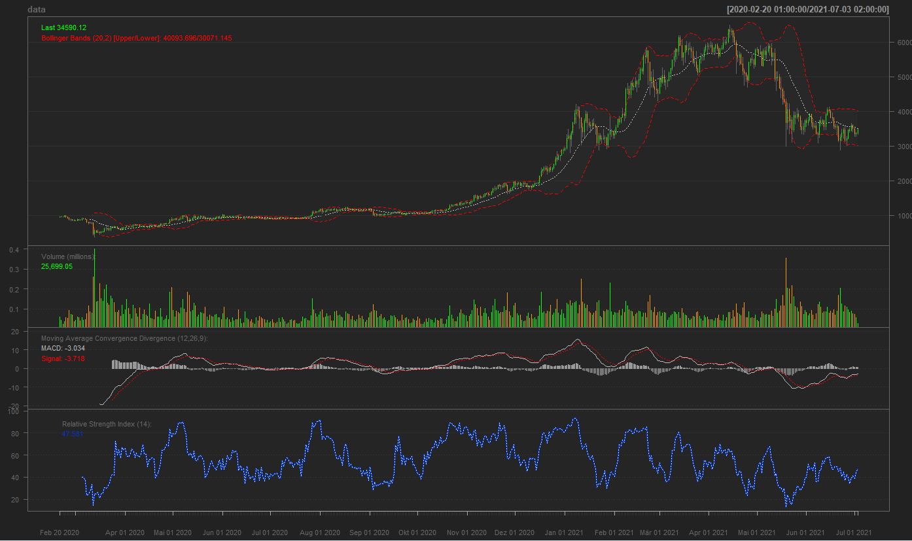
Technical Analysis (TA)
Example of a trading chart (Bitcoin price development)
“Technical analysis is a trading discipline employed to evaluate investments and identify trading opportunities by analyzing statistical trends gathered from trading activity, such as price movement and volume.”
https://www.investopedia.com
Image own, part of the exercises
Dr. Mario Gellrich, Summer School 2022

Slide 8
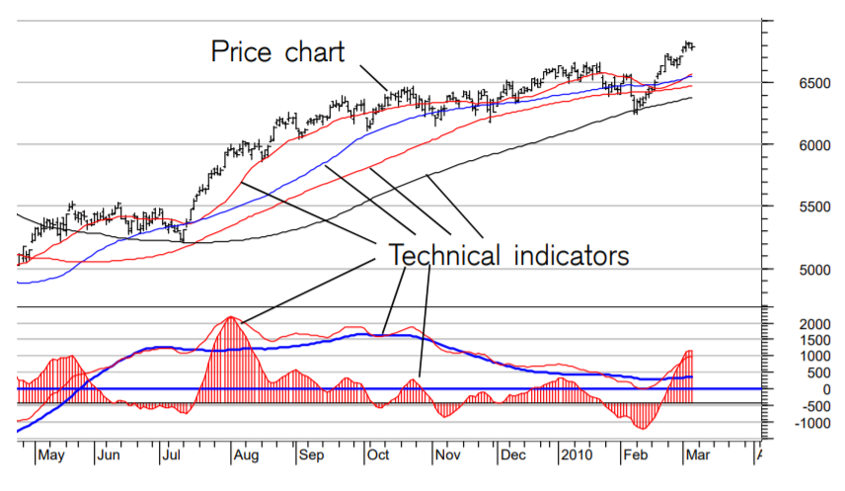
Technical Analysis (TA)
Unlike Fundamental Analysis, which is a practice of analyzing securities by determining the intrinsic value of the stock, the Technical Analysis is a method of determining the future price of the stock using charts to identify the patterns and trends.
Image Credit: Credit Suisse (n.d.) Technical Analysis Explained
Source: https://keydifferences.com/difference-between-fundamental-and-technical-analysis.html
Dr. Mario Gellrich, Summer School 2022

Slide 9
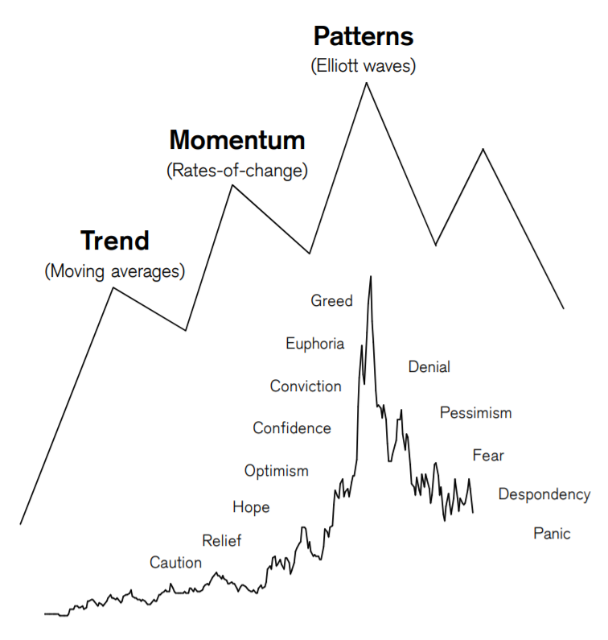
Technical Analysis (TA)
Optimism, pessimism, greed and fear …
Image Credit: Credit Suisse (n.d.) Technical Analysis Explained
Dr. Mario Gellrich, Summer School 2022

Slide 10
Technical Analysis (TA)
Trend indicators
SMA (Simple Moving Average)
EMA (Exponential Moving Average)
MACD (Moving Average Convergence Divergence)
Bollinger Bands
...
Oscillators
RSI (Relative Strength Index)
…
Dr. Mario Gellrich, Summer School 2022

Slide 11
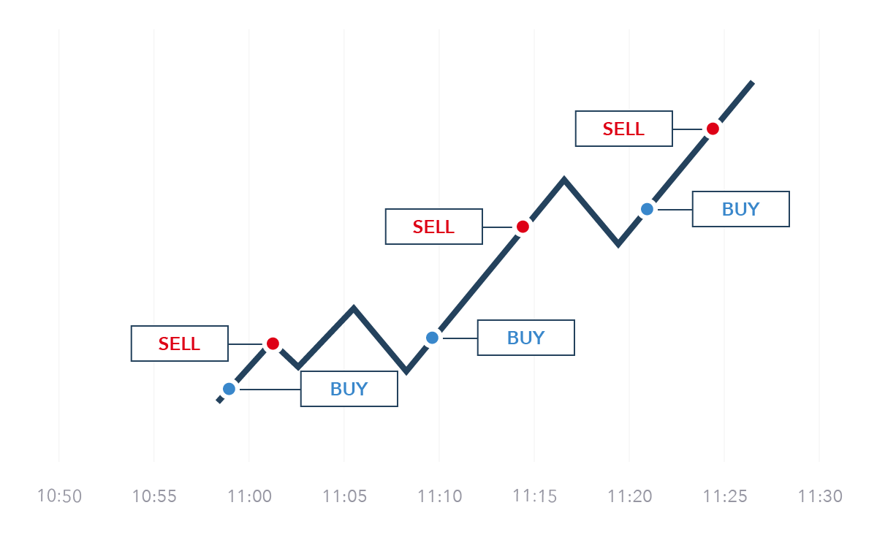
Trading Strategies
“In finance, a trading strategy is a fixed plan that is designed to achieve a profitable return by going long or short in markets. The main reasons that a properly researched trading strategy helps are its verifiability, quantifiability, consistency, and objectivity. For every trading strategy one needs to define assets to trade, entry/exit points and money management rules.”
Wikipedia
Image Credit: https://www.ig.com/en-ch/trading-strategies
Dr. Mario Gellrich, Summer School 2022

Slide 12
Trading Strategies
Types of trading strategies
Long/short equity
Pairs trade
Swing trading strategy
Scalping trading
Day trading
Trading the news
Trading signals
Social trading
Dr. Mario Gellrich, Summer School 2022

Slide 13
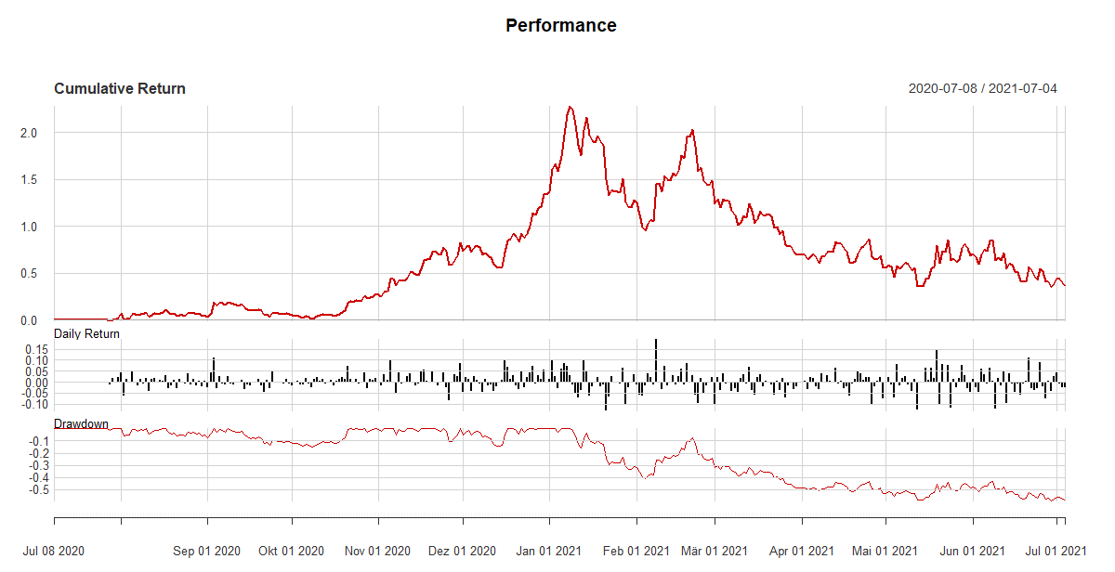
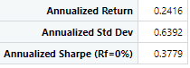
Backtesting a trading strategy
“Backtesting is the general method for seeing how well a strategy or model would have done ex-post. Backtesting assesses the viability of a trading strategy by discovering how it would play out using historical data. If backtesting works, traders and analysts may have the confidence to employ it going forward.”
Image own, part of the exercises …
https://www.investopedia.com
Dr. Mario Gellrich, Summer School 2022

Slide 14
Keyword pinboard (basis to define group tasks)
(Topic 1) Advanced functionality of R and RStudio
-
-
-
-
-
-
-
-
(Topic 2) Getting and exploring data from exchanges
-
-
-
-
-
-
-
-
(Topic 3) Technical Analysis (TA)
-
-
-
-
-
-
-
(Topic 4) Defining the Trading Strategy
-
-
-
-
-
-
-
Dr. Mario Gellrich, Summer School 2022

Slide 15
Keyword pinboard (basis to define group tasks)
(Topic 5) Backtesting the Trading Strategy
-
-
-
-
-
-
-
(Topic 6) Programing the Trading Bot
-
-
-
-
-
-
-
-
(Topic 7) Performance Analysis
-
-
-
-
-
-
-
(Topic 8) Scheduling the Trading Bot
-
-
-
-
-
-
-
Dr. Mario Gellrich, Summer School 2022

Slide 16
Expert groups and definition of tasks
Expert Group (X): Technical analysis (TA)
Trend indicators & oscillators
Simple Moving Average (SMA)
Exponential Moving Average (EMA)
Relativ Strength Indicator (RSI)
Moving Average Convergence Divergence (MACD)
Candle Stick Chart
Bollinger Bands (BB)
Example!
Dr. Mario Gellrich, Summer School 2022

Slide 17
Recommended structure of the «expert» sessions
Questions which help to explain the software, functions, methods, etc. by each expert group
Q: What is ...? / Explain ...!
Q: What problem is solved with ...?
Q: How does ... work?
Q: What applications are there for ...?
Dr. Mario Gellrich, Summer School 2022

Slide 18
Minimal structure of the final presentation
1 Introduction
1.1 Problem framing
1.2 Objectives
1.3 Research question
2 Materials and Methods
2.1 Data sources, -description & -preparation
2.2 Technical Analysis
2.3 Trading Strategy & Backtesting
2.4 Programing the trading bot
2.5 Performance Analysis
3 Results & Discussion
4 Conclusions
Dr. Mario Gellrich, Summer School 2022

