Slide 1
Azure shared responsibility model
A look at Azure's Storage Services security responsibilities

Slide 2
#whoami
20 years of security interest (late 90s hacking was fun), 16 professionally
Owner at Privacy Beacon and Director of CyberSecurity for Broadlight
Professional experience includes penetration testing, on-prem & cloud security operations and engineering, security design authority, risk management, assurance, governance and compliance for SMBs, FTSE 100 and NASDAQ listed organisations
Community contributor – ISECOM Hacker Highschool, ISO 27001 standards, OWASP GDPR Patterns and early involvement in OWASP DSOMM (DevSecOps Maturity Model)

Slide 3
Shared responsibilities.
You need to understand it if you're looking at being compliant with <insert-preferred-auditable-standard>
Microsoft know fully well what they're responsible for. You should too
You don't want to find out when the wolf's ICO or your customers are at the door asking questions

Slide 4
Why it's important
826 million records reported lost or stolen in 2017
+58 million were security breaches
+6.7 million due to configuration errors
+374 million due to internal error
+5 million due to Ransomware, Phishing or Malware
Average of 19 hours downtime following attack
Average cost is 2.48 million
Source: https://www.itgovernance.co.uk/blog/infographic-list-of-data-breaches-in-2017/

Slide 5
Most still getting it wrong, it seems Consider the ask, consider the audience

Slide 6
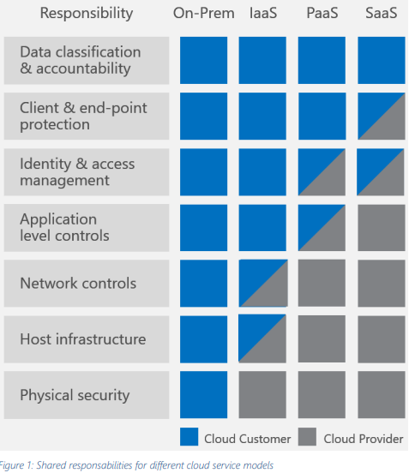
The model

Slide 7
Before talking Storage Services, a rule of thumb...

Slide 8
If it's configurable in your Azure portal, it's your responsibility to assess its need

Slide 9
Data Classification and Compliance
It's up to you:
To identify, label and classify data
Distinguish between content that is to be public and confidential
SaaS
Office Lockbox and DLP
You still need to configure it securely though
PaaS
Azure Rights Management or similar.
Protect data and your product feature set
IaaS
Protection of data in storage objects

Slide 10
Application level control
It's up to you:
Have processes in place to control user access to apps
Distinguish between content that is to be public and confidential
SaaS
You still need to configure it securely though
Microsoft deal with infrastructure(VM,patching, antimalware and baseline security)
Protect data and your product feature set
IaaS
Customer protects OS and app layers of VMs
Default's are permissive
PaaS

Slide 11
Physical security
That is in all Cloud deployment models, Microsoft's responsibility
They provide assurances of their periodic audits and include:
SOC 2 Type II
ISO 27001, ISO 27017 and 27018
CSA Star
Etc, etc, etc, etc, etc, etc.....
They also provide security reports of their services

Slide 12
Practical tips for your storage services (of what's up to you)

Slide 13
Management Plane Protecting the storage accounts
Don't use Classic deployment model
It can only provide "all or nothing" access, not role based
But if you do, manage your storage account keys
Cycle them regularly and have processes for incident response
Storage explorer apps keep keys. Options are cycling or be exposed
Better yet, use a secrets management solution (Azure Key Vault or equivalent)
Assess the roles you need and design for them

Slide 14
Data Plane Protecting the data in your storage accounts
Use Shared Access Signatures (SAS)
fine grain permissions and criteria for access
service level access and account level access
Consider scaling, don't create a mess to clean up later
Use Stored Access policies to manage constraints to multiple Shared Access signatures
Avoid the loose ends that can get you on the news
Azure Storage is now encrypted at rest by default but you still need to assess your OS and Data disks
Consider complementing access restrictions with Firewalls or Virtual networks, and Multi-factor auth

Slide 15
Encryption in transit Protecting the transfer of data between storage resources
Use HTTPS for REST API calls and object access
With SAS, you can specify that HTTPS is the only allowed protocol for transit
File share usage
Intra-region by default it uses SMB 2.1 (no encryption) but you can restrict to SMB 3.0.
Inter-region SMB 3.0 is mandatory
You can always do client-side encryption if that's a requirement

Slide 16
Monitoring Know who's accessing your data and what they're doing with it
Azure Storage analytics or similar capability
You can search log files for operation types, authentication types and track any kind of calls to a storage account
Find a way to identify anomalies or an alternative solution to support incident detection and response

Slide 17
Cross-Origin Resource Sharing define the domains that host expected resources outside your domain
Allows for "relaxing" of Same Origin Policy, particularly when dealing with AJAX requests and affects client-side
Helps protect against XSS attacks

Slide 18
Final Thoughts Being pragmatic about it
Consider using open-source software technology and support
Reasonable assurance against predictable threats
Know your contracts and customer expectations
Consider de facto security standards and compensating measures
Always have a (good & documented) story to tell an external party on how you've been diligent about procuring and configuring your cloud services.

