Slide 1

Blockchain Proof of Presence
Dennis Salzmann
Mario Ruoff
Fernando Leon
Fabian Jakob

Slide 2
Hello!
We are 4 students @Uni Stuttgart from different IT-backgrounds (Computer Science, Mechatronics)
You can find the project @github: mario-r99/hackathon-2022

Slide 3
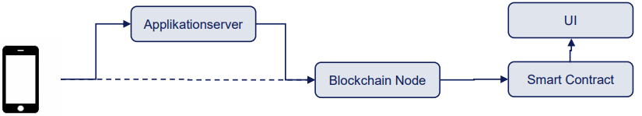
Project Motivation

Slide 4
Outline
Setup and Components
Demonstration
Discussion

Slide 5
Outline
Setup and Components
Demonstration
Discussion

Slide 6
I – Asdf
subtitle

Slide 7
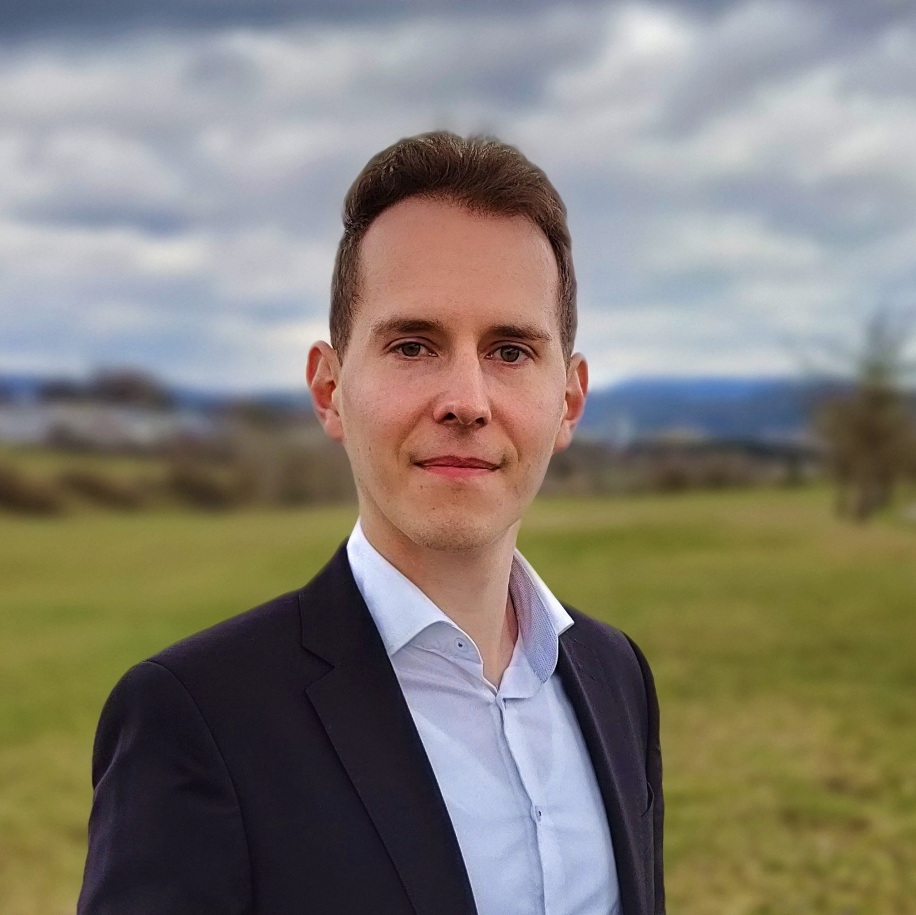
Fabian Jakob
e-mail
fjakob@rj-cad-deisgn.de
phone +49 (0) 179 131 4477
University of Stuttgart

