Slide 1

Blockchain Proof of Presence
Dennis Salzmann
Mario Ruoff
Fernando Leon
Fabian Jakob

Slide 2
Hello!
We are 4 students @Uni Stuttgart from different IT-backgrounds (Computer Science, Mechatronics)

Slide 3
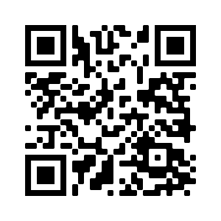
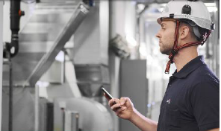
Project Motivation
mantainance service
SPIE Presence Service
Scan QR-Code
Information encrypted in Blockchain
No overview over maintainance
Unreliable
Monetary loss

Slide 4
Outline
Setup and Components
Demonstration
Discussion

Slide 5
Outline
Setup and Components
Demonstration
Discussion

Slide 6
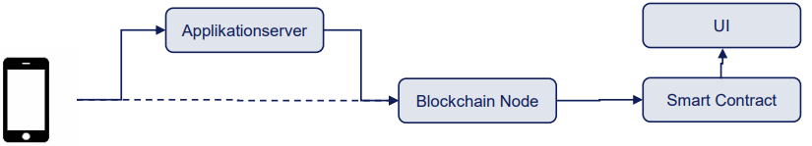
I – Setup and Components
Software Architecture

Slide 7
I – Setup and Components
Software Architecture

Slide 8




I – Setup and Components
Software Architecture
QR-Code Scanner
Server
Blockchain
User Interface
protocol
protocol
protocol
Kotlin
blabla
Python
blabla
Solidity, Python
blabla
Python, InfluxDB
blabla

Slide 9
Project Motivation

Slide 10
Outline
Setup and Components
Demonstration
Discussion

Slide 11
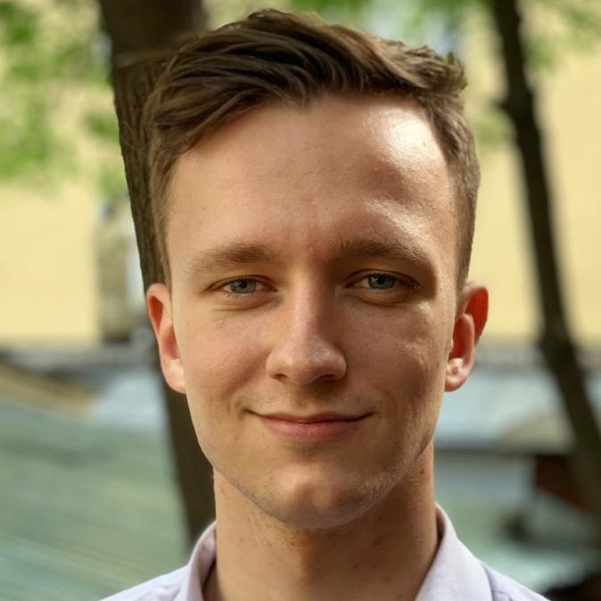
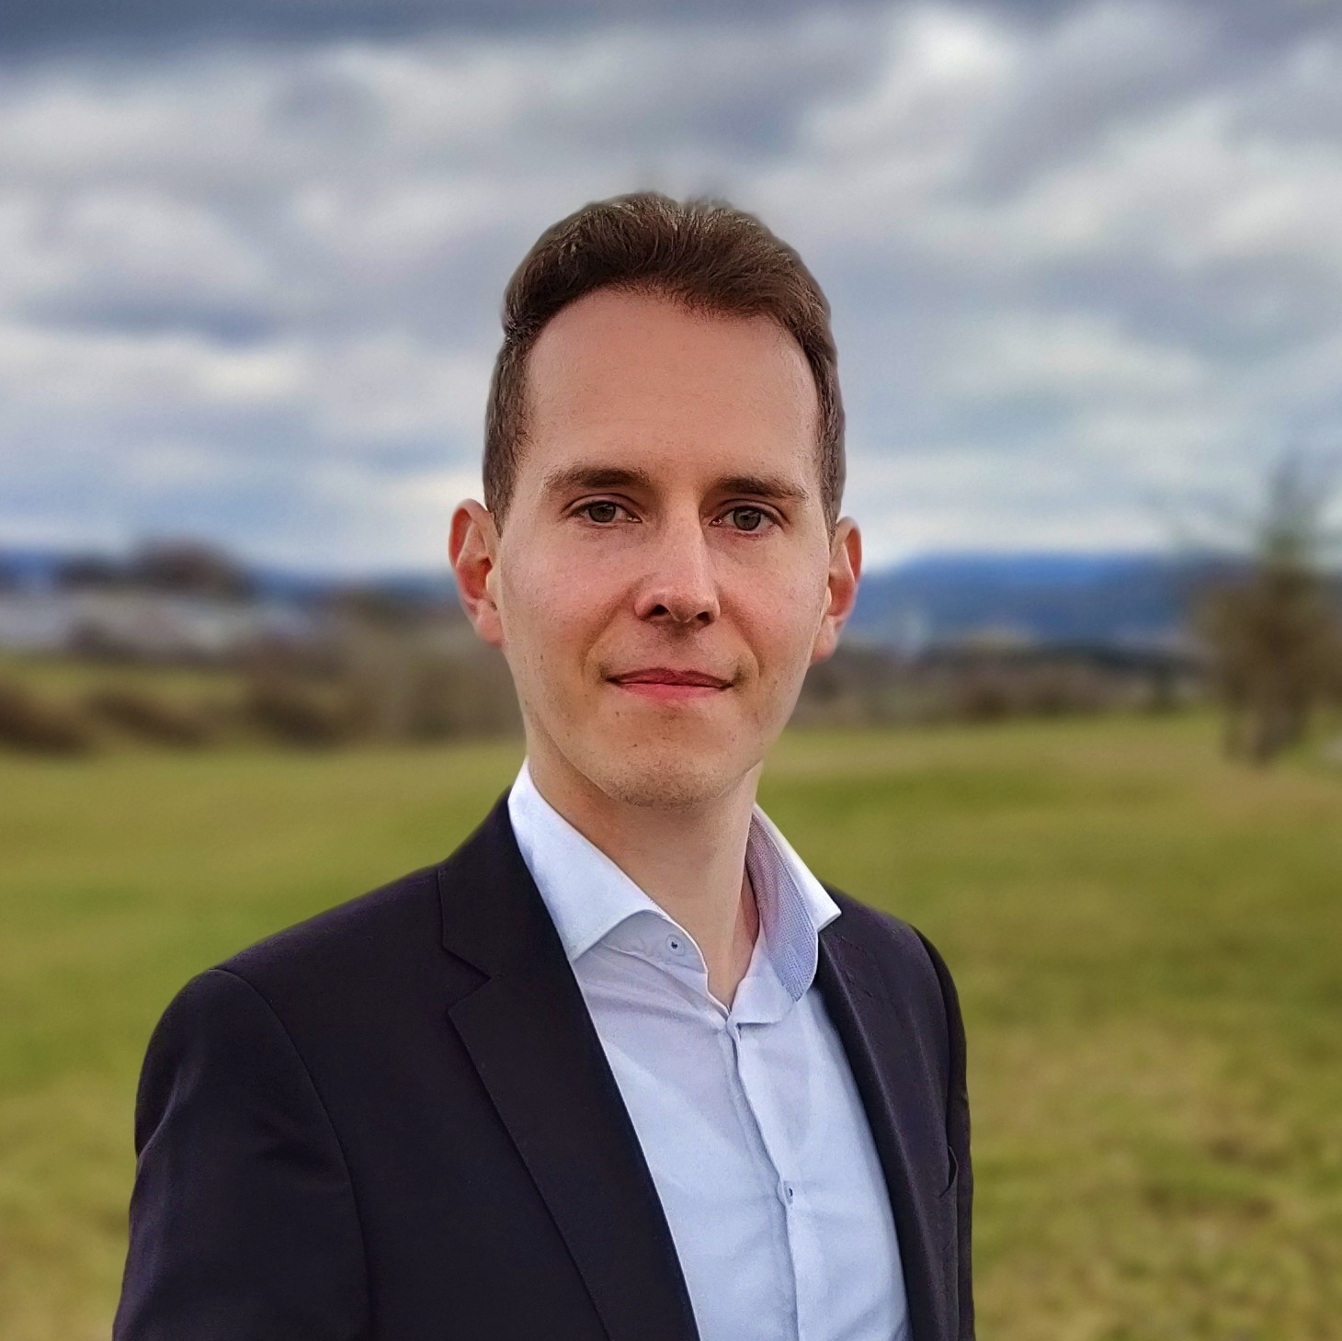
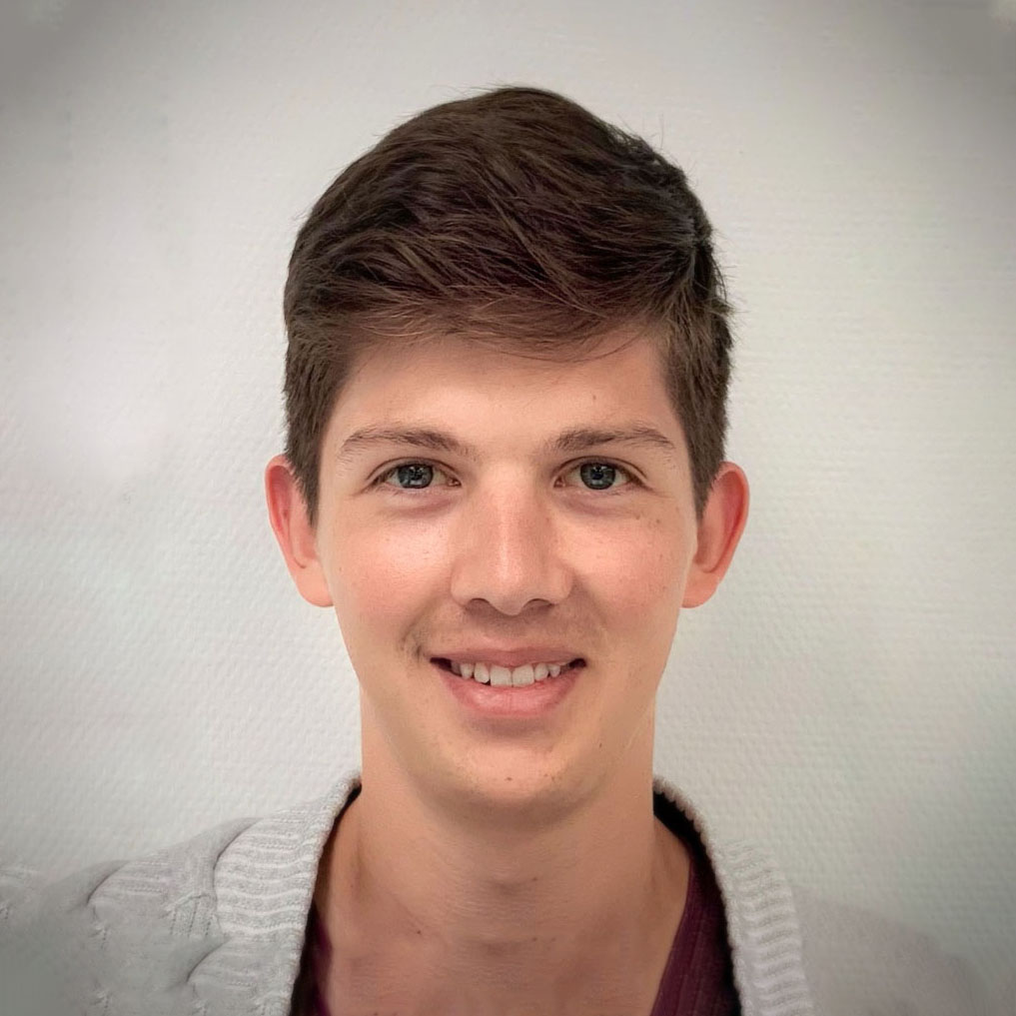
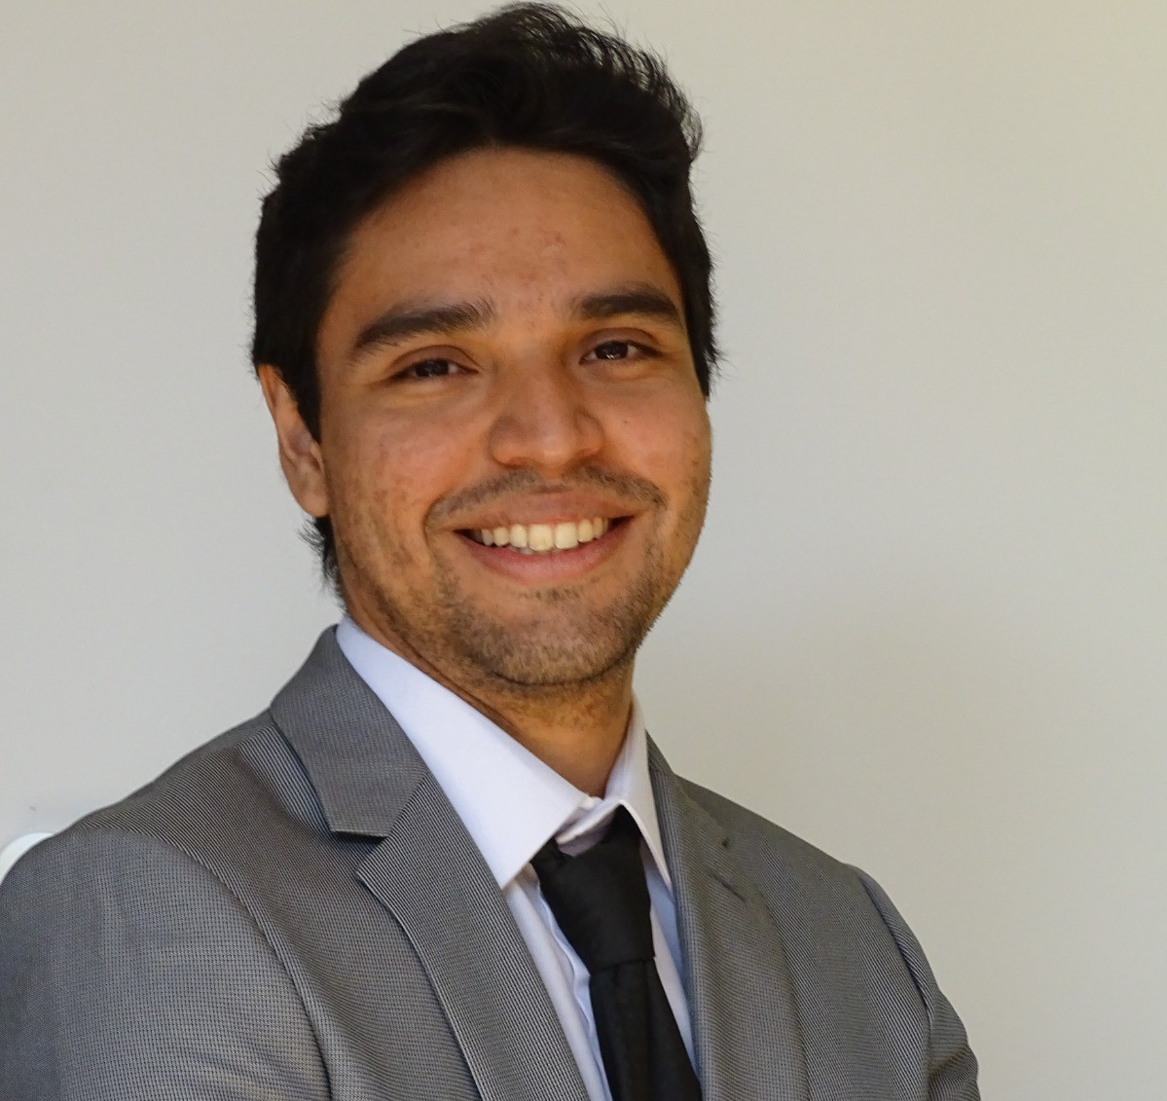
Dennis Salzmann
Fabian Jakob
M.Sc. Engineering Cybernetics
M.Sc. Engineering Cybernetics
e-mail
den.salzmann@gmail.com
e-mail
fjakob@rj-cad-design.de
University of Stuttgart
University of Stuttgart
Mario Ruoff
Fernando Leon
M.Sc. Autonomous Systems
M.Sc. Mechatronics
e-mail
mario.srx99@gmail.com
e-mail
f.leon.marquez.st@outlook.com
University of Stuttgart
University of Stuttgart

