Slide 1

Blockchain Proof of Presence
Dennis Salzmann
Mario Ruoff
Fernando Leon
Fabian Jakob

Slide 2
Hello!
We are 4 students @Uni Stuttgart from different IT-backgrounds (Computer Science, Mechatronics)
You can find the project @github: mario-r99/hackathon-2022

Slide 3
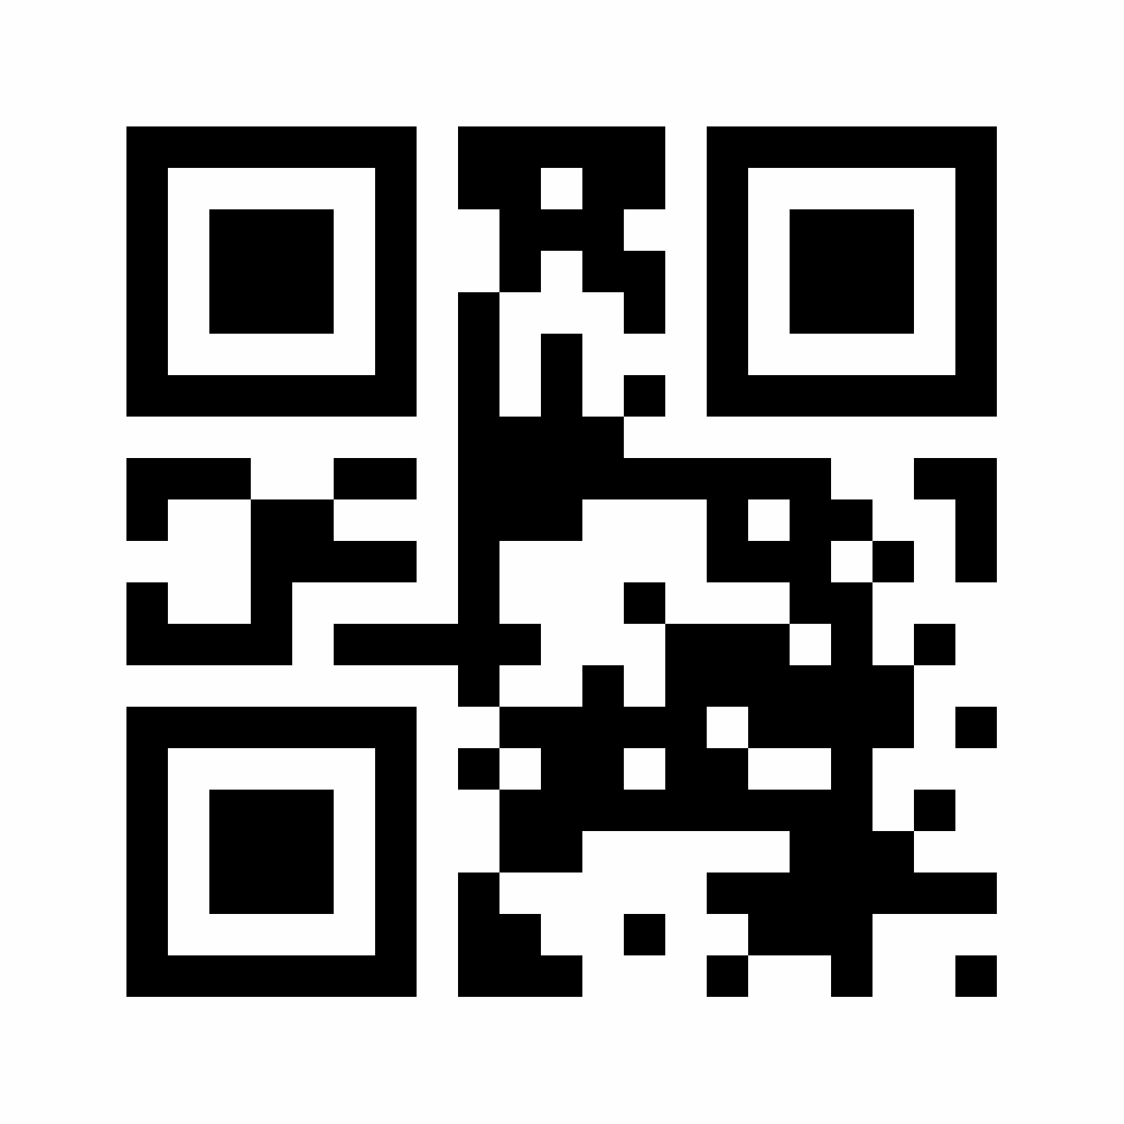
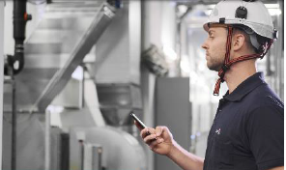
Project Motivation
mantainance service
SPIE Presence Service
Scan QR-Code
Information encrypted in Blockchain
No overview over maintainance
Unreliable
Monetary loss

Slide 4
Outline
Setup and Components
Demonstration
Discussion

Slide 5
Outline
Setup and Components
Demonstration
Discussion

Slide 6
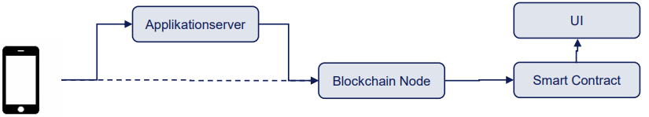
I – Setup and Components
Software Architecture

Slide 7
Project Motivation

Slide 8
Outline
Setup and Components
Demonstration
Discussion

Slide 9
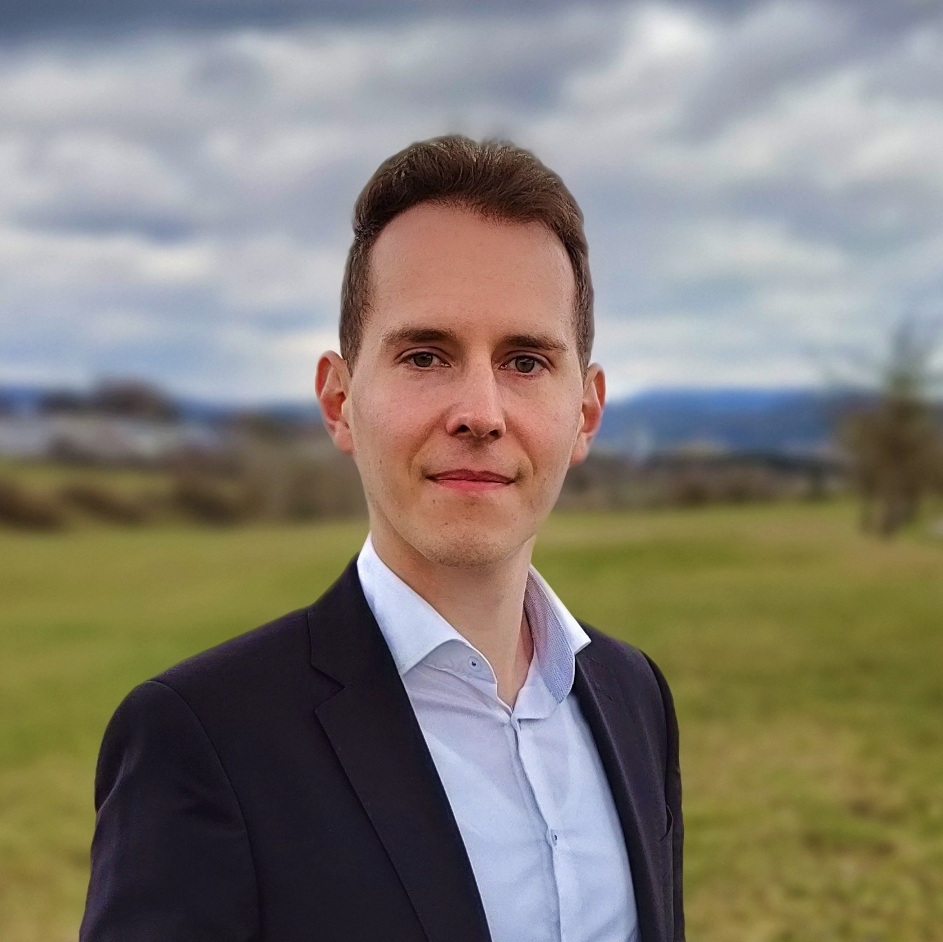
Dennis Salzmann
Fabian Jakob
e-mail
e-mail
fjakob@rj-cad-deisgn.de
phone
phone +49 (0) 179 131 4477
University of Stuttgart
University of Stuttgart
Mario Ruoff
Fernando Leon
e-mail
e-mail
phone
phone
University of Stuttgart
University of Stuttgart

