Slide 1
Using Timers
Dr. Ricky T. Castles
EENG 3040- Microprocessors

Slide 2
Timers and Counters
Up to this point, we have written our own timer routine and counter routines
The PIC microcontroller has built in functions to do this also
Can be used to count number of transitions from external input or clock time from oscillator

Slide 3
Counters
Counts the number of either rising or falling edge events on a particular input pin on PIC
Keeps count in timer register
Can set interrupt when an overflow occurs

Slide 4
Timers
Use same registers as in counter mode
Counts based on number of clock cycles
Can be scaled to count each clock cycle, every other one, up to one every 256
Can be set to cause overflow interrupt

Slide 5
PIC16F887 Timers/Counters
Timer 0
8-bit (TMR0)
Clock source selectable
Oscillator or T0CKI (RA4)
3-bit prescaler
Can set interrupt for FF to 00 transition (INTCON)
Datasheet section 5

Slide 6
Timer 0 Registers
Timer counter in TMR0
INTCON used to enable interrupt and flag
OPTION_REG
T0CS-selects T0CKI or instruction clock
T0SE-1 = falling edge, 0 = rising edge
PSA- 1 = prescaler to WDT, 0 to TMR0
PS0-PS2 = prescaler

Slide 7
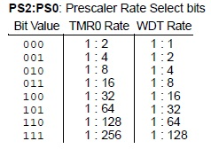
TMR0 Prescalers

Slide 8
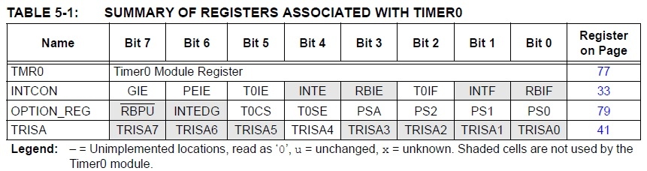
Timer 0 registers

Slide 9
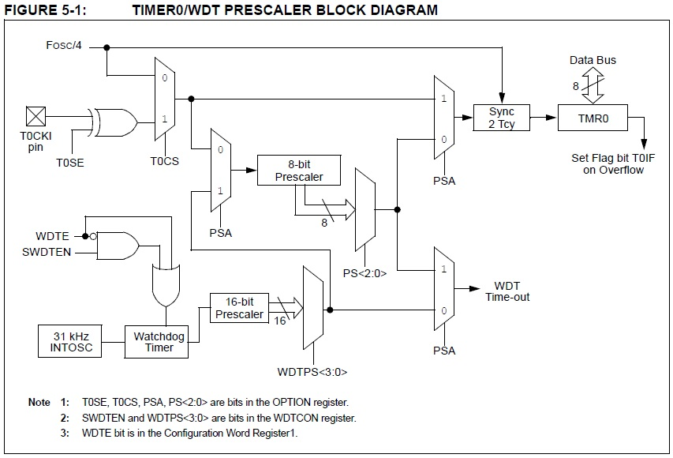
Timer 0 Block Diagram

Slide 10
PIC16F887 Timers/Counters
Timer 1
16-bit (TMR1H, TMR1L)
Timer mode or Counter mode
Uses instruction cycle or external clock (T1CKI)
2-bit prescalar (T1CON bits 4&5)
Can set interrupt for FFFF to 0000 overflow (INTCON, PIR1, PIE1)
Datasheet section 6 (p. 57)

Slide 11
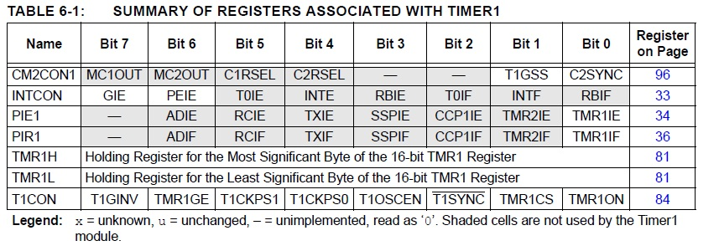
Timer 1 Registers

Slide 12
Timer 1 Registers
TMR1H and TMR1L are registers holding current count
Interrupts are peripheral (INTCON-PEIE, PIE1, PIR1)
T1CKPS1 and T1CKPS0 prescalers
T1OSCEN enables oscillator
TMR1CS selects clock source
1 = external clock (T1CKI), 0 internal
TMR1ON enables timer 1

Slide 13
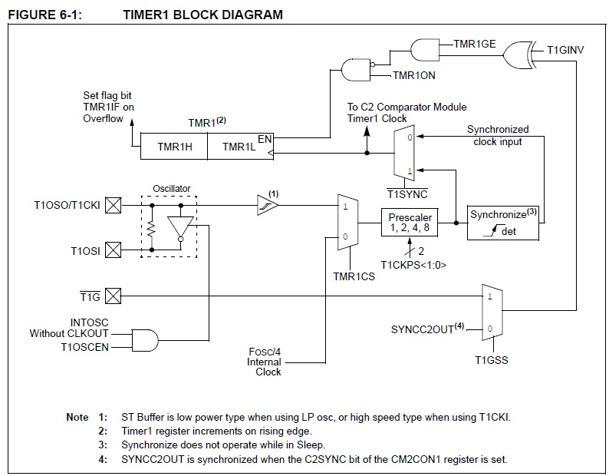
Timer 1 Block Diagram

Slide 14
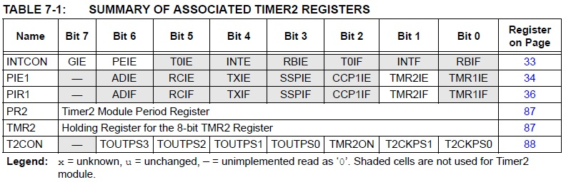
Timer 2 Registers

Slide 15
Watchdog Timer
The watchdog timer allows you to check to see if the code is running properly.
Small counter that must be reset regularly.
If not reset, assumes error and code is stuck somewhere

Slide 16
Working With the Watchdog Timer

Slide 17
General Usage of Timers
Determine time needed to run
Set prescalar accordingly
Initialize TMR0 (or others) to value that will lead to overflow at desired time
Enable interrupts for TMR0
In ISR, check which flag is set
Handle timing

