Slide 1
Interrupts
Dr. Ricky T. Castles
EENG 3040- Microprocessors

Slide 2
What are Interrupts?
An interrupt is a special event that happens that should be handled right away.
When an interrupt event happens
code execution stops where it was
an interrupt service routine (ISR) is called to handle the interrupt
After ISR completes, returns back to where code was running before

Slide 3

Interrupt Example
What would happen if a fire alarm went off right now?
We would stop the lecture
Everyone would go outside
Once all clear, go back
Continue lecture
Fire alarm can be thought of as interrupt event

Slide 4
PIC16F887 Interrupts
There are 17 interrupts available on the PIC we are using
Each interrupt must be enabled individually
RB0 (external)
PORTB change
TMR0 overflow
14 peripheral interrupts

Slide 5
When Interrupt Occurs
Code stops executing
Flag gets set
All interrupts disabled
Value of PC put on stack
PC moves to Interrupt Service Vector (line 04H)
In location 04H, put GOTO Interrupt Service Routine (ISR)
End ISR with RETFIE (return from interrupt)
Returns, reenables interrupts

Slide 6
Interrupt Service Routines
Handle response to interrupt event
Good idea to store values of ports, w, etc if anything will be modified. Restore these at the end of ISR.
Do bit tests on flags to determine which interrupt triggered
Then have code do handling
RETFIE

Slide 7
INTCON Register
Bit 7- GIE-Global interrupt enable
Bit 6- PEIE- Peripheral interrupt enable
Bit 5- T0IE- Timer 0 overflow interrupt enable
Bit 4- INTE- RB0 interrupt enable
Bit 3- RBIE-Port B change interrupt enable
Bit 2- T0IF- Timer 0 overflow flag
Bit 1- INTF-RB0 Interrupt Flag
Bit 0- RBIF-PORTB change Flag

Slide 8
PIE1 and PIE2 Registers
Used to enable peripheral interrupts
Mostly used for serial and parallel communication, A/D, other timers, comparators, memory writes, problem detection
7 Interrupts each enabled by PIE1& PIE2
More on these registers later

Slide 9
PIR1 and PIR2 Registers
Contains flags for the interrupts controlled by PIE1 and PIE2, respectively
More on these registers later

Slide 10
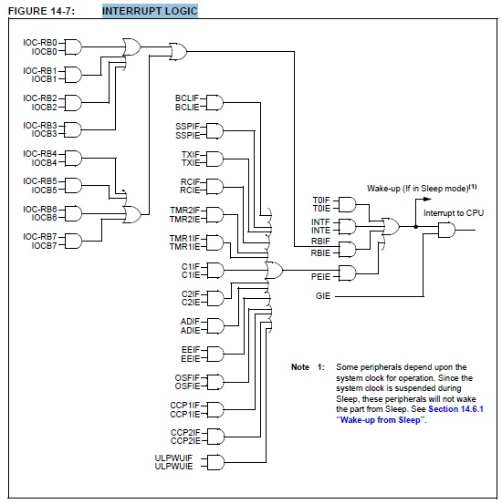
Interrupt Logic

Slide 11
RB0/INT Interrupt
See p. 224, section 14.3.1 of datasheet
Enabled by setting GIE and INTE (INTCON bits 7 and 4, respectively)
Triggered by either rising or falling edge on RB0
Edge triggering-setting or clearing OPTION_REG register bit 6
1=rising edge, 0 = falling edge

Slide 12
PORTB Change Interrupt
Enabled through RBIE (INTCON(4))
Triggered when the value input on any bit of PORTB changes
Only applies to those bits set as input through TRISB
Bits used to trigger interrupt set in IOCB register (see p. 51)
Flag is RBIF (INTCON(0))

Slide 13
TMR0 Interrupt
Timer 0 can be used as either an 8-bit timer or 8-bit counter
Value in TMR0 incremented on either clock events or external events on T0CKI (RA4)
Interrupt can be enabled to trigger on overflow from FF to 00
Enabled with T0IE bit (INTCON(5))
Flag on T0IF (INTCON(2))

Slide 14
Configuring TMR0 Interrupt
OPTION_REG used to choose:
Transition on internal clock or external pin T0CKI (RA4)
TOCS (OPTION_REG(5))
Rising or falling edge on T0CKI
T0SE (OPTION_REG(4))
Prescaling of clock
PSA to assign to TMR0 (OPTION_REG(3))
PS to choose rate scaler (OPTION_REG(0-2))

Slide 15
Uses of Interrupts
External or PORTB change interrupts could be used if you are waiting on input from a user or a digital sensor
Push button
Gas level low
Intruder detected
Timers/counters used to track time and number of items
Timed process
Limited access
Manufacturing

Slide 16
Summary
Interrupts allow code to stop on specific events
PC shifted to Interrupt Service Routine to handle event
PC stored on stack, popped off with RETFIE
More on timers later

