Slide 1
Parallelizing Word2Vec in Shared Memory
Advanced Algorithms and Parallel Programming
2016/2017
ZHOU YINAN

Slide 2
Problem Background
NLP : express word in dense vector
Neural Network : Skip-gram model architecture with negative sampling
Optimization : Stochastic Gradient Descent (SGD) – Mini batch

Slide 3
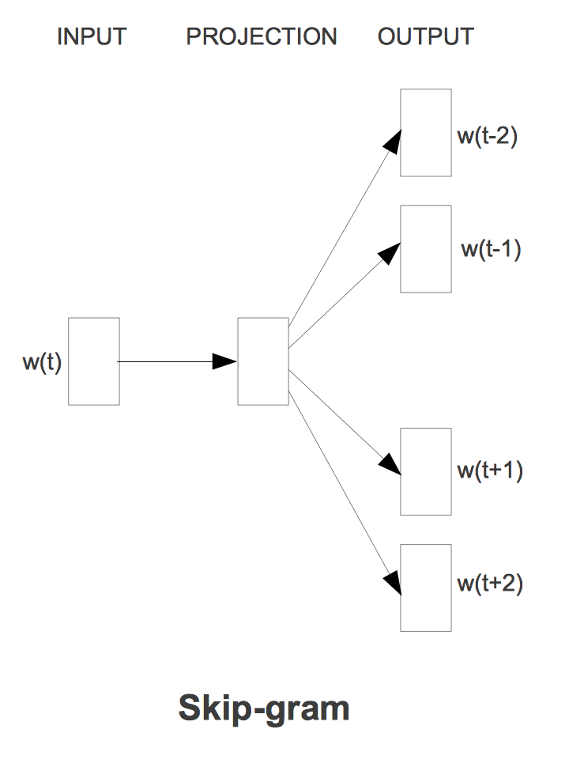
Skip-Gram Architecture
Skip-gram predicts the surrounding words
given the input words.

Slide 4
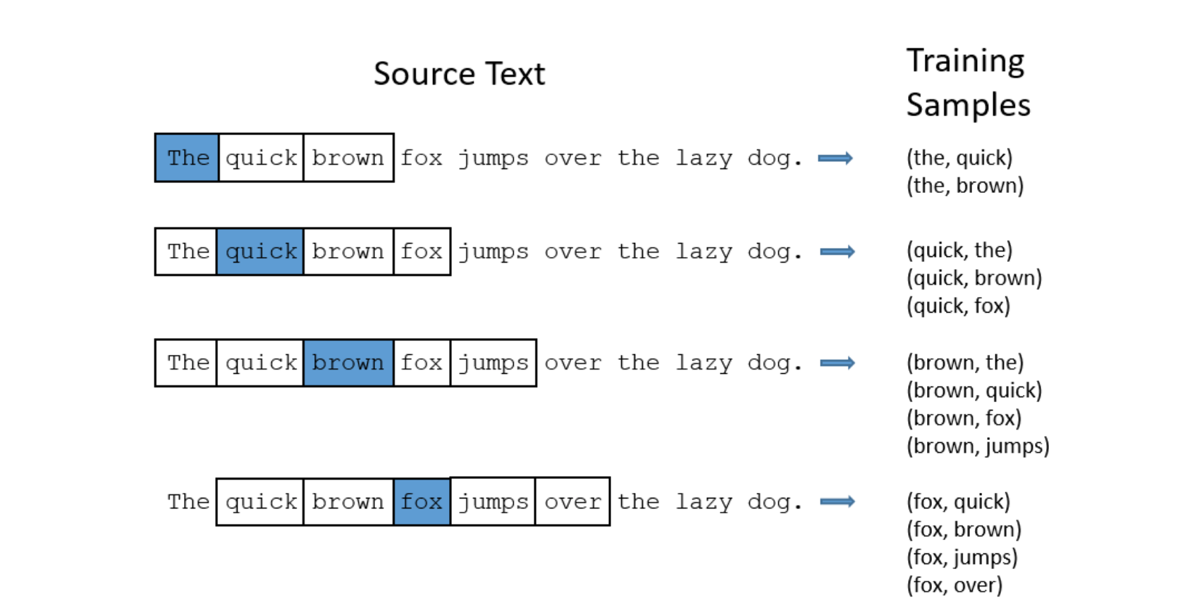

Slide 5
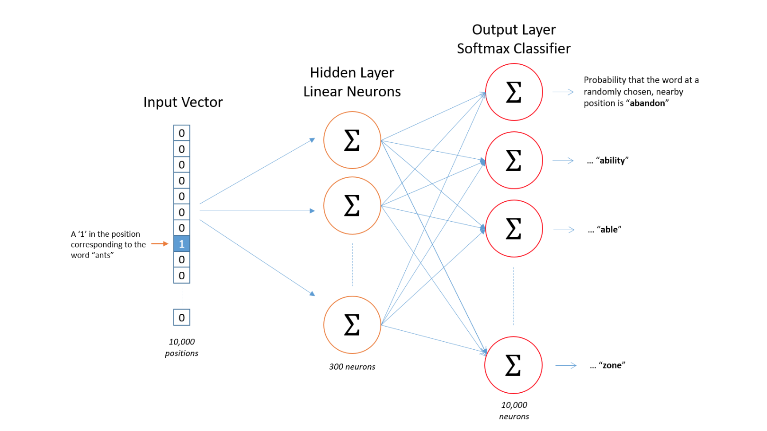


$$M_{out}$$
$$M_{in}$$

Slide 6
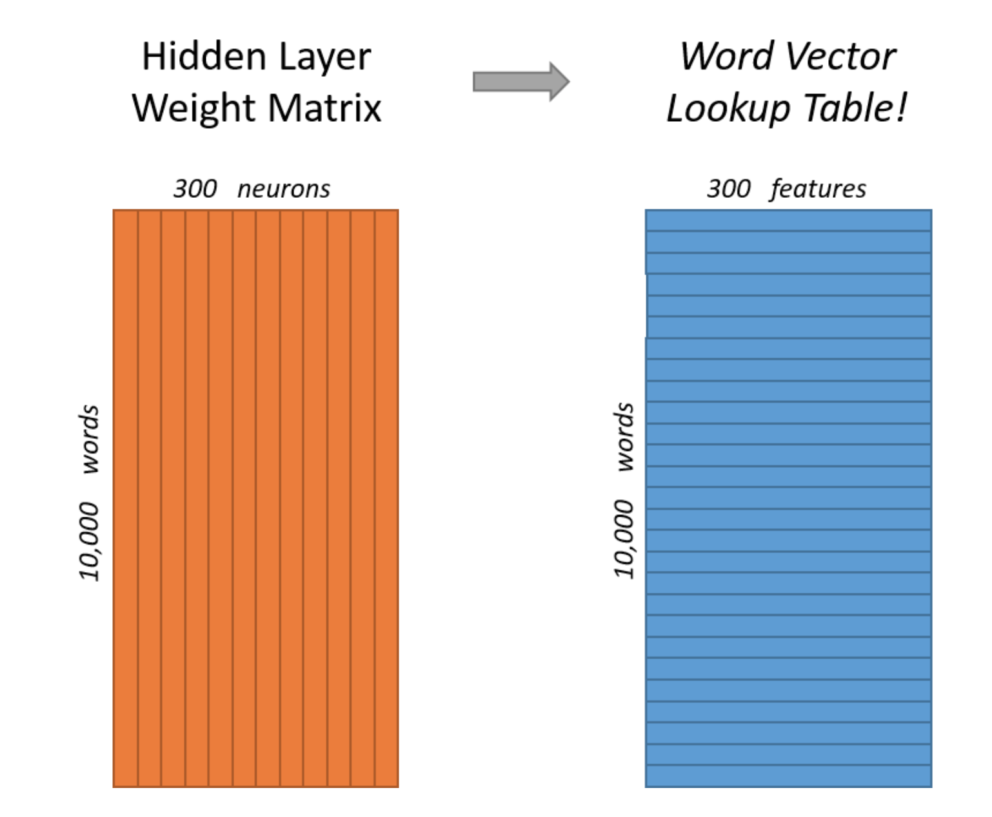
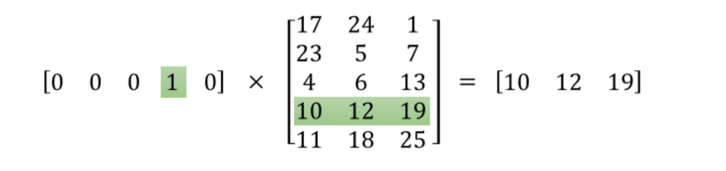

$$M_{in}$$

Slide 7
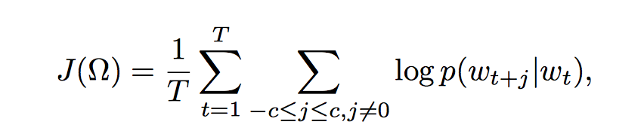

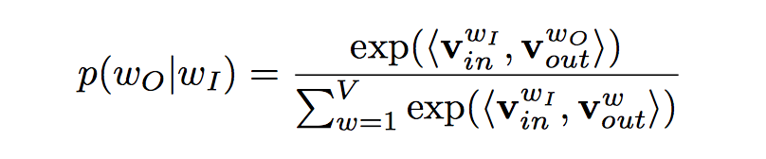
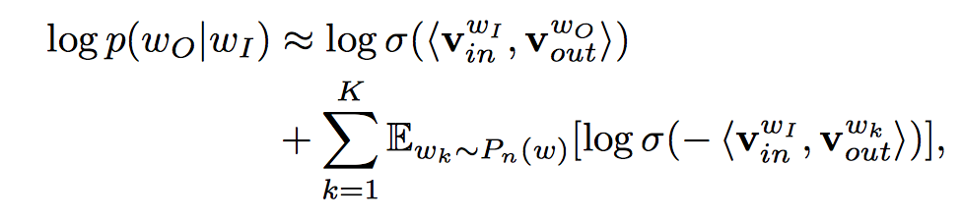
Negative Sampling
Softmax

Slide 8
How to Train the Neural Net ?

Slide 9
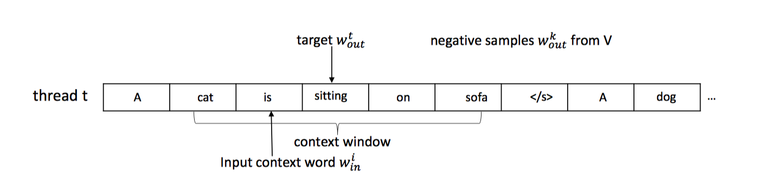
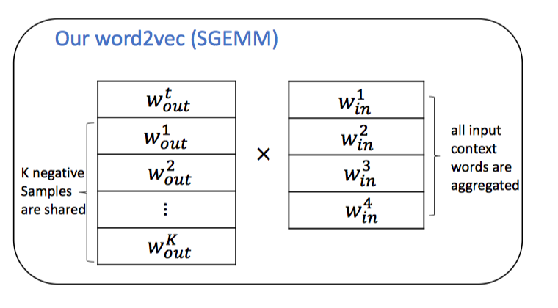
Mini-batch
sitting
dog
pencil
man
cat
is
on
sofa

Slide 10
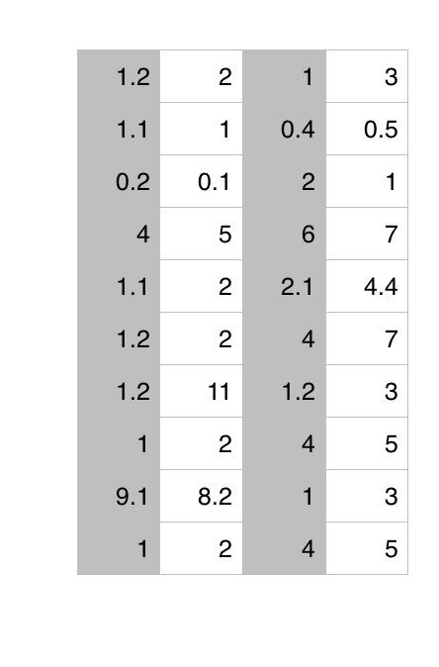
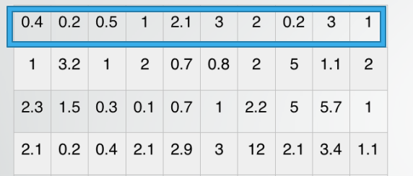


sitting
$$M_{in}$$
cat
$$M_{out}$$
cat
is
on
sofa
sitting
dog
pencil
man

Slide 11
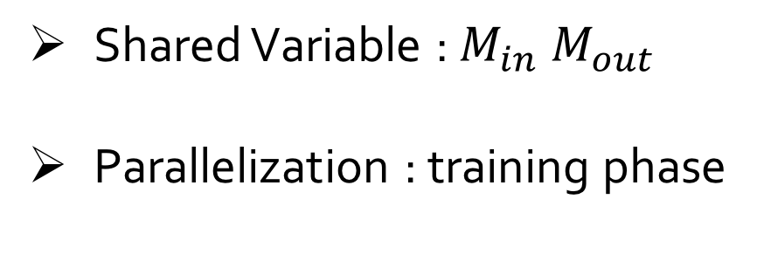
OpenMP
Shared Variable : $M_{in} M_{out}$
Parallelization : training phase

Slide 12
Thread Work
Take different file portion
Load sentences from file
Construct words training pair and mini-batch
Calculate error
Update weight matrix

Slide 13
Performance

Slide 14
DEMO

Slide 15

Q & A
https://github.com/marioZhou/AAPP

