Slide 1
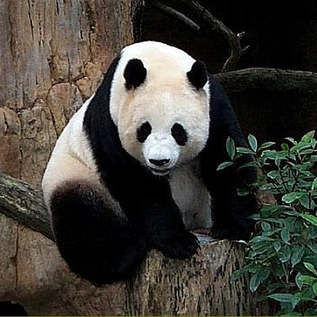
1024
fully connected
128
fully connected
3-class classification
256
stretch
several convolutions
and pooling
2
2
image
fully connected layers

Slide 2
128
3
256
256
256
128
128
128
2
2
2
1
1
1
2
2
2
128
1
1
1
256
several convolutions
and pooling
convolution
1
3
2
1
filter size = 2x2x256
1
2
1
image

