Slide 1
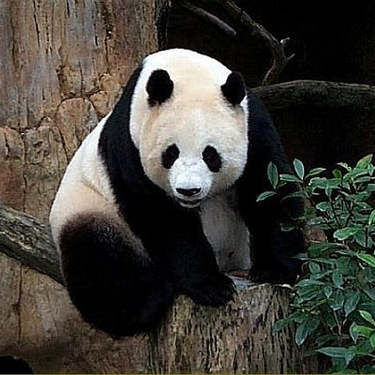
1024
fully connected
3-class classification
256
fully connected
128
several
convolutions
and pooling
stretch
2
image
2
fully connected layers

Slide 2
128
3
256
256
256
128
128
128
2
2
2
1
1
1
256
2
128
1
2
2
1
1
several
convolutions
and pooling
2
1
convolution
1
3
1
2
filter size = 2x2x256
1
image

