Slide 1

A Java Grande Benchmark to compare
Java and C++ performance for a discrete event
simulation application
Ana Bosque Arbiol

Slide 2

Contents
A Java Grande Benchmark to compare… what???
Ns, a network simulator
How the scheduler works
The project
Outstanding work
Summary

Slide 3
Java Grande Benchmark?
Java = programming language
Grande = application with large memory, network or
computational requirements
Java wasn’t built for being used in these kinds of applications but...

Slide 4
Java important features
Java has a number of important features:
Portability
Nonexistence of pointers
No need of complex Makefiles
Remote method invocation (RMI)
Remote file access
Database access
Good software engineering environments

Slide 5
Lacks of Java
Java has also some disadvantages:
Lack of some features for scientific programmers
(multidimensional arrays, complex numbers, …)
Absence of the familiar parallel programming models
(MPI and OpenMP)
Performance

Slide 6
Java Grande Benchmark
The aim is to provide the community a standard benchmark suite
which can be used to:
Demonstrate the use of Java for Grande applications.
Provide metrics for comparing Java execution environments
Expose features of the environments critical for Grande Applications
Further information:
www.epcc.ed.ac.uk/research/publications/journal/javabenchcpe.ps.gz
www.epcc.ed.ac.uk/research/publications/conference/jgflangcomp_final.ps.gz

Slide 7




A discrete event simulator?
A discrete event simulation application is a simulator which
works with a set of initial events generating new events or
cancelating the old ones in the execution of each event.

Slide 8
Ns, a network simulator
Ns is a network simulator that simulates variety of IP networks.
It implements network protocols such as almost all variants of
TCP and UDP, several forms of multicast, traffic source behaviour
such as FTP, Telnet, Web, ...
www.isi.edu/nsnam/ns
The ns project is now a part of the VINT project. The aim of this
project is to build a network simulator that will allow the study of
scale and protocol interaction in the context of current and future
network protocols.
www.isi.edu/nsnam/vint/index.html

Slide 9


Different parts of ns
Tcl interface
Network component object libraries
Network setup module libraries
Event scheduler
Event
Generator
Event treatment

Slide 10
Event scheduler
In ns, an event scheduler keeps track of simulation time and fires
all the events in the event queue scheduled for the current time
invoking appropriate network components.
Basically, it’s an structure in which are really important the
next operations:
Insertion
Deletion
Look for the next event to execute

Slide 11
Different implementations of the scheduler
We can think in a lot of different data structures. In the ns
project three different structures have been implemented:
List
Heap
Calendar

Slide 12
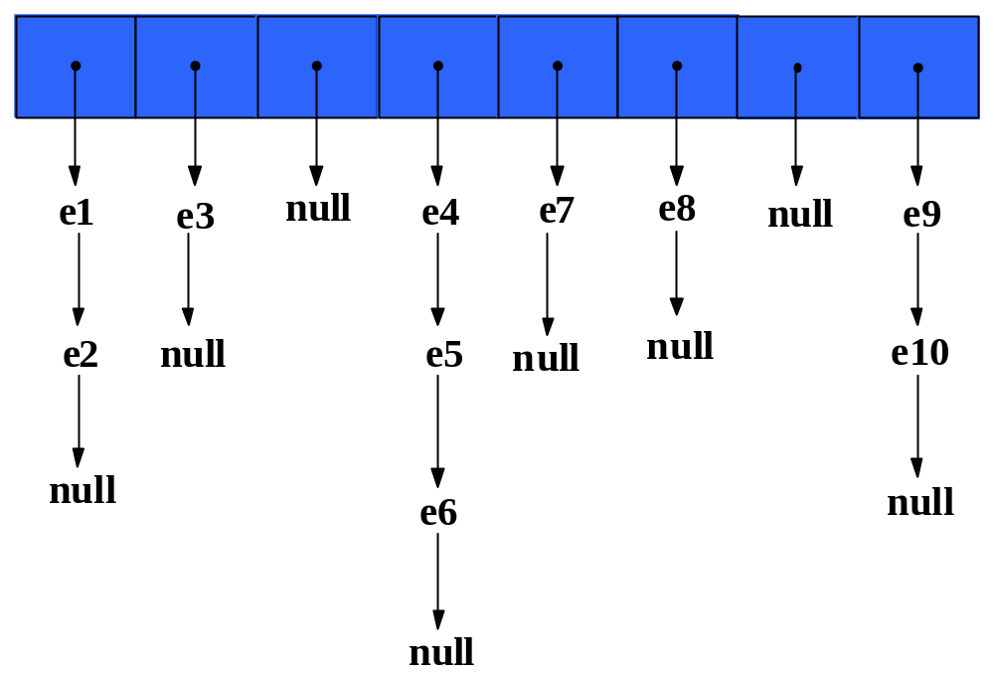
Calendar Scheduler

Slide 13
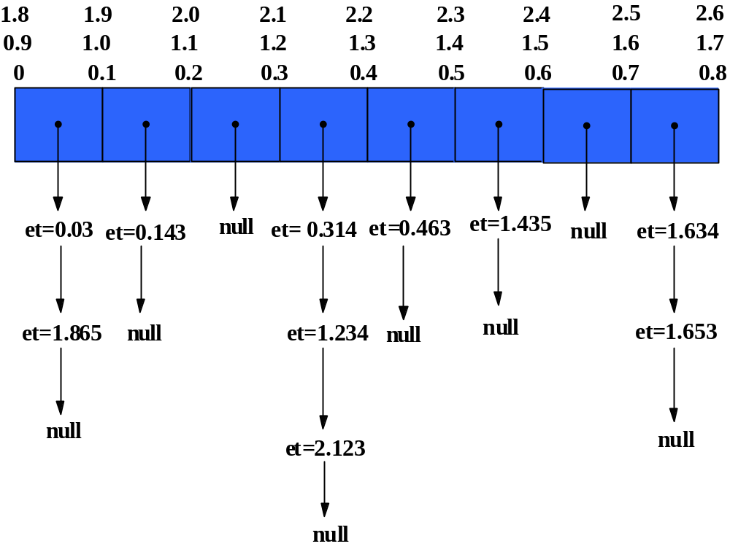
Calendar Scheduler

Slide 14

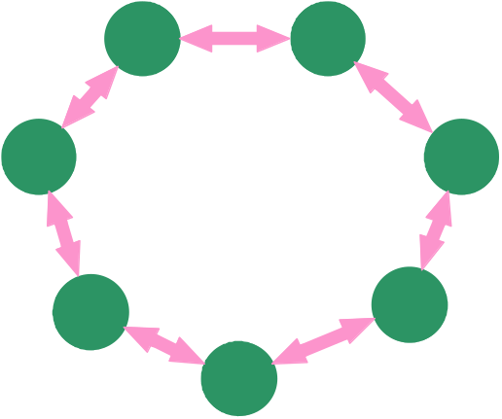
Calendar Scheduler execution
Models executed:
50x10Mb_simple_tcp.tcl
number of nodes
web clients per node
ftp clients per node
distance between servers
ring-master.tcl

Slide 15
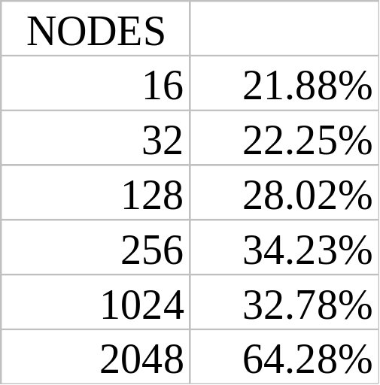
Calendar Scheduler execution
Scheduler time vs. Event execution time

Slide 16
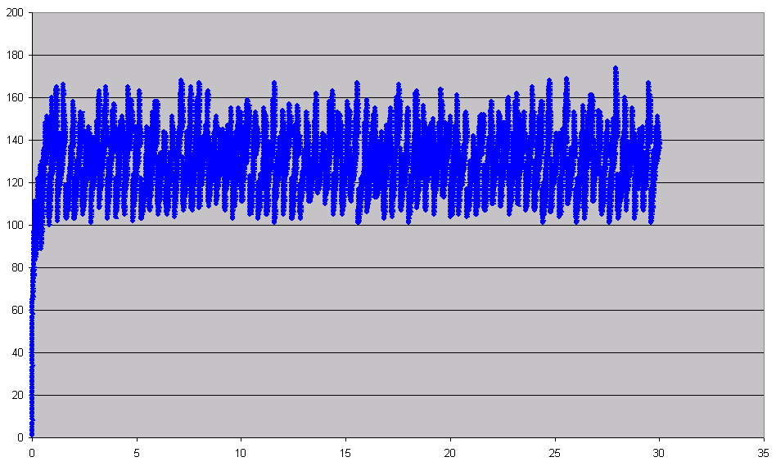
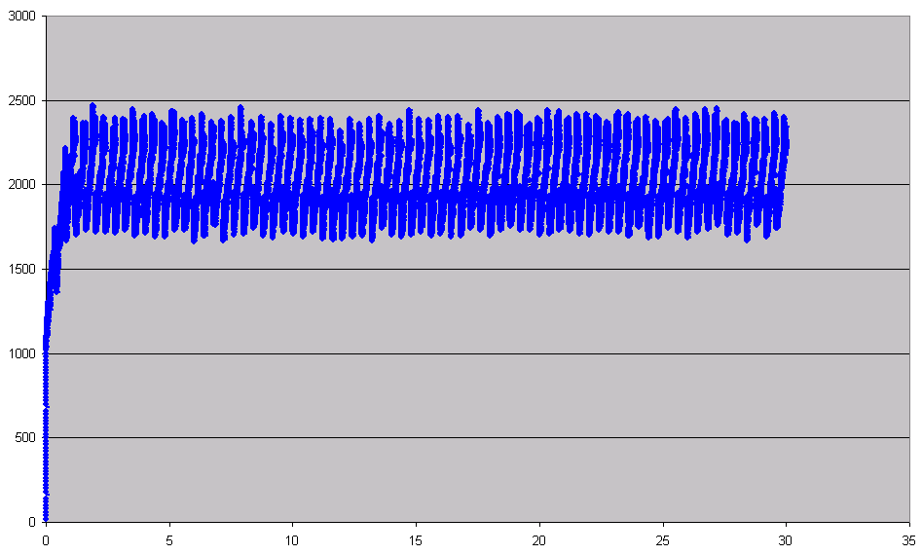
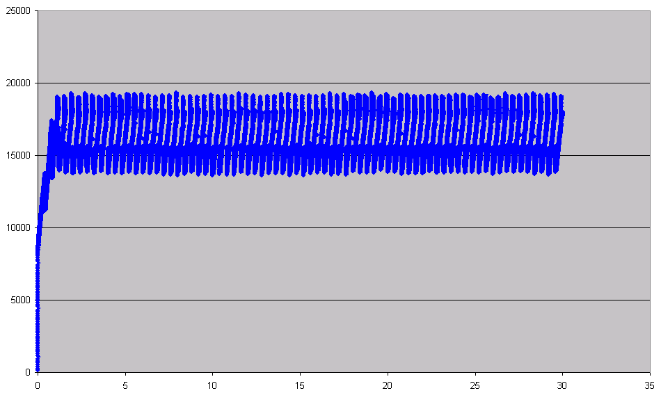
Calendar Scheduler execution
Load of the Scheduler
Number of nodes = 256
Number of nodes = 2048
Number of nodes = 16

Slide 17
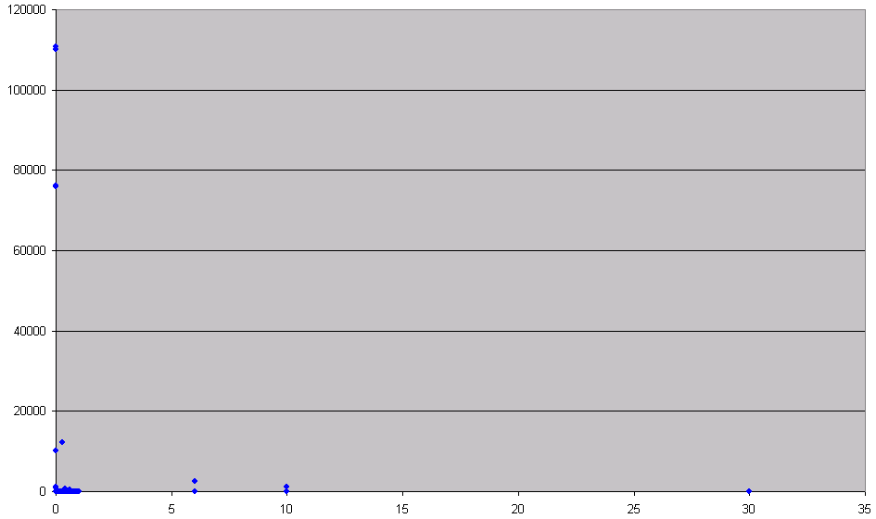
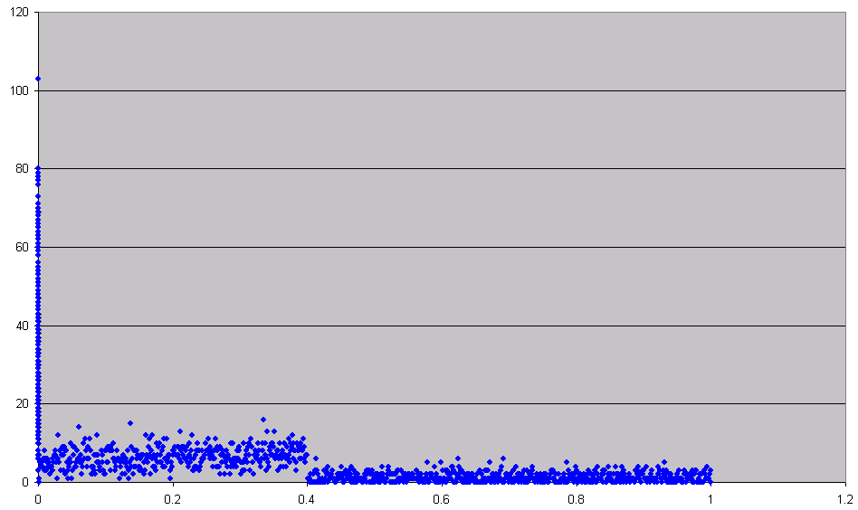
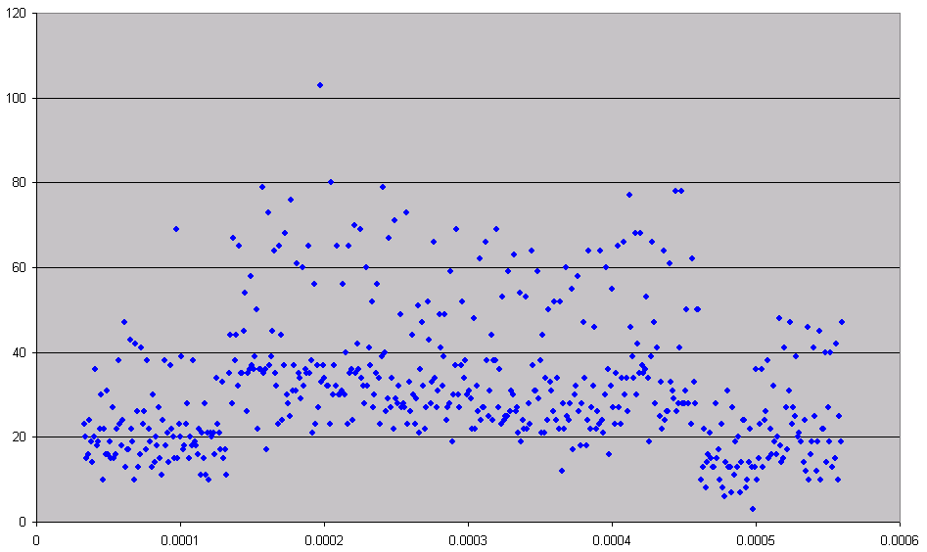
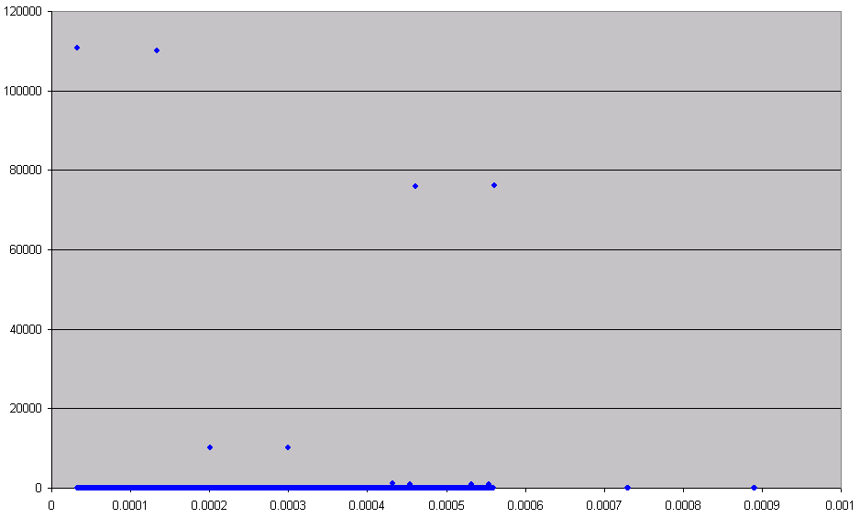
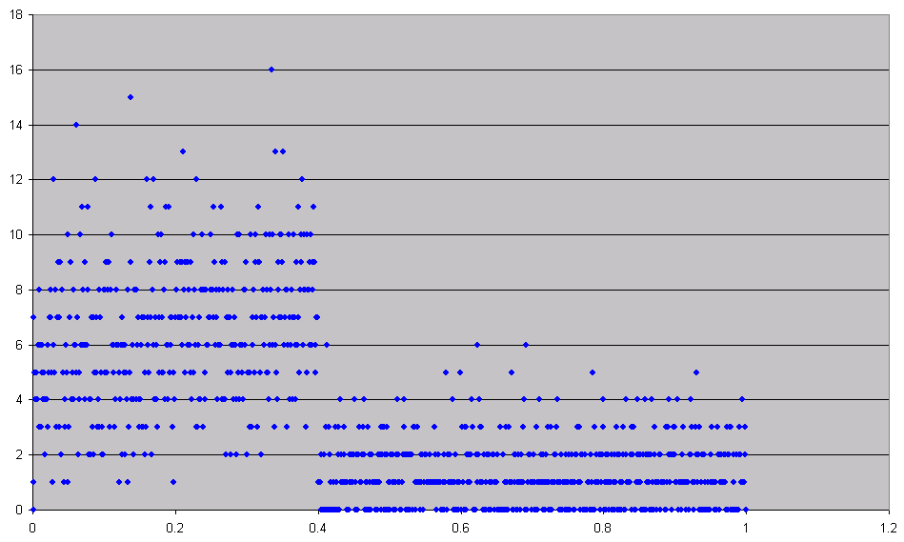
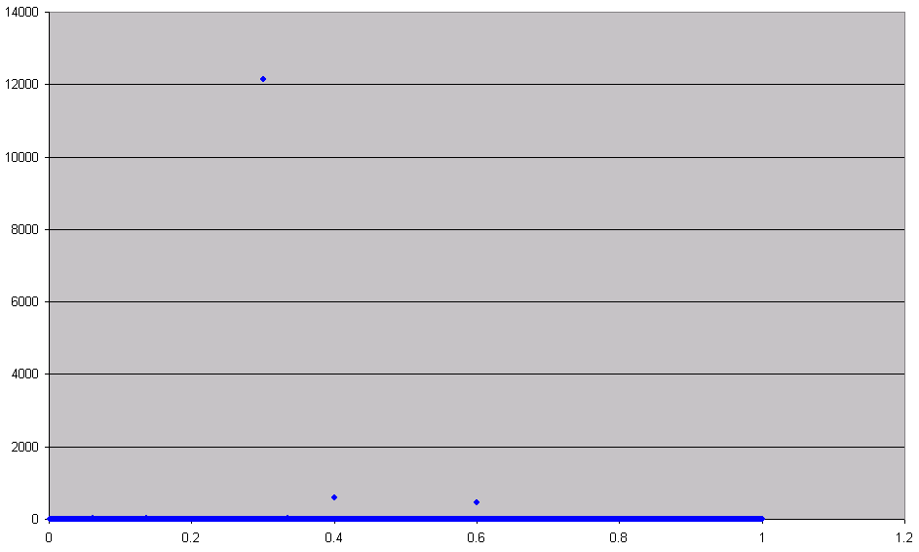
Calendar Scheduler execution
Insertion delay events distribution

Slide 18
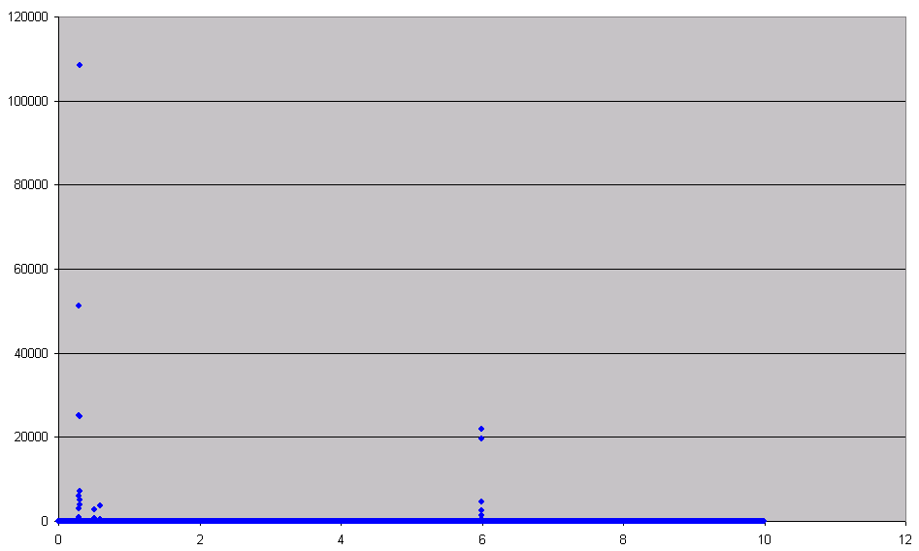
Calendar scheduler execution
Cancellation delay events distribution

Slide 19
Our model
We use trace files instead of building the insertion and cancellation
distributions.
Information in these trace files:
Insertion: delay
Cancellation: timestamp and id of the event
Look up: id of the event

Slide 20
Outstanding work
I have the model in Java and C++
I am measuring between 2 and 3 seconds
We will have results comparing Java and C++ in a discrete
event application

Slide 21
Summary
Why a Java Grande Benchmark?
Why the ns simulator?
How works the treatment of events in ns?
How did I build my model?
Where am I now?

Slide 22

Questions

