Slide 1

Ficha Nacional
Mayo 2026

Slide 2






NACIONAL
IMSS atiende 55% de la población (incluye COPLAMAR)
63,646,900 47%
Otros 1,200,692 0.89%
Población nacional 134,407,258
10,777,036 8%
44,643,161 33%
14,139,469 11%
Fuente: CONAPO, proyección a enero de 2026.
Categoría | 2018 | 2026 | Variación
PDA | 57,221,796 | 63,646,900 | 11%
Titulares | 32,414,694 | 38,214,939 | 18%
Puestos de trabajo | 20,079,365 | 22,724,680 | 13%
Pensionados | 4,333,052 | 6,171,926 | 42%
Conservación de derechos | 655,386 | 676,076 | 3%
Sin empleo asociado | 7,346,891 | 8,637,042 | 18%
Estudiantes | 6,911,859 | 8,240,676 | 19%
Seguro de Salud de Familia | 268,771 | 141,619 | -47%
Continuación voluntaria | 166,261 | 254,747 | 53%
Familiares | 24,807,102 | 25,431,961 | 3%
Esposa(o)/concubina(rio) | 8,464,382 | 9,211,015 | 9%
Hijas e hijos | 11,900,106 | 10,327,222 | -13%
Madres y padres | 4,442,614 | 5,893,724 | 33%
marzo |  | Variación
2025 | 2026
63,411 | 56,540 | -10%
marzo |  | Variación
2025 | 2026
303,371 | 415,717 | 37%
Fuente: Dirección de Incorporación y Recaudación, IMSS, datos abiertos con información mensual del número de personas derechohabientes adscritas a clínicas del IMSS. Corte marzo de 2026.
marzo 2026
155,520
*La afiliación al Seguro de Salud de Familia disminuye en virtud del incremento en los nuevos esquemas de aseguramiento.
** PTPD que superaron el umbral de ingreso mínimo neto

Slide 3

NACIONAL
2. Población derechohabiente adscrita
Entidad | 2018 | 2026 | Variación %
Hidalgo | 834,539 | 1,115,656 | +34%
Estado de México | 5,902,344 | 7,813,922 | +32%
Chiapas | 803,426 | 1,062,345 | +32%
Tlaxcala | 409,814 | 527,140 | +29%
Nayarit | 512,403 | 641,294 | +25%
Tabasco | 639,196 | 793,320 | +24%
Yucatán | 1,090,589 | 1,312,573 | +20%
Colima | 412,460 | 492,568 | +19%
Querétaro | 1,371,919 | 1,635,531 | +19%
Baja California | 2,082,530 | 2,464,335 | +18%
Quintana Roo | 972,330 | 1,149,409 | +18%
Baja California Sur | 486,036 | 570,499 | +17%
Morelos | 749,643 | 875,422 | +17%
Oaxaca | 746,140 | 860,435 | +15%
Zacatecas | 606,471 | 692,206 | +14%
Puebla | 1,954,798 | 2,225,021 | +14%
Jalisco | 4,758,012 | 5,401,473 | +14%
Aguascalientes | 897,442 | 999,072 | +11%
Guerrero | 696,285 | 772,094 | +11%
Sonora | 1,839,183 | 2,038,961 | +11%
Michoacán | 1,502,653 | 1,657,353 | +10%
San Luis Potosí | 1,261,206 | 1,390,394 | +10%
Sinaloa | 1,839,188 | 2,020,319 | +10%
Guanajuato | 2,697,616 | 2,923,634 | +8%
Chihuahua | 2,410,625 | 2,602,534 | +8%
Durango | 841,093 | 905,890 | +8%
Nuevo León | 4,122,799 | 4,430,739 | +7%
Veracruz | 2,742,560 | 2,925,651 | +7%
Coahuila | 2,331,199 | 2,486,261 | +7%
Tamaulipas | 1,928,671 | 2,054,000 | +6%
Campeche | 363,191 | 386,695 | +6%
Ciudad de México | 7,415,435 | 6,420,154 | -13%
Nacional | 57,221,796 | 63,646,900 | +11%
Var
+11%
Adscripciones plenamente identificadas a UMF de titulares y de sus personas beneficiarias. Fuente: Datos DIR IMSS. Diciembre 2018 frente a marzo de 2026.

Slide 4
NACIONAL
3. Puestos de trabajo asegurados
Entidad | 2018 | 2026 | Variación %
Nayarit | 138,808 | 186,135 | +34%
Hidalgo | 226,929 | 290,880 | +28%
Querétaro | 576,858 | 726,766 | +26%
Baja California Sur | 181,598 | 226,276 | +25%
Tabasco | 165,576 | 204,245 | +23%
Estado de México | 1,627,196 | 2,005,563 | +23%
Nuevo León | 1,608,191 | 1,964,088 | +22%
Baja California | 877,445 | 1,049,556 | +20%
Colima | 134,121 | 158,529 | +18%
Quintana Roo | 447,348 | 527,238 | +18%
Tlaxcala | 100,979 | 118,650 | +17%
Jalisco | 1,761,000 | 2,061,532 | +17%
Yucatán | 374,432 | 434,758 | +16%
Chiapas | 225,667 | 261,010 | +16%
Aguascalientes | 321,298 | 365,354 | +14%
Guanajuato | 994,870 | 1,127,415 | +13%
Michoacán | 447,924 | 501,480 | +12%
Oaxaca | 215,491 | 239,496 | +11%
San Luis Potosí | 439,816 | 484,725 | +10%
Sonora | 607,140 | 667,771 | +10%
Chihuahua | 882,868 | 963,465 | +9%
Coahuila | 779,580 | 845,532 | +8%
Durango | 243,651 | 263,599 | +8%
Ciudad de México | 3,410,841 | 3,636,987 | +7%
Puebla | 620,188 | 659,282 | +6%
Sinaloa | 562,199 | 594,944 | +6%
Morelos | 212,112 | 220,575 | +4%
Veracruz | 752,659 | 779,054 | +4%
Zacatecas | 185,244 | 190,369 | +3%
Campeche | 125,280 | 127,951 | +2%
Guerrero | 157,793 | 160,980 | +2%
Tamaulipas | 674,263 | 680,475 | +1%
Nacional | 20,079,365 | 22,724,680 | +13%
Var
+13%
Adscripciones plenamente identificadas a UMF de titulares y de sus personas beneficiarias. Fuente: Datos DIR IMSS. Diciembre 2018 frente a marzo de 2026.
* No se consideran salas de tococirugía, expulsión y recuperación.

Slide 5
NACIONAL
4. Registros patronales
Entidad | 2018 | 2026 | Variación %
Quintana Roo | 16,176 | 21,536 | +33%
Querétaro | 24,451 | 30,246 | +24%
Baja California Sur | 12,216 | 14,883 | +22%
Colima | 10,098 | 11,607 | +15%
Nuevo León | 67,183 | 76,253 | +14%
Tabasco | 10,426 | 11,590 | +11%
Jalisco | 93,370 | 103,555 | +11%
Tlaxcala | 4,979 | 5,509 | +11%
Yucatán | 19,239 | 21,213 | +10%
Hidalgo | 15,233 | 16,790 | +10%
Estado de México | 70,722 | 77,011 | +9%
Oaxaca | 13,672 | 14,770 | +8%
Ciudad de México | 115,460 | 122,963 | +6%
Puebla | 32,165 | 34,210 | +6%
Nayarit | 12,202 | 12,688 | +4%
Chihuahua | 39,080 | 40,218 | +3%
Coahuila | 33,815 | 34,508 | +2%
San Luis Potosí | 22,356 | 22,781 | +2%
Aguascalientes | 15,705 | 15,956 | +2%
Chiapas | 14,238 | 14,344 | +1%
Sinaloa | 39,084 | 39,009 | -0%
Campeche | 6,016 | 5,997 | -0%
Baja California | 37,963 | 37,510 | -1%
Guanajuato | 48,513 | 47,495 | -2%
Michoacán | 34,834 | 33,973 | -2%
Durango | 14,074 | 13,680 | -3%
Morelos | 12,152 | 11,413 | -6%
Sonora | 39,887 | 37,354 | -6%
Zacatecas | 11,707 | 10,925 | -7%
Veracruz | 44,349 | 40,206 | -9%
Tamaulipas | 33,119 | 29,813 | -10%
Guerrero | 13,793 | 11,990 | -13%
Nacional | 978,277 | 1,021,996 | +4%
Var
+4%
Adscripciones plenamente identificadas a UMF de titulares y de sus personas beneficiarias. Fuente: Datos DIR IMSS. Diciembre 2018 frente a febrero de 2026.

Slide 6
NACIONAL
5. Salario base de cotización
Entidad | 2018 | 2026 | Variación %
Quintana Roo | 263.11 | 591.33 | +60%
Baja California | 355.44 | 744.32 | +49%
Tamaulipas | 337.52 | 701.15 | +48%
Sinaloa | 257.11 | 533.59 | +48%
Nayarit | 265.29 | 537.45 | +45%
Baja California Sur | 319.02 | 645.79 | +45%
Chihuahua | 343.59 | 691.59 | +44%
Sonora | 309.68 | 620.28 | +43%
Colima | 296.55 | 588.76 | +42%
Tabasco | 301.56 | 587.99 | +39%
Durango | 278.19 | 540.20 | +39%
Oaxaca | 281.96 | 543.42 | +38%
Guerrero | 285.91 | 550.52 | +37%
Guanajuato | 304.33 | 580.16 | +36%
Aguascalientes | 334.06 | 627.76 | +34%
Chiapas | 302.98 | 569.16 | +34%
Jalisco | 347.36 | 650.24 | +34%
Tlaxcala | 297.28 | 550.90 | +32%
San Luis Potosí | 359.30 | 664.90 | +32%
Michoacán | 296.37 | 546.73 | +32%
Coahuila | 358.27 | 659.68 | +31%
Zacatecas | 326.91 | 599.09 | +31%
Yucatán | 304.05 | 554.84 | +30%
Puebla | 319.46 | 581.86 | +30%
Ciudad de México | 444.27 | 809.18 | +30%
Hidalgo | 305.99 | 556.71 | +30%
Nuevo León | 397.12 | 721.72 | +30%
Querétaro | 402.99 | 715.72 | +27%
Veracruz | 350.25 | 619.43 | +26%
Estado de México | 341.64 | 602.56 | +26%
Morelos | 338.43 | 592.16 | +25%
Campeche | 402.34 | 702.78 | +25%
Nacional | 354.35 | 663.45 | +34%
Var
+34%
Adscripciones plenamente identificadas a UMF de titulares y de sus personas beneficiarias. Fuente: Datos DIR IMSS. Diciembre 2018 frente a marzo de 2026.

Slide 7
NACIONAL
6. Infraestructura médica y social
Concepto | 2018 | 2026 | Variación %
Consultorios de Medicina Familiar | 7,566 | 8,019 | +6.0%
Consultorios de especialidad | 6,077 | 7,488 | +23.2%
Camas censables | 33,752 | 39,008 | +15.6%
Quirófanos | 1,292 | 1,298 | +0.5%
Adscripciones plenamente identificadas a UMF de titulares y de sus personas beneficiarias. Fuente: Datos DIR IMSS. Diciembre 2018 frente a enero de 2026.

Slide 8



NACIONAL
7. Capacidad instalada por nivel de atención
Entidad | Unidades de primer nivel | Unidades de segundo nivel | Unidades de tercer nivel | Camas censables | Camas no censables | Consultorios de MF | Quirofanos
Aguascalientes | 12 | 4 | 0 | 564 | 351 | 139 | 18
Baja California | 30 | 10 | 0 | 1,446 | 602 | 274 | 37
Baja California Sur | 15 | 5 | 0 | 342 | 162 | 81 | 10
Campeche | 9 | 6 | 0 | 304 | 211 | 58 | 12
Chiapas | 29 | 15 | 0 | 737 | 456 | 123 | 26
Chihuahua | 49 | 14 | 0 | 1,945 | 812 | 333 | 57
Ciudad de México | 47 | 17 | 9 | 5,749 | 2,667 | 904 | 191
Coahuila | 39 | 17 | 1 | 1,806 | 786 | 325 | 51
Colima | 10 | 3 | 0 | 309 | 198 | 57 | 7
Durango | 31 | 7 | 0 | 664 | 326 | 140 | 18
Estado de México | 85 | 20 | 1 | 3,644 | 1,698 | 927 | 101
Guanajuato | 39 | 13 | 2 | 1,535 | 743 | 318 | 53
Guerrero | 15 | 7 | 0 | 548 | 263 | 118 | 13
Hidalgo | 16 | 11 | 0 | 728 | 397 | 129 | 20
Jalisco | 107 | 18 | 3 | 3,583 | 1,858 | 644 | 97
Michoacán | 47 | 18 | 0 | 1,208 | 616 | 225 | 37
Morelos | 21 | 3 | 0 | 511 | 219 | 121 | 12
Nayarit | 21 | 8 | 0 | 463 | 338 | 86 | 16
Nuevo León | 50 | 10 | 4 | 2,606 | 1,082 | 560 | 79
Oaxaca | 27 | 14 | 0 | 644 | 315 | 97 | 20
Puebla | 45 | 14 | 2 | 1,348 | 738 | 235 | 50
Querétaro | 22 | 4 | 0 | 701 | 416 | 168 | 22
Quintana Roo | 9 | 6 | 0 | 516 | 296 | 90 | 12
San Luis Potosí | 31 | 12 | 0 | 985 | 446 | 183 | 32
Sinaloa | 42 | 10 | 0 | 1,224 | 551 | 261 | 30
Sonora | 63 | 16 | 1 | 1,480 | 913 | 253 | 47
Tabasco | 31 | 4 | 0 | 355 | 259 | 106 | 14
Tamaulipas | 42 | 12 | 0 | 1,292 | 656 | 289 | 37
Tlaxcala | 14 | 3 | 0 | 207 | 122 | 63 | 6
Veracruz | 104 | 23 | 1 | 2,078 | 1,074 | 429 | 61
Yucatán | 27 | 10 | 1 | 908 | 412 | 176 | 27
Zacatecas | 35 | 8 | 0 | 526 | 284 | 107 | 17
Total | 1,164 | 342 | 25 | 40,956 | 20,267 | 8,019 | 1,230
*Incluye 379 Unidades Auxiliares de Medicina Familiar. Fuente: IFU y CUUMSP, enero 2026.
40,956
camas
1,230
quirófanos
8,019
consultorios de MF

Slide 9


NACIONAL
8.Unidades Médicas de Tiempo Completo
OOAD | No. Unidades | Unidades de tiempo completo | Total consultorios MF | Total consultorios de Tiempo completo | Porcentaje de consultorios UMTC | Productividad acumulada enero a abril 2026
Aguascalientes | 12 | 10 | 139 | 42 | 3020.0% | 630,901
Baja California | 30 | 13 | 237 | 61 | 2570.0% | 1,051,449
Baja California Sur | 15 | 3 | 66 | 9 | 1360.0% | 273,488
Campeche | 9 | 5 | 42 | 11 | 2620.0% | 186,246
Chiapas | 29 | 3 | 115 | 15 | 1300.0% | 481,271
Chihuahua | 49 | 12 | 301 | 54 | 1790.0% | 1,190,449
Ciudad de México | 47 | 22 | 857 | 96 | 1120.0% | 3,700,965
Coahuila | 39 | 7 | 238 | 29 | 1220.0% | 1,027,747
Colima | 10 | 3 | 50 | 16 | 3200.0% | 240,663
Durango | 31 | 5 | 136 | 23 | 1690.0% | 600,261
Estado de México | 85 | 41 | 895 | 183 | 2040.0% | 3,830,120
Guanajuato | 39 | 10 | 233 | 30 | 1290.0% | 1,010,481
Guerrero | 15 | 3 | 84 | 12 | 1430.0% | 370,305
Hidalgo | 16 | 7 | 84 | 24 | 2860.0% | 361,430
Jalisco | 107 | 21 | 606 | 99 | 1630.0% | 2,475,049
Michoacán | 47 | 13 | 198 | 51 | 2580.0% | 839,928
Morelos | 21 | 9 | 79 | 21 | 2660.0% | 340,538
Nayarit | 21 | 7 | 72 | 21 | 2920.0% | 317,955
Nuevo León | 50 | 27 | 499 | 113 | 2260.0% | 2,283,243
Oaxaca | 27 | 7 | 86 | 16 | 1860.0% | 377,930
Puebla | 45 | 20 | 235 | 82 | 3490.0% | 1,074,368
Querétaro | 22 | 12 | 168 | 61 | 3630.0% | 791,163
Quintana Roo | 9 | 6 | 70 | 50 | 7140.0% | 406,595
San Luis Potosí | 31 | 6 | 156 | 31 | 1990.0% | 637,899
Sinaloa | 42 | 6 | 187 | 31 | 1660.0% | 805,089
Sonora | 63 | 9 | 230 | 40 | 1740.0% | 1,019,947
Tabasco | 31 | 8 | 104 | 25 | 2400.0% | 442,932
Tamaulipas | 42 | 8 | 273 | 40 | 1470.0% | 1,361,680
Tlaxcala | 14 | 9 | 47 | 19 | 4040.0% | 217,522
Veracruz | 104 | 16 | 371 | 67 | 1810.0% | 1,612,086
Yucatán | 27 | 15 | 161 | 31 | 1930.0% | 729,315
Zacatecas | 35 | 3 | 107 | 10 | 930.0% | 424,478
Total | 1,164 | 346 | 7,126 | 1,413 | 16.5% | 31,113,493
346
Unidades de TC
1,413
consultorios

Slide 10
NACIONAL
9. Día Típico
Crecimiento en consultas
Consultas | 2018 | 2025 | 2026* | Variación
Medicina Familiar | 343,693 | 394,888 | 435,659 | +26.8%
Especialidades | 70,171 | 103,748 | 127,174 | +81.2%
Urgencias | 52,730 | 49,091 | 47,762 | -9.4%
Dentales | 18,167 | 25,104 | 25,270 | +39.1%
Total* | 484,761 | 572,831 | 635,865 | +31.2%
Var +31.2%
* Corte información: marzo de 2026. Incluye: medicina familiar, especialidades, dental y urgencias. Fuente: División de Información en Salud/DataMart Estadísticas Médicas
Crecimiento de consultas de Especialidades y MF
Servicio | 2018 | 2025 | 2026* | Variación
Egresos | 5,486 | 6,074 | 6,491 | +18.3%
Intervenciones quirúrgicas | 3,831 | 3,771 | 5,060 | +32.1%
Partos | 1,083 | 694 | 707 | -34.7%

Slide 11
NACIONAL
10. Principales motivos de atención, 2019-2024
Medicina Familiar | Consultas | Porcentaje
Enfermedades del corazón | 20,563,977 | 34.7%
Diabetes mellitus | 19,816,086 | 33.4%
traumatismos e intoxicaciones | 4,536,971 | 7.6%
Infecciones respiratorias agudas | 4,008,710 | 6.8%
Enfermedades y trastornos de las articulaciones | 2,720,317 | 4.6%
Enfermedades mentales | 2,652,203 | 4.5%
Embarazo, parto y puerperio | 2,403,011 | 4.0%
Problemas y enfermedades de la columna vertebral | 1,836,621 | 3.1%
Obesidad | 513,314 | 0.9%
Trastornos de la piel y tejidos superficiales | 103,432 | 0.2%
Otras enfermedades | 183,302 | 0.3%
TOTAL | 59,337,944 | 100.0%
Especialidades | Consultas | Porcentaje
Tumores malignos | 2,250,781 | 19.3%
Traumatismos e intoxicaciones | 2,102,608 | 18.0%
Enfermedades y trastornos de las articulaciones | 1,550,891 | 13.3%
Enfermedades del corazón | 1,197,710 | 10.3%
Insuficiencia renal | 1,023,813 | 8.8%
Problemas y enfermedades de la columna vertebral | 891,353 | 7.6%
Enfermedades mentales | 836,583 | 7.2%
Trastornos de la piel y tejidos superficiales | 514,586 | 4.4%
Embarazo, parto y puerperio | 511,157 | 4.4%
Diabetes mellitus | 462,155 | 4.0%
Otras enfermedades | 314,214 | 2.7%
TOTAL | 11,655,851 | 100.0%
Cirugías | cirugías | Porcentaje
Traumatismos y envenenamientos | 221,084 | 19.9%
Cesárea | 196,555 | 17.7%
Cirugía de cataratas (Facoemulsificación con implante de lente intraocular) | 138,071 | 12.4%
Cirugía de Hernias (Hernioplastía) | 112,231 | 10.1%
Tumores malignos | 93,809 | 8.4%
Cirugía de vesicula biliar (Colecistectomía) | 90,497 | 8.1%
Artropatias | 63,753 | 5.7%
Tumores de comportamiento incierto o desconocido | 59,525 | 5.4%
Insuficiencia renal | 24,876 | 2.2%
Enfermedades del corazón | 17,764 | 1.6%
Otras cirugías | 93,421 | 8.4%
TOTAL | 1,111,586 | 100.0%

Slide 12
NACIONAL
11. Estrategia 2-30-100
 | Avance abril | Meta abril | Meta anual | Avance a abril | Avance anual
Cirugías OOAD | 450,978 | 512,190 | 1,525,085 | +88% | +30%
Cirugías UMAE | 126,411 | 164,112 | 489,467 | +77% | +26%
Consulta de Especialidad OOAD | 7,877,830 | 8,383,596 | 25,082,070 | +94% | +31%
Consulta de Especialidad UMAE | 1,886,010 | 2,054,418 | 6,146,330 | +92% | +31%
Consulta Medicina Familiar | 35,168,349 | 35,480,724 | 106,111,604 | +99% | +33%
Fuente: Información acumulada a la semana 17 de 2026, IMSS/DPTI
Fuente: Información acumulada a la semana 17 de 2026, IMSS/DPTI

Slide 13
NACIONAL
11. Estrategia 2-30-100
MEDICINA FAMILIAR
Entidad | Avance abril | Meta abril | Meta anual | Avance a abril | Avance anual
Aguascalientes | 630,901 | 630,705 | 1,886,360 | +100% | +33%
Baja California | 1,210,420 | 1,250,408 | 3,739,192 | +97% | +32%
Baja California Sur | 336,415 | 348,200 | 1,040,792 | +97% | +32%
Campeche | 263,958 | 262,131 | 783,716 | +101% | +34%
Chiapas | 515,069 | 536,402 | 1,603,424 | +96% | +32%
Chihuahua | 1,337,943 | 1,420,533 | 4,246,960 | +94% | +32%
Ciudad de México | 3,925,445 | 4,047,793 | 12,132,348 | +97% | +32%
Coahuila | 1,395,293 | 1,402,528 | 4,193,748 | +99% | +33%
Colima | 274,693 | 272,919 | 815,924 | +101% | +34%
Durango | 620,343 | 627,059 | 1,874,524 | +99% | +33%
Estado de México | 3,956,024 | 4,060,626 | 12,143,816 | +97% | +33%
Guanajuato | 1,399,111 | 1,406,771 | 4,207,008 | +99% | +33%
Guerrero | 534,822 | 529,874 | 1,584,224 | +101% | +34%
Hidalgo | 574,446 | 580,996 | 1,737,132 | +99% | +33%
Jalisco | 2,644,687 | 2,727,022 | 8,152,360 | +97% | +32%
Michoacán | 969,179 | 959,675 | 2,868,528 | +101% | +34%
Morelos | 555,418 | 556,620 | 1,664,152 | +100% | +33%
Nayarit | 377,586 | 379,755 | 1,134,800 | +99% | +33%
Nuevo León | 2,549,817 | 2,495,863 | 7,464,504 | +102% | +34%
Oaxaca | 422,468 | 405,098 | 1,210,480 | +104% | +35%
Puebla | 1,074,368 | 1,057,052 | 3,160,196 | +102% | +34%
Querétaro | 791,163 | 793,169 | 2,371,808 | +100% | +33%
Quintana Roo | 491,403 | 476,888 | 1,426,224 | +103% | +34%
San Luis Potosí | 751,918 | 771,896 | 2,307,428 | +97% | +33%
Sinaloa | 1,138,975 | 1,140,615 | 3,410,252 | +100% | +33%
Sonora | 1,113,707 | 1,115,178 | 3,333,200 | +100% | +33%
Tabasco | 452,821 | 436,076 | 1,303,008 | +104% | +35%
Tamaulipas | 1,441,402 | 1,375,226 | 4,112,256 | +105% | +35%
Tlaxcala | 300,780 | 294,079 | 879,192 | +102% | +34%
Veracruz | 1,885,481 | 1,873,435 | 5,599,356 | +101% | +34%
Yucatán | 807,815 | 816,738 | 2,442,072 | +99% | +33%
Zacatecas | 424,478 | 429,394 | 1,282,620 | +99% | +33%
Nacional | 35,168,349 | 35,480,724 | 106,111,604 | +99% | +33%
Corte: Semana 17 IMSS/DPTI Incluye primer y segundo nivel.

Slide 14
NACIONAL
11. Estrategia 2-30-100
CONSULTA DE ESPECIALIDAD
Entidad | Avance abril | Meta abril | Meta anual | Avance a abril | Avance anual
Aguascalientes | 199,859 | 199,836 | 597,870 | +100% | +33%
Baja California | 342,174 | 315,004 | 942,430 | +109% | +36%
Baja California Sur | 105,110 | 103,700 | 310,250 | +101% | +34%
Campeche | 71,053 | 85,644 | 256,230 | +83% | +28%
Chiapas | 117,641 | 162,626 | 486,545 | +72% | +24%
Chihuahua | 314,769 | 383,690 | 1,147,925 | +82% | +27%
Ciudad de México | 824,453 | 917,928 | 2,746,260 | +90% | +30%
Coahuila de Zaragoza | 313,383 | 347,090 | 1,038,425 | +90% | +30%
Colima | 92,273 | 100,772 | 301,490 | +92% | +31%
Durango | 139,268 | 131,760 | 394,200 | +106% | +35%
Estado de México | 713,136 | 785,558 | 2,350,235 | +91% | +30%
Guanajuato | 299,834 | 301,462 | 901,915 | +99% | +33%
Guerrero | 134,894 | 141,642 | 423,765 | +95% | +32%
Hidalgo | 174,061 | 188,612 | 564,290 | +92% | +31%
Jalisco | 630,502 | 632,326 | 1,891,795 | +100% | +33%
Michoacán de Ocampo | 273,645 | 286,578 | 857,385 | +95% | +32%
Morelos | 131,955 | 159,332 | 476,690 | +83% | +28%
Nayarit | 142,666 | 161,406 | 482,895 | +88% | +30%
Nuevo León | 404,331 | 385,276 | 1,152,670 | +105% | +35%
Oaxaca | 45,495 | 59,292 | 177,390 | +77% | +26%
Puebla | 174,152 | 167,872 | 502,240 | +104% | +35%
Querétaro de Arteaga | 225,130 | 211,548 | 632,910 | +106% | +36%
Quintana Roo | 134,629 | 151,524 | 453,330 | +89% | +30%
San Luis Potosí | 150,622 | 177,266 | 530,345 | +85% | +28%
Sinaloa | 265,140 | 269,132 | 805,190 | +99% | +33%
Sonora | 309,877 | 361,852 | 1,082,590 | +86% | +29%
Tabasco | 136,820 | 123,220 | 368,650 | +111% | +37%
Tamaulipas | 251,213 | 264,862 | 792,415 | +95% | +32%
Tlaxcala | 74,985 | 76,860 | 229,950 | +98% | +33%
Veracruz de Ignacio de la Llave | 411,177 | 443,836 | 1,327,870 | +93% | +31%
Yucatán | 182,025 | 191,296 | 572,320 | +95% | +32%
Zacatecas | 91,558 | 94,794 | 283,605 | +97% | +32%
Nacional | 7,877,830 | 8,383,596 | 25,082,070 | +94% | +31%
Corte: Semana 17 Incluye solo segundo nivel.

Slide 15
NACIONAL
11. Estrategia 2-30-100
INTERVENCIONES QUIRÚRGICAS
Entidad | Avance abril | Meta abril | Meta anual | Avance a abril | Avance anual
Aguascalientes | 9,927 | 10,585 | 31,517 | +94% | +31%
Baja California | 18,279 | 19,649 | 58,530 | +93% | +31%
Baja California Sur | 5,137 | 6,092 | 18,137 | +84% | +28%
Campeche | 3,541 | 4,683 | 13,952 | +76% | +25%
Chiapas | 5,440 | 6,670 | 19,860 | +82% | +27%
Chihuahua | 17,508 | 25,106 | 74,750 | +70% | +23%
Ciudad de México | 38,670 | 42,216 | 125,672 | +92% | +31%
Coahuila de Zaragoza | 21,868 | 26,190 | 77,984 | +83% | +28%
Colima | 3,895 | 4,813 | 14,324 | +81% | +27%
Durango | 9,259 | 9,170 | 27,291 | +101% | +34%
Estado de México | 44,556 | 51,521 | 153,412 | +86% | +29%
Guanajuato | 19,496 | 20,127 | 59,943 | +97% | +33%
Guerrero | 10,341 | 10,393 | 30,944 | +99% | +33%
Hidalgo | 7,251 | 9,409 | 28,016 | +77% | +26%
Jalisco | 37,395 | 41,386 | 123,209 | +90% | +30%
Michoacán de Ocampo | 14,861 | 16,843 | 50,132 | +88% | +30%
Morelos | 8,524 | 8,857 | 26,457 | +96% | +32%
Nayarit | 7,320 | 9,564 | 28,481 | +77% | +26%
Nuevo León | 20,174 | 22,311 | 66,435 | +90% | +30%
Oaxaca | 2,706 | 3,354 | 9,984 | +81% | +27%
Puebla | 10,348 | 11,781 | 35,073 | +88% | +30%
Querétaro de Arteaga | 13,142 | 13,248 | 39,458 | +99% | +33%
Quintana Roo | 8,256 | 8,619 | 25,664 | +96% | +32%
San Luis Potosí | 10,356 | 12,627 | 37,586 | +82% | +28%
Sinaloa | 13,791 | 15,766 | 46,939 | +87% | +29%
Sonora | 18,231 | 23,722 | 70,619 | +77% | +26%
Tabasco | 9,340 | 8,955 | 26,660 | +104% | +35%
Tamaulipas | 15,434 | 16,822 | 50,078 | +92% | +31%
Tlaxcala | 5,177 | 5,144 | 15,315 | +101% | +34%
Veracruz de Ignacio de la Llave | 25,682 | 29,527 | 87,916 | +87% | +29%
Yucatán | 10,699 | 11,998 | 35,742 | +89% | +30%
Zacatecas | 4,374 | 5,042 | 15,005 | +87% | +29%
Nacional | 450,978 | 512,190 | 1,525,085 | -12% | -70%
Corte: Semana 17 Incluye solo segundo nivel.

Slide 16
NACIONAL
11. Estrategia 2-30-100
INTERVENCIONES QUIRÚRGICAS UMAE
Nombre | Avance abril | Meta abril | Meta anual | Avance a abril | Avance anual
UMAE 01 HES CMN La Raza | 2,857 | 6,952 | 20,700 | +41% | +14%
UMAE 02 HES CMN Siglo XXI | 8,952 | 10,974 | 32,775 | +82% | +27%
UMAE 03 HES CMN Occidente | 8,493 | 9,815 | 29,325 | +87% | +29%
UMAE 04 HES Monterrey | 5,829 | 6,373 | 18,975 | +91% | +31%
UMAE 05 HES Torreón | 6,677 | 5,793 | 17,250 | +115% | +39%
UMAE 06 HES Puebla | 3,071 | 5,793 | 17,250 | +53% | +18%
UMAE 07 HES CMN del Bajío | 5,844 | 6,373 | 18,975 | +92% | +31%
UMAE 08 HES Obregón | 3,588 | 5,793 | 17,250 | +62% | +21%
UMAE 09 HES Veracruz | 4,318 | 6,952 | 20,700 | +62% | +21%
UMAE 10 HES 1 Mérida | 1,323 | 2,318 | 6,900 | +57% | +19%
UMAE 11 HGO CMN La Raza | 3,684 | 4,056 | 12,075 | +91% | +31%
UMAE 12 HGO San Angel | 4,647 | 6,952 | 20,700 | +67% | +22%
UMAE 13 HGO CMN Occidente | 3,634 | 4,056 | 12,075 | +90% | +30%
UMAE 14 HGO Monterrey | 5,376 | 5,214 | 15,525 | +103% | +35%
UMAE 15 HTO Magdalena Salinas | 10,925 | 17,776 | 53,150 | +61% | +21%
UMAE 16 HTO Lomas Verdes | 6,103 | 9,236 | 27,600 | +66% | +22%
UMAE 17 HTO Puebla | 2,986 | 4,056 | 12,075 | +74% | +25%
UMAE 18 HTO Monterrey | 9,661 | 8,578 | 25,623 | +113% | +38%
UMAE 19 HP CMN Siglo XXI | 1,705 | 4,635 | 13,800 | +37% | +12%
UMAE 20 HP CMN Occidente | 4,146 | 3,980 | 11,826 | +104% | +35%
UMAE 21 HC CMN Siglo XXI | 2,382 | 2,359 | 7,045 | +101% | +34%
UMAE 22 HC Monterrey | 4,765 | 3,180 | 9,498 | +150% | +50%
UMAE 23 HGP CMN del Bajío | 3,352 | 4,635 | 13,800 | +72% | +24%
UMAE 24 HG CMN La Raza | 8,342 | 12,163 | 36,325 | +69% | +23%
UMAE 25 HOnco CMN Siglo XXI | 3,751 | 6,100 | 18,250 | +61% | +21%
Nacional | 126,411 | 164,112 | 489,467 | +77% | +26%
Corte: Semana 17 Incluye solo segundo nivel.

Slide 17
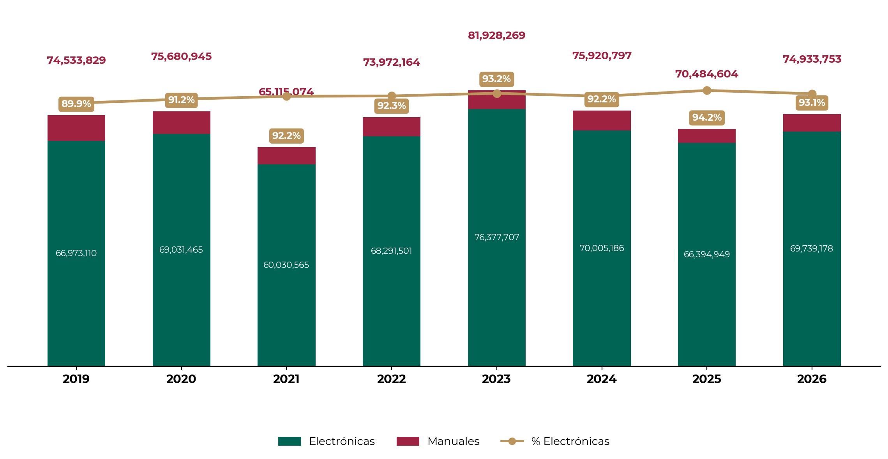
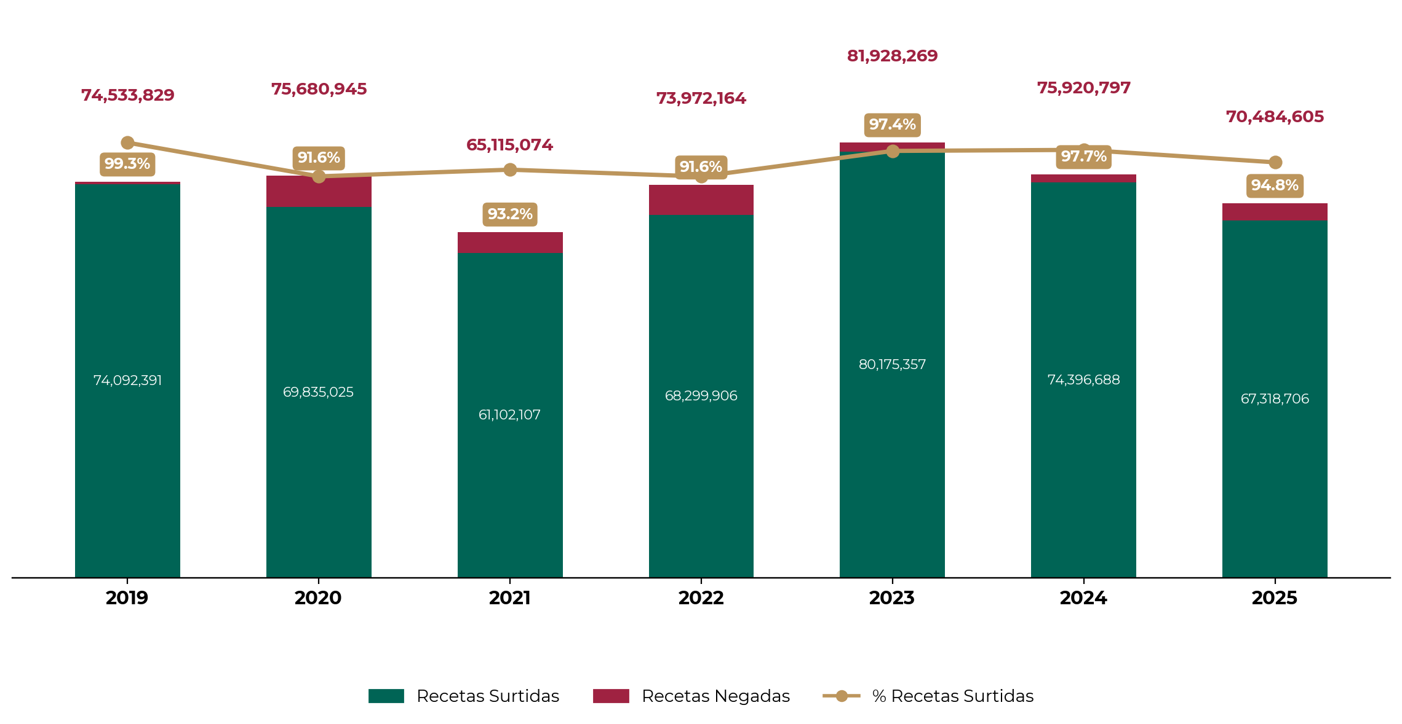
NACIONAL
12. Abasto
Receta electrónica vs. receta manual (millones de recetas)
Recetas surtidas vs. recetas negadas

Slide 18
NACIONAL
13. Uso de recetas electrónicas 2026
Entidad | Recetas presentadas | Recetas manuales | Receta manual (%) | Recetas electrónicas | Receta electrónica (%)
Durango | 10,899,234 | 280,746 | 2.6% | 10,618,488 | 97.4%
Sinaloa | 23,171,940 | 1,003,688 | 4.3% | 22,168,252 | 95.7%
Zacatecas | 7,376,084 | 362,092 | 4.9% | 7,013,992 | 95.1%
Hidalgo | 8,260,929 | 418,950 | 5.1% | 7,841,979 | 94.9%
Colima | 4,712,323 | 251,212 | 5.3% | 4,461,111 | 94.7%
Aguascalientes | 11,601,855 | 638,760 | 5.5% | 10,963,095 | 94.5%
Nuevo León | 35,733,303 | 1,988,572 | 5.6% | 33,744,731 | 94.4%
Tlaxcala | 4,160,749 | 238,233 | 5.7% | 3,922,516 | 94.3%
Tabasco | 5,932,845 | 346,109 | 5.8% | 5,586,736 | 94.2%
Jalisco | 47,249,120 | 2,946,263 | 6.2% | 44,302,857 | 93.8%
Quintana Roo | 6,735,165 | 431,975 | 6.4% | 6,303,190 | 93.6%
Baja California | 19,333,896 | 1,248,468 | 6.5% | 18,085,428 | 93.5%
Baja California Sur | 4,881,040 | 326,236 | 6.7% | 4,554,804 | 93.3%
Yucatán | 13,477,712 | 915,509 | 6.8% | 12,562,203 | 93.2%
Puebla | 18,579,936 | 1,312,278 | 7.1% | 17,267,658 | 92.9%
Querétaro | 11,081,490 | 784,097 | 7.1% | 10,297,393 | 92.9%
San Luis Potosí | 13,234,540 | 976,334 | 7.4% | 12,258,206 | 92.6%
Ciudad de México | 71,166,489 | 5,303,164 | 7.5% | 65,863,325 | 92.5%
Campeche | 3,719,628 | 279,700 | 7.5% | 3,439,928 | 92.5%
Veracruz | 30,752,527 | 2,342,669 | 7.6% | 28,409,858 | 92.4%
Morelos | 9,836,501 | 750,475 | 7.6% | 9,086,026 | 92.4%
Michoacán | 18,152,073 | 1,441,292 | 7.9% | 16,710,781 | 92.1%
Nayarit | 7,097,362 | 587,177 | 8.3% | 6,510,185 | 91.7%
Coahuila | 23,243,061 | 1,937,464 | 8.3% | 21,305,597 | 91.7%
Estado de México | 65,831,307 | 5,982,516 | 9.1% | 59,848,791 | 90.9%
Sonora | 21,748,389 | 2,028,444 | 9.3% | 19,719,945 | 90.7%
Chiapas | 8,281,489 | 824,250 | 10.0% | 7,457,239 | 90.0%
Chihuahua | 25,563,173 | 2,617,435 | 10.2% | 22,945,738 | 89.8%
Oaxaca | 6,257,804 | 655,300 | 10.5% | 5,602,504 | 89.5%
Guanajuato | 26,193,459 | 3,064,832 | 11.7% | 23,128,627 | 88.3%
Guerrero | 8,976,566 | 1,052,414 | 11.7% | 7,924,152 | 88.3%
Tamaulipas | 17,046,675 | 2,130,498 | 12.5% | 14,916,177 | 87.5%
Nacional | 590,288,664 | 45,467,152 | 7.7% | 544,821,512 | 92.3%
Fuente: Aplicativo Portal de Abasto. Periodo 01 de enero al 31 de octubre de 2025.

Slide 19
NACIONAL
14. Draft, especialistas 2026
Entidad | Sustitución | Plazas | Total
Aguascalientes | 116 | 91 | 207
Baja California | 211 | 111 | 322
Baja California Sur | 66 | 32 | 98
Campeche | 43 | 99 | 142
Chiapas | 110 | 261 | 371
Chihuahua | 155 | 234 | 389
Ciudad de México | 1,274 | 535 | 1,809
Coahuila | 114 | 323 | 437
Colima | 26 | 25 | 51
Durango | 70 | 81 | 151
Guanajuato | 204 | 105 | 309
Guerrero | 66 | 57 | 123
Hidalgo | 65 | 188 | 253
Jalisco | 531 | 169 | 700
Michoacán | 81 | 326 | 407
Morelos | 95 | 41 | 136
México | 550 | 573 | 1,123
Nayarit | 47 | 107 | 154
Nuevo León | 248 | 151 | 399
Oaxaca | 50 | 159 | 209
Puebla | 217 | 162 | 379
Querétaro | 168 | 37 | 205
Quintana Roo | 82 | 41 | 123
San Luis Potosí | 77 | 93 | 170
Sinaloa | 123 | 87 | 210
Sonora | 153 | 345 | 498
Tabasco | 96 | 35 | 131
Tamaulipas | 159 | 140 | 299
Tlaxcala | 48 | 9 | 57
Veracruz | 161 | 355 | 516
Yucatán | 137 | 141 | 278
Zacatecas | 39 | 90 | 129
Total | 5,582 | 5,203 | 10,785

Slide 20






NACIONAL
15. Personal médico y de Enfermería
Médicos generales
Médicos especialistas
+84.7%
+38.8%
2018
2026
2018
2026
2,702
4,991
55,995
77,733
Enfermeras
Paramédicos
+17.4%
+18.0%
2018
2026
2018
2026
108,208
127,074
76,580
90,396
Residentes
Técnicos
+82.5%
-5.0%
2018
2026
2018
2026
13,476
24,589
22,213
21,098
Fuente: Dirección de Administración, Base SIAP comparativa.
Vacantes
Personal administrativos y básico | 7,954
Personal de Enfermería | 5,290
Personal médico | 4,157
Personal paramédico y técnico | 5,757
Total | 23,158
Fuente: Sistema de Información Operativa.

Slide 21
NACIONAL
16. Ocupación de personal médico y de Enfermería
Entidad | Especialidad | Medicina General | Enfermería | Especialidad | Medicina General | Enfermería
Aguascalientes | 1,107 | 22 | 1,829 | 1,535 | 74 | 2,270
Baja California | 1,921 | 84 | 3,398 | 2,663 | 151 | 4,204
Baja California Sur | 572 | 58 | 933 | 808 | 129 | 1,228
Campeche | 408 | 11 | 755 | 707 | 52 | 1,076
Chiapas | 765 | 48 | 1,317 | 1,473 | 100 | 2,116
Chihuahua | 1,867 | 213 | 4,236 | 2,841 | 364 | 5,802
Ciudad de México | 9,324 | 119 | 20,461 | 11,942 | 403 | 21,842
Coahuila | 1,875 | 148 | 4,395 | 2,822 | 235 | 5,012
Colima | 551 | 25 | 1,039 | 749 | 45 | 1,156
Durango | 906 | 31 | 1,564 | 1,169 | 57 | 1,771
Guanajuato | 2,458 | 82 | 4,233 | 3,129 | 148 | 4,818
Guerrero | 826 | 51 | 1,440 | 1,077 | 75 | 1,629
Hidalgo | 801 | 30 | 1,209 | 1,486 | 60 | 1,957
Jalisco | 4,563 | 228 | 9,308 | 5,970 | 373 | 10,411
Michoacán | 1,450 | 104 | 2,645 | 2,195 | 145 | 3,290
Morelos | 825 | 47 | 1,310 | 1,128 | 79 | 1,557
México | 5,780 | 169 | 9,847 | 7,589 | 326 | 11,436
Nayarit | 550 | 42 | 973 | 1,145 | 69 | 1,734
Nuevo León | 3,464 | 127 | 7,203 | 4,691 | 230 | 7,960
Oaxaca | 638 | 33 | 1,099 | 899 | 88 | 1,290
Puebla | 1,703 | 54 | 3,444 | 2,330 | 111 | 3,769
Querétaro | 1,058 | 19 | 1,665 | 1,575 | 67 | 2,455
Quintana Roo | 805 | 17 | 1,380 | 1,150 | 76 | 1,740
San Luis Potosí | 1,057 | 75 | 2,001 | 1,383 | 118 | 2,345
Sinaloa | 1,514 | 135 | 2,973 | 1,971 | 218 | 3,405
Sonora | 1,920 | 150 | 4,151 | 3,083 | 256 | 4,914
Tabasco | 566 | 58 | 991 | 882 | 106 | 1,398
Tamaulipas | 1,677 | 133 | 3,277 | 2,246 | 225 | 4,117
Tlaxcala | 434 | 21 | 710 | 584 | 46 | 810
Veracruz | 2,797 | 241 | 5,250 | 3,923 | 391 | 5,793
Yucatán | 1,304 | 104 | 2,374 | 1,829 | 130 | 2,690
Zacatecas | 509 | 23 | 798 | 759 | 44 | 1,079
Total | 55,995 | 2,702 | 108,208 | 77,733 | 4,991 | 127,074
Fuente: Dirección de Administración, Base SIAP con corte en 2018 al 31 de diciembre y al 15 de noviembre de 2026.

Slide 22
NACIONAL
17. Hospitales concluidos y en proceso
HOSPITALES HABILITADOS (2019-2025)
Hospital | Entidad | Camas | Consultorios | Quirófanos | Inversión | Apertura
HGZ No. 32 Villa Coapa* | Ciudad de México | 201 | 53 | 9 | $332 | 2020
HGZ No. 92 Ciudad Acuña | Coahuila | 90 | 28 | 5 | $1,303 | 2020
HGZ No. 252 Atlacomulco | México | 102 | 29 | 5 | $1,257 | 2020
HGZ/MF No.7 Cuautla* | Morelos | 80 | 10 | 2 | $908.5 | 2020
HGZ No. 33 Bahía de Banderas | Nayarit | 144 | 43 | 8 | $1,892.7 | 2020
HGZ No. 1 Tapachula | Chiapas | 186 | 40 | 6 | $2,627.6 | 2021
HGZ No. 36 Pachuca | Hidalgo | 187 | 33 | 3 | $2,125.5 | 2021
HGZ/MF No. 5 Atlixco | Puebla | 65 | 13 | 3 | $394 | 2021
HGSZ No. 185 Arandas | Jalisco | 28 | 6 | 1 | $127.6 | 2023
HGZ No. 35 Cuautlancingo | Puebla | 92 | 9 | 2 | $607 | 2023
Hospital de Expansión, Tláhuac | Ciudad de México | 82 | - | 2 | $774.3 | 2024
Hospital de Expansión, Uruapan | Michoacán | 90 | 10 | 3 | $1,059 | 2024
UEH HGZ No. 2A Cárdenas | Tabasco | 87 | 14 | 3 | $878 | 2024
HGR No. 2 Ciudad Juárez | Chihuahua | 260 | 52 | 9 | $2,918.4 | 2024
HGR N0. 23 Ensenada | Baja California | - | 40 | 2 | $1,446.1 | 2025
Total |  | 1,694 | 380 | 63 | $18,650.7
* Sustitución.
1,694 camas, 380 consultorios y 63 quirófanos
HOSPITALES EN PROCESO
Proyecto | Entidad | Camas | Consultorios | Quirófanos | Apertura | Avance | Inversión
HGZ Zaragoza | Ciudad de México | 180 | 40 | 6 | Ago, 2025 | 100% | $2,618.4
HGZ Tuxtla Gutiérrez | Chiapas | 144 | 62 | 5 | Nov, 2025 | 100% | $3,321.4
HGZ San Alejandro | Puebla | 180 | 35 | 6 | Dic, 2025 | 100% | $2,368.2
HGO Cd. del Carmen | Campeche | 38 | 11 | 3 | Nov, 2025 | 98.0% | $900.3
HGZ Navojoa | Sonora | 90 | 39 | 3 | Dic, 2025 | 93.8% | $1,579.7
HGZ Guanajuato | Guanajuato | 72 | 29 | 3 | Dic, 2025 | 97.9% | $1,598.71
HGZ Tula | Hidalgo | 144 | 35 | 5 | Mar, 2026 | 77.2% | $2,200.5
HGZ Hermosillo, Ramos Bours | Sonora | 90 | 10 | 1 | Dic, 2025 | 93.0% | $992.2
HGZ Ticul | Yucatán | 70 | 11 | 4 | Abr,2026 | 73.5% | $917.5
HGR Ensenada etapa 2 | Baja California | 216 | 22 | 6 | May,2027 | 13.6% | $1,958.3
HGZ San Luis Río Colorado | Sonora | 120 | 33 | 5 | Jun, 2027 | 14.8% | $2,957.6
HGZ Yecapixtla | Morelos | 90 | 23 | 3 | Ago, 2027 | 7.8% | $3,073
HGR Sta. Catarina | Nuevo León | 260 | 68 | 8 | Abr,2028 | 3.7% | $3,766
Total |  | 1,694 | 418 | 58 |  |  | $28,251
1,344 camas, 327 consultorios y 47 quirófanos

Slide 23
NACIONAL
18. Hospitales en planeación 2025
Proyecto | Entidad | Camas | Consultorios | Quirófanos | Inversión (mdp)
HGR Los Cabos | Baja California Sur | 260 | 53 | 8 | $4,163.1
HGR Saltillo | Coahuila | 260 | 68 | 8 | $3,936.2
Oncológico Ecatepec | Estado de México | 40 | 27 | 2 | $1,049
HGR Yecapixtla | Morelos | 90 | 23 | 3 | $2,400.0
HGR Santa Catarina | Nuevo León | 260 | 39 | 8 | $4,368.8
HGR Culiacán | Sinaloa | 216 | 50 | 9 | $3,645.5
HGR Guadalupe | Zacatecas | 216 | 47 | 6 | $3,570.4
Total |  | 1,342 | 307 | 44 | $23,133
1,342 camas, 307 consultorios y 44 quirófanos
19. Hospitales en planeación 2026-2030
Proyecto | Entidad | Camas | Consultorios | Quirófanos | Inversión (mdp)
HGZ Pabellón de Arteaga | Aguascalientes | 70 | 18 | 6 | $801.7
HGR Aguascalientes | Aguascalientes | 260 | 68 | 8 | $3,016.4
HGZ Manzanillo | Colima | 72 | 13 | 3 | $2,562.6
HGZ Comitán | Chiapas | 60 | 15 | 3 | $1,561.2
HGZ Cd.Neza | Estado de México | 260 | 34 | 5 | $2,829.0
HGR Chimalhuacán | Estado de México | 144 | 24 | 5 | $2,829.0
HGZ Salamanca | Guanajuato | 144 | 62 | 2 | $2,800.4
HGR Irapuato | Guanajuato | 216 | 62 | 5 | $3,298.4
HGR Zapopan | Jalisco | 260 | 68 | 8 | $3,360.4
HGR Morelia | Michoacán | 260 | 53 | 9 | $3,487.5
HGR Oaxaca | Oaxaca | 144 | 62 | 2 | $2,822.2
HGR Amozoc | Puebla | 260 | 68 | 8 | $4,067.1
HGOP Las Margaritas | Puebla | 140 | 62 | 4 | $3,156.9
HGZ Guaymas | Sonora | 120 | 14 | 4 | $3,294.8
HGR Villahermosa | Tabasco | 260 | 68 | 8 | $3,843.9
HGZ Cárdenas | Tabasco | 144 | 62 | 5 | $2,988.2
HGZ Minatitlán | Veracruz | 144 | 22 | 5 | $3,008.6
Total |  | 2,958 | 775 | 90 | $49,728.3
2,958 camas, 775 consultorios y 90 quirófanos

Slide 24
NACIONAL
20. UMF habilitadas, 2019-2025
29 UMF CON 312 CONSULTORIOS
Núm. | UMF | Estado | Consultorios | Inversión (mdp) | Apertura
1 | No. 68 Coatzacoalcos | Veracruz | 10 | $189.8 | Ene, 19
2 | No. 12 Zona Industrial | Aguascalientes | 24 | $59.2 | Ene, 19
3 | No. 39 Cabo San Lucas | Baja California Sur | 10 | $72.7 | Mar, 19
4 | No. 20 Delicias* | Chihuahua | 6 | $65.9 | Ago, 19
5 | No. 21 Rosarito | Baja California | 10 | $126.3 | Ene, 20
6 | No. 71 Apodaca | Nuevo León | 10 | $101.3 | Jul, 20
7 | No. 31 Mezcala | Guerrero | 2 | $11.6 | Sep, 20
8 | No. 85 Tarímbaro | Michoacán | 10 | $119.9 | Oct, 20
9 | No. 19 Agua Prieta | Sonora | 4 | $29.2 | Dic, 20
10 | No. 1 Durango* | Durango | 14 | $50.2 | Mar, 21
11 | No. 72 El Carmen | Nuevo León | 4 | $68.4 | Abr, 21
12 | No. 9 Cruz Azul* | Hidalgo | 2 | $29.9 | Sep, 21
13 | No. 58 Ciudad Modelo** | Puebla | 4 | $1.16 | Sep, 21
14 | No. 50 Durango* | Durango | 6 | $116.4 | Dic, 21
15 | No. 19 Benito Juárez | Quintana Roo | 10 | $315.5 | Feb, 22
16 | No. 26 Mixquiahuala* | Hidalgo | 6 | $89.8 | Nov, 22
17 | No. 18 Tizayuca* | Hidalgo | 10 | $105.5 | Feb, 23
18 | No. 15 Lindavista | Ciudad de México | 10 | $87.3 | Abr, 23
19 | No. 66 Cajeme* | Sonora | 10 | $101.9 | Jun, 23
20 | No. 7 Reynosa | Tamaulipas | 10 | $66.6 | Ago, 23
21 | No. 37 Tlaxcoapan* | Hidalgo | 10 | $153.6 | Sep, 23
22 | No. 60 Los Naranjos | Guanajuato | 10 | $136.3 | Ene, 24
23 | No. 61 Mérida | Yucatán | 14 | $149.5 | Ene, 24
24 | No. 40 La Fuente, La Paz | Baja California Sur | 14 | $202.6 | Sept, 24
25 | No. 21 Troncoso* | Ciudad de México | 32 | $577.2 | Sept, 24
ADMINISTRACIÓN CLAUDIA SHEINBAUM PARDO
26 | No. 58 Villa Fontana | Zacatecas | 6 | $78 | Nov, 24
27 | No. 73 San Nicolás de los Garza | Nuevo León | 10 | $169 | Nov, 24
28 | No. 93 La Joya**** | Coahuila | 10 | $220.8 | Ene, 25
29. | No. 93 Cerro Gordo* | Estado de México | 34 | $537.7 | Jul,25
 | Total |  | 312 | $4,033.3
8 UMF EN PROCESO, 2025-2026
Núm. | Proyecto | Estado | Consultorios | Inversión (mdp) | Avance | Conclusión
1 | No. 51 Puerto Libertad* | Sonora | 2 | $120.4 | 95.8% | 2025
2 | No. 6 Jesús María*** | Aguascalientes | 10 | $74.5 | 93.6% | 2025
3 | No. 15, Monterrey | Nuevo León | 34 | $411.3 | 26.8% | Feb 2026
4 | Francisco de Montejo | Yucatán | 10 | $228.9 | 76.7% | Feb, 26
5 | Santa Bárbara, Saltillo | Coahuila | 10 | $214.4 | 48.2% | Abr, 26
6 | Juárez | Nuevo León | 10 | $212.1 | 98.2% | Mar,26
7 | El Cortijo, Saltillo | Coahuila | 10 | $190.2 | 26.9% | Mar,26
8 | No. 2 Benito Juárez , Mexicali* | Baja California | 34 | $122.4 | 56% | Mar, 26
 | Total |  | 120 | $1,574.2
* Sustitución
** Donación
*** Ampliación y remodelación

Slide 25


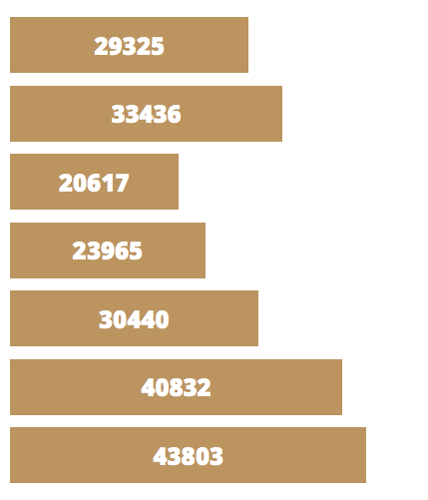
NACIONAL
21. Salas de hemodinamia
NUEVAS SALAS DE HEMODINAMIA EN SEGUNDO NIVEL
Núm. | Unidad | Entidad | Inicio
1 | HGR No. 17 Cancún | Quintana Roo | Abr, 2021
2 | HGR No. 1 Charo | Michoacán | Oct, 2022
3 | HGZ No. 1 Tepic | Nayarit | Feb, 2023
4 | HGR No. 2 El Marqués | Querétaro | Jun, 2023
5 | HGZMF No. 7 Monclova | Coahuila | Jul, 2023
6 | HGR No. 251 Metepec | México | Ago, 2023
7 | HGZ No. 3 Jesús María | Aguascalientes | Ago, 2023
8 | HGZ/MF No. 1, La Paz | Baja California Sur | Sep, 2023
9 | HGR/MF No.1 Cuernavaca | Morelos | Sep, 2023
10 | HGR No. 197 Texcoco | México | Dic, 2023
11 | HGR No. 46 Guadalajara | Jalisco | Ene, 2024
12 | HGZ No. 1, Zacatecas | Zacatecas | Ene, 2024
13 | HGZ No. 14 Hermosillo | Sonora | Feb, 2024
14 | HGR No. 6 Cd. Madero | Tamaulipas | Feb, 2024
15 | HGZ No. 36 Pachuca | Hidalgo | Feb, 2024
16 | HGZ/MF No. 1 Campeche | Campeche | Mar, 2024
17 | HGZ No. 50 Tangamanga | San Luis Potosí | Jul, 2024
18 | HGZ No. 1 Durango | Durango | Dic, 2024
19 | HGR No. 1 Orizaba | Veracruz | Ene, 2025
20 | HGR No. 2 Ciudad Juárez | Chihuahua | Dic, 2024
21 | HGZ No. 1 Oaxaca | Oaxaca | Ene, 2025
22 | HGR No. 30 Mexicali | Baja California | Ene, 2025
23 | HGZ No. 1 Acapulco | Guerrero | Abril, 2025
24 | HGZ No. 1 Villa de Álvarez | Colima | Abril, 2025
24
nuevas salas
813.4 mdp
11
salas en proceso
Productividad segundo y tercer nivel
2018 vs. 2024
+49.4%
procedimientos
SALAS DE HEMODINAMIA PARA 2025
Núm. | Unidad | Estatus | Entidad
1 | HGZ No. 4 Cd. del Carmen | En proceso | Campeche
2 | HGR No. 1 Chihuahua¹ | En proceso | Chihuahua
3 | HGR No. 1 McGregor | En proceso | Ciudad de México
4 | HGZMF No.2 Irapuato² | En proceso | Guanajuato
5 | HGZMF No. 3 Mazatlán³ | En proceso | Sinaloa
6 | HGZ No. 11 Xalapa⁴ | En proceso | Veracruz-Norte
7** | HGZ Tuxtla Gutiérrez | En proceso | Chiapas
8** | HGR Los Cabos | Planeación | Baja California
9** | HGZ Saltillo | Planeación | Coahuila
10** | HGR Santa Catarina | Planeación | Nuevo León
11** | HGZ Guadalupe | Planeación | Zacatecas
2018
2019
2020
2021
2022
2023
2024
** Ubicadas en unidades médicas en planeación
Fechas de conclusión^{: 1/} 30 agosto. ^{2/} 15 agosto. ^{3/} 15 septiembre.^{4/} 13 septiembre.

Slide 26
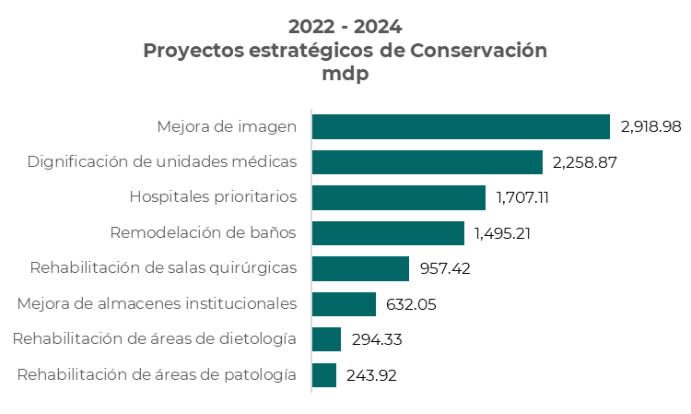
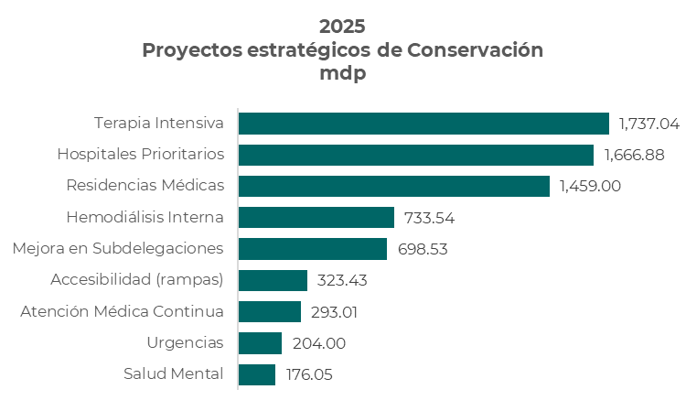
NACIONAL
22. Proyectos Estratégicos de Conservación 2022-2024
Total de Inversión 2022-2025
17,799.4
mdp

Slide 27

NACIONAL
23. Acciones de Conservación 2025
9 Programas, total de unidades y montos avalados
83
24
Unidades de Terapia Intensiva
$1,757.1 mdp
Hospitales prioritarios
$1,765.6 mdp
93
53
Áreas de Hemodiálisis
$737.7 mdp
Mejora en Subdelegaciones
$716.8 mdp
383
285
Rampas
$325.9 mdp
Áreas para residentes
$1,466.3 mdp
89
71
Áreas para Salud Mental
$187.6 mdp
Atención Médica Continua y Urgencias
$497 mdp
7,454.4 mdp

Slide 28
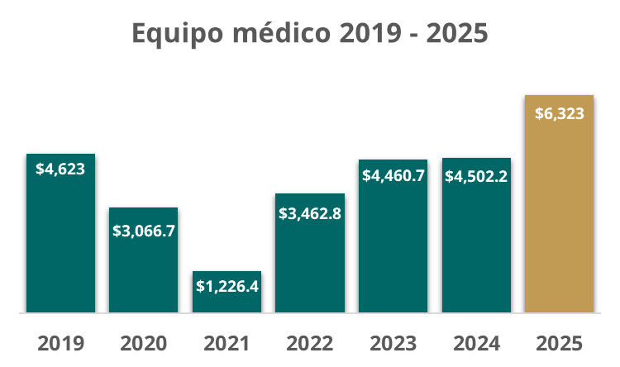
NACIONAL
24. Inversión equipo médico 2019-2025
Monto de Inversión
2019 - 2024
21,342
Equipos médico 2025
$2,419.1 mdp
$1,178.1 mdp
$39.2 mdp
12
Aceleradores lineales
42
Tomógrafos
20
Unidades de anestesia y otros equipos médicos
$917.8 mdp
$657.1 mdp
$84.7 mdp
7,912
Camillas, sillas de ruedas y carro camilla
12
Resonancias
326
Monitores y radiación y equipos refrigerantes
$548.5 mdp
$427.3 mdp
$51.2 mdp
17
Angiógrafos
67
Mastógrafos
73
Otros equipos médicos
Monto de
Inversión
2025
6,323
mdp
8,481
bienes
2025

Slide 29
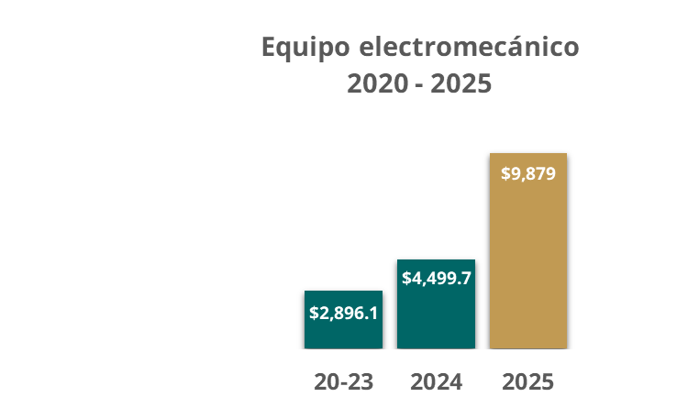
NACIONAL
25. Inversión equipo electromecánico 2020-2025
Monto total de Inversión
2020 - 2024
7,395.8
mdp
Equipos electromecánicos 2025
$6,324 mdp
$1,109.2 mdp
938
Aires acondicionados
144
Equipos de casas de Máquinas
$875.6 mdp
$983.5 mdp
179
Elevadores
213
Lavadoras/secadoras
$586.8 mdp
Monto de
Inversión
2025
Sistemas
de Supresión de incendio
9,879 mdp

Slide 30
NACIONAL
26. Inversión en infraestructura hospitalaria
20
Centros de Mezcla en 15 entidades
669.98 mdp
# | Central de Mezclas | Estado | Monto mdp
1 | UMAE HES 14, Veracruz* | Veracruz | $22.2
2 | UMF 12, Caucel* | Yucatán | $34.5
3 | HES 2 CMN, Cd. Obregón* | Sonora | $17.06
4 | UMAE HO CMN Siglo XXI* | Ciudad de México | $16.1
5 | UMF 1 Tapachula* | Chiapas | $21.2
6 | UMAA 68, Chihuahua* | Chihuahua | $19
7 | UMAE 24 Monterrey* | Nuevo León | $0.82
8 | UMAA 36 Tijuana | Baja California | $67.4
9 | HGZ 2 Tuxtla Gutiérrez | Chiapas | $59.1
10 | UMAE HE 71 Torreón | Coahuila | $60.6
11 | UMF 29 con UMAA Acapulco | Guerrero | $54.1
12 | UMAE CMNO Guadalajara | Jalisco | $71.9
13 | HGZ 14 Hermosillo | Sonora | $65
14 | HGR 6 Ciudad Madero | Tamaulipas | $61.8
15 | CMN La Raza | Ciudad de México | $72.3
16 | UMAE CMN HE Puebla | Puebla | $60.9
17 | UMF 48 Cd. Juárez | Chihuahua | $62
18 | UMF 34 La Paz | BCS | $64.8
19 | UMAE El Bajío | Guanajuato | $78.2
20 | HGR 1 Culiacán | Sinaloa | $61.1
* Conservación

Slide 31

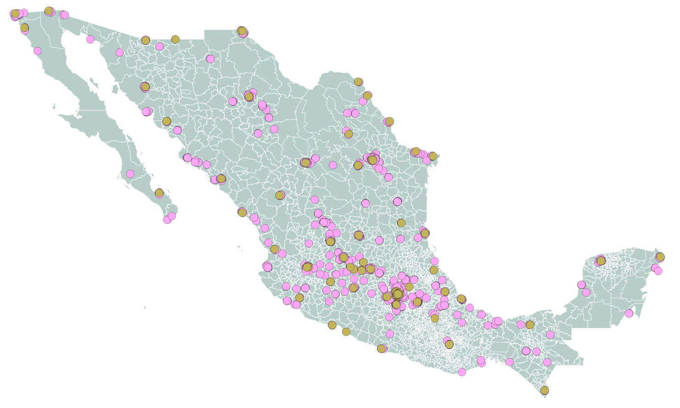
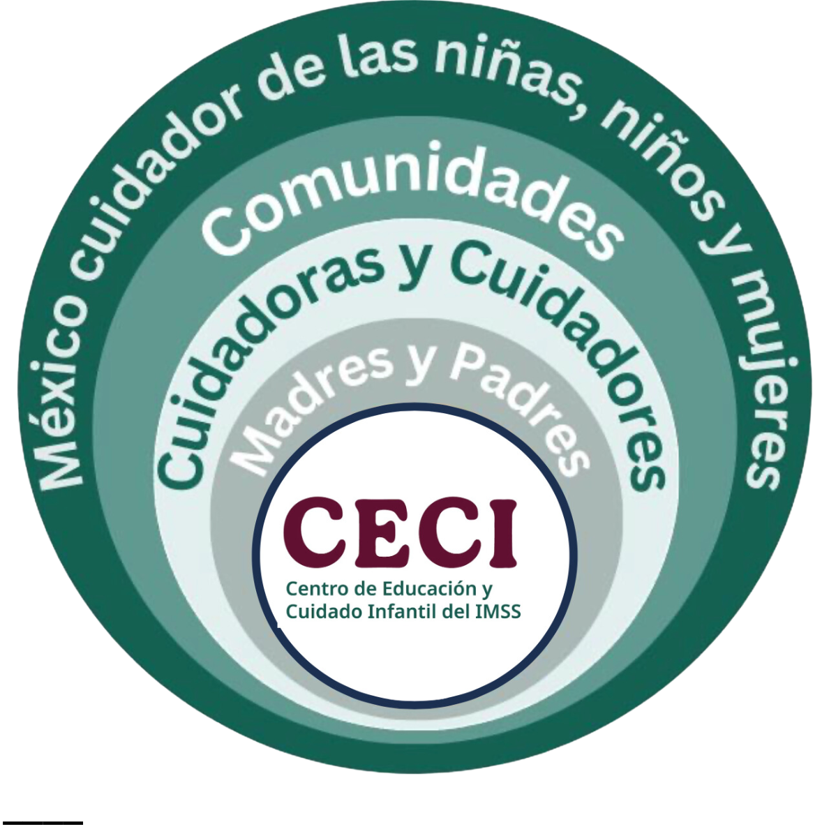
NACIONAL
27. Guarderías y CECI
ATENCIÓN A POBLACIÓN INFANTIL
Guarderías | 1,271 unidades | 185,163 Inscritos
Prestación directa | 129 unidades | 15,100 inscritos
Prestación indirecta | 1,142 unidades | 173,063 inscritos
Capacidad instalada | 235,268
En espera | 34,959
Directa
Indirecta
Fuente : Boletín de guarderías agosto de 2025
Modelos: Centros de Educación y Cuidado Infantil (CECI)
110 niñas y niños​
Terreno: 1,500 m²​ | Construcción: 1,100 m²​
150 niñas y niños​
Terreno: 1,800 m²​ | Construcción: 1,300m²​
200 niñas y niños​
Terreno: 2,200 m²​ | Construcción: 1,700 m²​
250 niñas y niños​
Terreno: 2,500 m²​ | Construcción: 2,000 m²​
Fuente : SCI

Slide 32

NACIONAL
28. Centros de Educación y Cuidado Infantil (CECI)
Inversión
2025 | 2026
Cd. Juárez, Chihuahua | Plan México Oriente
1. Las Gladiolas | 1. Ecatepec, Edomex
2. Municipio Libre | 2. Chimalhuacán. Edomex
3. Paraje de Oriente 17 | 3. Chalco, Edomex
4. Senderos de San Isidro | 4. Nezahualcóyotl, Edomex
5. Urbivilla del Cedro
Mexicali, Baja California | Municipios con propuesta de terreno
6. Finca los Jazmines | 5. Yecapixtla. Mor
7. Hacienda de las Torres | 6. Cancún, Q.Roo
 | 7. Cozumel, Q,Roo
 | 8. Playa del Carmen, Q.Roo
 | 9. Texmelucan, Edomex
 | 10. San Pedro, N.L
 | 11. Escobedo, N.L
 | 12. Tuxtla Gtz, Chis
 | 13. Tizayuca, Hgo
 | 14. San Francisco del Rincón, Edomex
 | 15. San Luis de la Paz
 | 16. Valle de Santiago
 | 17. Matamoros
2027 al 2030
176 CECI en planeación (necesidades con base en población trabajadora sector manufactura, jornaleras y brechas)
Fuente : SCI

Slide 33
NACIONAL
29. Equipo médico Aceleradores lineales
Inversión 2019-2024 y 2025
16 aceleradores lineales en 10 unidades médicas
4,052.7 mdp
INVERSIÓN 2019-2024
Unidad médica | Estado | Unidad | Descripción | Monto mdp
UMAE H. Oncología (proceso) CMN SXXI | Ciudad de México | 2 | Acelerador lineal baja energía | $292
 |  | 1 | Acelerador lineal baja energía. Tomógrafo simulador | $227.1
UMAE H.E. CMNO, Guadalajara | Jalisco | 1 | Acelerador lineal de baja energía | $155
 |  | 1 | Acelerador lineal baja energía. Tomógrafo simulador | $176.7
UMAE H.E. Puebla | Puebla | 1 | Acelerador lineal de baja energía. Radiocirugía con simulador | $295.7
UMAE Oncología CMN SXXI | Ciudad de México | 1 | Acelerador lineal de baja energía tomógrafo simulador | $163.8
 |  | 1 | Acelerador lineal de baja energía. Radiocirugía robótica | $163.8
UMAE H.E. CMNO Guadalajara (proceso) | Jalisco | 1 | Acelerador lineal de baja energía. Tomógrafo simulador | $176.7
UMAE H.E. CMN León | Guanajuato | 1 | Acelerador lineal de alta energía con simulador | $177.3
UMAE H.E. 25 Monterrey | Nuevo León | 1 | Acelerador lineal dedicado a radiocirugía con simulador | $295.7
HGR 1 Cd. Obregón | Sonora | 1 | Acelerador lineal dedicado a radiocirugía con simulador | $295.7
INVERSIÓN 2025
HES 71 Torreón * | Coahuila | 1 | Acelerador lineal de alta energía con simulador | $116.8
HGR 20 Tijuana* | BC | 1 | Acelerador lineal de baja energía | $957.77
HES 25 Monterrey* | NL | 1 | Acelerador lineal de baja energía | $464.9
HES CMN Mérida* | Yucatán | 1 | Acelerador lineal de alta energía | $93.8
*4 Sustituidos en 4 unidades médicas en 2023.

Slide 34
NACIONAL
30. Camas por cada 1000 habitantes
ENTIDAD | Indicador de camas 2024 | Indicador de camas 2026
Ciudad de México | 1.12 | 1
Sonora | 0.84 | 0.79
Chihuahua | 0.65 | 0.71
Coahuila | 0.72 | 0.68
Guerrero | 0.77 | 0.67
Nayarit | 0.75 | 0.67
Jalisco | 0.76 | 0.66
Durango | 0.69 | 0.64
Veracruz | 0.72 | 0.63
Campeche | 0.56 | 0.63
Colima | 0.68 | 0.62
Baja California Sur | 0.7 | 0.61
Yucatán | 0.68 | 0.6
Nuevo León | 0.66 | 0.6
Michoacán | 0.63 | 0.59
Morelos | 0.61 | 0.58
Sinaloa | 0.66 | 0.58
Tamaulipas | 0.62 | 0.57
San Luis Potosí | 0.61 | 0.56
Aguascalientes | 0.63 | 0.56
Baja California | 0.64 | 0.55
Guanajuato | 0.59 | 0.52
Hidalgo | 0.55 | 0.49
Puebla | 0.59 | 0.49
México | 0.5 | 0.48
Quintana Roo | 0.5 | 0.45
Zacatecas | 0.51 | 0.44
Tabasco | 0.53 | 0.44
Oaxaca | 0.53 | 0.43
Querétaro | 0.49 | 0.43
Chiapas | 0.5 | 0.4
Tlaxcala | 0.46 | 0.39
Nacional | 0.68 | 0.61
Meta: 1 cama por cada 1,000 DH
Var +0.1
Indicador Nacional 2025: 0.61 camas por cada 1,000 DH

Slide 35
NACIONAL
31. Actividad Económica
Principales empleadores públicos
Entidad | Empleador | Empleos
CDMX | Instituto Mexicano del Seguro Social | 108,412
Jalisco | Gobierno del Estado de Jalisco | 56,021
Veracruz | Secretaría de Educación | 55,961
CDMX | Secretaría de la Defensa Nacional | 52,653
Yucatán | Gobierno del Estado Libre y Soberano de Yucatán | 52,371
Principales empleadores privados
Entidad | Empleador | Empleos
Estado México | Itelevate Solutions S.A. de C.V. | 64,561
CDMX | Lieberbv S. de R.L. de C.V. | 46,393
CDMX | Banco Nacional de México SA | 34,411
Estado México | Nueva Wal Mart de México S. de R.L. de C.V. | 33,306
CDMX | Nueva Wal Mart de México S. de R.L. de C.V. | 28,678

Slide 36
NACIONAL
32. Principales deudores
Principal deudor del Gobierno del Estado
Entidad | Empleador | Monto de deuda (mdp)
Nayarit | Universidad de Nayarit | $910,063.5
CDMX | Secretaría de la Defensa Nacional | $810,002.1
Morelos | Universidad Autónoma del Estado de Morelos | $541,741.6
Campeche | Municipio del Carmen | $230,093.5
Zacatecas | Secretaría de Educación | $224,871.4
Principal deudor privado
Entidad | Empleador | Monto de deuda (mdp)
Hidalgo | Grupo Constructor Industrial Oil & Gas S.A. de C.V. | $313,628.5
CDMX | México Railway Engineering Technology S.A.P.I. de C.V. | $246,624.1
Jalisco | Roberto Ochoa Ruiz | $107,722.5
CDMX | La Casa del Utensilio S.A.S. de C.V. | $107,194.9
Sonora | Grupo Chamberlain S. de R.L. de C.V. | $97,869.0

