Slide 1




POP CULTURE RENEGADES
Analyzing public sentiment via popular culture

Slide 2
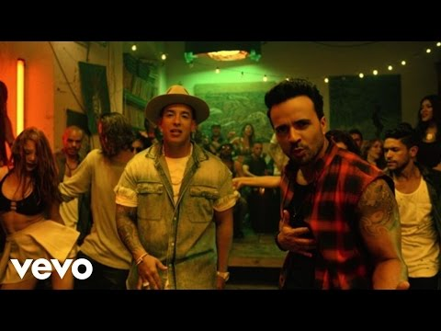

Slide 3


Slide 4
The Question
Can we trace American sentiment over the last few decades by analyzing the movies we loved, the songs we rocked out to, and the books we curled up with?
The Movies They Watch
The Books They Read
The American Public
The Songs They Listen To
Notes:
Can Despacito and Wonder Woman show us what the American public felt in 2017?

Slide 5


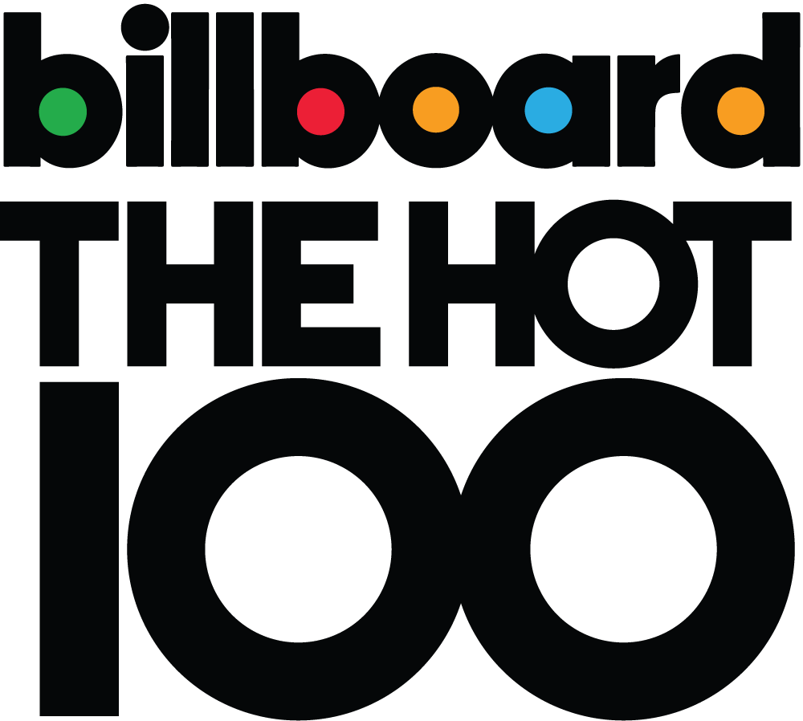
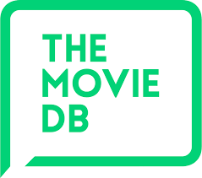
The Metrics
FINDING TOP 100 BY YEAR:
Movies
Songs
Books
Working with Human Language Data.
Analyzing text
Capturing linguistic structures
Notes:
Identify the top X according measures of public opinion
Analyze of content of those top X and identify sentiment: analyzing song titles and lyrics; movie and book abstracts.

Slide 6



The Data
EVENTS
BOOKS
MOVIES
SONGS
NYT weekly list of bestsellers back to 1930s
Historical ranks and reviews
+45,000 movies
Key words, revenue, release
JSON files
+380,000 lyrics
Artist, year, song
Top Stories
API
API
(All non-commercial uses allowed by T&C)

Slide 7


The Output
Timeline
Search Engine
Dominant Sentiment: Fear?
Major event: JFK Assassination
Top Song: “Sugar Shack” by The Fireballs
Top Book: “The Shoes of the Fisherman” by Morris West
Top Movie: Cleopatra
Dominant Sentiment: Hope?
Major event: “Yes We Can”
Top Song: “Low” by Flo-Rida ft. T-Pain
Top Book: “The Appeal” by John Grisham
Top Movie: The Dark Knight
1998
1963
2008
Dominant Sentiment: Disappointment?
Major event: “I did not have sexual relations with that woman”
Top Song: “Too Close” by Next
Top Book: “The Street Lawyer” by John Grisham
Top Movie: Saving Private Ryan
Notes:
An interactive website with 1) a search engine where you type in a year, and it returns the top songs (genre), movies, and books from that year as well as the major political event or social occurrence that defined public sentiment during that year 2) an interactive THYMELINE where you can hover over a year and see a quick view

Slide 8
QUESTIONS?

