Slide 1
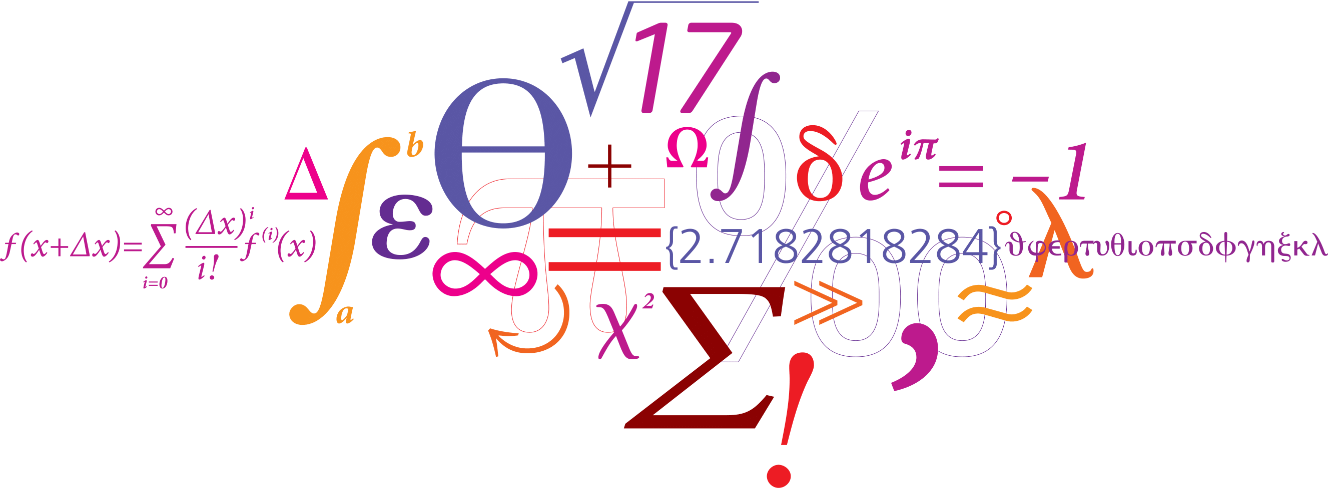
Probabilistic Chan-Vese
Advanced Image Analysis - Group 3
Sheyla Barrado Ballestero
Mario Corral Bolaños

Slide 2
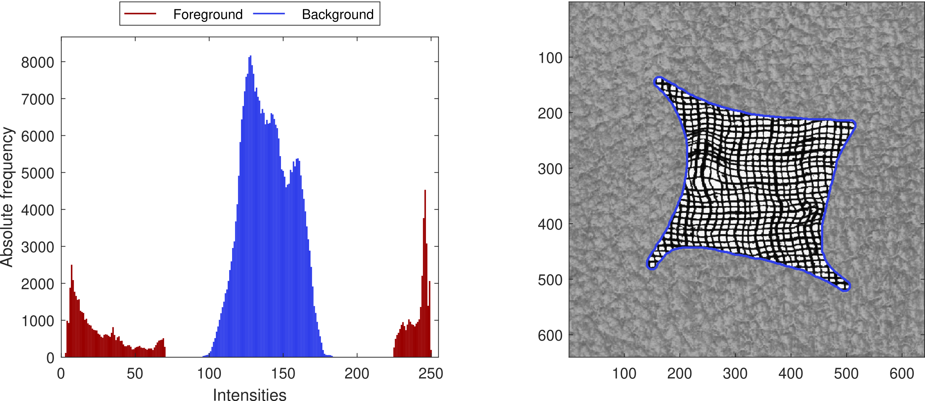
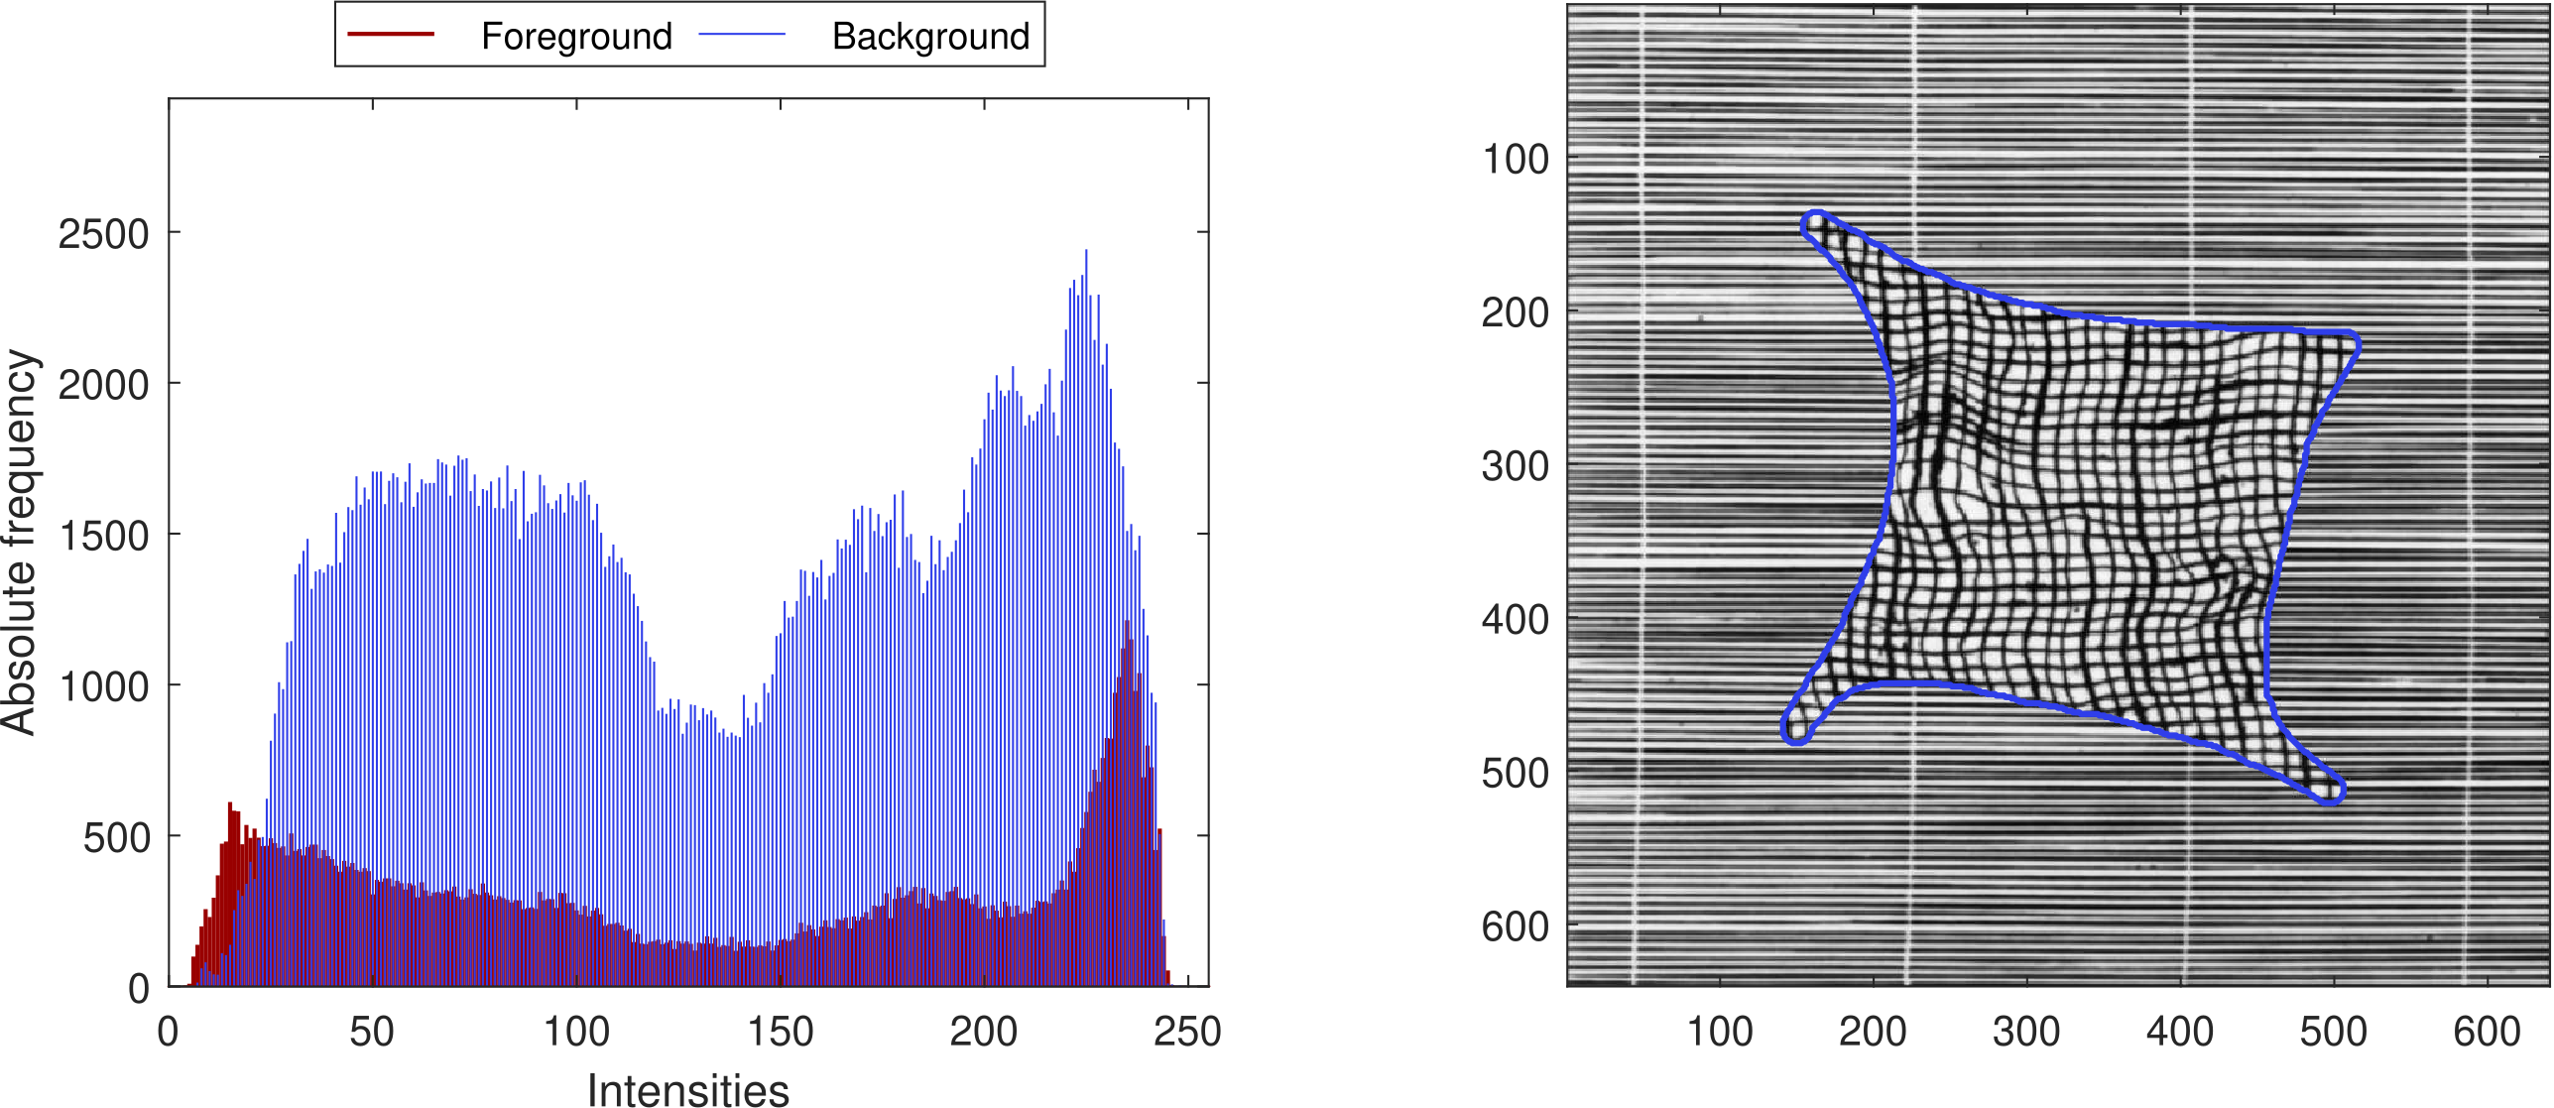
Problem statement
Chan-Vese algorithm proposes a method to differentiate two regions with different mean intensities:
$$F_{ext}=\left(m_{in}−m_{out}\right)·\left(2I −m_{in} −m_{out}\right)·N$$
Intensity distribution approach
Patch-based approach
Vedrana Andersen Dahl and Anders Bjorholm Dahl. A probabilistic framework for curve evolution. In Scale Space and Variational Methods in Computer Vision, pages 421–32. Springer, 2017
Notes:
The Chan-Vese algorithm proposes a method which separates a background from the foreground based on the mean intensities of the area. By its own, this method cannot handle many realistic situations in which this difference is not so big. Those cases are exemplified on the images, in which the mean intensity of the background and the foreground are pretty the similar.
To generalize the chan vese algorithm we use the probabilistic approach proposed by Dahl and Dahl (2017). In which two approaches are proposed, one in which we use the intensities distributions inside and outside the curve to estimate the curve evolution, and a second one in which we use image patches to take advantage of different textures of the foreground and background.

Slide 3
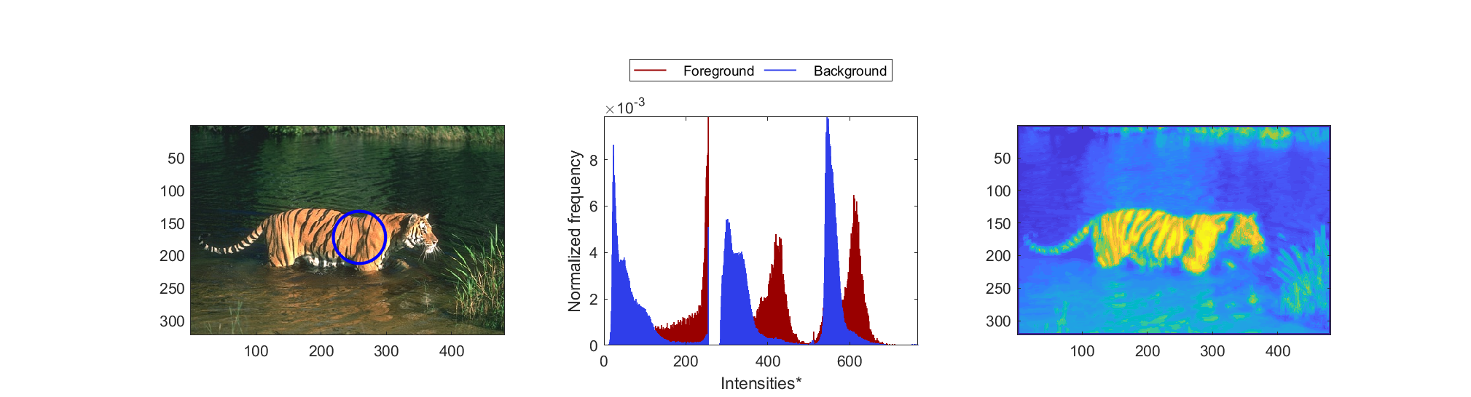
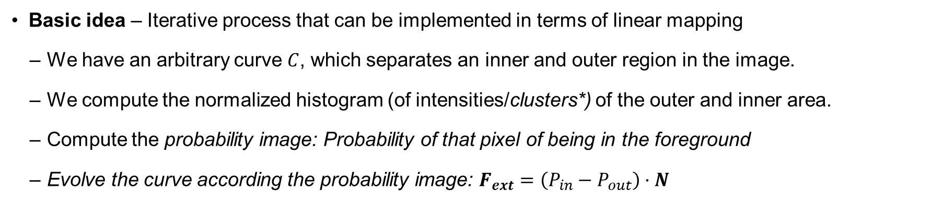
Algorithm
Basic idea – Iterative process that can be implemented in terms of linear mapping
We have an arbitrary curve $C$, which separates an inner and outer region in the image.
We compute the normalized histogram (of intensities/clusters*) of the outer and inner area.
Compute the probability image: Probability of that pixel of being in the foreground
Evolve the curve according the probability image: $F_{ext}=\left(P_{in}−P_{out}\right)·N$

Slide 4
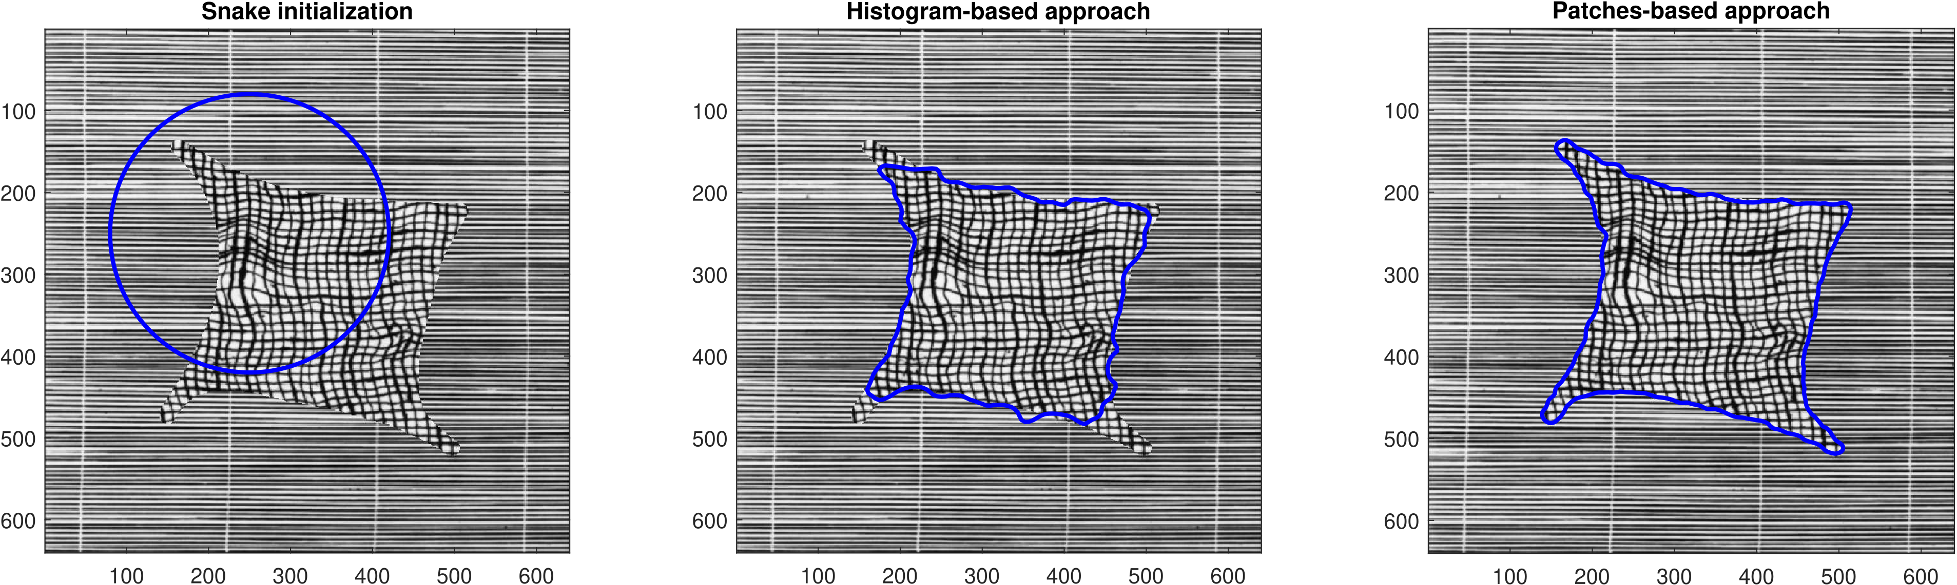
Results
Intensity-distribution vs Patch-based
Regularization α | 3 | 0.8
Regularization β | 1 | 0.1
Step size | 50 | 50
N. Dictionary entries | - | 50

Slide 5
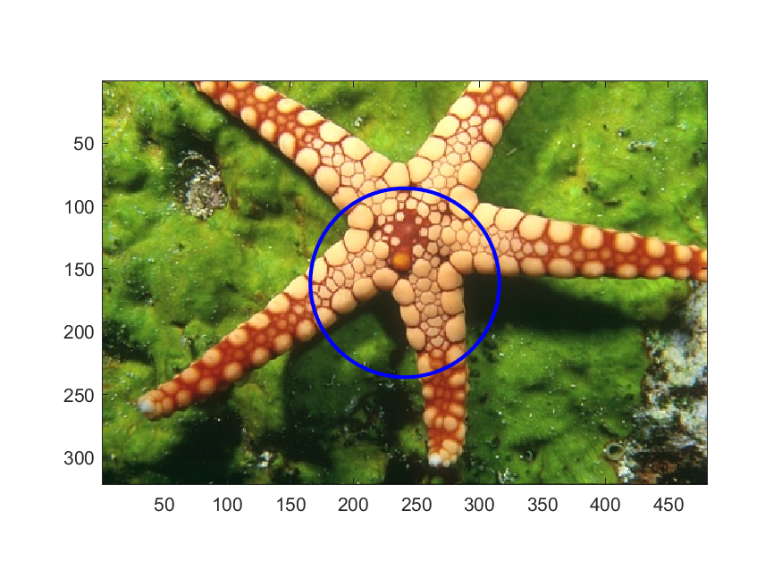
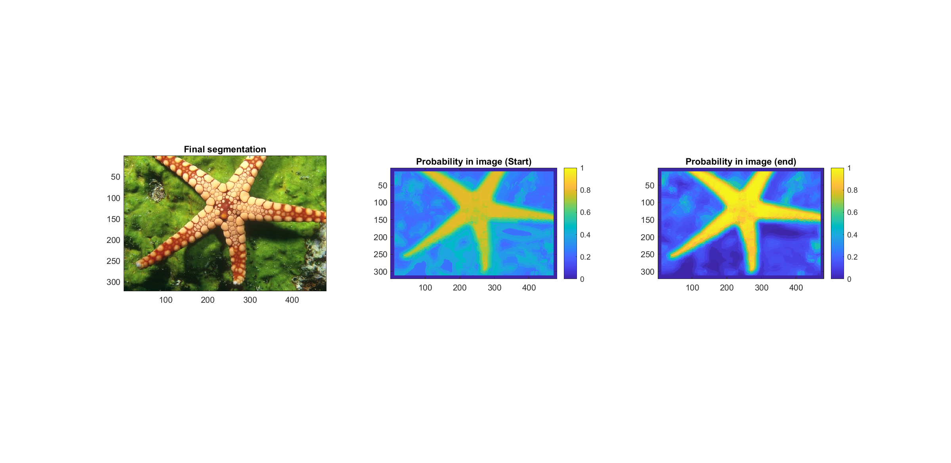
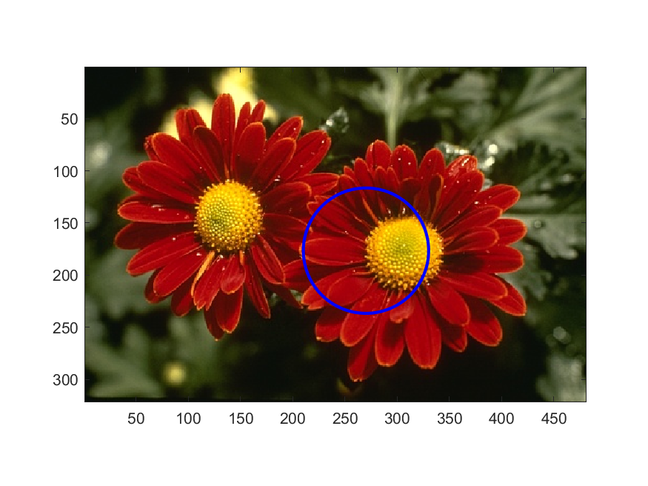
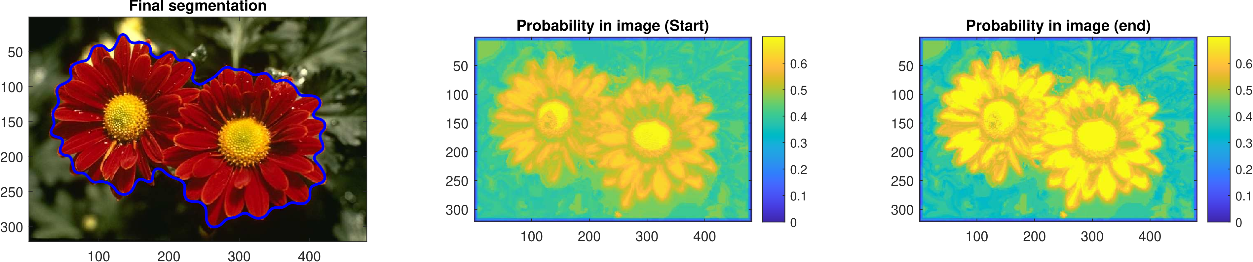
Results: Patch-based methods in natural images
Image | R_channel – 0.2 · G_channel | α | 0.2 | β | 0 | Step size | 5 | Dict size | 170
Image | RGB | α | 2 | β | 0.005 | Step size | 5 | Dict size | 300

Slide 6
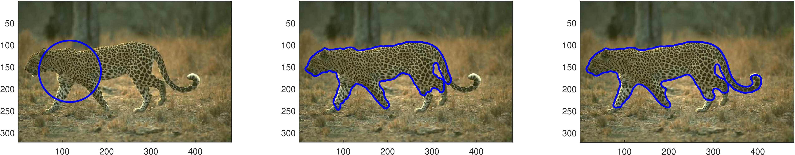
Results
Multiple patch-scales combination
Patches size | 7x7
Patches size | 5x5
Patches size | 11x11

Slide 7
Thank you!
Group 3: Sheyla Barrado & Mario Corral

