Slide 1
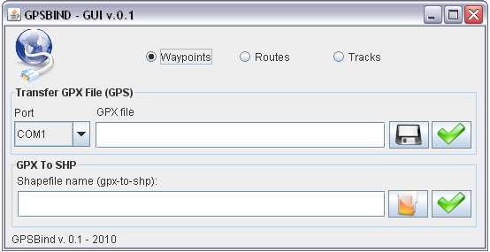
GPSBind-GUI | QuickStart Tutorial
A graphical front end to GPSBabel and gpx2shp.
  GPSBabel to transfer data to and from GPS devices and to import (*.gpx) file written by Robert Lipe.¹
  GPX2SHP converts the GPS Exchange Format(*.gpx) to ESRI/shape format(*.shp) written by Toshihiro Hiraoka.² http://gpx2shp.sourceforge.jp/
1 – Select one option.
3 – Filename.
4 – Select directory.
2 – Select a serial/usb port.
5 – Data transfer of GPS (Wait).
7 – Convert gpx to shp.
6 – Select (*.gpx) file.
¹ http://www.gpsbabel.org/
² http://gpx2shp.sourceforge.jp/
By Mario C. Ponciano - a.k.a Razec
<mrazec@gmail.com>

