Slide 1



TIME WINDER
02:16
Start
PAUSE
Clear

Slide 2

TIME WINDER
02:16
Start
PAUSE
Clear

Slide 3

TIME WINDER
02:16
Start
PAUSE
Clear

Slide 4
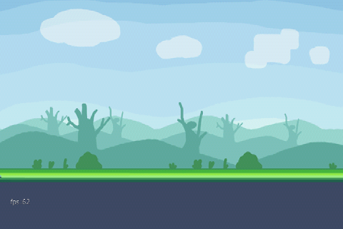
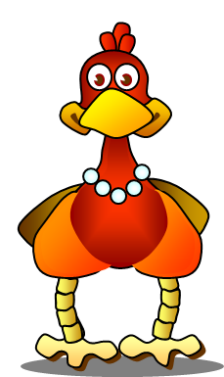
Small Ben
02:16
Minutes: 2
Seconds: 16
Start

Slide 5
Small Ben
02:16
Minutes: 2
Seconds: 16
Start

Slide 6
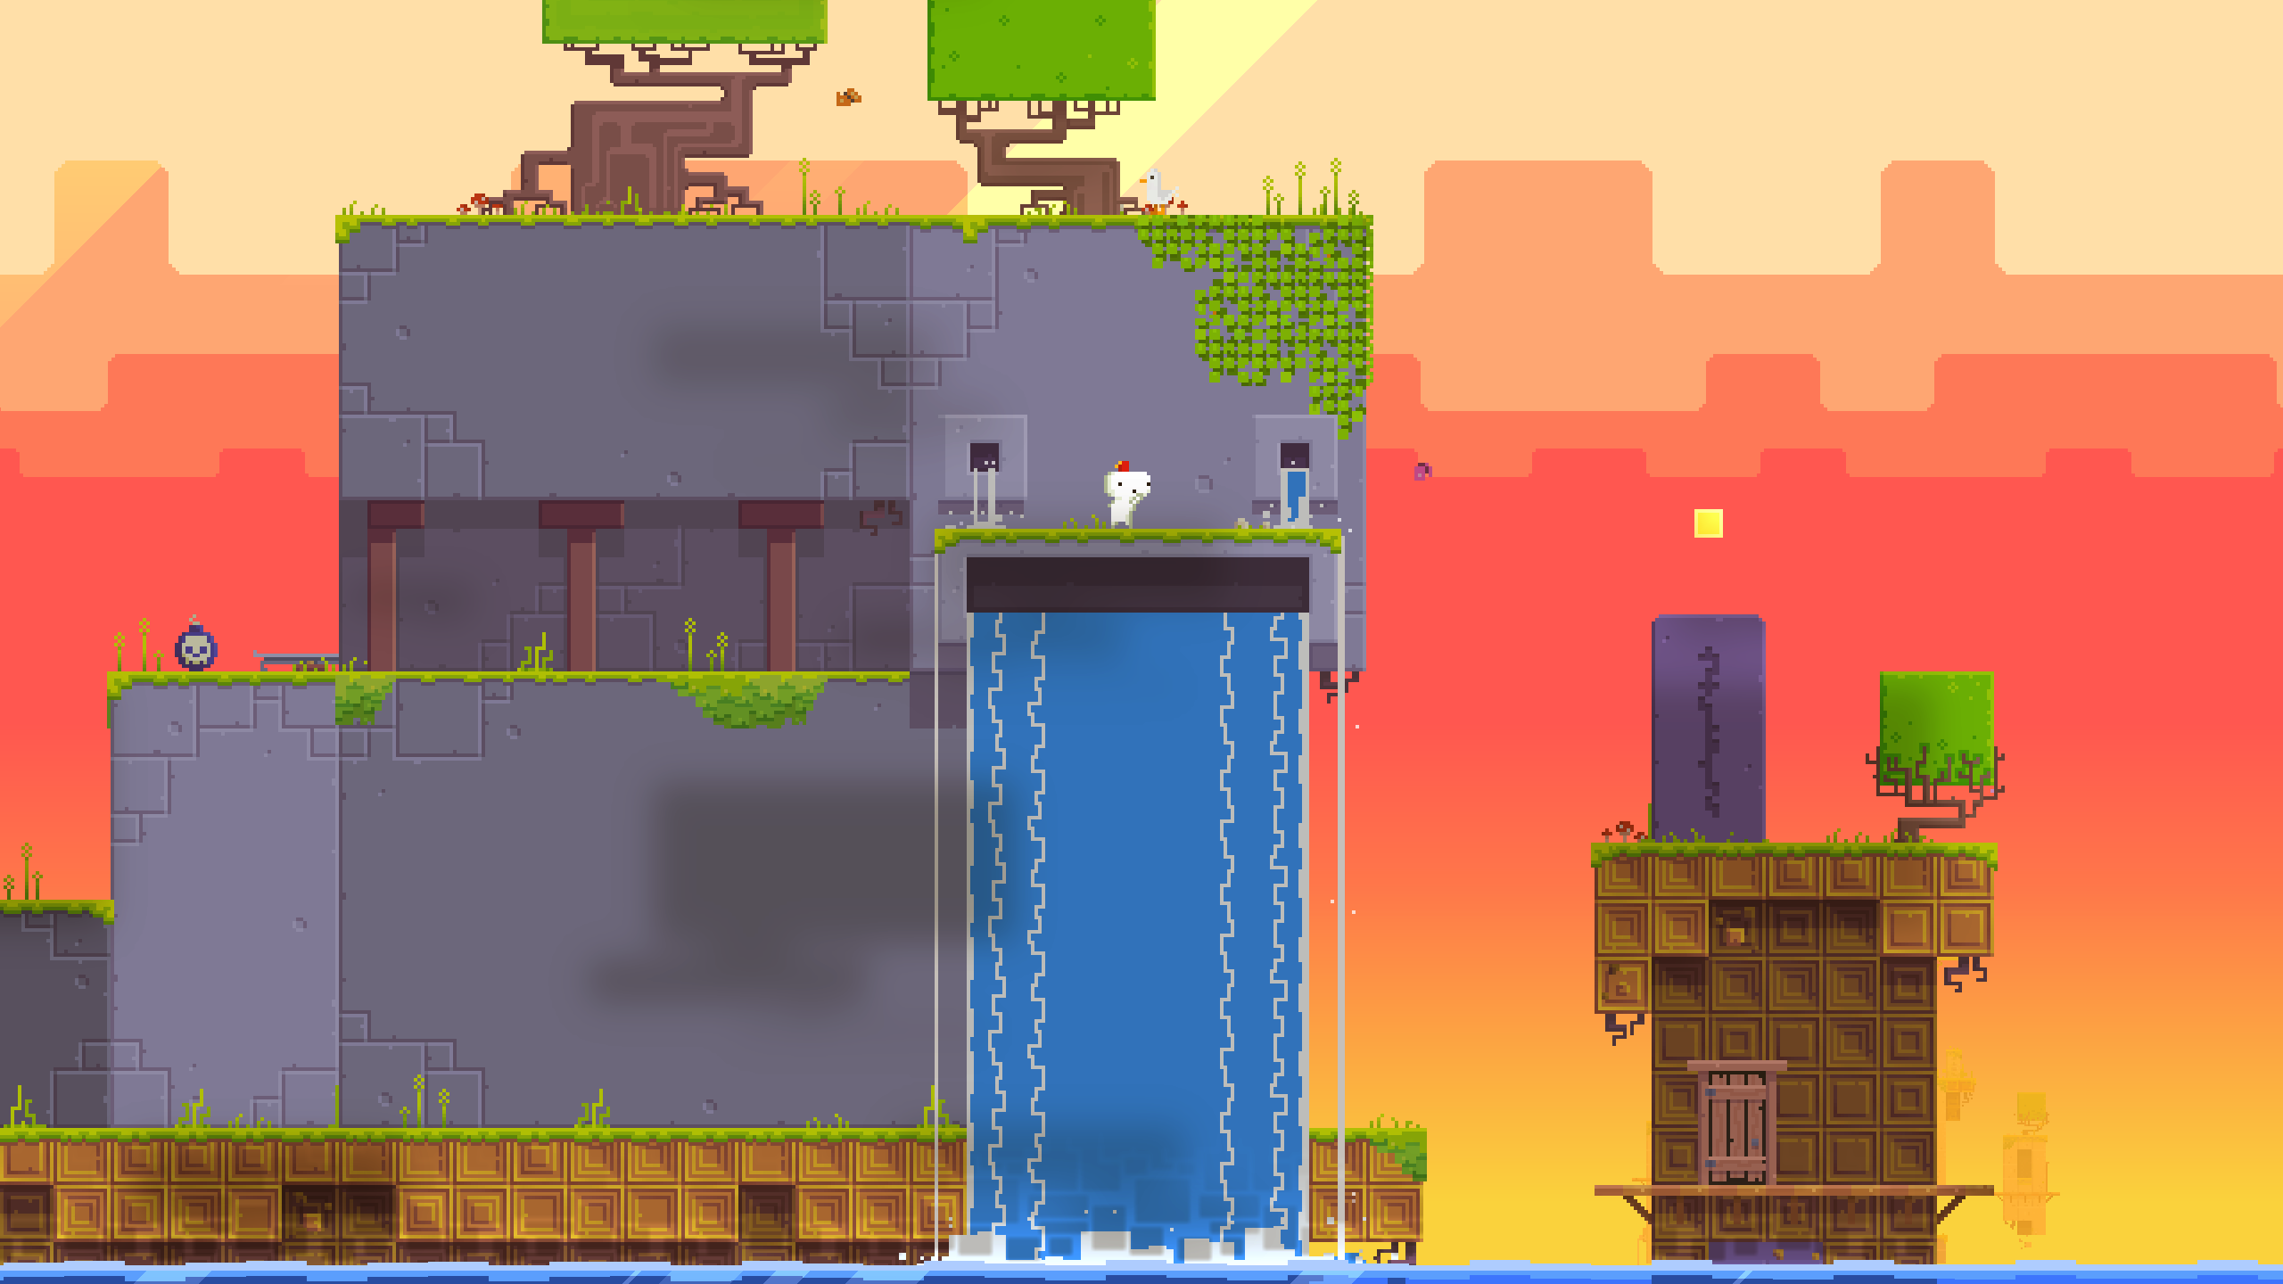
Small Ben
02:16
Minutes: 2
Seconds: 16
Start

Slide 7
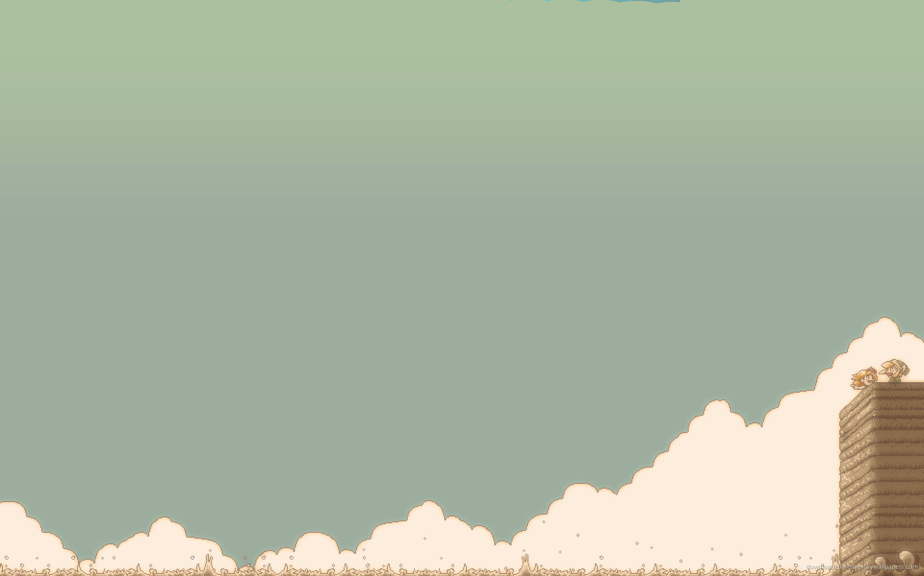
Small Ben
02:16
Minutes: 2
Seconds: 16
Start

Slide 8
Small Ben
02:16
Minutes: 2
Seconds: 16
Start

Slide 9

TIME WINDER
02:16
Start
PAUSE
Clear

Slide 10
Small Ben
02:16
Minutes: 2
Seconds: 16
Start

