Slide 1


Mean Reversion: Soybean Crush Complex
Notes:
Grant

Slide 2
Crushing & The Soybean Crush Spread
Methodology: "Crushing" is the act of turning soybeans (the input) into soybean oil and meal (the outputs). The crush spread provides opportunity for speculation/hedging the relationship between the prices of the input and outputs.
Long spread: Sell soybeans, buy soybean oil, buy soybean meal
Short spread: Buy soybeans, sell soybean oil, sell soybean meal
Notes:
Grant

Slide 3
Introduction to Academic Paper
John Mitchell, Central Michigan University (2010)
Entry: $100 to $400 deviation from 5 day M.A.
Exits: $0 to $200 deviation from the 5 day M.A.
Strategy: Simple mean reversion without oscillation
Leg in to each individual contract
No stop losses present
No utilization of intraday trades
Notes:
Doug- The academic paper was done over a 22 year study similar to what we are doing but closed positions before they reached the moving average (early). This was still an improvement from the predecessors that waited for the spread to oscillate the moving average. The quantity of trades over the 22 year period were 70-994. Average profit was -$42 to $122. Even at the best scenario for each element, ignoring parameter differences, the paper only saw $5,500 profit per year.

Slide 4
Scope, Abstract & Process
Analyze and create algorithmic strategy for Soybean Crush Complex
Mean reversion (academic paper as starting point)
Modify strategy for updated market conditions & technology
Intraday, chart frequency and stop losses
Create algorithmic program that successfully trades the crush spread
Optimize and manage program using historical data for backtesting
Notes:
Connor

Slide 5

Synthetic Soybean Crush Spread (BCX)
Specifications (CME Globex):
Size: 50,000 bushels (deliverable)
Price Quote: Cents per bushel
Minimum Price Fluctuation: ¼ Cent ($125.00 /tick)
Traded Months: Jan (F), Mar (H), May (K),
Jul (N), Aug (Q), Sep (U), Oct (V), Dec (Z)
Notes:
Grant

Slide 6
Mean Reversion Strategy
Technical Indicators:
Simple Moving Average
Standard range of prices for reference to establish open triggers
Long Entry Requirements:
Offer = Specified Proportion Below the SMA
(Buy to Open)
Short Entry Requirements:
Bid = Specified Proportion Above the SMA
(Sell to Open)
Long Exit Requirements:
Bid = SMA
(Sell to Close)
Short Exit Requirements:
Offer = SMA
(Buy to Close)
Notes:
Grant

Slide 7
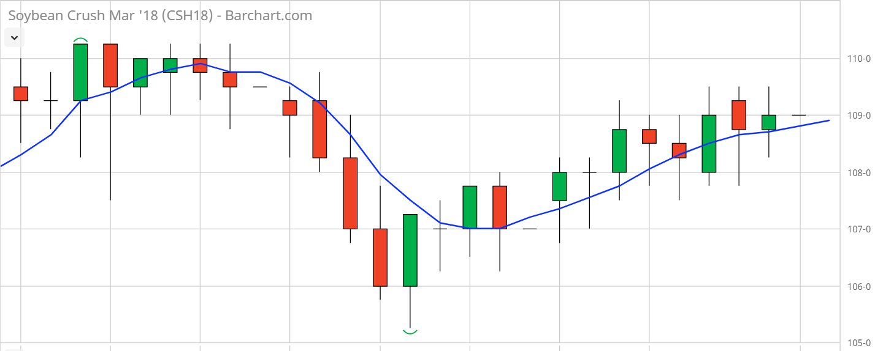
SELL TO CLOSE
BUY TO OPEN
Notes:
Doug

Slide 8
SELL TO OPEN
SELL TO CLOSE
BUY TO OPEN
BUY TO CLOSE
Notes:
Doug

Slide 9
SELL TO OPEN
STOP-LOSS TRIGGER
SELL TO CLOSE
BUY TO OPEN
BUY TO CLOSE
STOP-LOSS TRIGGER
Notes:
Doug

Slide 10
Developments & Solutions
Execution in the spread
BCX spread to avoid slippage from legs
Improves execution times
Market orders with modified entry triggers
Entry for long positions = Offer price
Exit for long positions = Bid price
Entry for short positions = Bid price
Exit for short positions = Offer price
Stop-Loss Orders
Placed at a reward/risk proportion
(Example Using 3:1 Reward/Risk)
Area between entry and SMA = 12 ticks
Area between entry and stop = 4 ticks
Total Reward = $1500
Total Risk = $500
Displacement from M.A.
Reward to Risk Ratio
Stop = Entry Price +/-
Notes:
Grant/Doug
The higher the reward to risk ratio is, the closer the stop will be set to the entry price= more likely to be stopped out

Slide 11
Determining Contract Traded
Traded CME BCX contract
Largest Open Interest
Greater than 1-2 weeks before First Notice Day (FND)
Find the contract which provides best:
Liquidity
Volume
Time
Notes:
Grant

Slide 12
User Defined Parameters
Displacement from M.A. required to open a position
Reward : Risk Ratio (Triggers)
Moving Average Period
Dynamic/Static Moving Average
Order TIF (Fill or Kill)
Number of Contracts Traded
Only Long/Short Positions
Stop-Loss Trigger On/Off
Time of Day Traded (Day Session v Night Session)
On/Off switch
Notes:
Mario

Slide 13
Back Testing & Data Analysis
March 2018 BCX (BCXH8)
October 2nd 2017 ---> February 1st 2018 (4 months total)
Average Daily Volume = 208 contracts
Trade Price Median = 1.035 cents/bushel
Low = 0.835 cents/bushel High = 1.25 cents/bushel
Time of Day Analyzed = 8:30am CDT ---> 1:20pm CDT
Day Session (Highest Volume and Volatility historically)
Notes:
Connor- Talk about the use of Excel to confirm that our backtest results were properly triggering the open and close of positions.

Slide 14
Challenges
Data limitations
Backtesting & local development servers
Implementation of stops
Breakout price action
Methodology to determine proportion on open positions
Notes:
Mario Grant

Slide 15
Construction of the Code
Formulas and algorithms allowing for user-determined variables
Analysis of P/L statements to determine the optimal parameter
settings
Utilizing stops to limit risk
Identifying trigger points in data based on constructed
algorithms and formulas
Notes:
Mario

Slide 16
Results of Backtesting
Open Trigger Percentage | Reward to Risk Ratio | :1 | Flat on EOD | Result
1.25% | 0.1 | : 1 | 0 | $ (557)
1.50% | 0.1 | : 1 | 0 | $ (1,792)
1.00% | 0.1 | : 1 | 0 | $ (2,943)
1.25% | 0.1 | : 1 | 1 | $ (7,200)
0.75% | 0.1 | : 1 | 0 | $ (9,588)
1.25% | 0.5 | : 1 | 0 | $ (10,202)
1.25% | 0.5 | : 1 | 1 | $ (12,089)
1.00% | 0.1 | : 1 | 1 | $ (12,968)
1.00% | 0.5 | : 1 | 0 | $ (15,977)
0.75% | 0.1 | : 1 | 1 | $ (17,745)
1.00% | 0.5 | : 1 | 1 | $ (17,862)
0.50% | 0.1 | : 1 | 0 | $ (18,488)
0.75% | 0.5 | : 1 | 1 | $ (27,032)
0.50% | 0.1 | : 1 | 1 | $ (27,893)
0.75% | 0.5 | : 1 | 0 | $ (42,277)
0.50% | 0.5 | : 1 | 1 | $ (63,619)
0.50% | 0.5 | : 1 | 0 | $ (70,853)
Notes:
Grant/ Mario
Best scenarios happened before we updated the code to not allow trades before we hit the moving average when we get stopped out in any trade ($820 profit). The best results that we saw were best when the percentage to open is high, risk to reward ratio is low and hold overnight

Slide 17
Future Implementations/Verdict
Future Implementations
Automate tradable contract determination
Control losses on breakout periods
Trade multiple contracts
Explore the use of separate legs in spread
Slippage & Execution
Use implied/historical volatility
Supplement analysis to find open trigger proportions
Conclusion and Results
Mean reversion can be profitable
Control breakout periods
Optimize for past & future volatility
Notes:
Mario Grant Doug

Slide 18
Thank You!
Questions?
Notes:
Mario Grant Doug

