Slide 1
WebAssembly con C#
Mario Di Vece

Slide 2
Necesario
Visual Studio 2019 Preview (Community)
.NET Core 3.1 or later (Preview) SDK

Slide 3
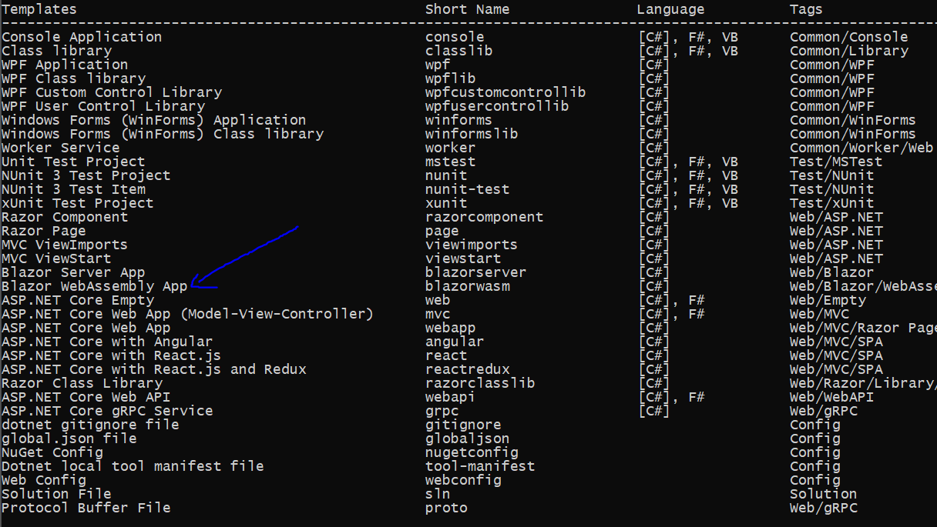
Instalar los Templates
dotnet new -i Microsoft.AspNetCore.Blazor.Templates::3.2.0-preview1.20073.1

Slide 4
Necesario
Visual Studio 2019 Preview (Community)

Slide 5
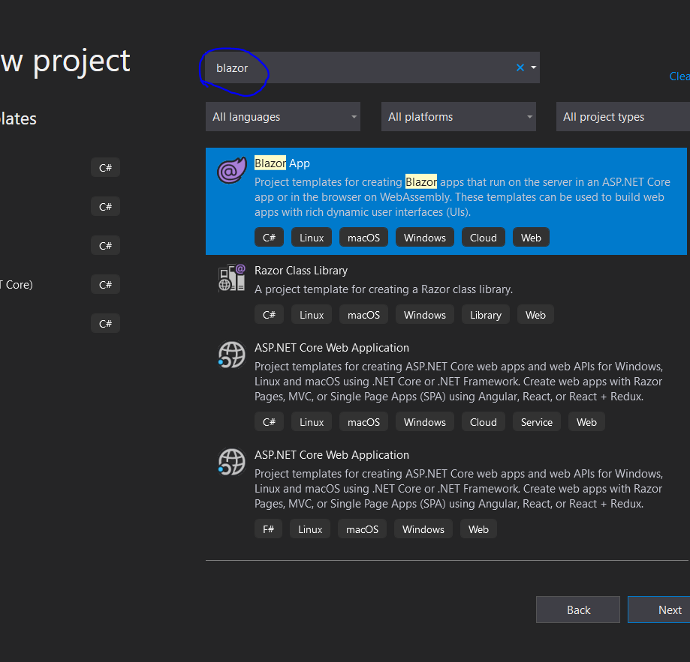
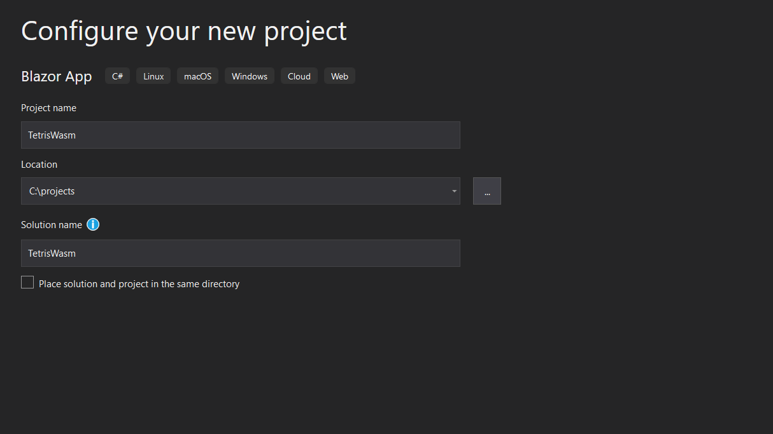

Slide 6
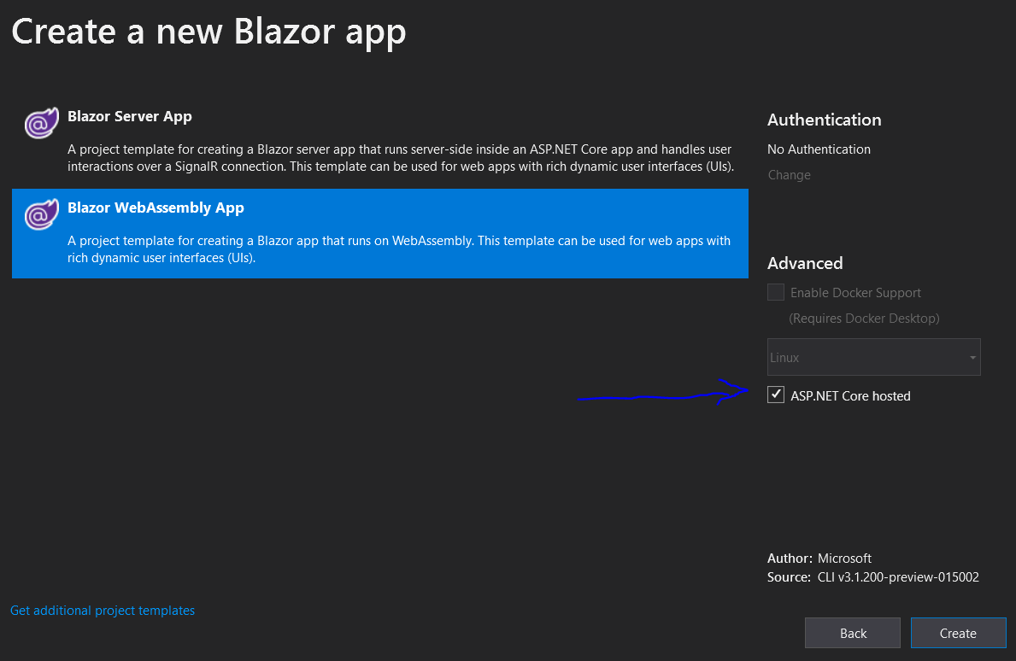

Slide 7
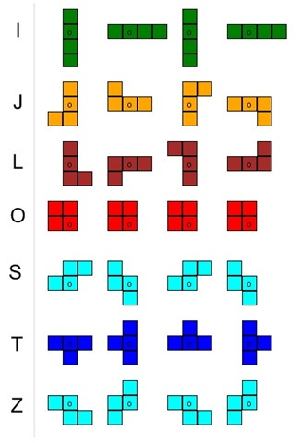
Las Piezas

Slide 8
https://github.com/mariodivece/tetriswasm

