Slide 1
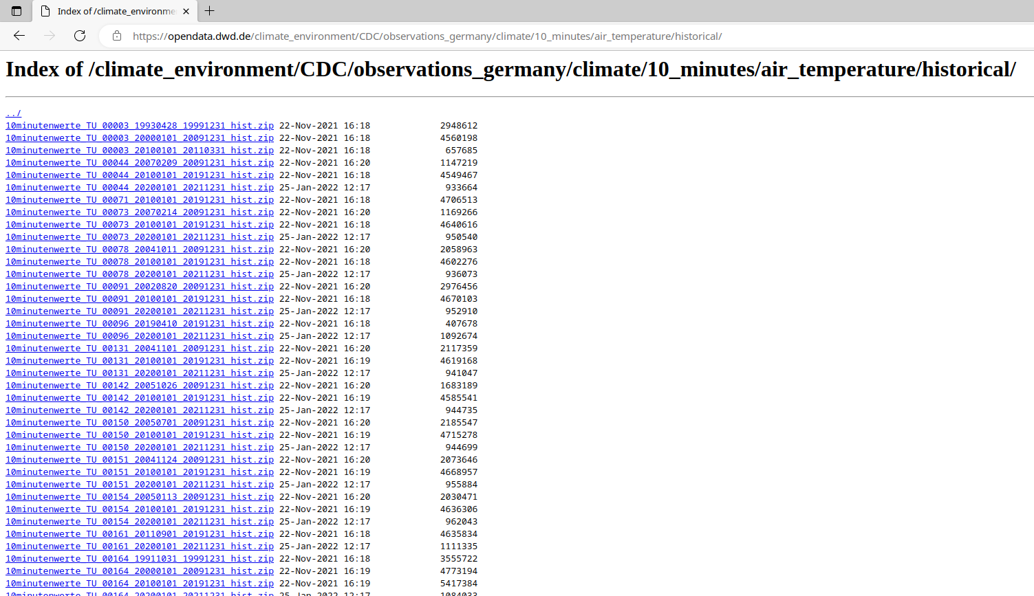
Many, many smaller Files…
https://opendata.dwd.de/climate_environment/CDC/observations_germany/climate/10_minutes/air_temperature/historical/
https://opendata.dwd.de/climate_environment/CDC/observations_germany/climate/10_minutes/solar/historical/
Durchcklicken skaliert nicht

Slide 2
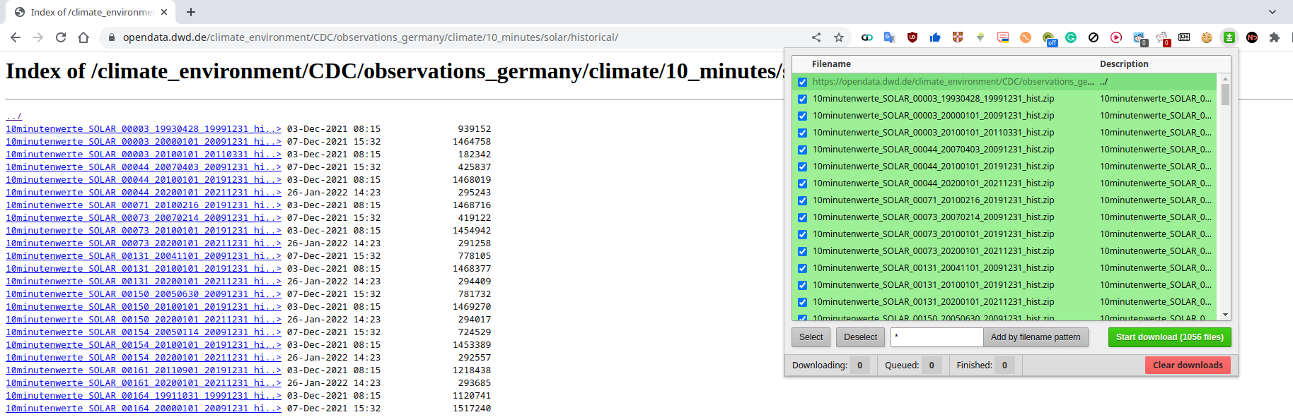
Chrome Extension - Batch link downloader
Alle verfügbare Links mit einem Click herunterladen
https://chrome.google.com/webstore/detail/batch-link-downloader/aiahkbnnpafepcgnhhecilboebmmolnn

Slide 3
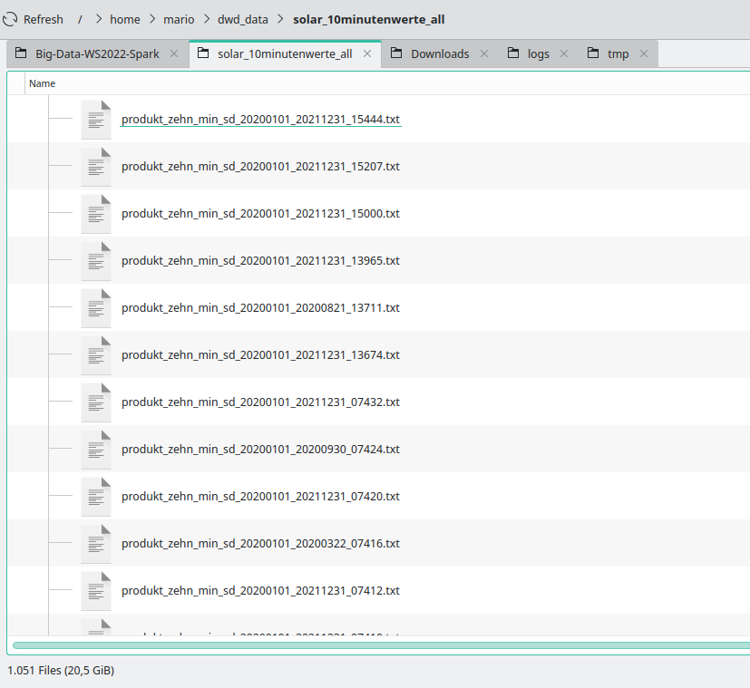
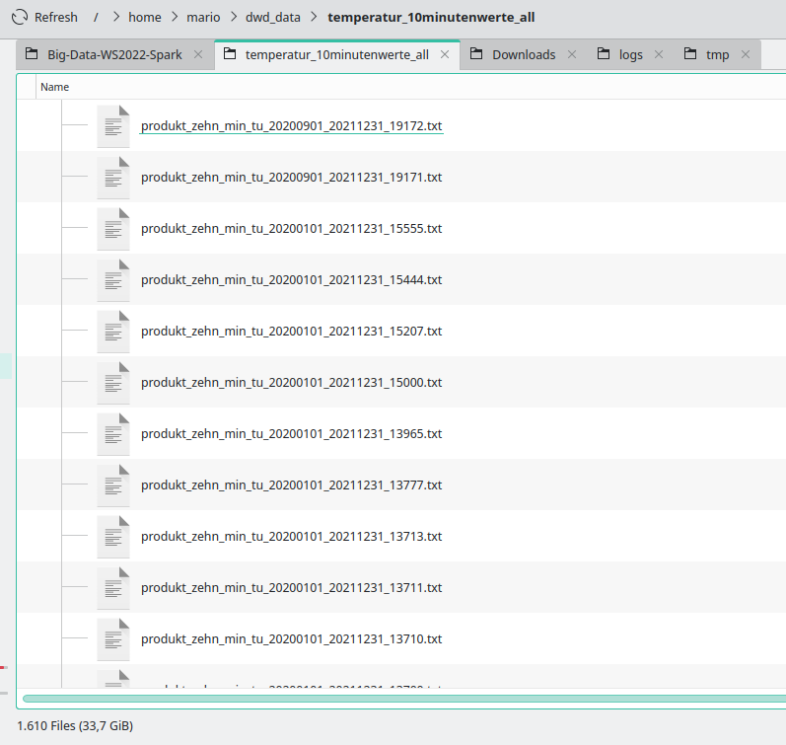
20,5 GB + 33,7 GB
Zu viel für PoC

Slide 4
Schau extracting_files.py
20,5 GB + 33,7 GB
Input data: 1555 MB

Slide 5
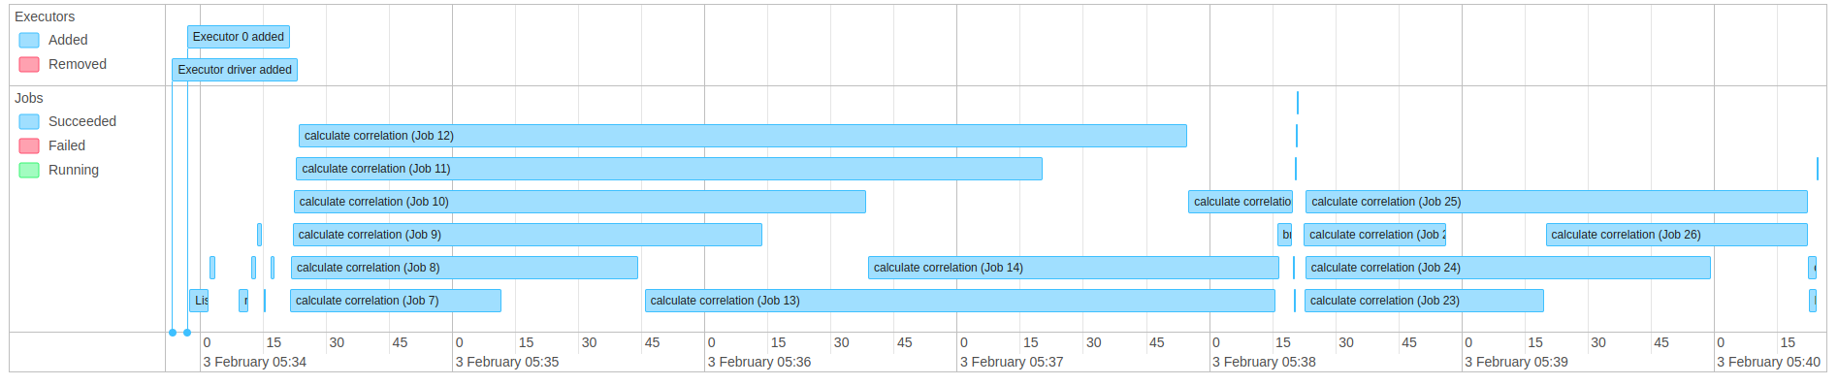
Start: 05:34:22
End: 05:40:24
Total time: 6 min 2 sec

Slide 6
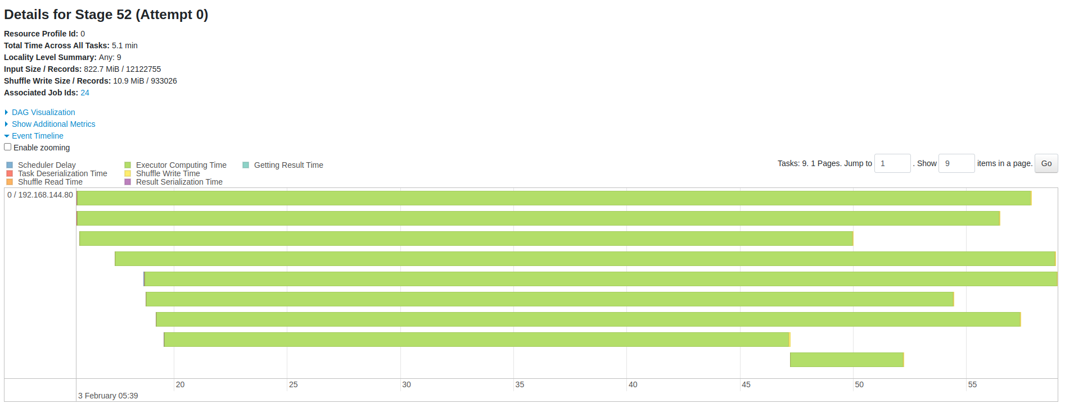
Alle Cores sind beschäftigt – gut!

Slide 7
Cluster Setup
2 laptops
Connected on a local network over the router via WIFI

Slide 8
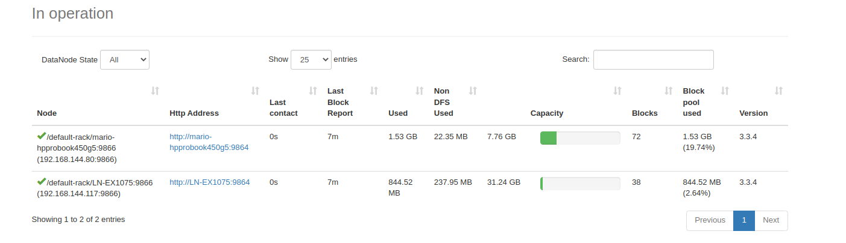
HDFS
Node 1 - hat alle Daten
Node 2 - 844 MB

Slide 9
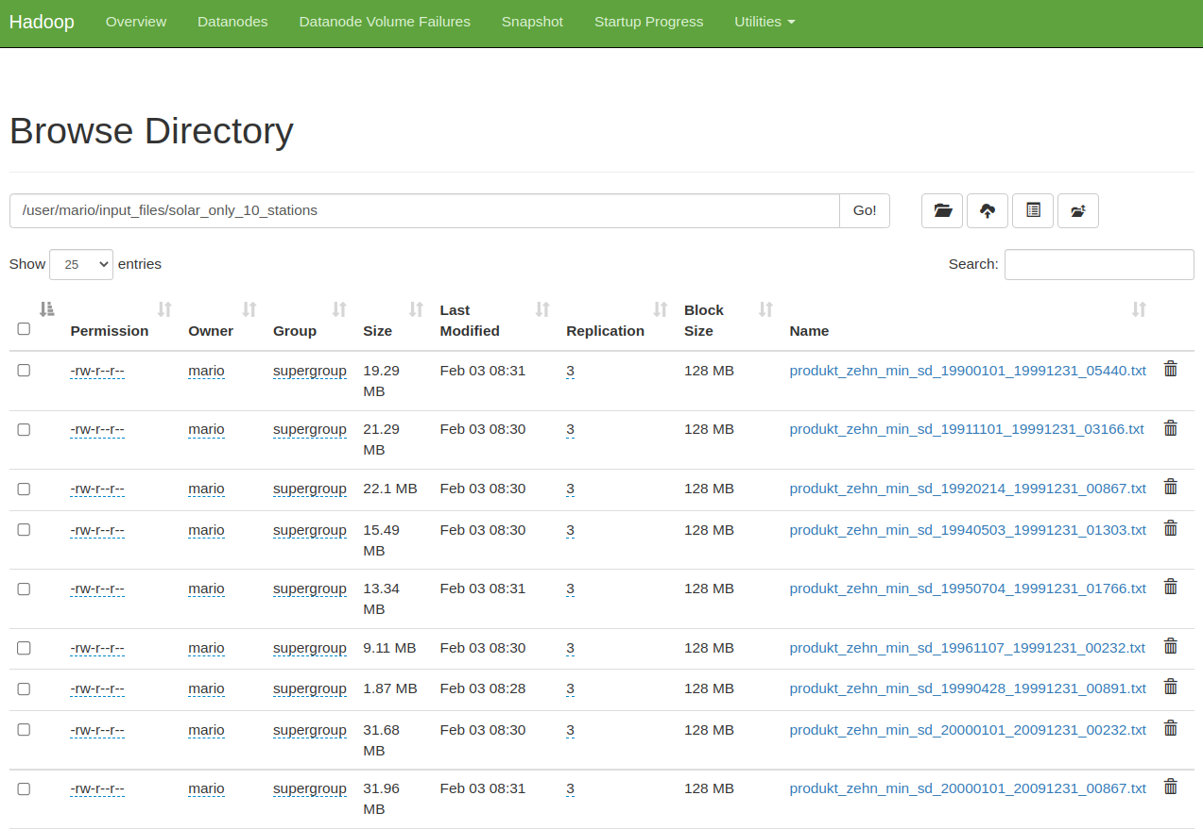
HDFS

Slide 10
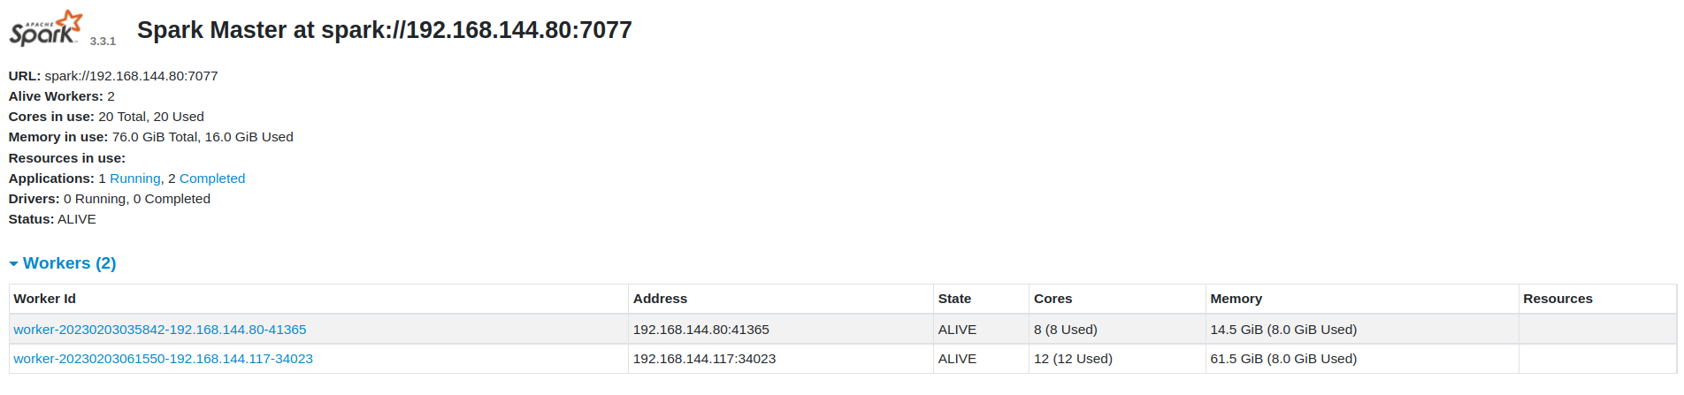
2 nodes

Slide 11
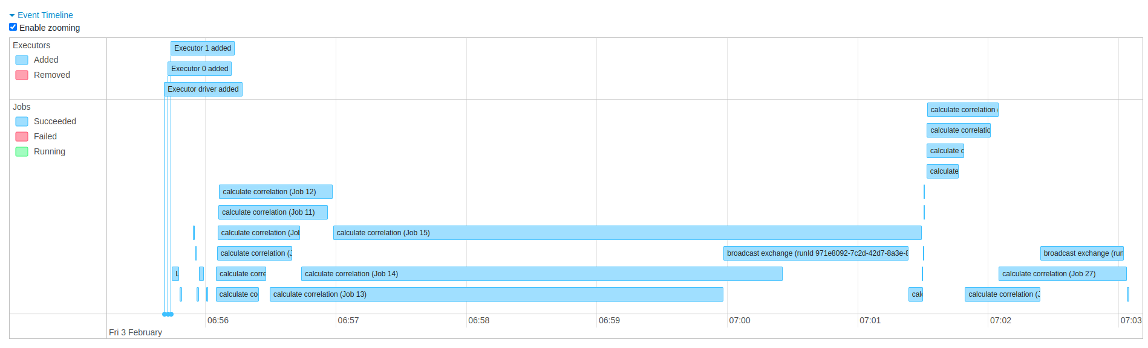
Start: 06:56:06
End: 07:03:04
Total time: 6 min 58 sec

Slide 12
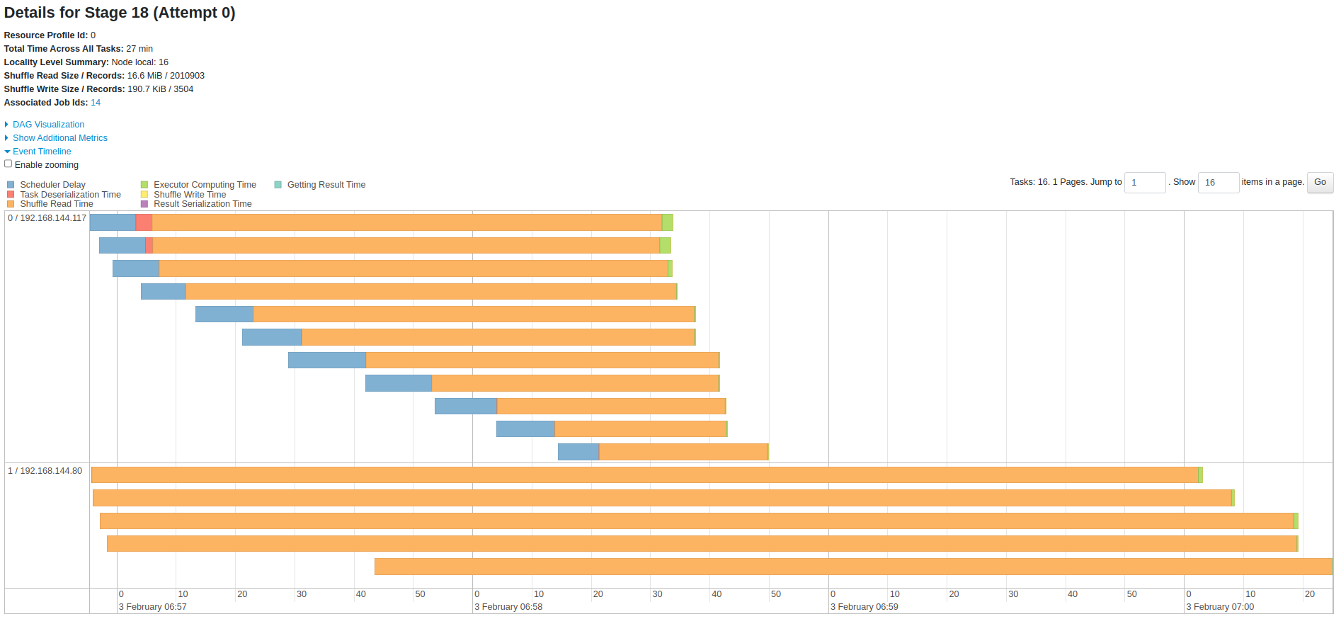
Sehr viel Shuffle...

Slide 13
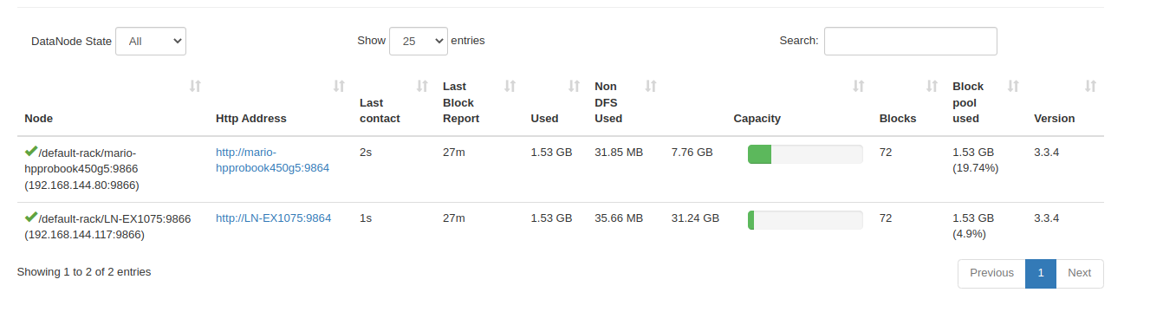

Slide 14
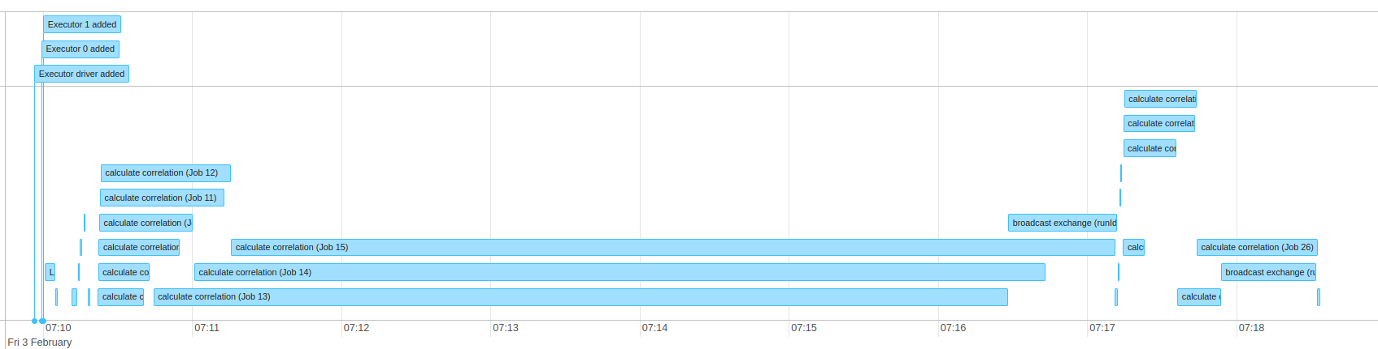

Slide 15
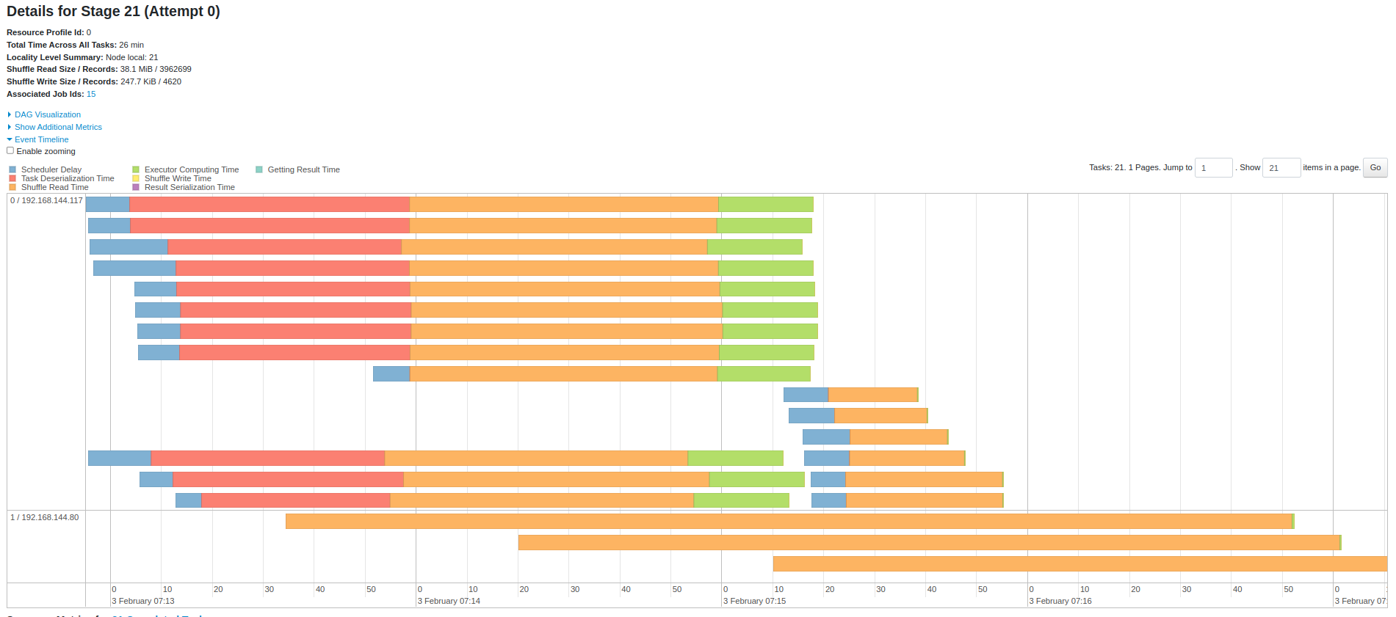

Slide 16
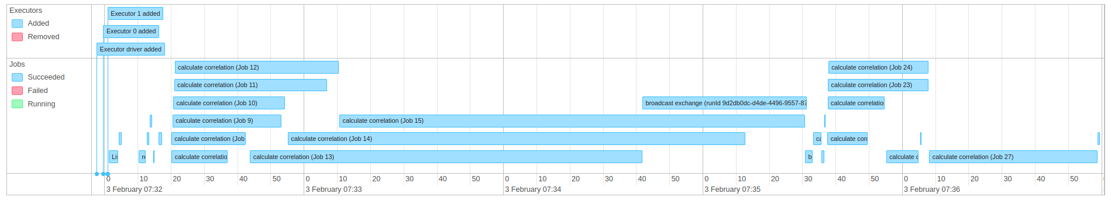
Start: 07:32:21
End: 07:36:59
Total time: 4 min 38 sec

Slide 17
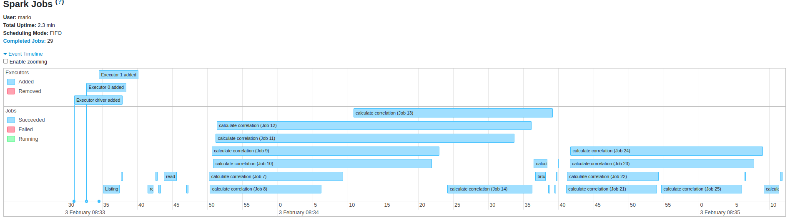
Start: 08:33:43
End: 08:35:11
Total time: 1 min 28 sec

Slide 18
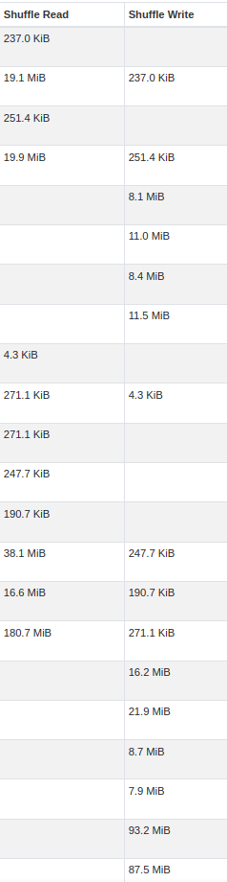
Shuffles are very acceptabe

Slide 19
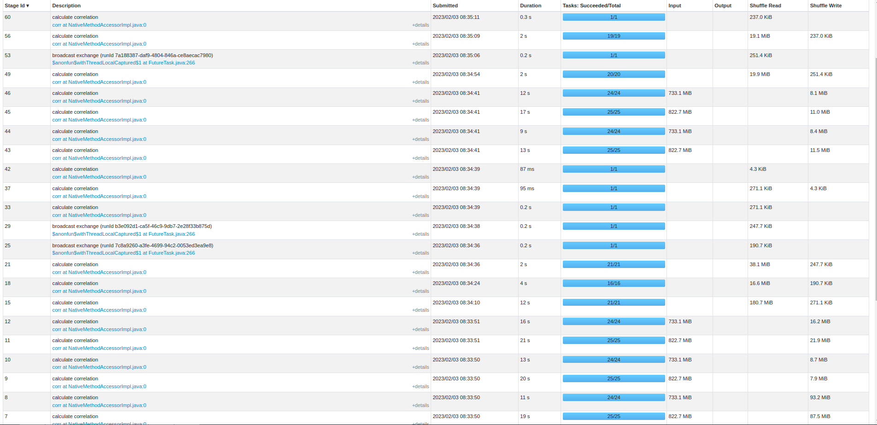

Slide 20
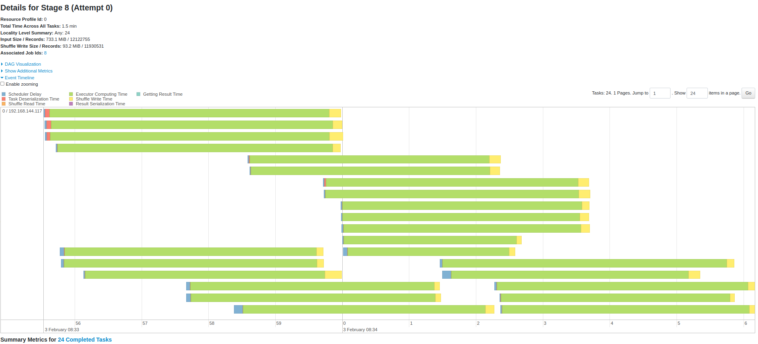
Biggest shuffle still very small fraction of the whole job

Slide 21
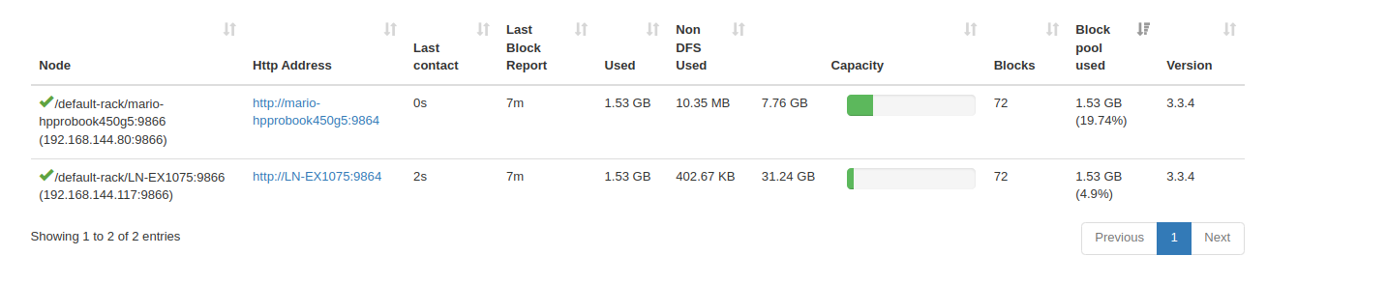

Slide 22
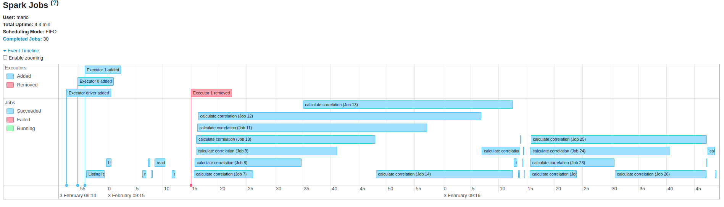
Fault Tolerance

Slide 23
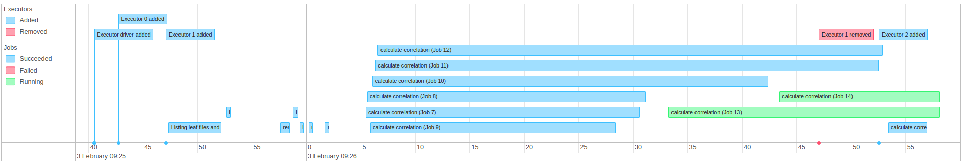
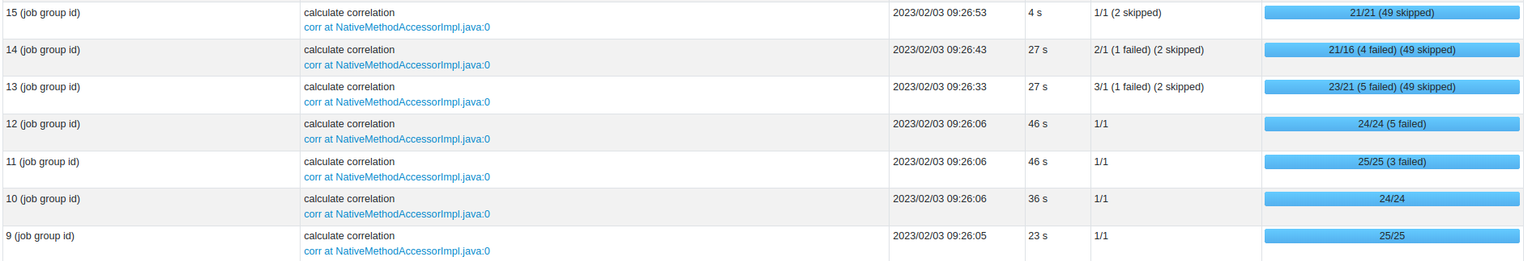
Fault Tolerance

Slide 24
