Slide 1
Go The Distance
App created by
Ivan Duarte, Namir Fawaz, Shaina Fils-Aime, Mario Frare and Salem Sharek

Slide 2
What It Does
Our application uses GPS to track the user’s location, and it calculates the user’s speed, accuracy, distance traveled, and time.
The user enters the distance they will be running and press the Start button.
The run will be tracked using the progress bar.
The units can be customized by the user! Either miles/miles per hour or kilometers/kilometers per hour.
The user also uses their e-mail to get an access code, which connects them to a database where they can see their personal log and a leaderboard.

Slide 3
Home Screen --- New/Existing User
New User:
enter valid email and name
returns an access code
Existing User:
enter email and name OR e-mail access code
Saves sign in information in save file
Main file checks for login information every time app is opened
if user is signed in, this screen won’t show (straight to Screen While Running screen)
If not signed in, screen will request login information as shown

Slide 4
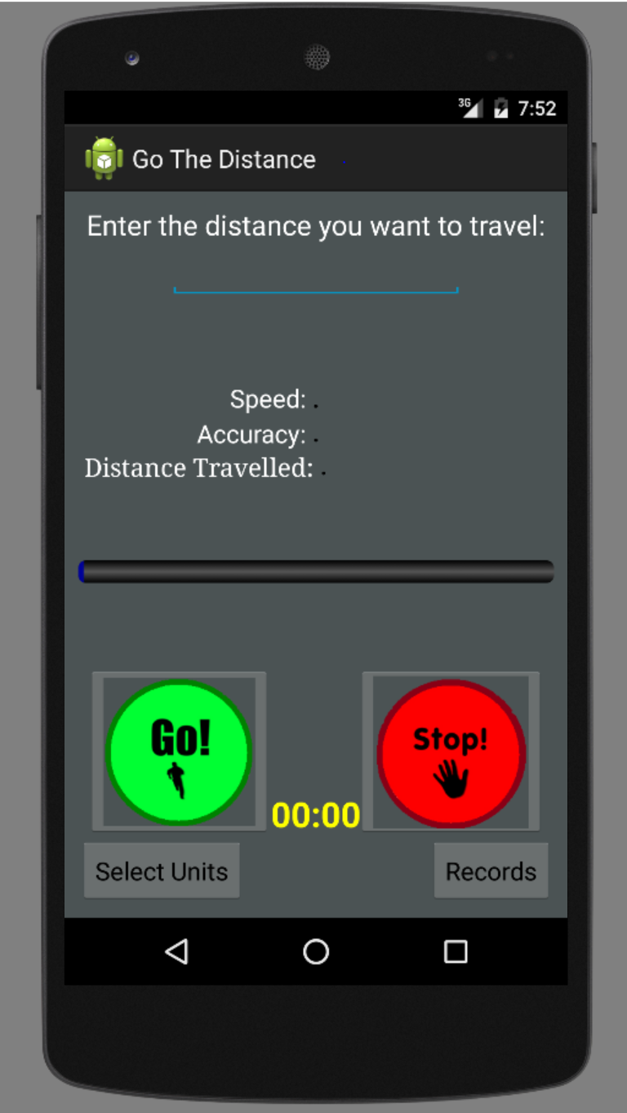
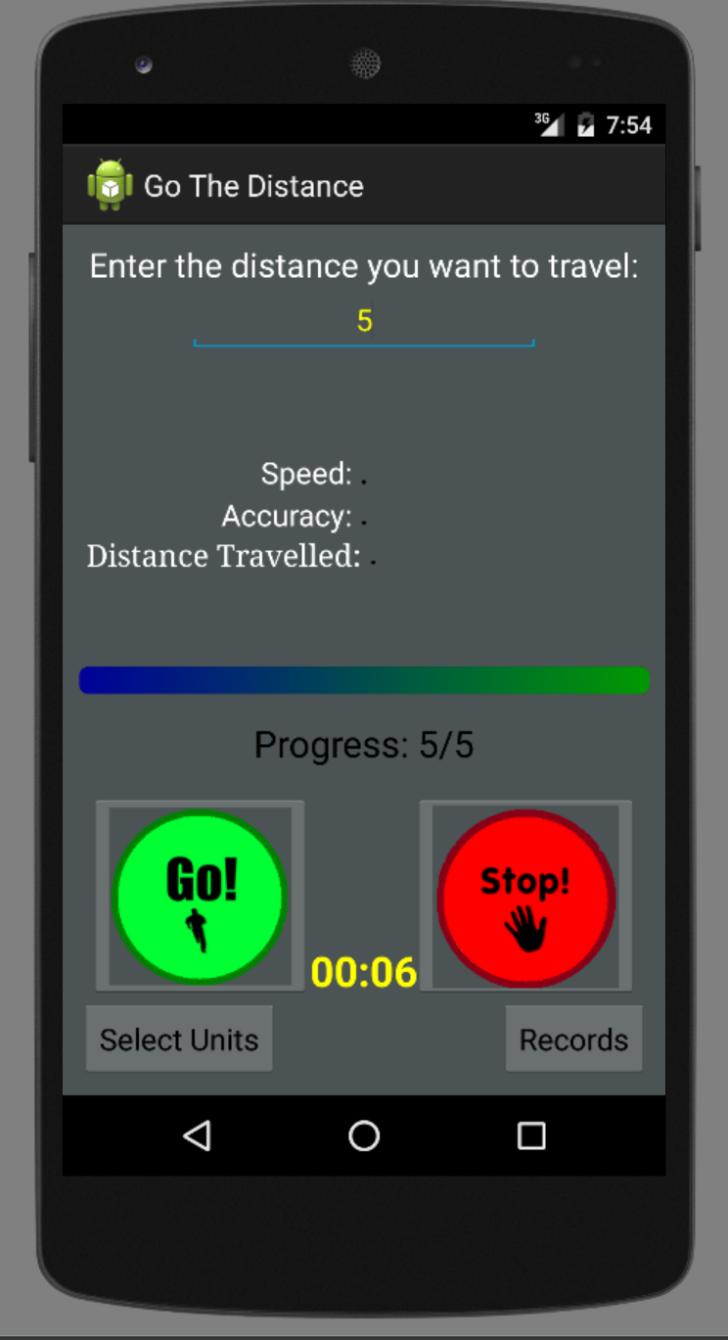
Screen While Running
Speed
Accuracy
Distance Traveled
Progress Bar
Go Button
Stop Button
Timer
Select Units button
Records button

Slide 5
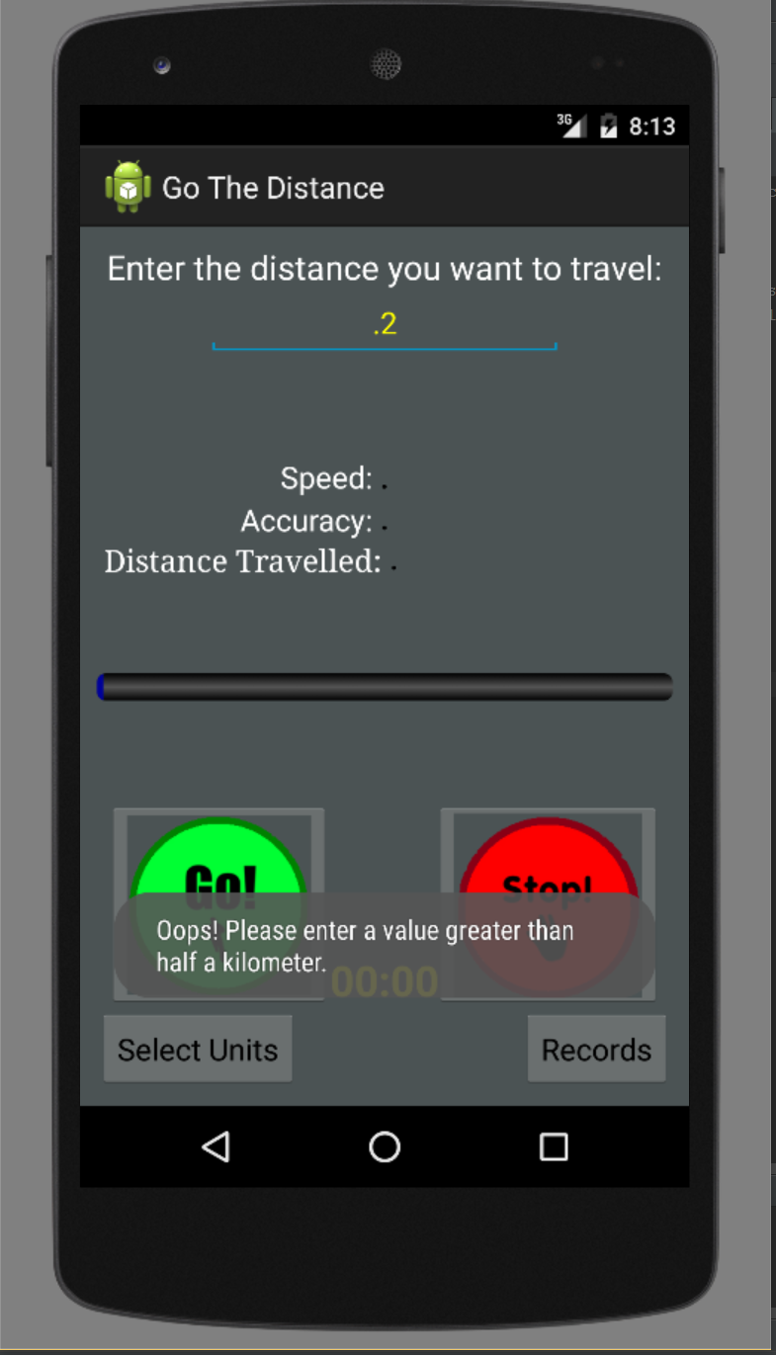
Errors
If no distance is entered:
“Oops! Please enter a value as your travel distance.”

Slide 6
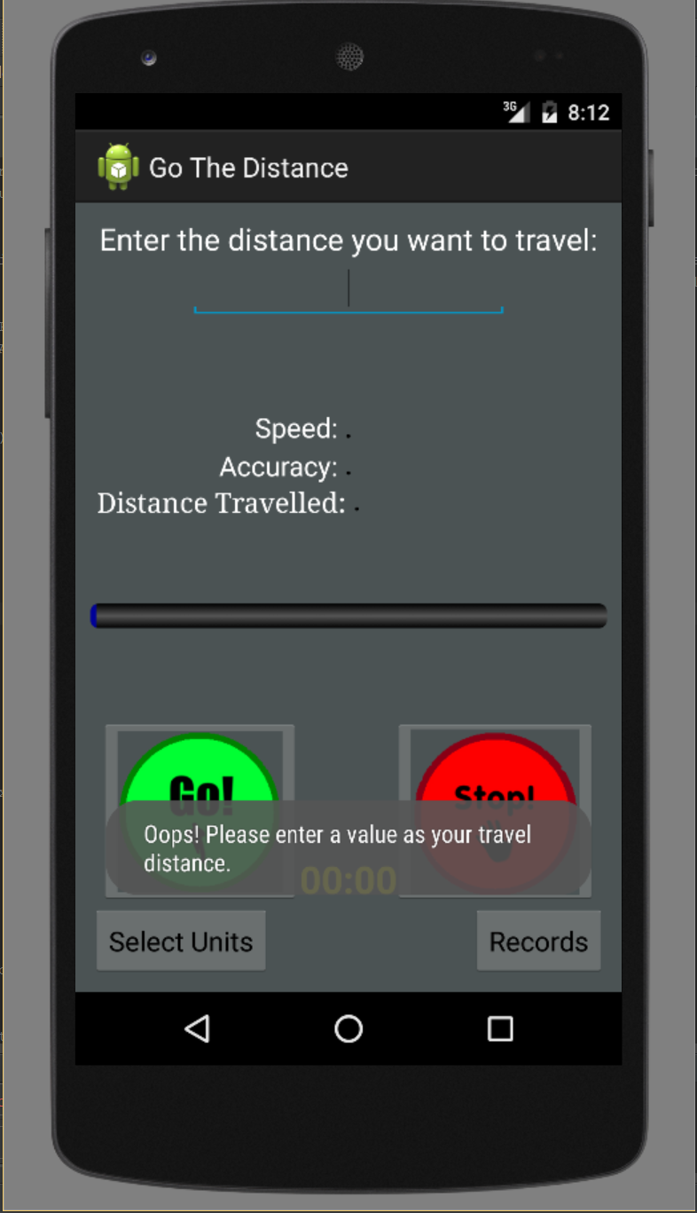
Errors (continued)
If distance is less that 0.5 miles/kilometers:
“Please enter a value greater than half a mile.” OR “Please enter a value greater than half a kilometer.”
Helps improve the accuracy of the app; the greater the distance entered, the more accurate GPS tracking will be.

Slide 7
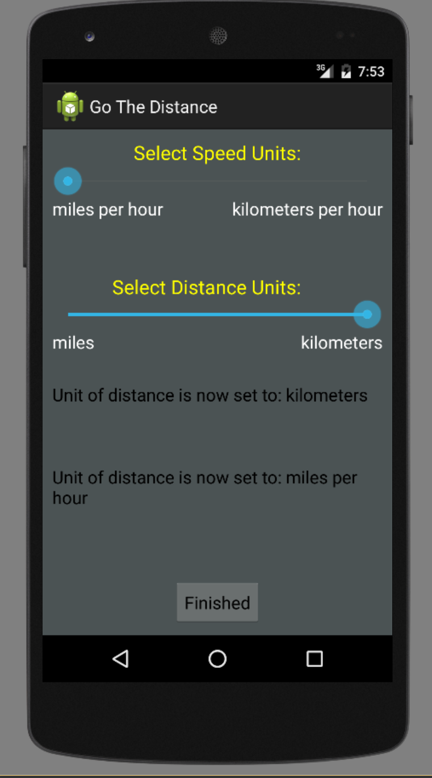
Settings Menu - - - Select Units
Select Speed Units:
miles per hour or kilometers per hour
Select Distance Units:
miles or kilometers
Readout of distance and speed
“Unit of distance is now set to”
“Unit of distance is now set to”
Saved to a save file which is stored within phone when you press the Finished button
Reads from file every time you start app

Slide 8
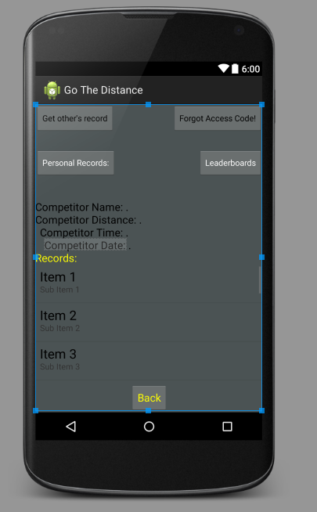
Database
User registers using their e-mail address
Receives an access code (number starting at 1 that is incremented with each new user)
Allows access to all personal records and leaderboard
Forget your access code? Get it emailed to you!

Slide 9
Database (continued)
Leaderboard
Allows access to friend’s logs
Enter friend’s user ID and compare your runs with their most recent run

Slide 10
THANK
YOU
AND
DOWNLOAD
TODAY

