Slide 1
Problem?
Best place to open a restaurant in Portugal based on foreign citizens

Slide 2
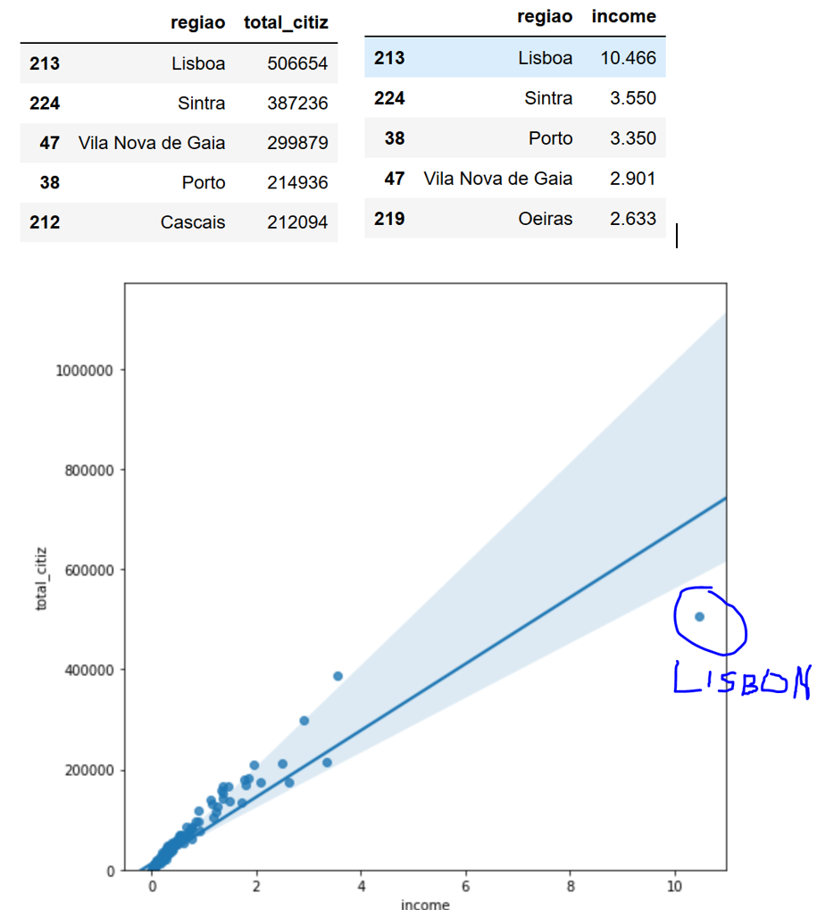
Choose City?
LISBON is the most populated and most rich region in Portugal

Slide 3
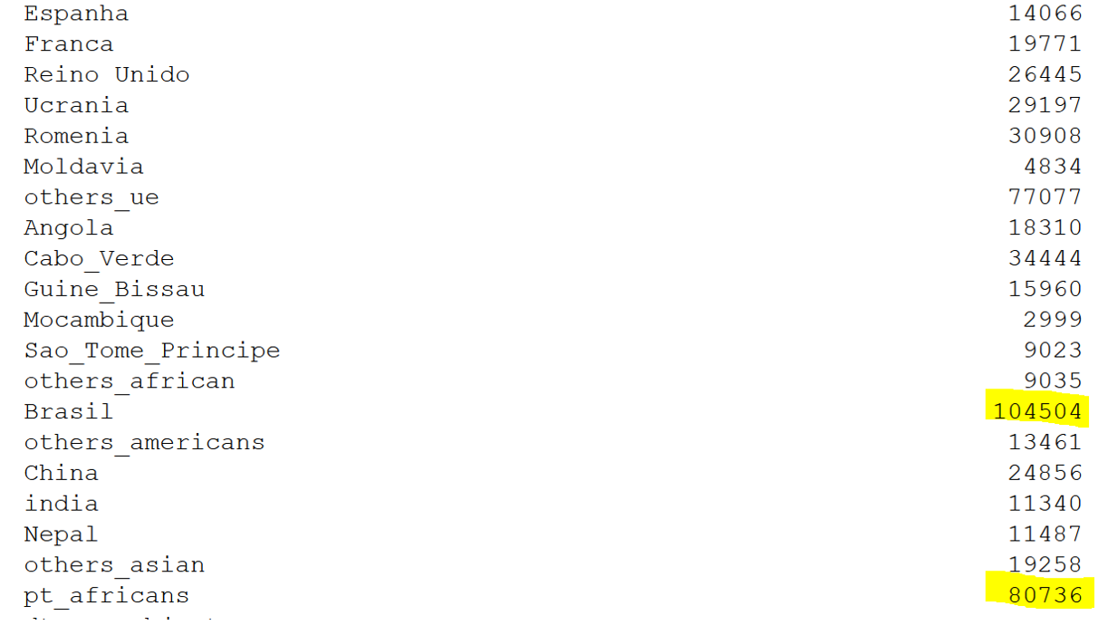
Type of Restaurant?
Most representative communities of foreign citizens are Africans and Brazilians

