Slide 1

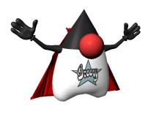
FUNCTIONAL PROGRAMMING
WITH
GROOVY
(Mario Garcia)

Slide 2





Who am I ?
Mario García
Software engineer at Kaleidos.net
Groovy enthusiast
Dublin GUG & Madrid GUG
@marioggar
desmontandojava.blogspot.com
https://github.com/mariogarcia
#FF9900

Slide 3
What's functional programming ?

Slide 4
What's functional programming ?
“In computer science, functional programming is a programming paradigm, a style of building the structure and elements of computer programs, that treats computation as the evaluation of mathematical functions and avoids state and mutable data. Functional programming emphasizes functions that produce results that depend only on their inputs and not on the program state - i.e. pure mathematical functions. It is a declarative programming paradigm, which means programming is done with expressions. In functional code, the output value of a function depends only on the arguments that are input to the function, so calling a function f twice with the same value for an argument x will produce the same result f(x) both times. Eliminating side effects, i.e. changes in state that don't depend on the function inputs, can make it much easier to understand and predict the behavior of a program, which is one of the key motivations for the development of functional programming...”
Wikipedia
(http://en.wikipedia.org/wiki/Functional_programming)

Slide 5
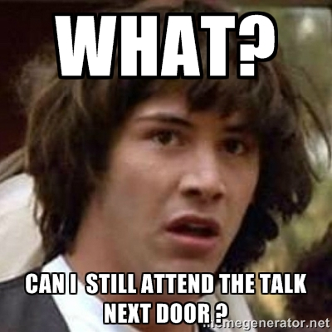
What's functional programming ?

Slide 6
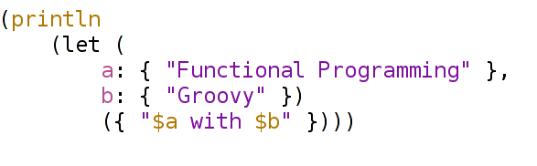

Slide 7

Groovy is amazing!!!

Slide 9

Why FP matters ?
Aren't you tired of the same things ?
  COPY / PASTE
  REFACTORING IS HARD
  PATTERNS REQUIRE TMC
  FOR EACH
  HOW TO OPEN/CLOSE A FILE
  ... NOT ENOUGH SPACE :(

Slide 10
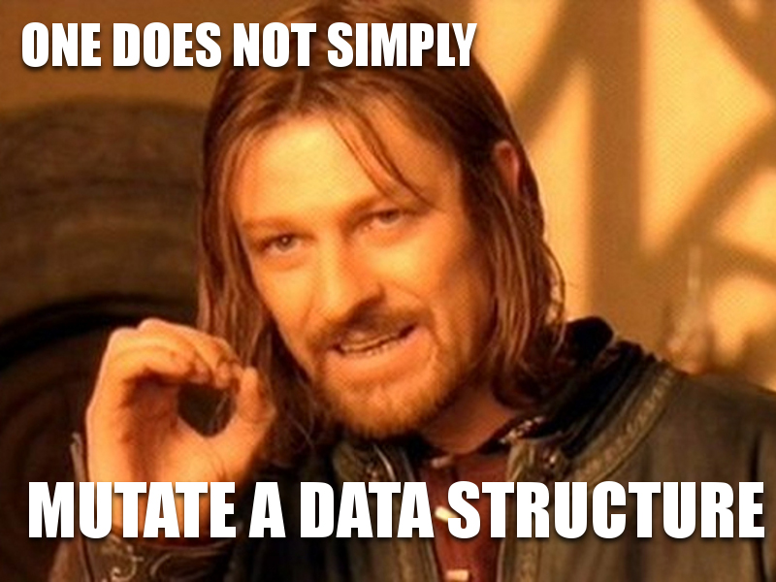
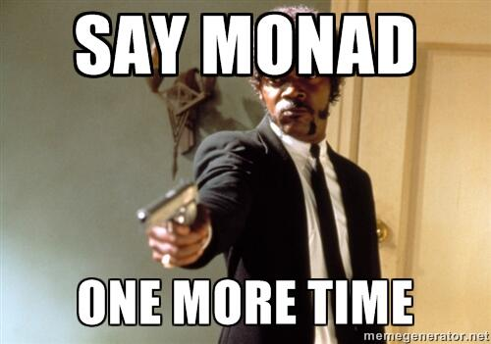
Why FP matters ?
Tacking Accidental complexity
          i.e: why I still should bother on how to loop through a data structure
Modularity
        “...higher-order functions and lazy evaluation, can contribute greatly to modularity...” (John Hughes)

Slide 11

It's not about the language!!!!
FP IS NOT ABOUT A LANGUAGE ONLY
IS ABOUT THE WAY YOU USE YOURS

Slide 12
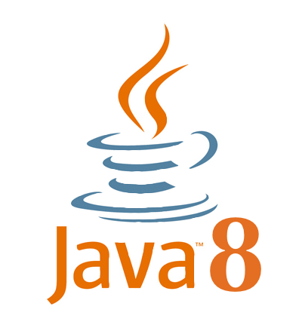



FP in the JVM
FUNCTIONAL STYLE
PURE FUNCTIONAL
You can
You do

Slide 13

It's Groovy a functional language ?
It's not a pure functional language but...
  Good news! You can do FP :-)
  I don't want to be pure anyway :P
  Let's see some code

Slide 14
It's imperative so bad ?

Slide 15
Would you keep using Java 1.4 ?

Slide 16
Is “imperative” so bad ?
No per se but:
    Most of the time it doesn't enforce you in the right direction
    Time to re-think on how we do things
    FP enables concurrency and parallel programming
Changing your programming paradigm is always a WIN:
    Most languages have at least a “functional style” of doing things
    Change your mind often...with some criteria of course ;)

Slide 17


Slide 18
THANKS !!!!

Slide 19
{ Q, A -> Q & A }

