Slide 1


GPARS
WORKSHOP
(Mario Garcia)

Slide 2





Who am I ?
Mario García
Software engineer at Kaleidos.net
Groovy enthusiast
Dublin GUG & Madrid GUG
@marioggar
desmontandojava.blogspot.com
https://github.com/mariogarcia
#FF9900

Slide 3
WHAT IS A WORKSHOP ?

Slide 4

What is a workshop ?
You are here to start learning how to use the tool/library
You should ask whenever you don't understand something

Slide 5

What is a workshop ?
You are here to have fun

Slide 6
What's GPars
An open-source concurrency and parallelism library for Java and Groovy
Version 1.1.0
It comes out-of-the-box with Groovy

Slide 7
GPars
Chose your abstraction for any particular problem
  Fork/Join
  Async execution
  Actors
  Agents
  Dataflows
  ...

Slide 8

The plan
First hour
  Introduction
  Parallel Collections
  Asynchronous Ex.
  Speculations
Second hour
  Dataflow
  Actors

Slide 9

What will you need
GPARS DOCUMENTATION
http://gpars.org/1.1.0/guide/guide/introduction.html
EXAMPLES
https://github.com/mariogarcia/greach_2014

Slide 10

LETS

Slide 11
Parallel Collections

Slide 12
Asynchronous Closures

Slide 13

Speculations
(And go grab some caffeine)

Slide 14
Agents

Slide 15
Dataflows

Slide 16
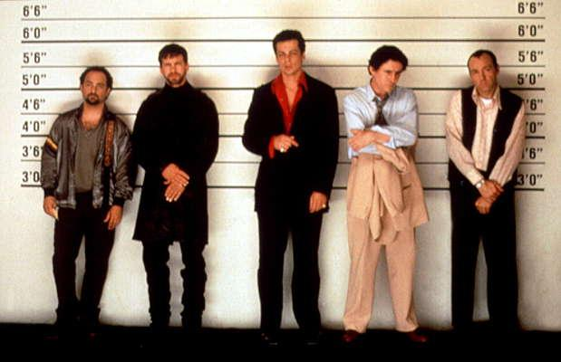
Actors

