Slide 1
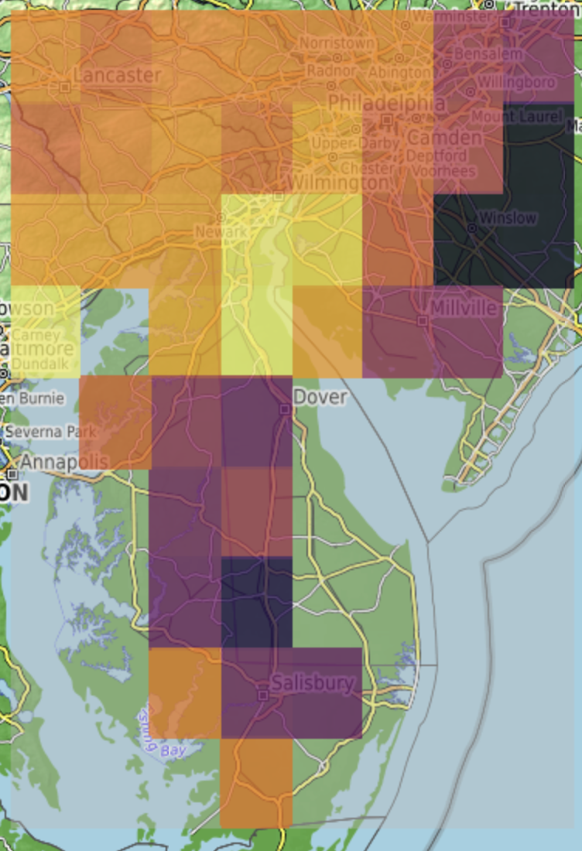
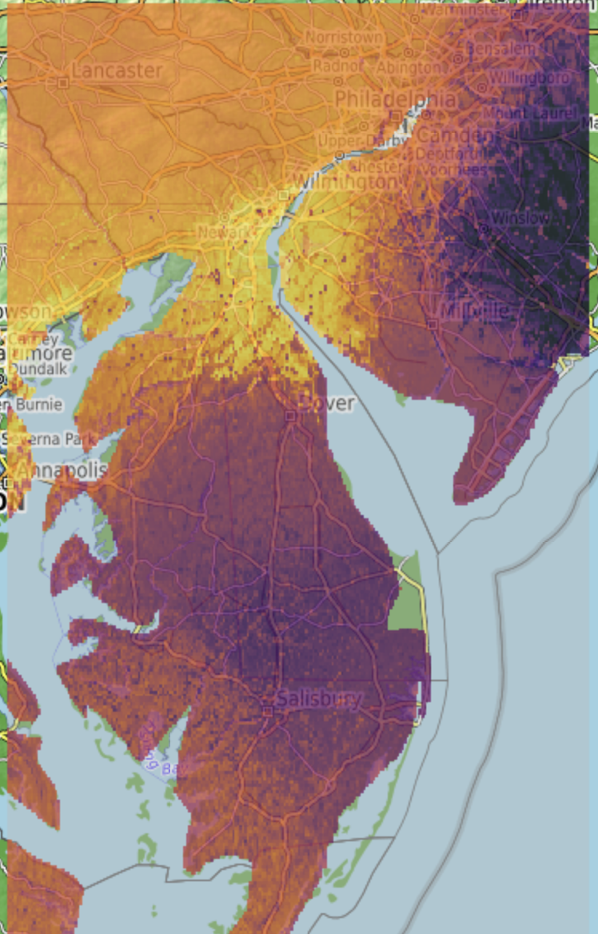
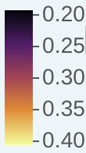
Satellite soil moisture (27 km grids)
Predicted soil moisture (1 km grids)
m³ m-3
m³ m-3

