Slide 1
Where Should You Open Your Fitness Business in the City of Chicago?
Coursera Capstone Project
By: Mario Sanchez, Jr.

Slide 2
Introduction/Business Problem
Introduction:
Business owners must consider many different things before opening their doors to the public.
Arguably the most important detail is location.
Depending on the type of business, their ideal location will depend on many different factors:
amount of foot traffic
proximity to other similar businesses
access to public transportation
median income
number of other similar business
Business Problem:
Where in the city of Chicago would be a good location/neighborhood to open a fitness facility/ business?
By leveraging the power of machine learning, we can reveal the answers to these most critical questions.
Critical details about the area such as and can impact your bottom line greatly and possibly mean the difference between a successful business or not.

Slide 3
Background & Data
Important business information utilizing the Foursquare API
Neighborhood data scraped from Wikipedia
Public health data downloaded from the City of Chicago data portal
Foursquare was ultimately the largest source of data with critical information such as:
venue names
types
locations

Slide 4
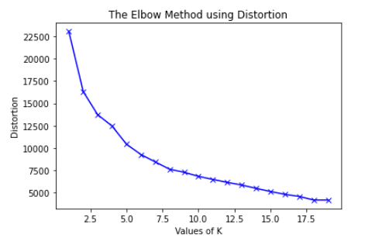
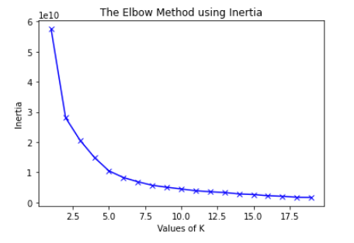
Methodology
I determined which of the categories would best fall under the category of 'health-related' and decided on:
Farmers Market
Fruit & Vegetable Store
Park
Climbing Gym
Sporting Goods Shop
Gym
Yoga Studio
Gym / Fitness Center
Dance Studio
Massage Studio
Supplement Shop
Field
Soccer Field
Health & Beauty Service
Organic Grocery
College Gym
Basketball Court
Tennis Court
Health Food Store
Baseball Field
Finally these health statistics plus the frequency of business category types was used as input into the KMeans unsupervised clustering algorithm.
In order to determine the proper choice of K, or clusters, I utilized the 'elbow method' plotting K vs distortion and K vs inertia.

Slide 5
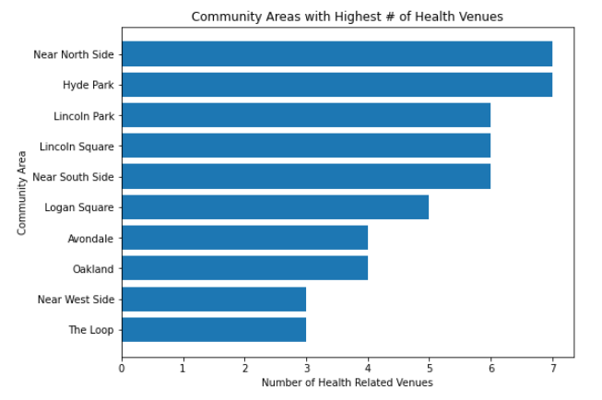
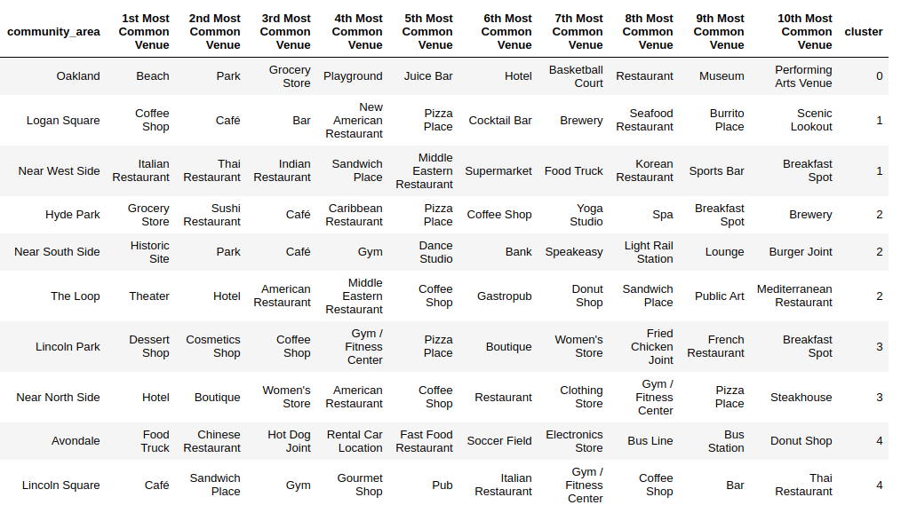
Results
There were 219 unique venue categories found throughout the city of Chicago.
The average rate per 100,000 residents for the whole city:
- 'Birth Rate': 15.7
- 'Breast cancer in females': 26
- 'Colorectal Cancer': 21.6
- 'Diabetes-related': 71.9
- 'Lung Cancer': 51.5
- 'Prostate Cancer in Males': 36.8
- 'Stroke (Cerebrovascular Disease)': 46.5
- 'Per Capita Income': $25107
- 'Unemployment': 13.3

Slide 6
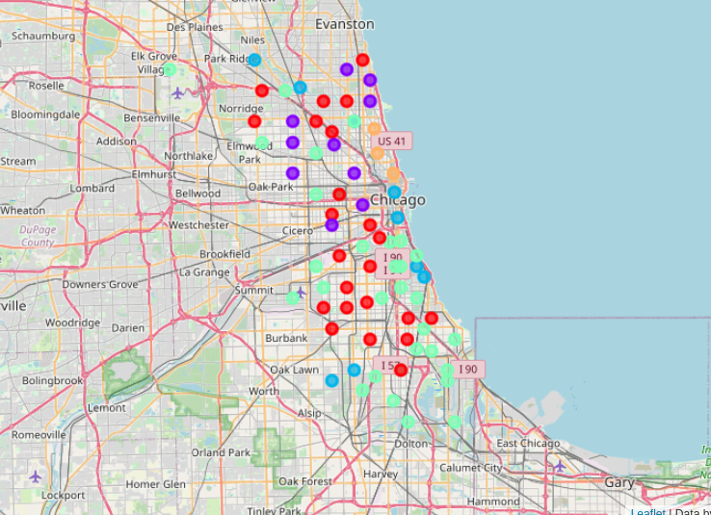
Chicago Cluster Map
5 clusters as determined by the KMeans machine learning algorithm showing noticeable patterns.

Slide 7
Discussion
- Chicago is a very diverse and dynamic city which can be seen in the vast distribution of venues. However, our model revealed that despite this, when grouped based on health and venue data, distinct patterns arise. We can see that communities in the center of the city are quite different than those on the periphery and intuitively, this would make sense. With the information that was obtained we can visually see this and determine the personality of each area.
- These representations I believe can greatly assist with making a determination on where you may want to open your fitness business. The center of the city as well as communities to the immediate north and northwest have higher incomes and a larger business presence. As for the communities on the edges of the city, their characteristics change drastically and are much more suburban, while those on the far south side are much more industrial.
Recommendations:
- The Loop and Lincoln Park area are great business districts but are also going to be highly competitive and expensive to start. However, income in these areas allow for the targeting of a more affluent crowd.
- If space is more important, the communities further away from the center of the city look to be great areas with high business activity as well as a more suburban setting.

Slide 8
Conclusion
Opening a business is a huge undertaking and can very quickly become overwhelming when trying to find a location in a major metropolitan area.
In a city like Chicago with 77 different communities, picking the right one takes research and smart decision making.
With the results we obtained, I am confident that you will be able to make the most informed possible decision.
Plus, you will learn more about the community you pick as well as scout any future sites as your business grows!

