Slide 1
NEXT SONG
Brief introduction to next song

Slide 2
Index

Slide 3
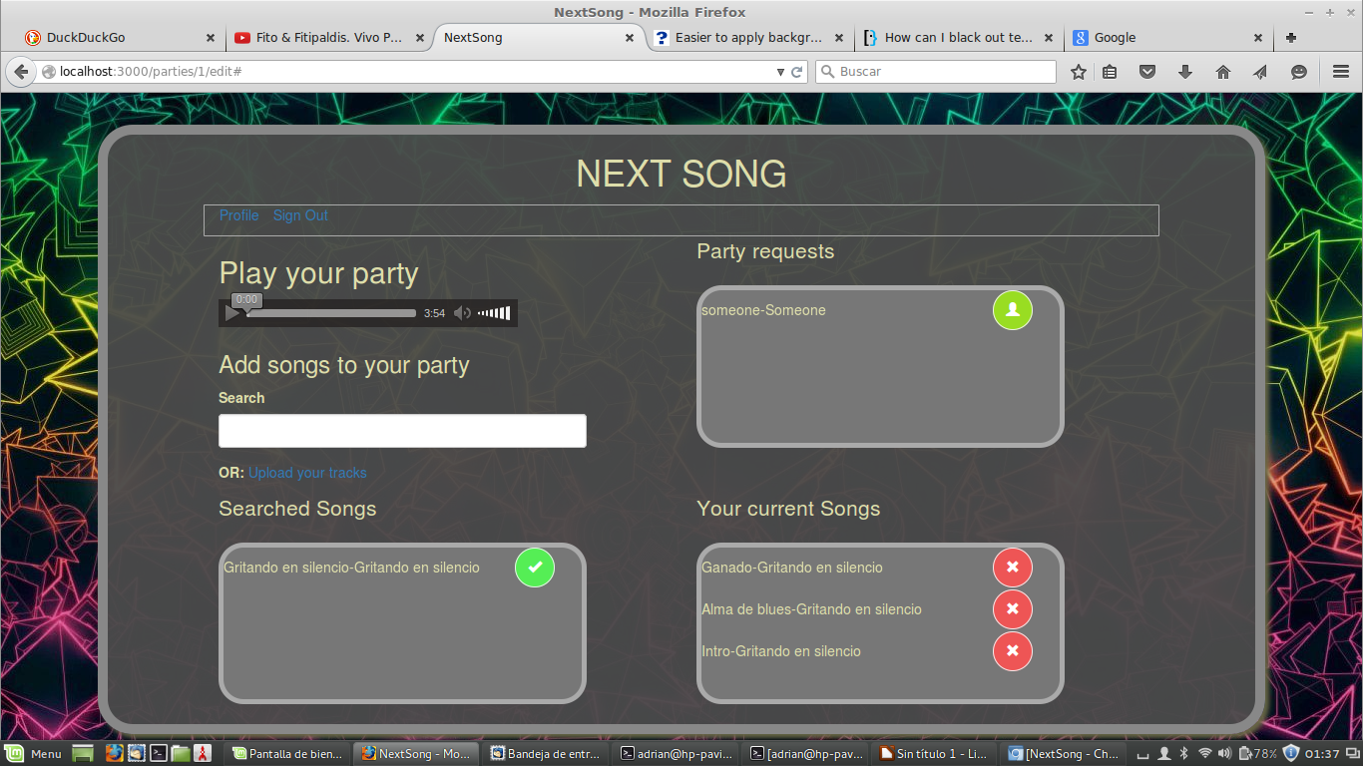
Party
The party is the main view of the application.
This view will reproduce the music
This view manages the songs that can be voted and the user that can vote

Slide 4

Audio
The audio tag allow the party admin adjust the music display
It is an audio html5 tag
The control of that audio tag is done with jQuery
Use ajax for reading the most voted song and jQuery for insert that song

Slide 5
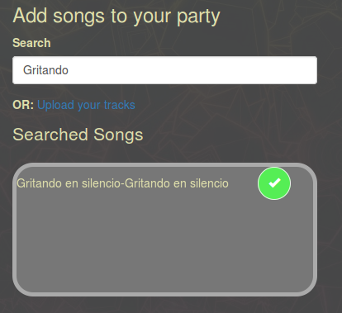
Search
Use ajax for founding similar search result
It use a search api
Use search by coincidence in the database
Is case sensitive(but I will change it)

Slide 6
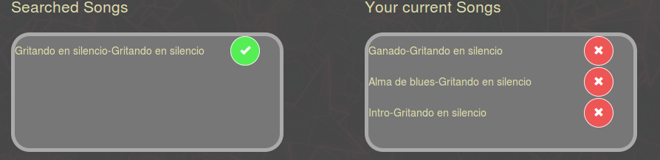
Added songs
It uses websocket-rails for real time updates
Add and remove the allowed songs in the party
It update the posible songs to vote for all the party users

Slide 7
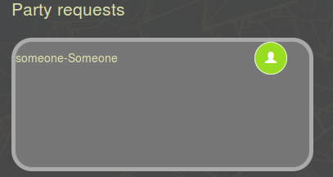
Party request
Party request are users that want to participate in a party
It use websocket for real time updates
It allows a user to enter in the party inmediately when he has been accept

Slide 8

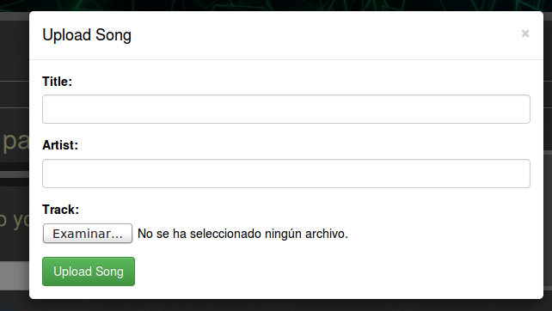
Upload songs
We can upload our songs
Use bootstrap modal for the form
Use partials for form due to readability ease
Paperclip for uploading files due to simplicity
Ajax request for avoiding refresh the page
Remotipart for easy audio uploading through ajax

Slide 9
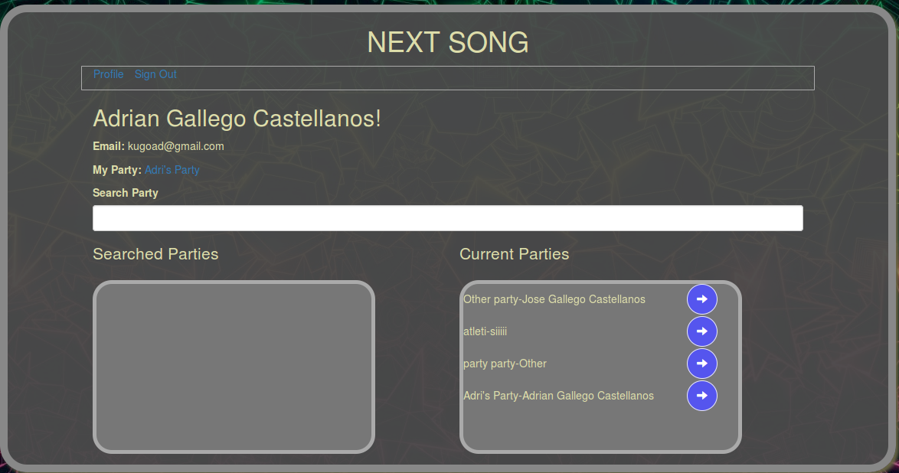
Profile
Main user page
User data, rendered in erb
Search with ajax just like in the party search
Websocket-rails for current parties realtime update when a party request is accepted

Slide 10
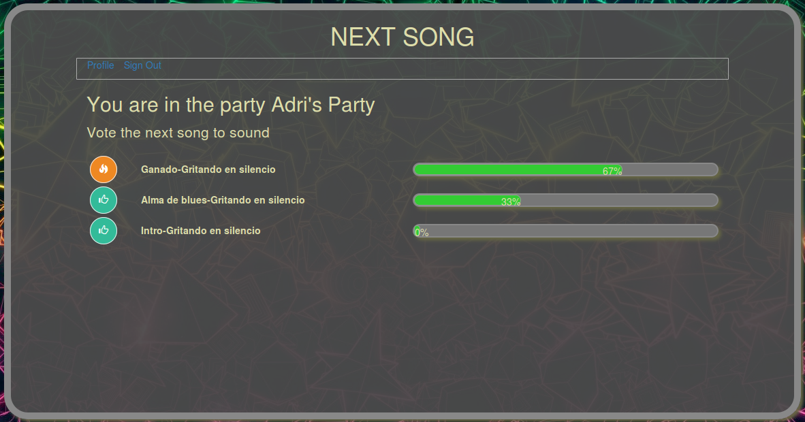
Vote
View for user vote songs
Show songs avaibled for select, and the selected one
Show the percentage of vote of each song

Slide 11
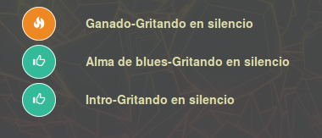
Vote Song
Ajax request for first time show songs
Websocket-rails for maintaining the songs updated with the avaible party songs

Slide 12
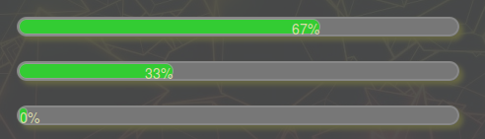
Graphichs
Css for creating graphics
Real time update of user votes with websocket

Slide 13
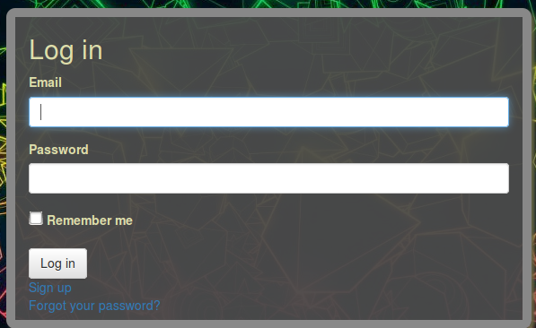
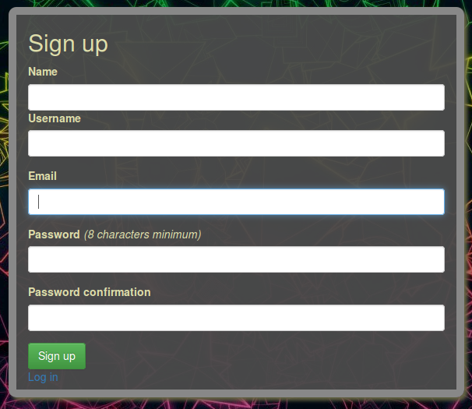
Login
Login form an sign up form with devise
Login needed for access the page
Admin access needed for go to a party. Only is posible edit your party
Acceptance needed for going to vote inside a page

Slide 14

Connections
A party has many tracks through plays
A party has many user through invitations (guest)
A party belongs to one user (owner/admin)
The votes and the party acceptance are inside each invitation.

Slide 15
The end

