Slide 1
Are we doomed?

Slide 2

Are we doomed?

Slide 3

Are we doomed?

Slide 4
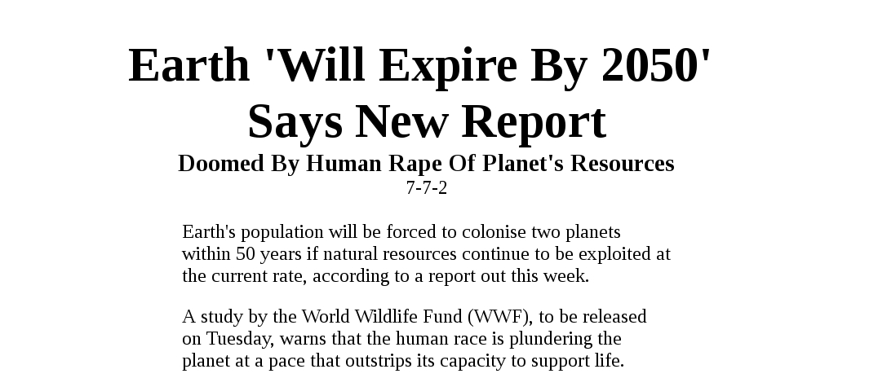
Are we doomed?

Slide 5
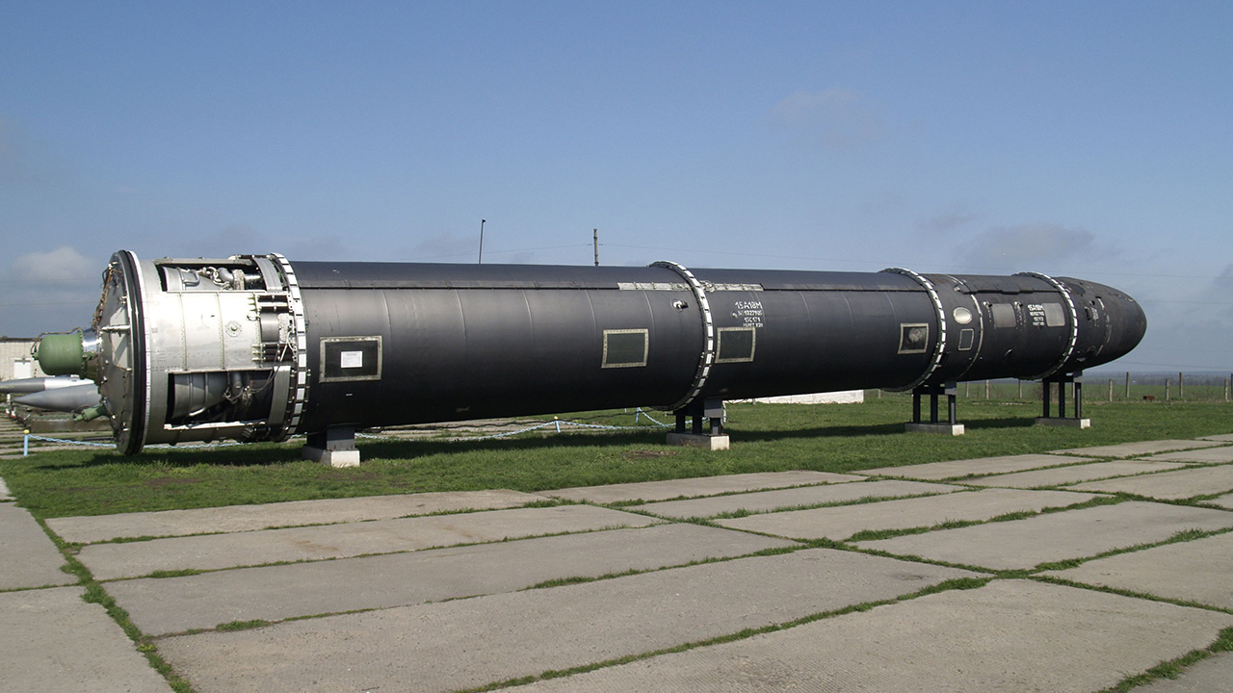
Are we doomed?

Slide 6
Short answer: Yes!!

Slide 7
However, are these really a threat?

Slide 8
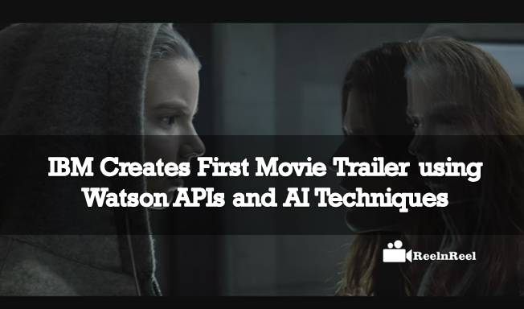
However, are these really a threat?

Slide 9
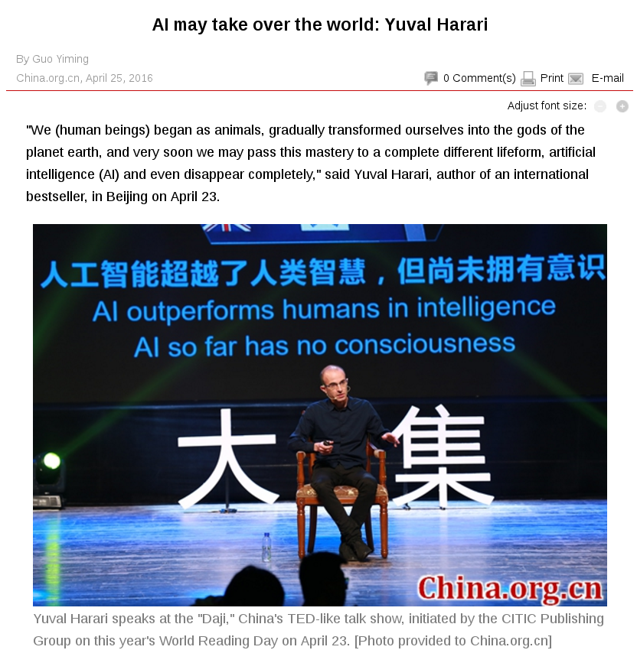
However, are these really a threat?

Slide 10
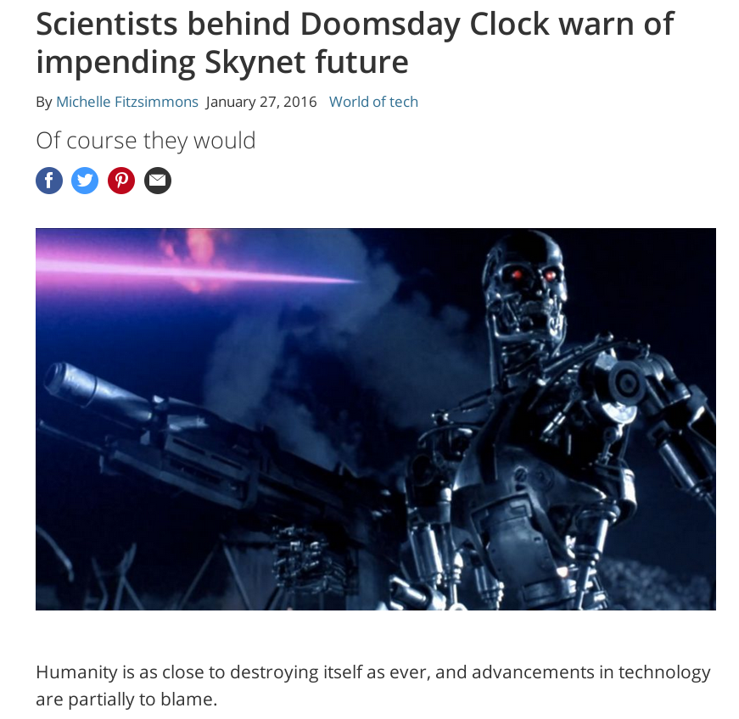
However, are these really a threat?

Slide 11
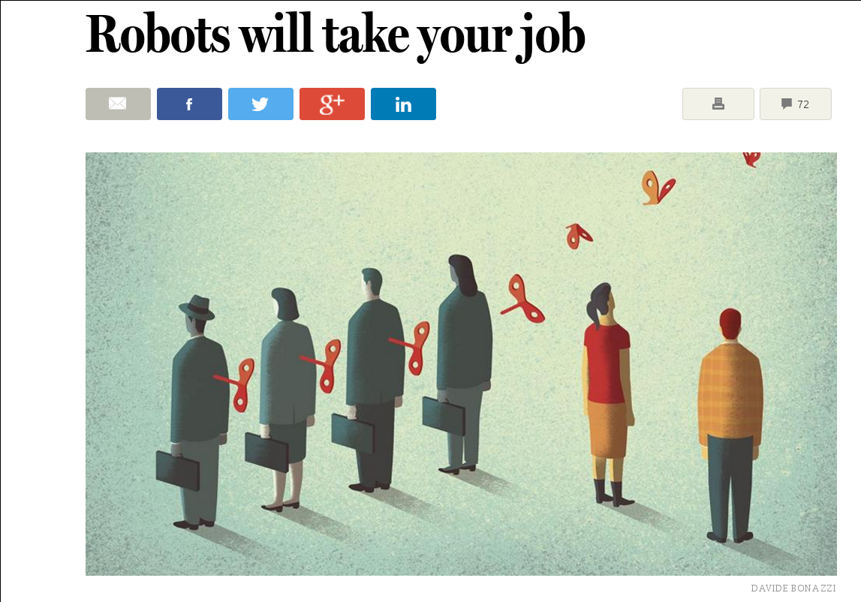
However, are these really a threat?

Slide 12
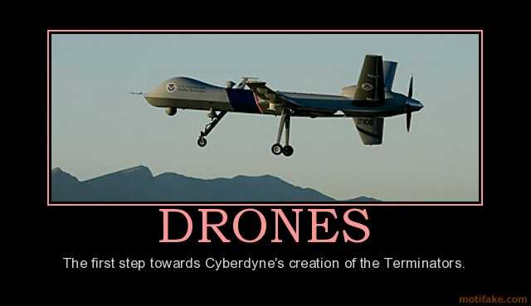
However, are these really a threat?

Slide 13

However, are these really a threat?

Slide 14
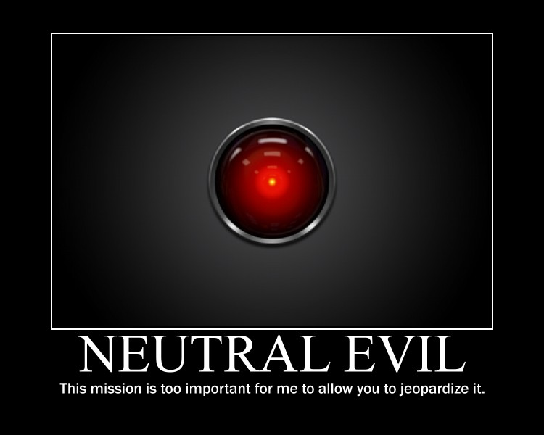
However, are these really a threat?

Slide 15

However, are these really a threat?

Slide 16
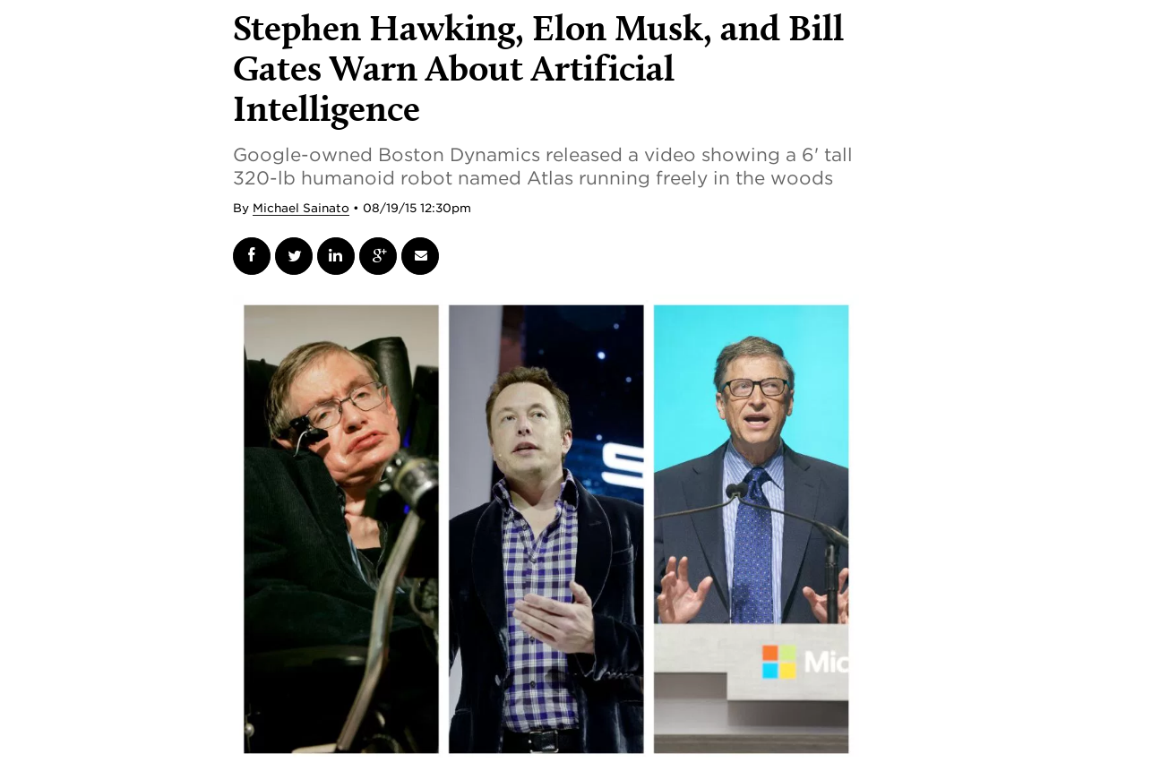
What our “experts” say

Slide 17
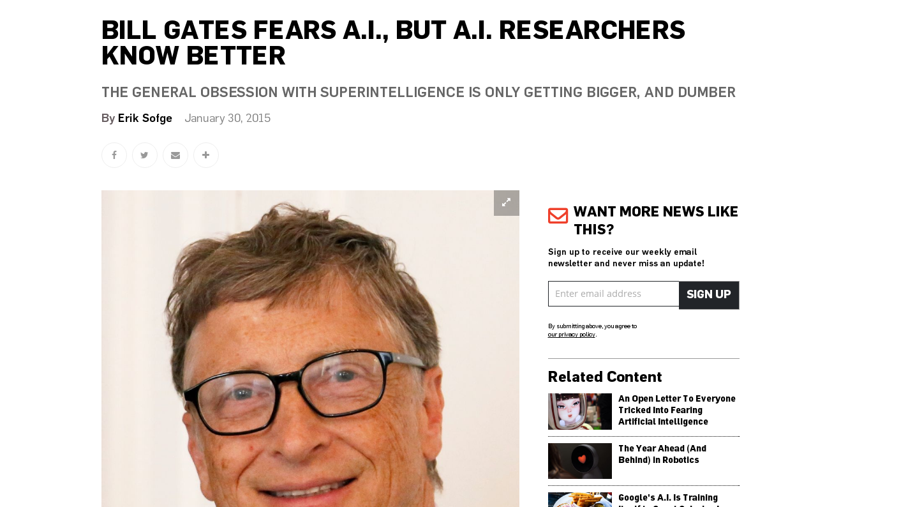
What our “experts” say

Slide 18
The answer is yes and no

Slide 19
Let us discuss 3 examples

Slide 20
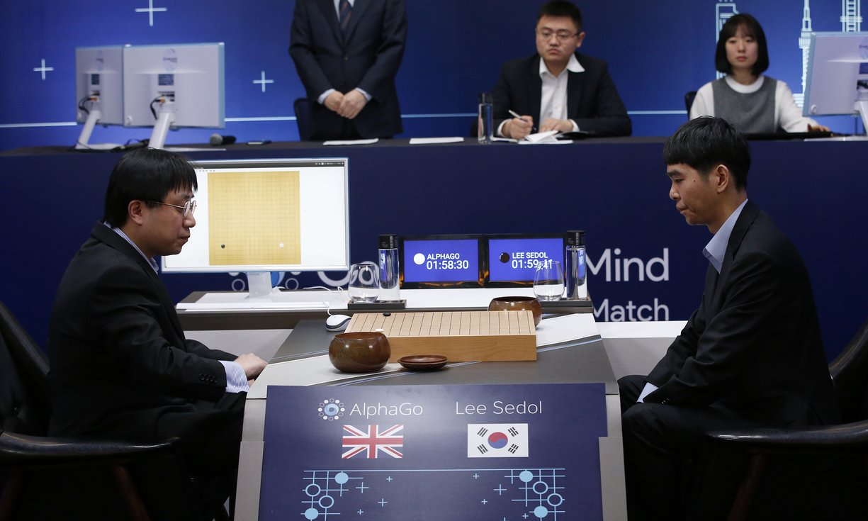
AlphaGo

Slide 21
AlphaGo
Here we introduce a new approach to computer Go that uses ‘value networks’ to evaluate board positions and ‘policy networks’ to select moves. These deep neural networks are trained by a novel combination of supervised learning from human expert games, and reinforcement learning from games of self-play. Without any lookahead search, the neural networks play Go at the level of state-of-the-art Monte Carlo tree search programs that simulate thousands of random games of self-play. We also introduce a new search algorithm that combines Monte Carlo simulation with value and policy networks. Using this search algorithm, our program AlphaGo achieved a 99.8% winning rate against other Go programs, and defeated the human European Go champion by 5 games to 0.

Slide 22
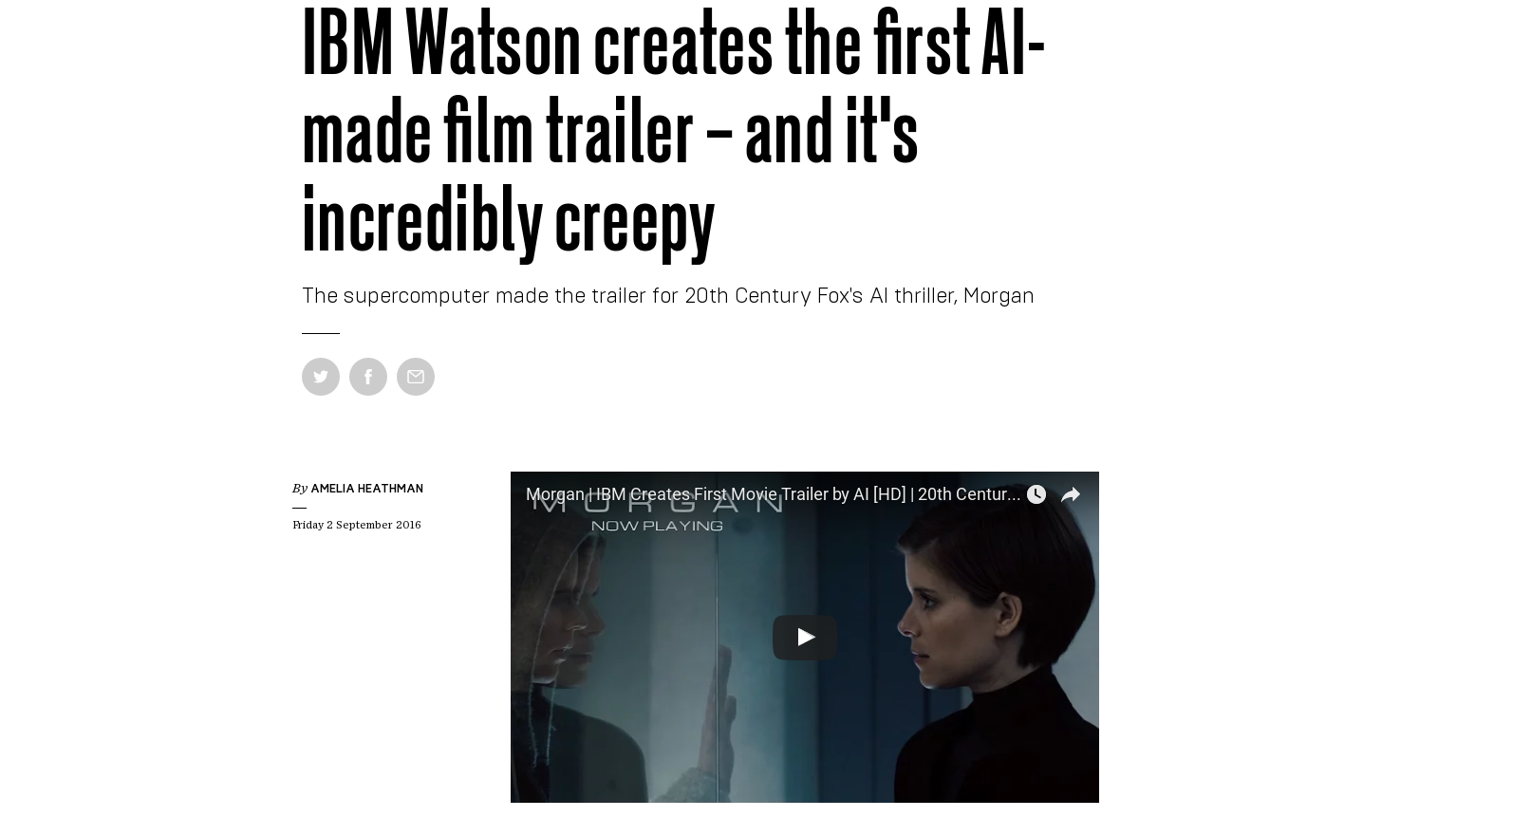
IBM Watson

Slide 23
IBM Watson
IBM researchers fed Watson more than 100 horror film trailers cut into separate moments and scenes. It performed a series of visual, sound and composition analyses on each scene to get an idea of how to create the dynamics of a trailer. Watson then processed 90 minutes of Morgan to find the right moments to include in the trailer.
Once the supercomputer finished processing Morgan, it isolated 10 scenes – a total of six minutes of video. Although a human editor was still needed to patch the scenes together to tell a coherent story, the AI shortened the process down to only 24 hours when it typically takes around 10 to 30 days to complete a trailer.

Slide 24
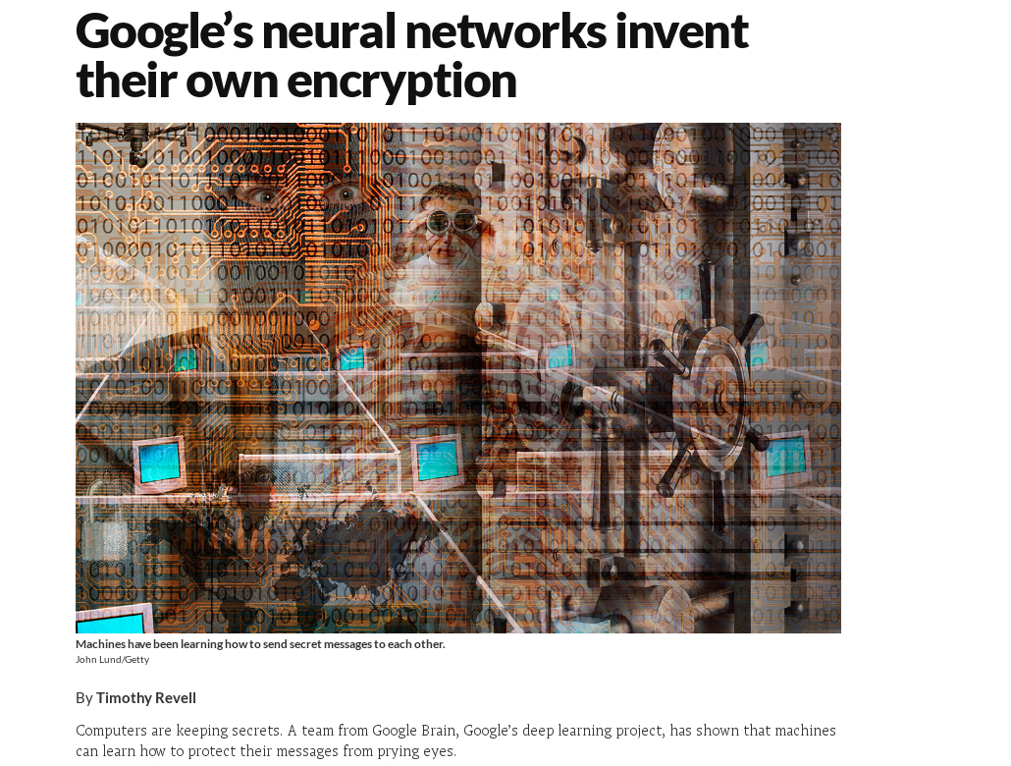
NN invent their own encryption

Slide 25
NN invent their own encryption
Computers are keeping secrets. A team from Google Brain, Google’s deep learning project, has shown that machines can learn how to protect their messages from prying eyes.
The Google Brain team started with three neural nets called Alice, Bob and Eve. Alice’s job was to send a secret message to Bob, Bob’s job was to decode the message that Alice sent, and Eve’s job was to attempt to eavesdrop.
To make sure the message remained secret, Alice had to convert her original plain-text message into complete gobbledygook, so that anyone who intercepted it (like Eve) wouldn’t be able to understand it. The gobbledygook – or “cipher text” – had to be decipherable by Bob, but nobody else. Both Alice and Bob started with a pre-agreed set of numbers called a key, which Eve didn’t have access to, to help encrypt and decrypt the message.
The encryption was very basic, especially compared to our current human-designed systems

Slide 26
Issues with murderers AI (or any AI)

Slide 27
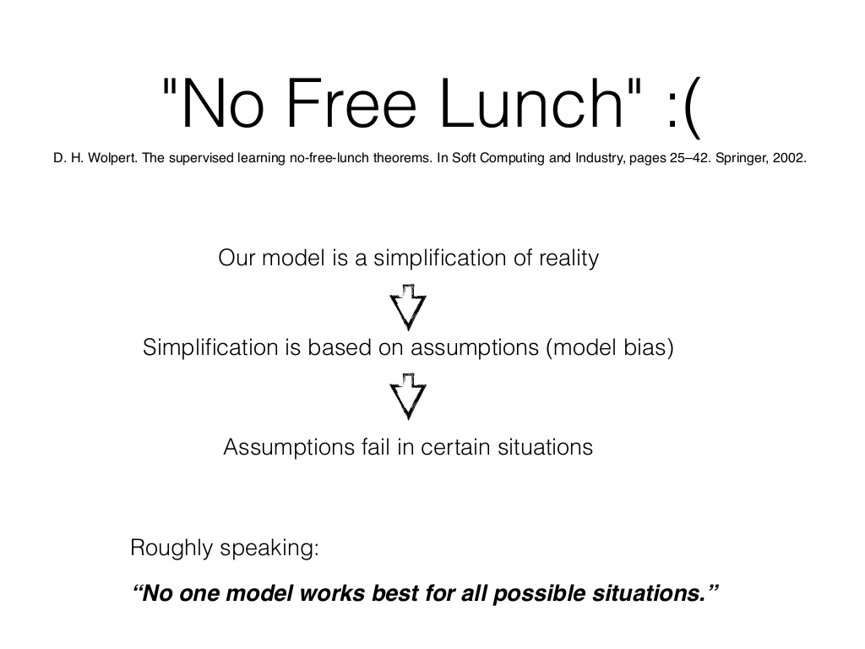
No free lunch

Slide 28
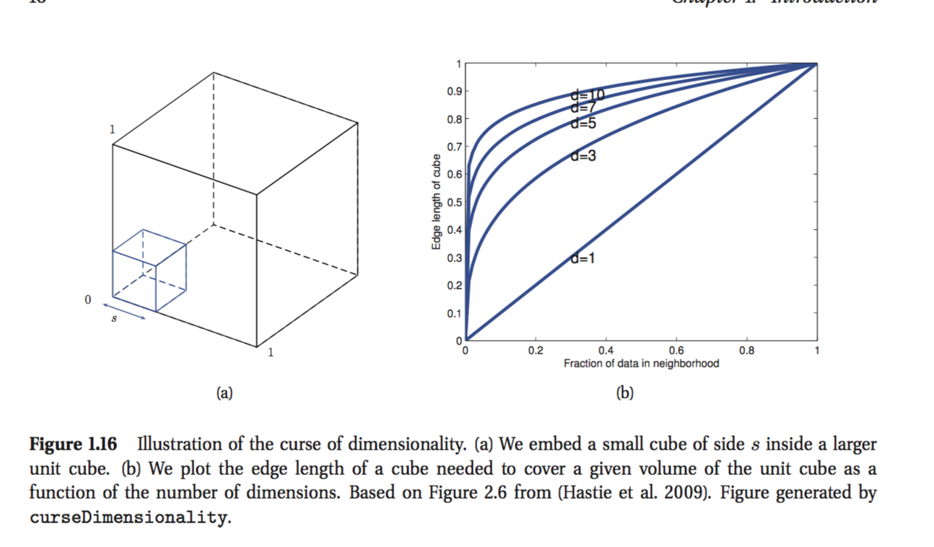
Curse of dimensionality

Slide 29

Self-awareness

Slide 30
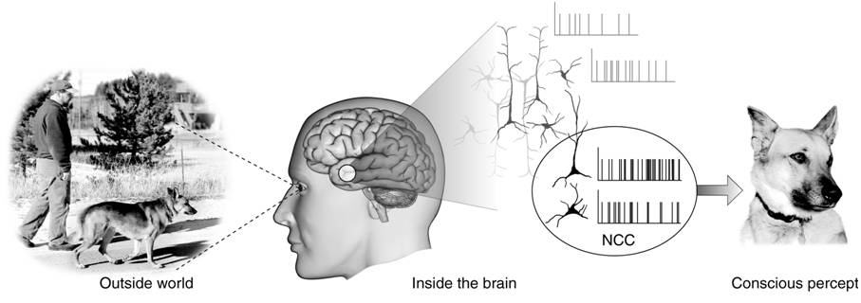
Consciousness

Slide 31
But lets assume it is possible to develop an AI right now.

Slide 32
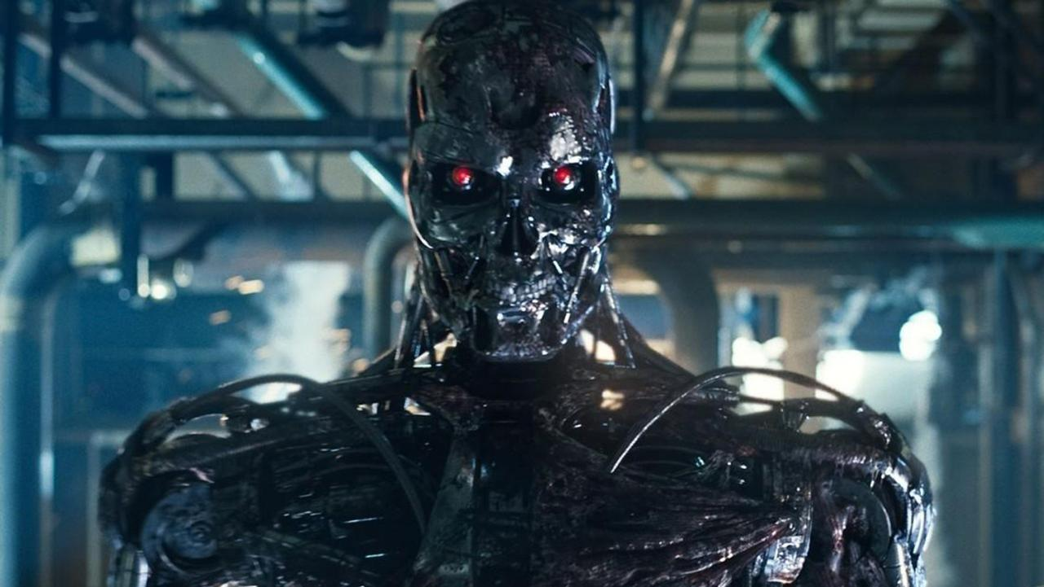
Regarding murderers AI

Slide 33

Regarding murderers AI

Slide 34
So, not really a threat to our safety!
Why the hype?

Slide 35


Slide 36
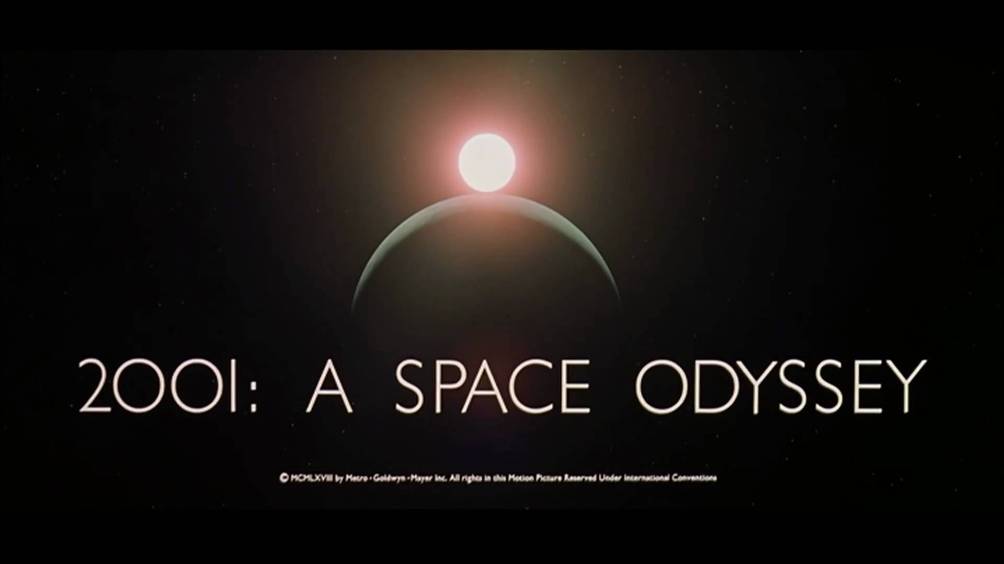

Slide 38
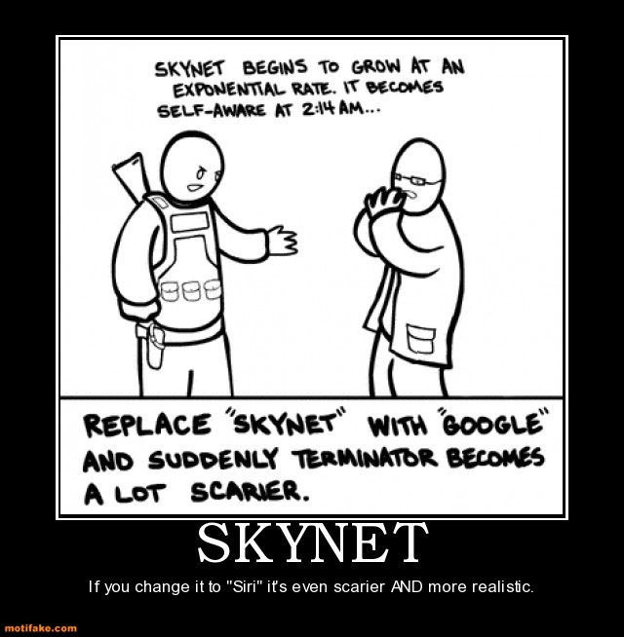

Slide 39
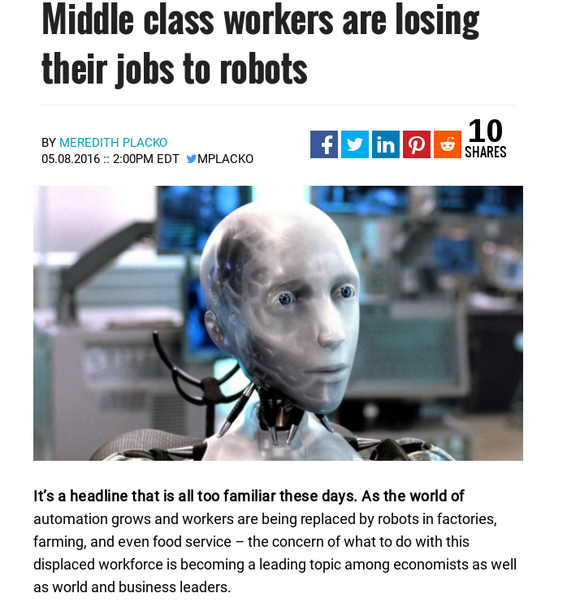
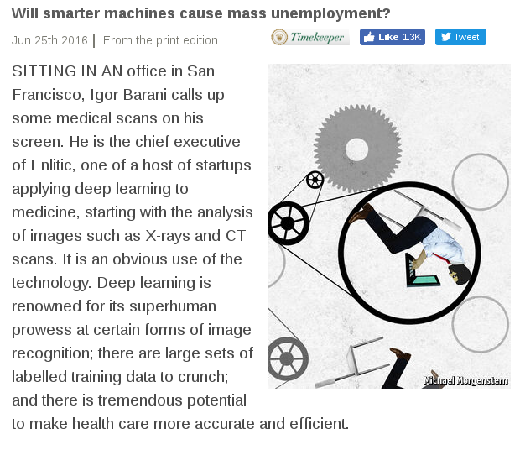
Losing jobs to machines

Slide 40
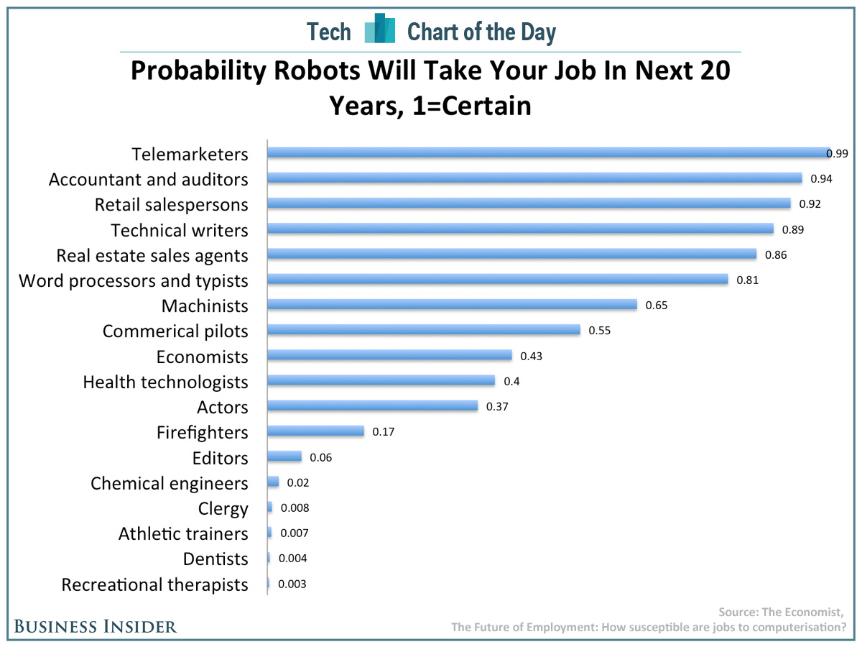
Losing jobs to machines

Slide 41
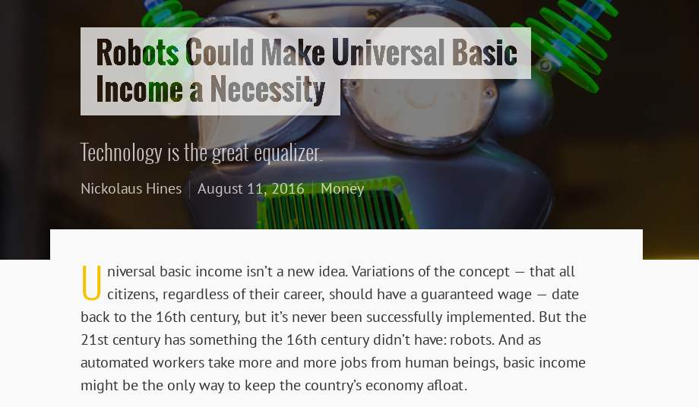
Losing jobs to machines

Slide 42
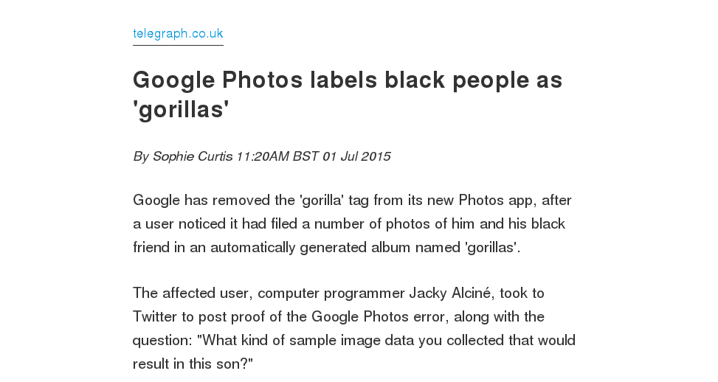
AI bloopers

Slide 43
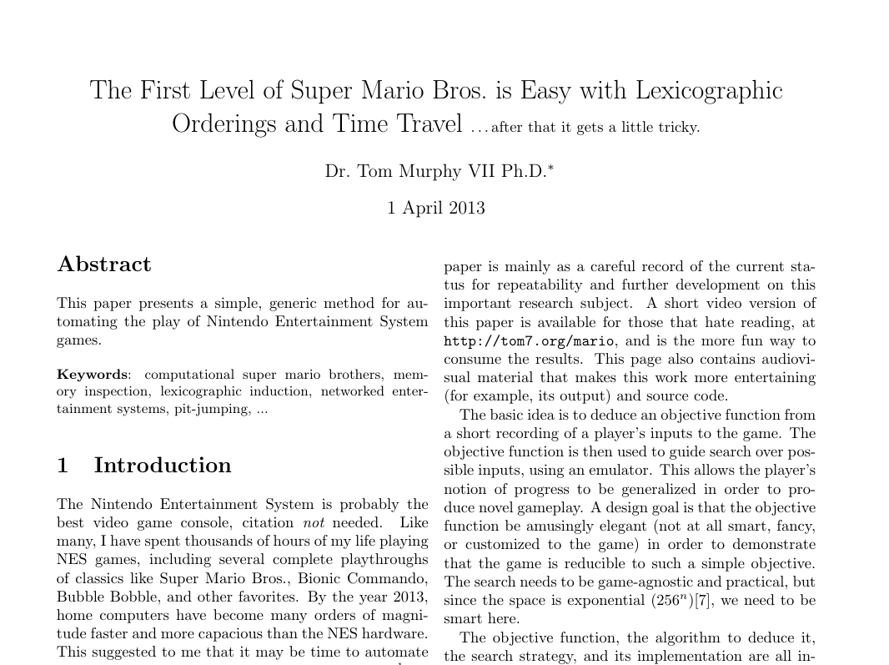
AI bloopers

Slide 44

The end

