Slide 1

Mário Gonçalves (24165)
Docente: Prof Doutor Carlos J. Costa
Notes:
11/11/17
1
1

Slide 2
What is Drupal?
Created in 2000 by Dries Buytaert and Hans Snijder
Content Management Software (CMS) that doubles as a Content Management Framework (CMF)
Notes:
11/11/17
2
2
https://www.drupal.org/about/history

Slide 3
Who uses Drupal?
Weather.com
Whitehouse.gov
The Economist
Red Hat
And a million more…
In Portugal
Notes:
11/11/17
3
3
https://www.drupal.com/showcases
http://www.zyxware.com/articles/4351/list-of-fortune-500-companies-using-drupal-for-their-websites

Slide 4
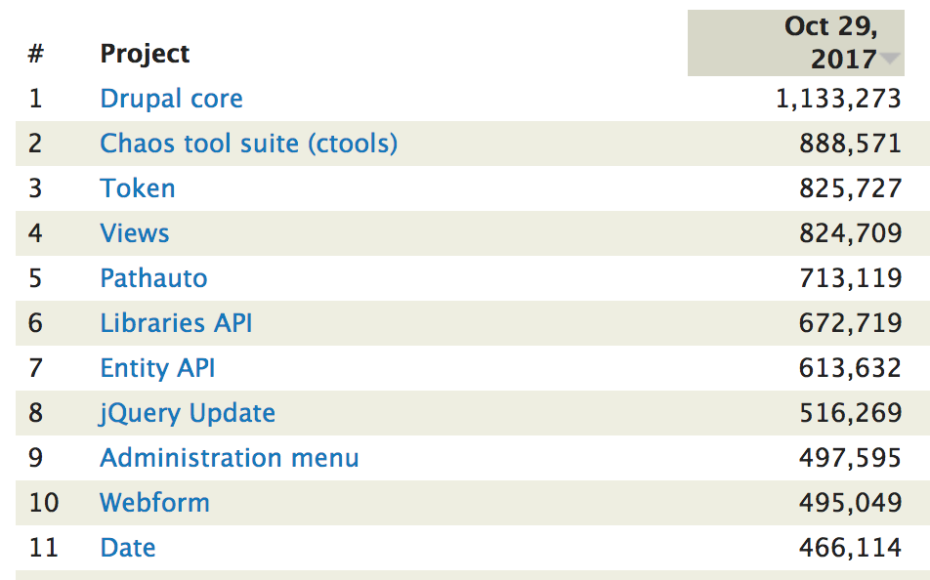
How many people use Drupal?
Core statistics Module Statistics CMS Ranking

Slide 5
Principles
Modularity
Code Quality
Standards based
Performance
Open Source
Usability
Collaboration
Notes:
11/11/17
5
5
https://www.drupal.org/about/mission-and-principles

Slide 6


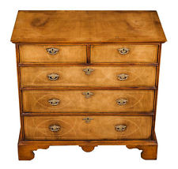
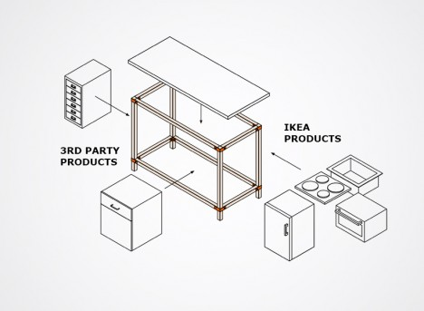
System vs Framework CMS vs CMF

Slide 7

Principles – Modularity
38k+ modules to handle everything from third-party Integration, Customization to Theming and SEO
Concentrated community effort to develop one good module
Community effort is rewarded by inclusion in Core (eg. Views, CKEditor and Media in Drupal 8)
Notes:
11/11/17
7
7
https://www.drupal.org/project/project_module
https://www.drupal.org/project/views

Slide 8
Principles – Open Source
GPLv2 licencing
All modules or themes must be GPLv2 compatible
Forever free and open
Notes:
11/11/17
8
8

Slide 9

Principles
Coding Standards
UI Standards
UI Testing
Profiling
Security
Notes:
11/11/17
9
9

Slide 10
Users of Drupal
Drupal Shops/Agencies
Developers and Sysadmins
Site Builders/Themers
Editors/Content Producers
End-Users
Notes:
11/11/17
10
10

Slide 11
Drupal Users - Agencies
Framework mentality makes it easy to use/build your own distributions
Open Source to fight employee churn/turnover
Easy to sell software that solved the problem of big market players
Notes:
11/11/17
11
11
https://www.drupal.org/project/project_distribution

Slide 12
Drupal Agencies in Portugal
Driven (old DRI)
Jump (ROFF Agency)
Bloomidea
Everis
Frontkom
And many others
Notes:
11/11/17
12
12
https://www.drupal.org/drupal-services/all/all/portugal

Slide 13
Drupal Users - Developers
Fully* OOP since 8.x version
Uses other well-known OSS as its basis ( Composer, Guzzle, Symfony, Twig, jQuery, CKEditor, React)
Extensively documented
Coding and testing standards enforced
Configuration can be versioned
Notes:
11/11/17
13
13
https://www.drupal.org/docs/develop

Slide 14
Drupal Users – Site Builders and Themers
Easy to use admin interface
Frequent releases and an assured upgrade path
No need to write a single line of code to get complex workflows working
Uses Twig for templating and enables major HTML/CSS frameworks ( Bootstrap, Foundation )
Notes:
11/11/17
14
14
https://www.drupal.org/theming

Slide 15
Drupal Users – Editors
In place, mobile, editing
Content revisions
Content workflows
Tagging and taxonomy
Multi language content
Media management
Notes:
11/11/17
15
15
https://www.drupal.com/feature/drupal-content-authoring

Slide 16
Drupal Users – End-User
Accessibility
Responsive, mobile first
User Experience focus
Performance
Security and Stability
Notes:
11/11/17
16
16

Slide 17
Installation Requirements (for 8.x)
Web Server
PHP
Database server
Browser
Notes:
11/11/17
17
17
https://www.drupal.org/docs/7/system-requirements/php#drupal-8

Slide 18
Requirements – Web Server
Apache (v2.x on Unix/Linux, OSX, Windows)
Nginx
Hiawatha
Microsoft IIS
PHP Built-in Web Server (Dev only)
Notes:
11/11/17
18
18
https://www.drupal.org/docs/8/system-requirements/web-server

Slide 19
Requirements – PHP
Latest version (8) requires PHP v5.5.9
PDO installed
And several other security and performance recommendations
Notes:
11/11/17
19
19
https://www.drupal.org/docs/8/system-requirements/php

Slide 20
Requirements – Database
MySQL 5.5.3, MariaDB 5.5.20, Percona 5.5.8 (Recommended DB)
PostgreSQL 9.1.2
SQLite 3.6.8
MS SQL, Oracle and MongoDB supported by community modules
Notes:
11/11/17
20
20
https://https://www.drupal.org/docs/8/system-requirements/database-server

Slide 21
Requirements – Browser
Internet Explorer 11 ( 9,10 dropped since 8.4 )
Microsoft Edge
Firefox 5.x and later
Opera 12 and later
Safari 5.x and later
Google Chrome
Notes:
11/11/17
21
21
https://www.drupal.org/docs/8/system-requirements/php

Slide 22
Installation simplytest.me
Notes:
11/11/17
22
22

Slide 23
Show me the code!
https://www.drupal.org/project/drupal/git-instructions
https://github.com/drupal/drupal
Notes:
11/11/17
23
23

Slide 24
Training
Training Companies and websites
Events
Drupal Global Training Days
Notes:
11/11/17
24
24
https://www.drupal.org/training

Slide 25
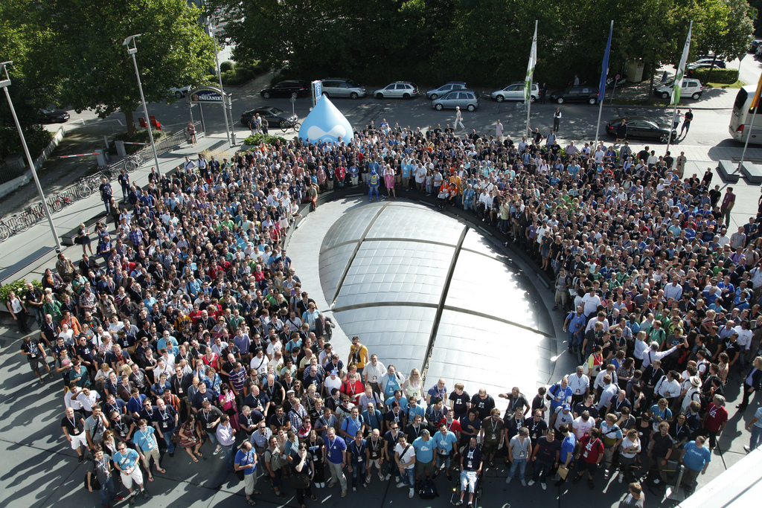
Community
Notes:
11/11/17
25
25

Slide 26
Community
Online and Local Groups
Events and Meetups
IRC
Planet Drupal
And much, much more

Slide 27
Portuguese Community
Website: http://drupal-pt.org/
Telegram: https://telegram.me/drupalportugal
Drupal.org: https://groups.drupal.org/portugal
Drupal Dev Days 2018: https://lisbon2018.drupaldays.org/
Notes:
11/11/17
27
27

Slide 28
Bibliography
http://drupal.org
http://drupal-pt.org
http://www.zyxware.com/articles/4351/list-of-fortune-500-companies-using-drupal-for-their-websites
Notes:
11/11/17
28
28

Slide 29
Questions?
Notes:
11/11/17
29
29

Slide 30
Thanks!
Notes:
11/11/17
30
30

