Slide 1
Hands on: Self-supervised learning (1)
20/03/2026
Deep learning a.y. 2025/2026

Slide 2
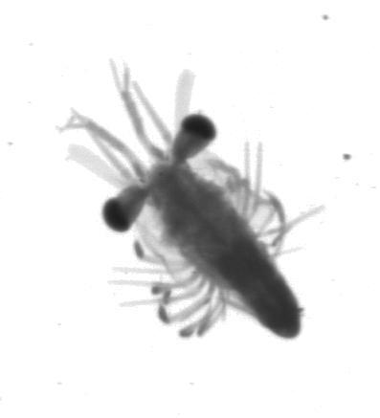
Self-supervised learning
Extensive amount of annotated data is necessary for training DNNs;
Annotations are expensive;
SSL to leverage unannotated data for learning a general representation;
Supervisory signals are implicit and generated from the data itself.

Slide 3
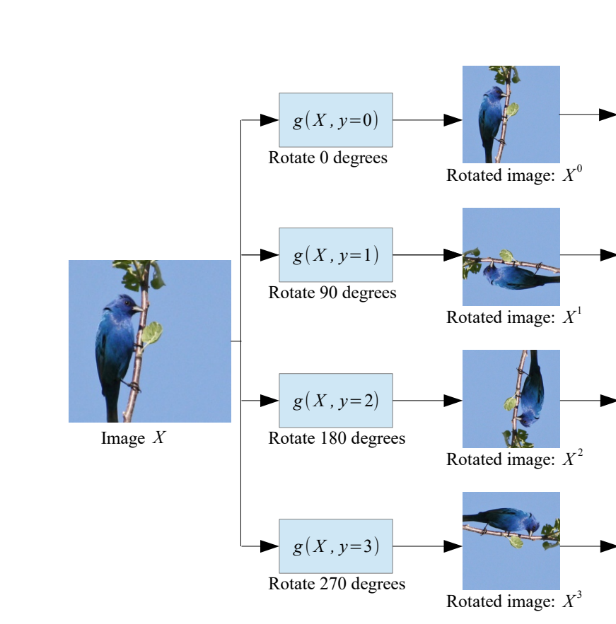
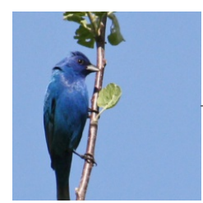
Self-supervised pre-text tasks: Rotation
Predict rotation
Transfer weights
Predict target class

Slide 4
Self-supervised pre-text tasks: Rotation
Predict rotation
Transfer weights
Predict target class

Slide 5
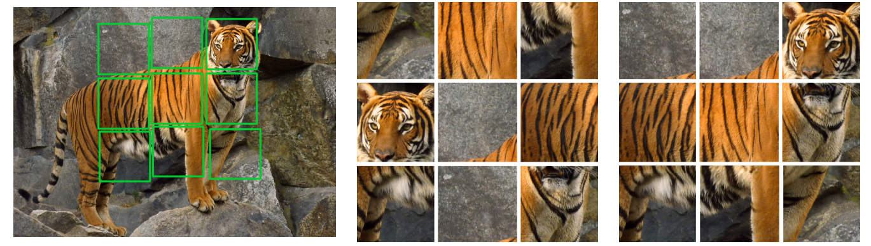
Self-supervised pre-text tasks: Jigsaw
Noroozi, Mehdi, and Paolo Favaro. "Unsupervised learning of visual representations by solving jigsaw puzzles." European conference on computer vision. Cham: Springer International Publishing, 2016.

Slide 6
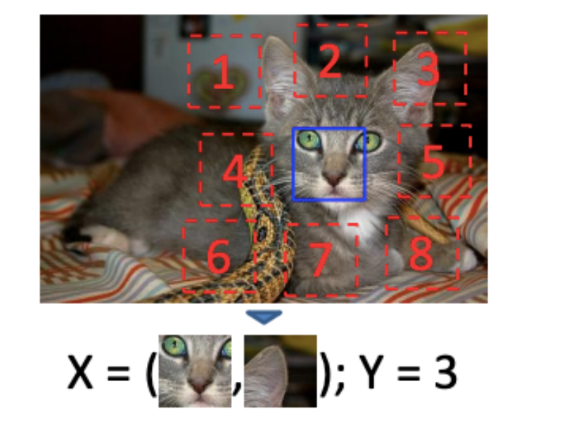
Self-supervised pre-text tasks: Patch position
Doersch, Carl, Abhinav Gupta, and Alexei A. Efros. "Unsupervised visual representation learning by context prediction." Proceedings of the IEEE international conference on computer vision. 2015.

Slide 7
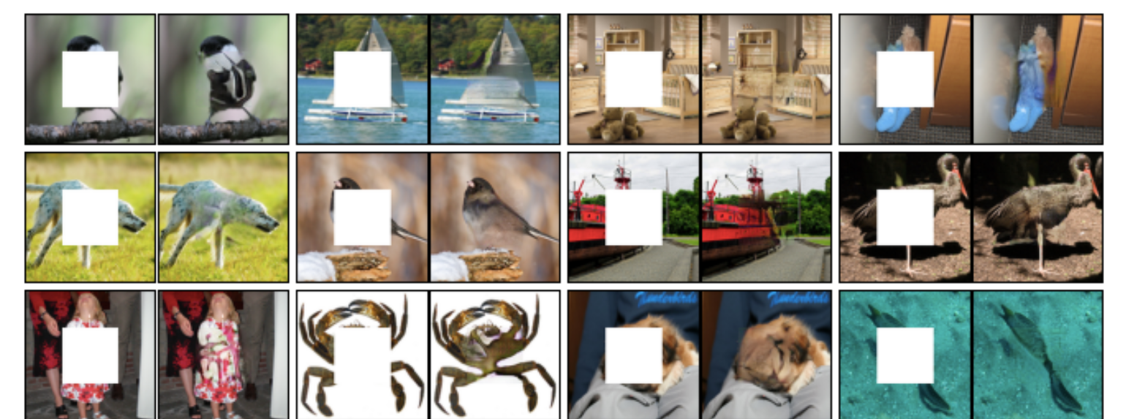
Self-supervised pre-text tasks: Impainting
Pathak, Deepak, et al. "Context encoders: Feature learning by inpainting." Proceedings of the IEEE conference on computer vision and pattern recognition. 2016.

Slide 8
What will you do in this lab?
Exploiting CIFAR10 with four different cardinalities
2000 images;
5000 images;
10000 images;
Full dataset.
Implementing a rotation pre-text task;
Fine-tuning the resulting model on CIFAR10 subsets;
Compare to training from scratch.

