Slide 1





HP Challenge Mariona Valero Canadell

Slide 2
Table of Contents
Implementation
Part 1: Image Classification
Part 2: Text Recognition
Part 3: Text To Speech
Results

Slide 3


Implementation

Slide 4
1.
Image Classification

Slide 5
Image classification tools
OpenCV
SkLearn
SGDClassifier

Slide 6
2.
Text Recognition

Slide 7
Image classification tools
Tesseract
RegEx

Slide 8
3. Text To Speech

Slide 9
Image classification tools
GTTS

Slide 10
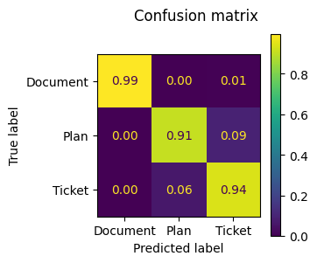
Results
Part 1
Accuracy: 94%
Confusion matrix:
Part 2:
Execution time: 3 seconds
Part 3:
.mp3 file

Slide 11

Thanks!
Any questions?
You can find me at:
mariona02599@gmail.com

