Slide 1
PROBLEM 2: ATM MACHINE
GROUP 2:
Lê Võ diễm hằng ITITIU18034
Huỳnh Phương quyên
ITITIU18181
Nguyễn huỳnh phương thanh ititiu18115
Nguyễn giang ngọc trâm ititiu18158

Slide 2
PART IV DEPOSIT
PSEUDOCODE
1. Get information
2. Update new information to update-file
3. Copy others information to update-file
4. Clear the main file
5. Scan information from update-file to main file
6. Delete all in the update-file

Slide 3
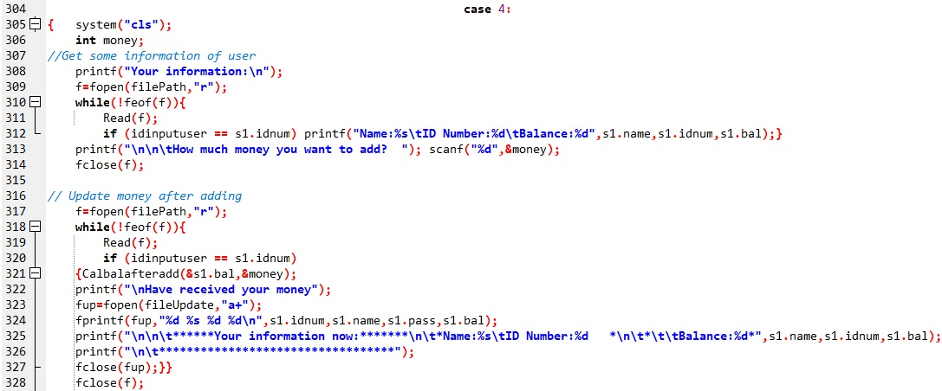
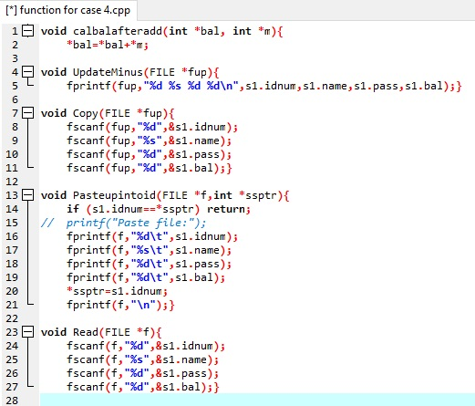
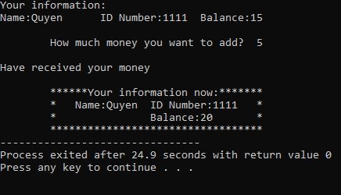
_ Get information _ Update new information to update-file

Slide 4
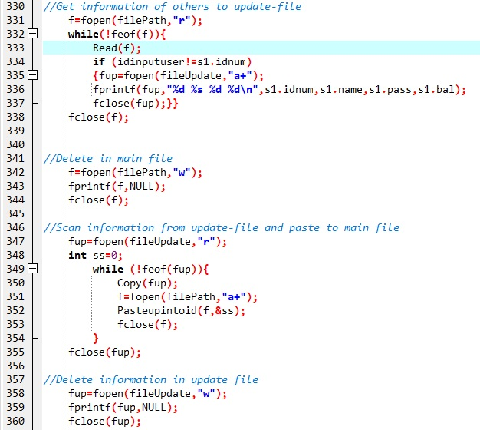
_ Copy others information to update-file
_ Clear the main file
_ Scan information from update-file to main file
_ Delete all in the update-file

